Slide 1
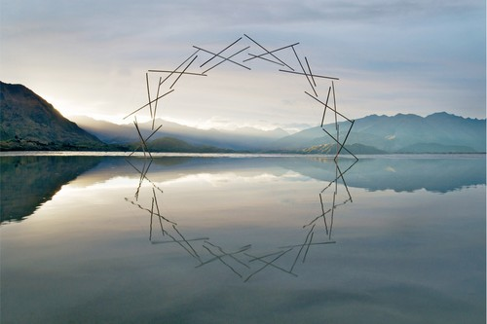
LAND ART
Wonders in Nature

Slide 2
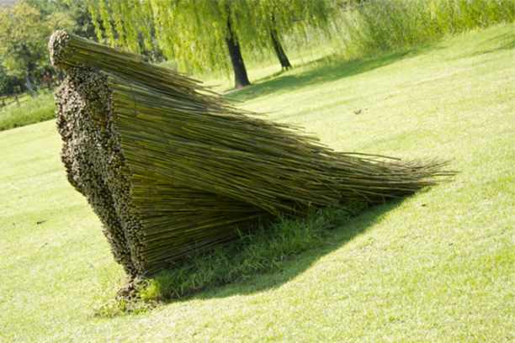
Land Art “makes Art from Nature”, a style which uses various natural elements such as leaves, rocks, twigs or water, to build sculptures that work in perfect harmony with the natural scenery. The resulting artwork makes a statement about man’s relationship to nature.

Slide 3
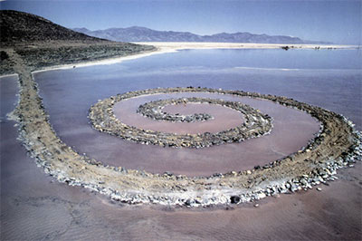
Robert Smithson
The most famous artist in this style was Robert Smithson, who was mostly active over the 1960s and 1970s. His famous iconic earthwork, “Spiral Jetty”, dates back to 1970, and was built of mud, salt crystals and basalt rocks on the north-eastern shore of the Great Salt Lake, in Utah.

Slide 4
“ I think it would be quite possible to make art in a quarry, a mine, a lake, or canal – you know, any number of places. To build directly out of the ground of the site is one of my intentions”. Robert Smithson, 1971

Slide 5
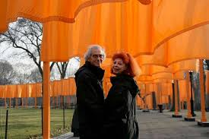
CHRISTO AND JEANNE-CLAUDE
Two prestigious artists who are partners and always cooperate

Slide 6
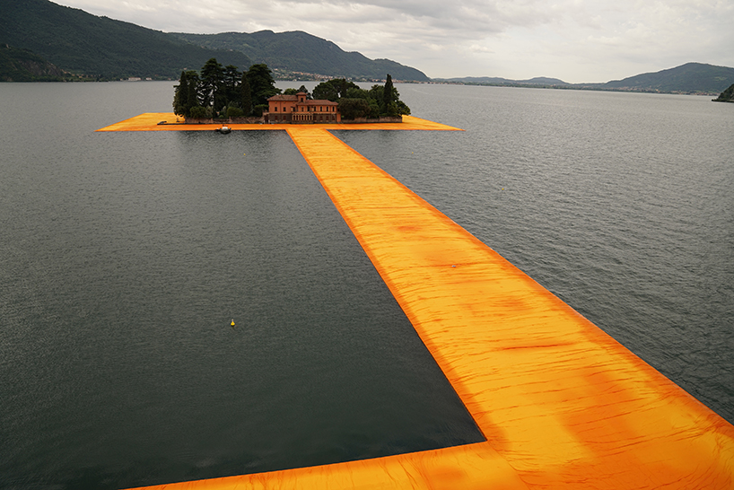
FLOATING PIERS, LAKE ISEO, ITALY, 2014-16
In the middle of Iseo lake, Christo and Jean Claude installed a huge floating panel, called the Floating Piers. It is a site-specific work of art consisting of 100,000 square metres of yellow fabric, carried by a modular floating dock system.

Slide 7
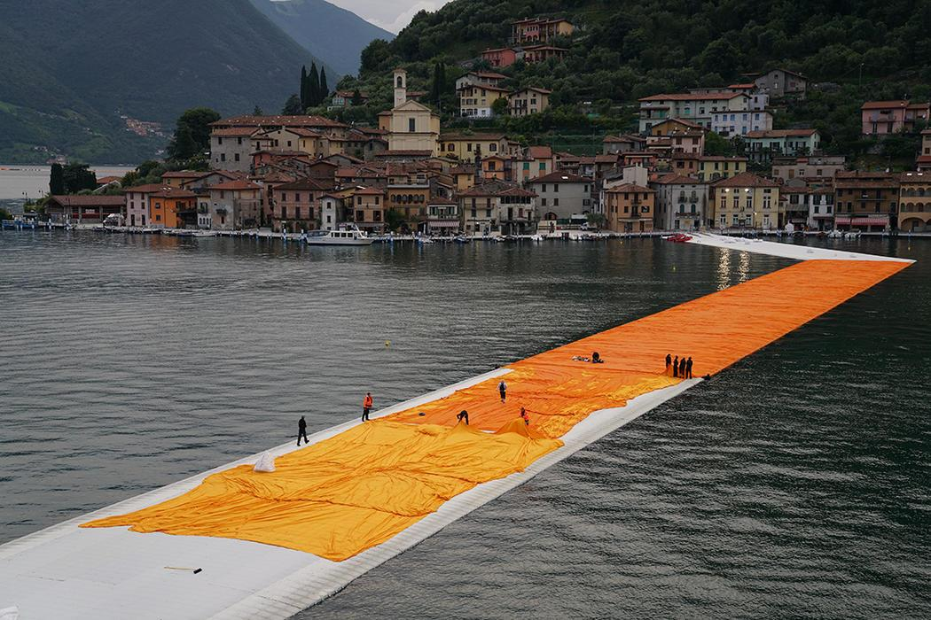
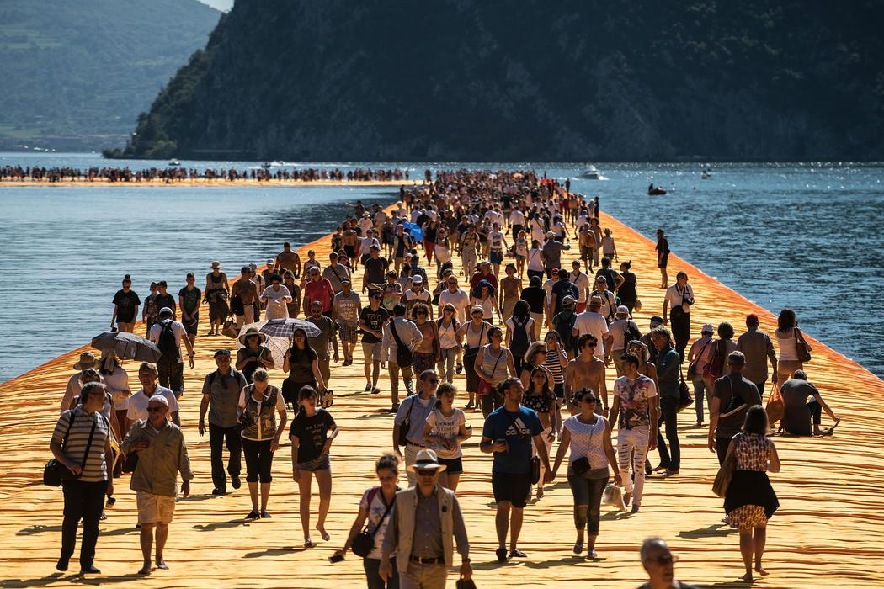
A group of tourists walking on the lake surface
Some labourers who cooperate to realize “The Floating Piers”

Slide 8
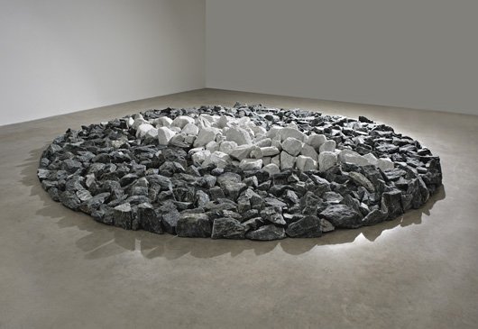
Winter Solstice Circle, 2002
Land Art isn’t just about experimentation of the 60s. This artwork by Richard Long, who dedicated his life to Land Art, is from 2002. A simple group of stones, it represents the singularity of the winter solstice, as a promise (stones in white) in the period of winter (stones in gray).

Slide 9
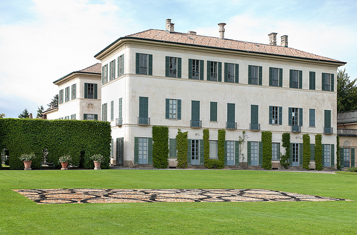
VILLA PANZA
Villa Panza, Varese, Northern Italy. In 2012 the project Art in Nature took the British artist Stuart Frost to the villa.

Slide 10
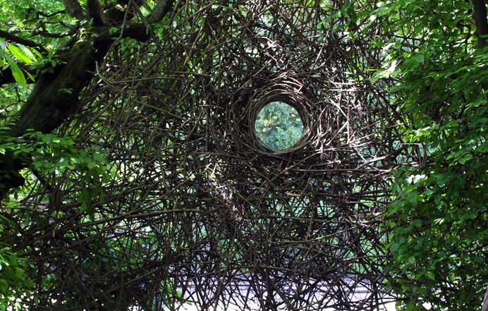
He realized three artworks, one per year.
In the picture you can see one of them, Tribute to Carpinata.

Slide 11
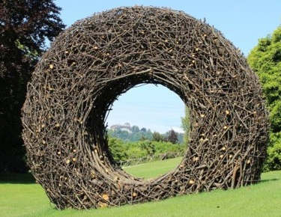
The Slope
Still in Villa Panza, The Slope is a wooden wheel to make people think of the flowing of time and the uncertainty of the natural environment.

Slide 12
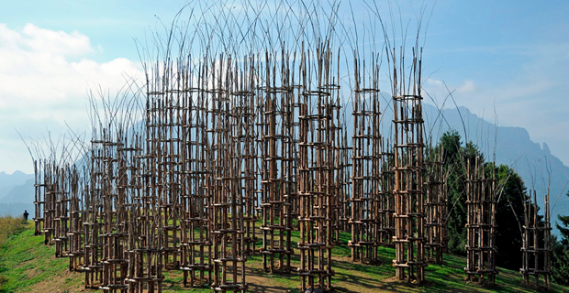
The Vegetal Cathedral
Giuliano Mauri, 2010,
Parco delle Orobie Bergamasche, Bergamo, Italy

Slide 13
Planned in 2009, the Cathedral was realized one year later because the artist suddenly disappeared, leaving the project to his son Roberto. It was supposed to be “a place of belief and gathering, where only Nature exists with its strength and silence and where to stare at the sky and pray on your own, or just let your thoughts flow, and be within the artwork”.
It is made up of 5 naves, 42 pillars, 1,800 masts of fir, 600 branches of chestnut trees, 6,000 metres of branches of hazel, intertwined by means of the old art of “weaving”.

Slide 14
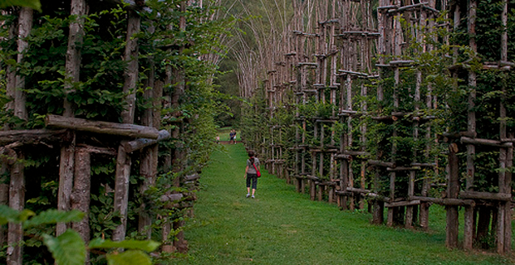
Another view of the huge Cathedral

Slide 15
Edited by
Paola Ancona
Luigi Maria Malgieri
Paola Robles

Slide 16
This project has been funded with support from the European Commission. This publication reflects the views only of the author, and the Commission cannot be held responsible for any use which may be made of the information contained therein.

