Slide 1
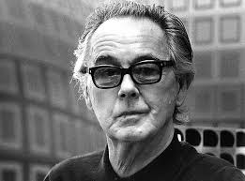
Victor Vasarely

Slide 2
Vasarely life
1908-Born in pecs,Hungary, April 9.
Spent his chilhood in Slovakia and Budapest.
After graduating secondary school in 1925 started studying medicine. However, these studies were discountinued because of his interest in art.
Entered Sandor Bortnyki‘s „Workshop“ , the „Budapest Bauhaus“. There he met his wife and after long traveling settled in Annet-sur-Marne. Where he died.

Slide 3
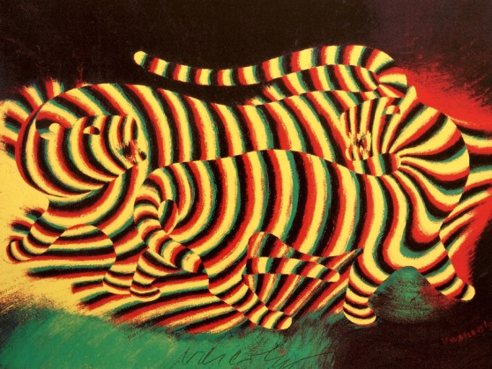
Vasarely art
In Paris intially worked as a graphicist. Black-and-white contrasts, the zebra and tiger motifs, appear in his works between 1933 and 1938.

Slide 4
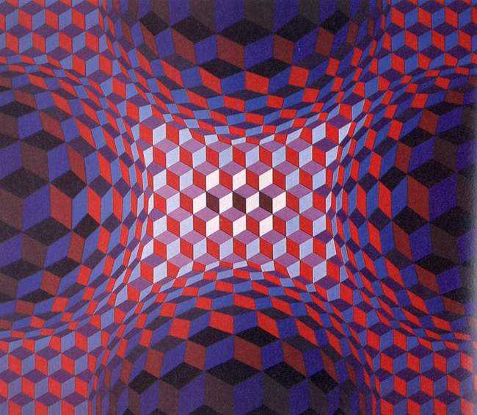
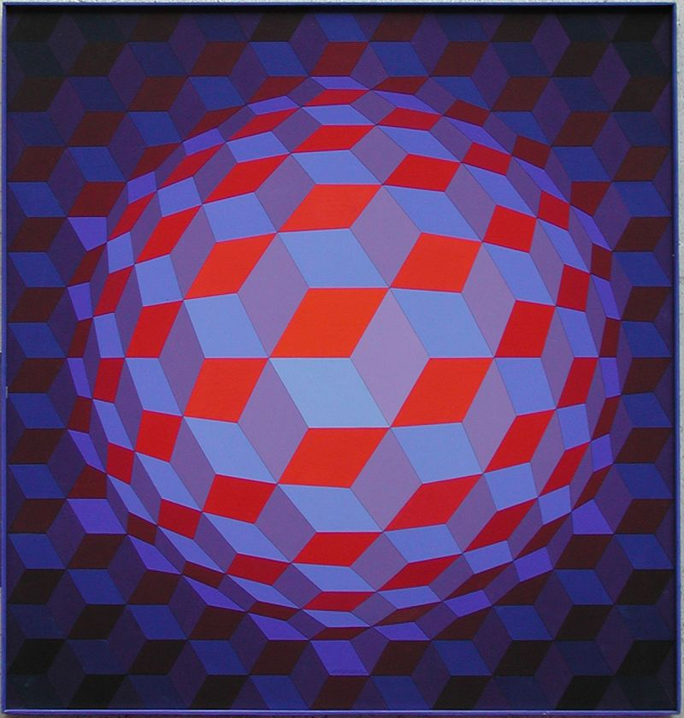
Began painting in oils more intensively, although he later summarized the works of this period under the lable „Wrong Roads“.
Developed his abstract image structures, which appear in the Denfert. Belle Isle and
Examined the basic situation of moving, vibrating black-and-white images.

Slide 5
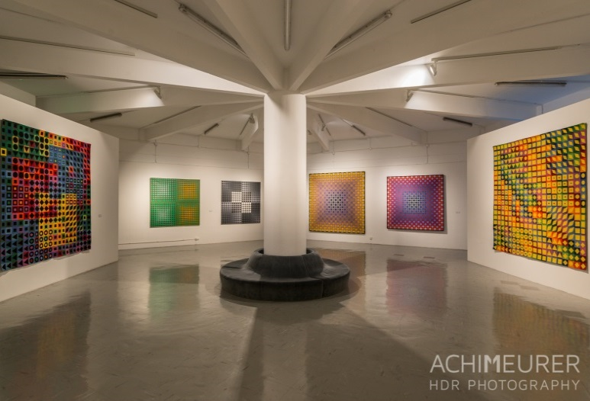
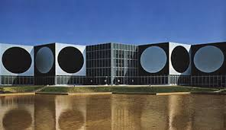
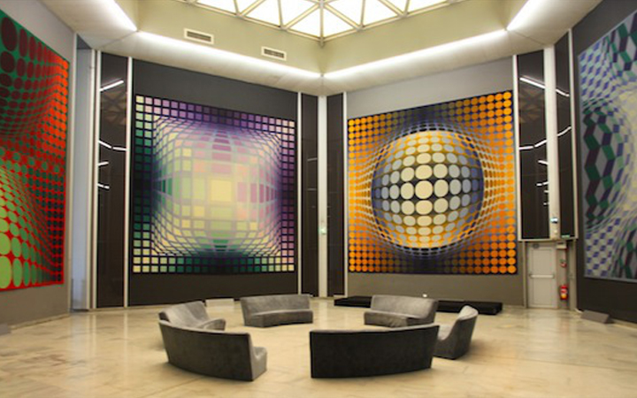
First museum of Vasarely opened in Pecs. The second museum in Hungary is opened in Budapest the Zichy mansion.

Slide 6
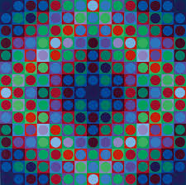
Awards and Prizes
Vasarely won a lot of awards and prizes including:
1964 - New York, Guggenheim Prize.
1976 – Honorary citizen of Pecs.
1977 – Venezuela, Order of Andre Bello Honorary doctor, University of Cleveland.

Slide 7
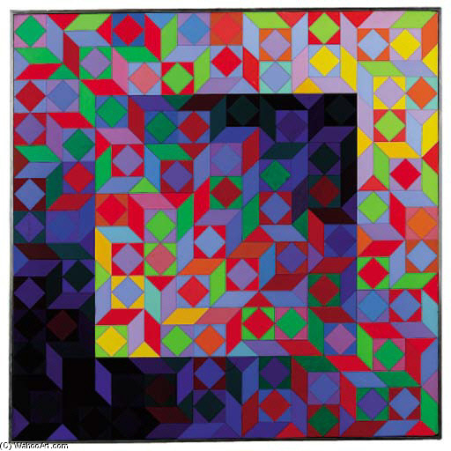
Works
Maamor 1969

Slide 8
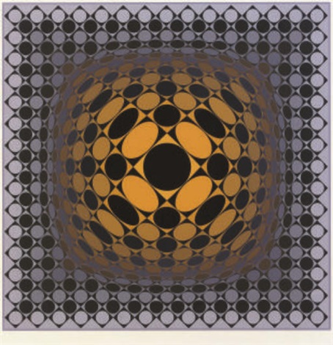
Works
Vega – sakk 1968- 69

Slide 9
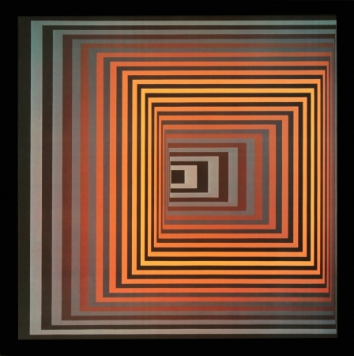
Works
Vonal fegn 1971

Slide 10
Works
Tuz 1966 – 70

Slide 11
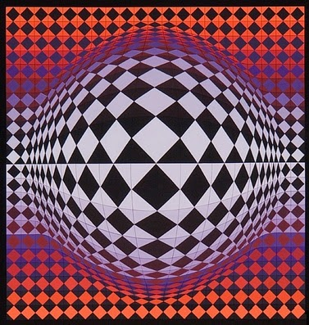
Works
Vega – arl 1968

Slide 12
Making Art Together Brings Us Closer

Slide 13
Thank you for your attention!

