Slide 1
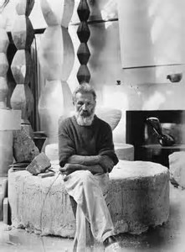
CONSTANTIN BRANCUSI
A modern sculptor

Slide 2
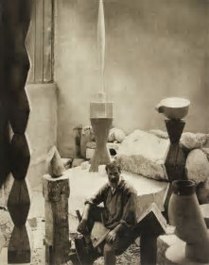
Costantin Brancusi was an internationally renowned Romanian sculptor, born in Hobita, Gorj. His sculpture, which blends simplicity and sophistication, paved the way to modernist sculptors

Slide 3
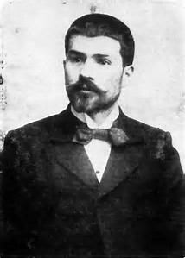
Born in Romania in 1876, he studied sculpture at the Bucharest Academy (1898-1901) and worked between Austria and Germany, Vienna and Munich, moving to Paris to enroll in the Ecole des Beaux-Arts.
In 1906 he participated with some sculptures at the Salon d'Automne, where he met Auguste Rodin.
In 1908 he knew and made friends with Amedeo Modigliani, Marcel Duchamp, Henri Matisse and Henri Rousseau.
He maintained a constant relationship with Romania, where he frequently returned to exhibit his works.

Slide 4
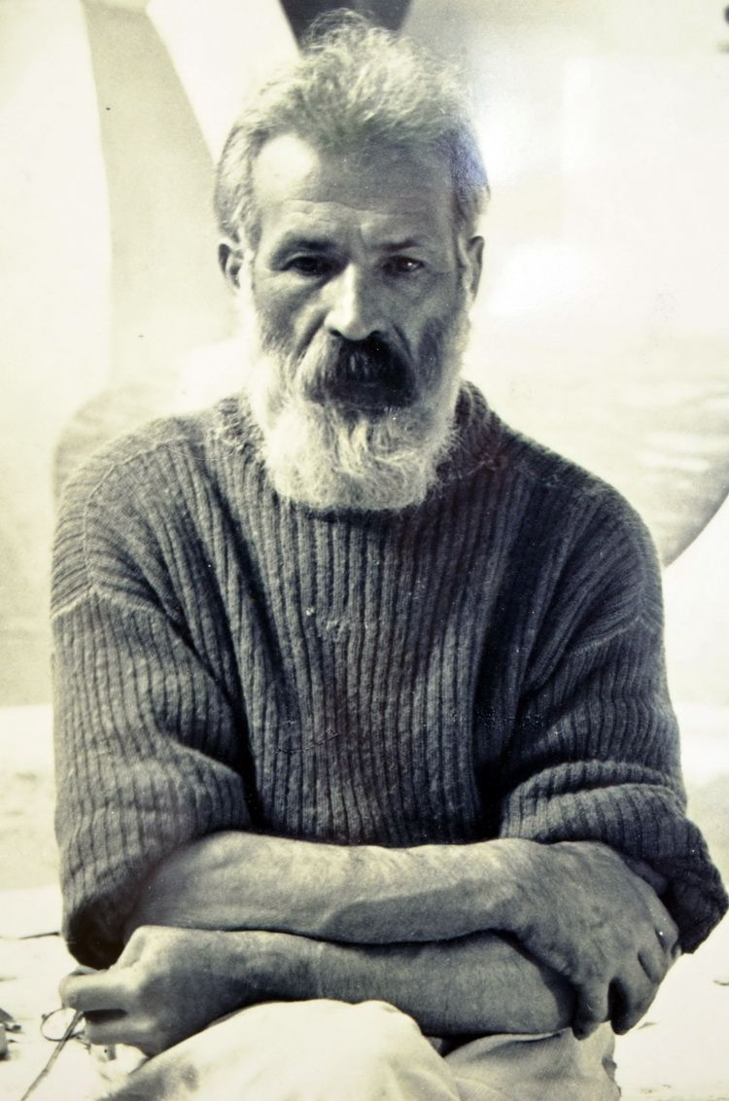
In 1913 five of his sculptures were on show at the Armory Show in Manhattan, and in 1914 he held his first personal exhibition in New York.
From 1914 to 1918 Brancusi created a series of wood carvings showing his interest in primitivism.
In the period following the First World War, he devoted himself to the search for the form-type.
In India. He also designed a meditation temple for the famous Indore's marathon.
Brancusi has never been a member of an organized artistic movement, although in the early 1920s he was close to Tristan Tzara and many other Dadaists.

Slide 5
During the Thirties, Brancusi made numerous trips, visiting India, Egypt and several European countries. In 1935 he was commissioned to make a monument to the fallen people of the Târgu Jiu park in Romania and designed a set of sculptures, which are the most important work he left in his own country. All of his work for the park includes portals, tables, stools and an "Endless Column".
After 1939 Brancusi worked alone in Paris, where he completed his last sculptures and where he obtained the French citizenship, in 1952.

Slide 6
Works
Sleeping Musa (1919-1920)
The Golden Bird (1919-1920)
The Beginning of the World (1920)
Endless column (about1920)
Adamo (1921)
Adam and Eve (1921)
Socrates (1921-1922)
Fish (1922)
New born (about 1923)
The Rooster (1924)
Fish (1924)
Bird in Space (1927)
Mademoiselle Pogany III (1931)
Bird in Space (1931-1936)
Bird in Space (1932-1940)
The Rooster (1935)
Endless Column (1937)
The door of the kiss (1937-1938
Silence Menu (1937-1938)
The kiss (1907-1908)
Portrait of Baroness R.F. (1909)
Sleeping Musa (1909-1910)
Maiastra (1910-1912)
A Musa (1912)
Maiastra (1912)
Mademoiselle Pogany (1913)
The Kiss (1916)
The Witch (1916-1924)
Shyness (1917)
Child in the world (1917)
Musa sleeping III (1917-1918)
Endless Column (1918)

Slide 7
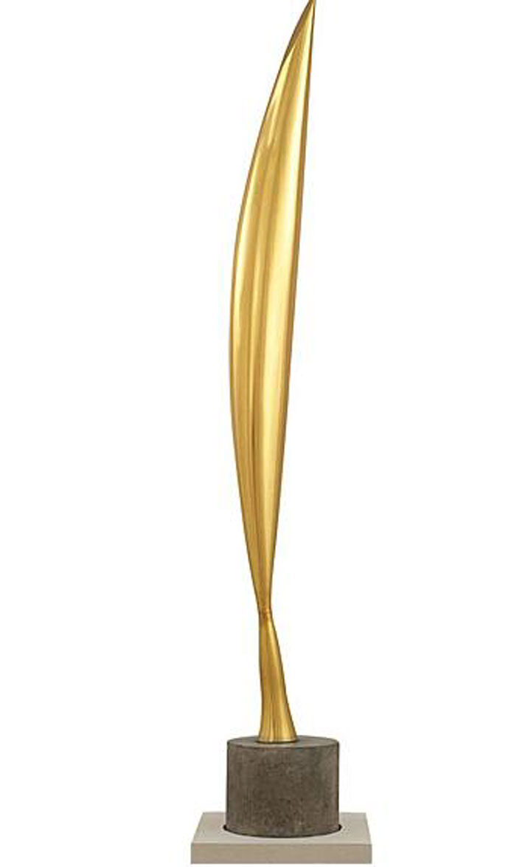
Bird in Space
The Bird in Space
1940s, Peggy Guggenheim Collection in Venice.
It is a symbol of a revolution for the sculpture of the twentieth century, representing not only an aesthetic, but also a philosophical revolution.
Unlike Cubism, Brancusi reduced every element of reality to absolute essence. This form of synthesis comes after studying at the Rodin atelier in 1907, and after the Paris experience with Cézanne and Picasso.
Brancusi dedicated much to the theme of flight but only in this work he reaches with intensity his goal. The work is the essence of all birds, a symbol of spirituality.
The perception of reality, the joy of the soul liberated from matter is his way to disclose an often concealed reality.

Slide 8
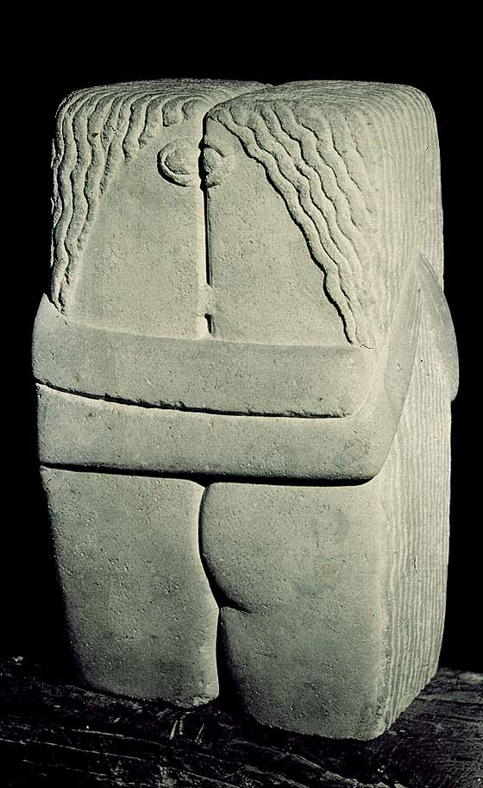
The Kiss
The Kiss, 1907, Muzeul de Arta, Craiova.
A large block of stone (28 cm) gives shape to two people who kiss with passion and tenderness. Their eyes are fixed on one another and their arms are clenched in a passionate embrace.
There are no details or decorations. All that is superfluous is eliminated, and the sculptor communicates the most important message: the happiness of a man and woman who are in love. The beauty of this work consists in the solid stone block from which he shapes of the two lovers emerge.
Brâncuşi, with his stylized shapes, inspired the art of sculpture of the twentieth century and, in general, abstract art.
The simplicity of his works suggests feelings of freedom.

Slide 9
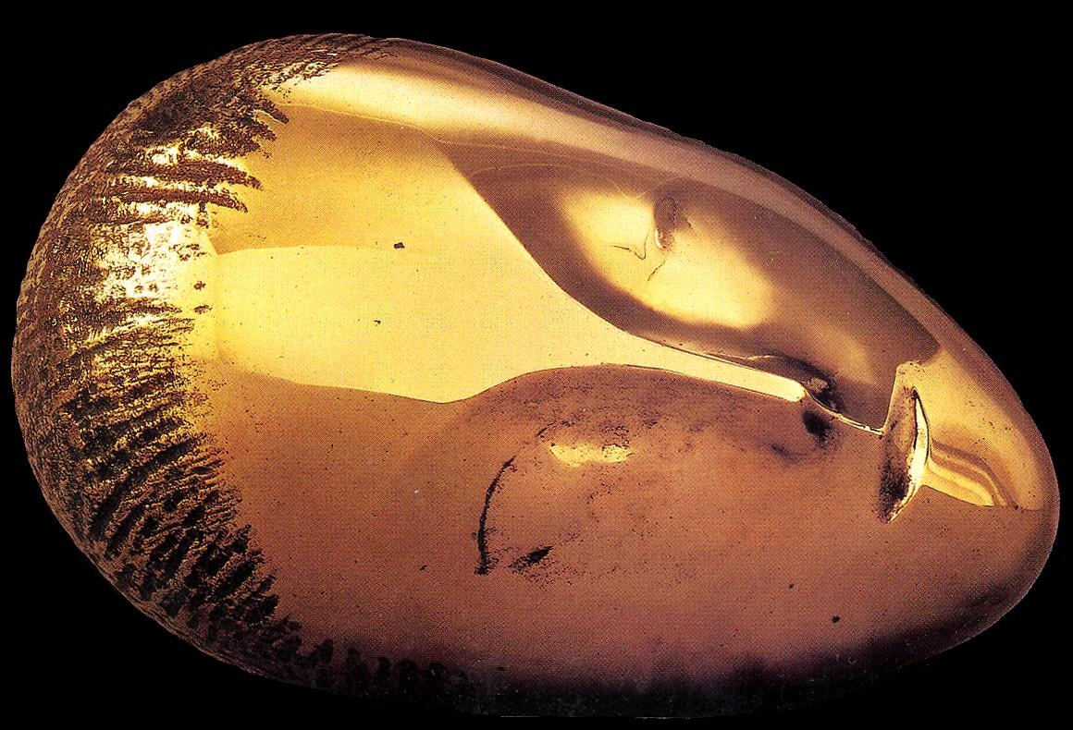
Sleeping Muse
Sleeping Muse, Bronze, 1910, The Metropolitan Museum of Art, NYC
The subject of a sleeping head occupied Brancusi for almost twenty years. In conceiving and executing Sleeping Muse, the sculptor avoided any detail in favour of reducing ideas to fundamental forms and simplicity.
This bronze is one of four casts made in 1910 from a marble, for which Baroness Renée Irana Franchon was the model.

Slide 10
CONSTANTIN BRANCUSI
A modern sculptor
EDITED BY
ANNA SARA NAPOLI
TOMMASO SAPONIERI

Slide 11
This project has been funded with support from the European Commission. This publication reflects the views only of the author, and the Commission cannot be held responsible for any use which may be made of the information contained therein.

