Slide 1
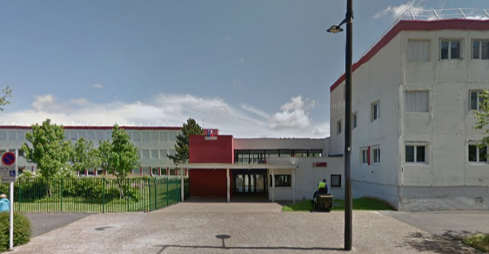
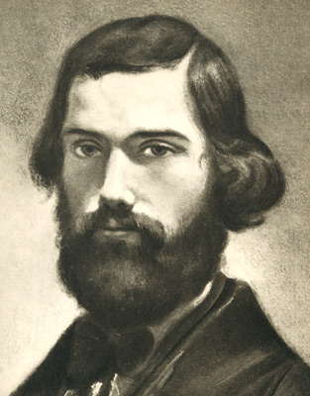
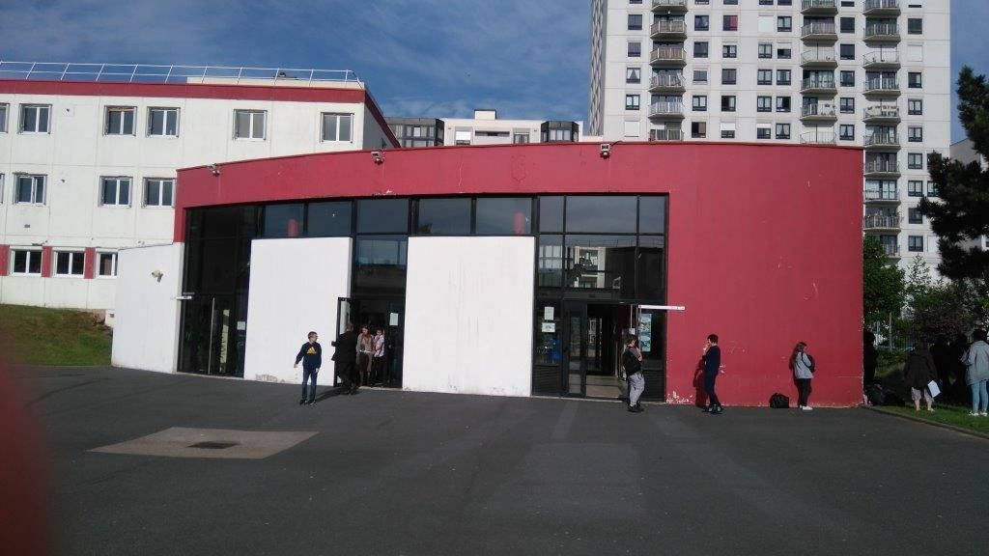
Secondary School Jules Vallès
julesvalles.arsene76.fr

Slide 2
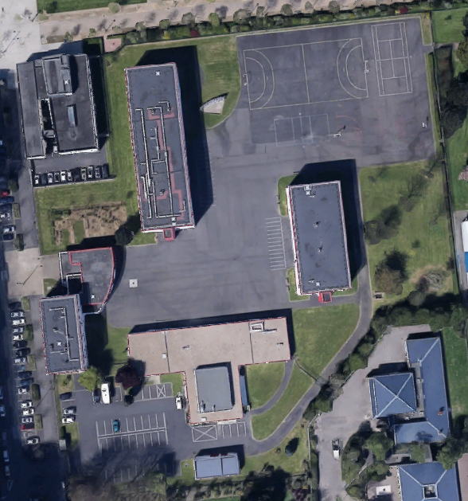
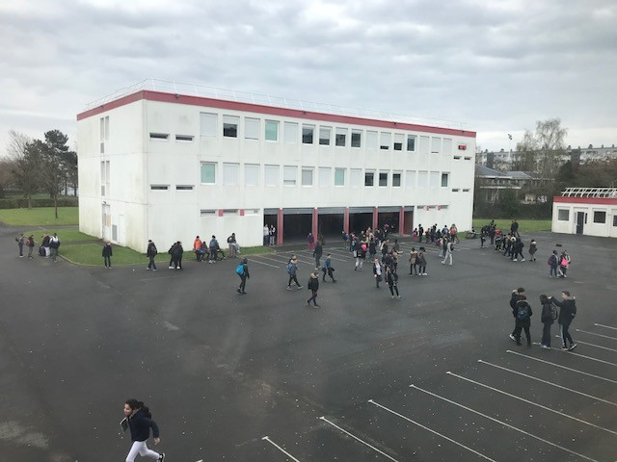
General presentation
Surface area: 15 480 m²
building 1
Capacity: 500 students
Including disabled people
2 buildings for classes – classrooms equipped with video-projectors
building 2
administration
school catering
An access to stadium and gym
A self-service school catering

Slide 3
Schedule
8:00 – 8:55 M1
8:55 – 9:50 M2
9:50 – 10:05 Break
10:10 – 11:05 M3
11:05 – 12:00 M4
12:00 – 13:25
Lunch break
13:30 – 14:25 S1
14:25 – 15:20 S2
15:20 – 15:35 Break
15:40 – 16:35 S3
16:35 – 17:30 S4
End of courses
Detention
or help for homework

Slide 4
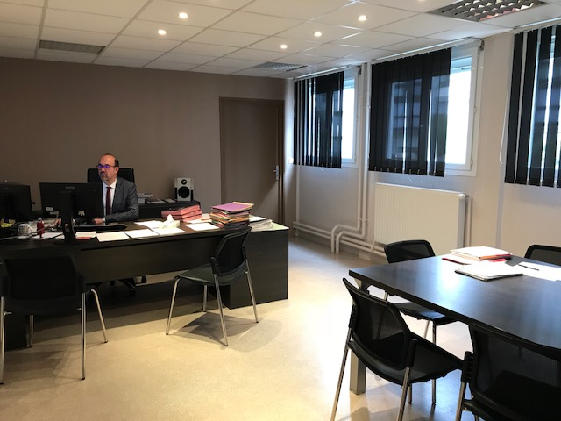
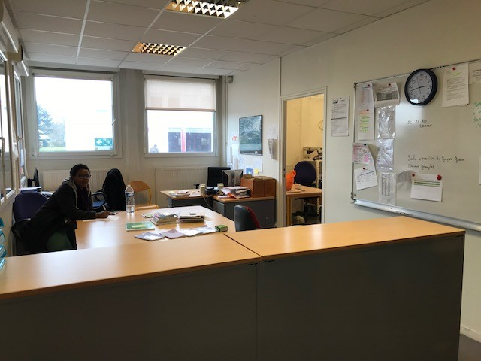
School staff
1 head-teacher,
1 deputy-head, 2 secretaries.
Teaching staff:
50 teachers, 1 library assistant,
5 teaching assistants.
Pastoral Care:
2 school life officers, 9 school attendants,
1 prevention and security assistant.
Guidance:
1 guidance counselor and psychologist.
Health and Social Service:
1 school nurse, 1 social worker.

Slide 5
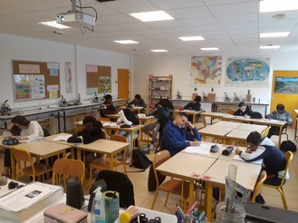
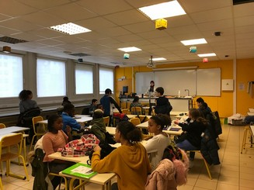
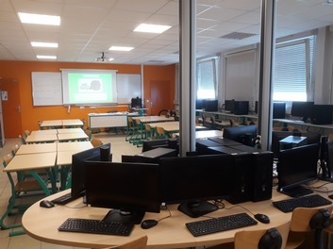
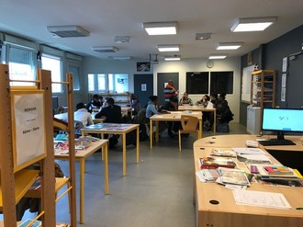
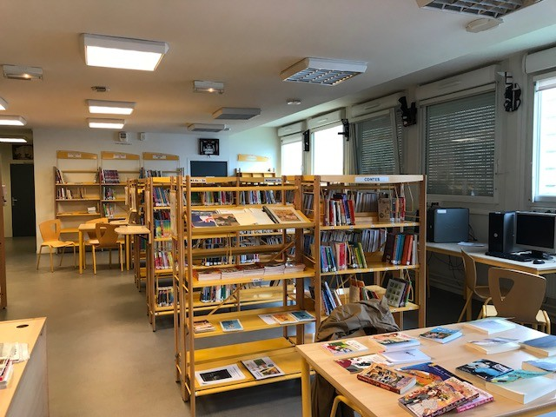
Science – French
5 specific classrooms for Science
Le CDI

Slide 6
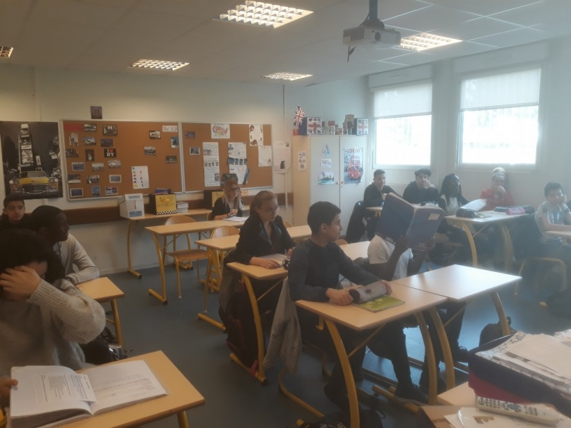
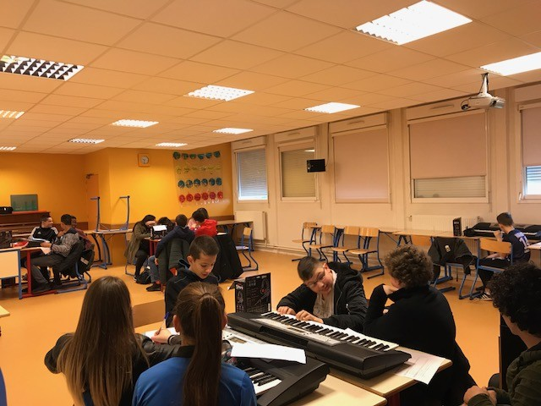
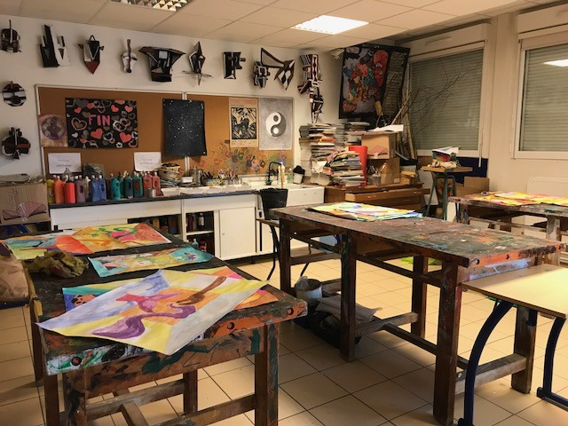
Languages – Arts
3 foreign languages & Latin
English
Spanish
German
Classroom for Art
Music Education

Slide 7
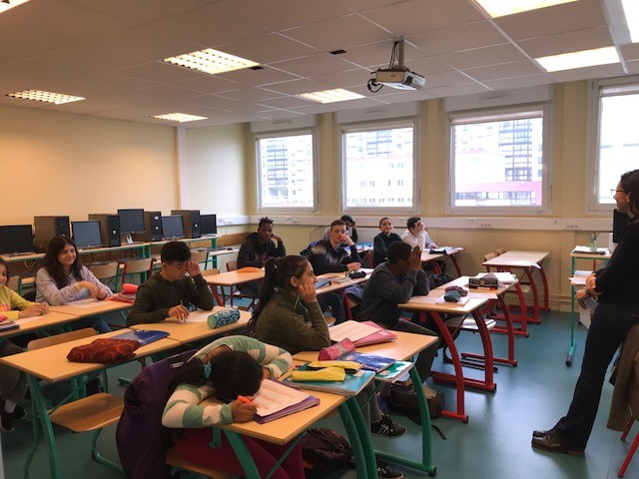
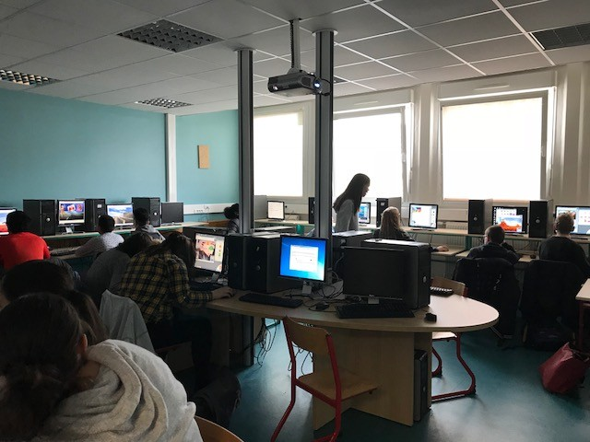
UPE2A – Computer rooms
UPE2A
Unité Pédagogique pour
Élèves Allophones Arrivants
= class for new allophone students
2 computer rooms
Capacity: 24 students
For each room

Slide 8
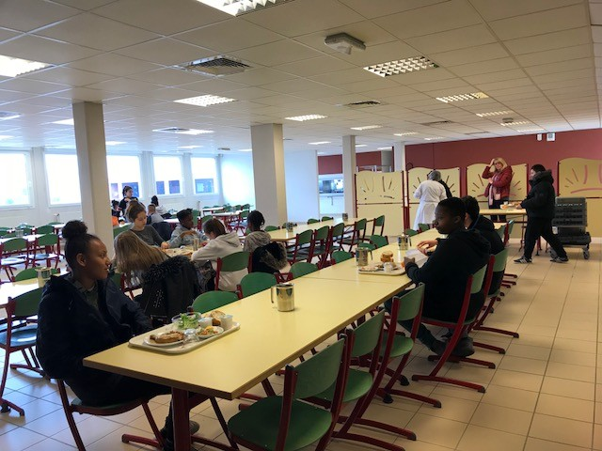
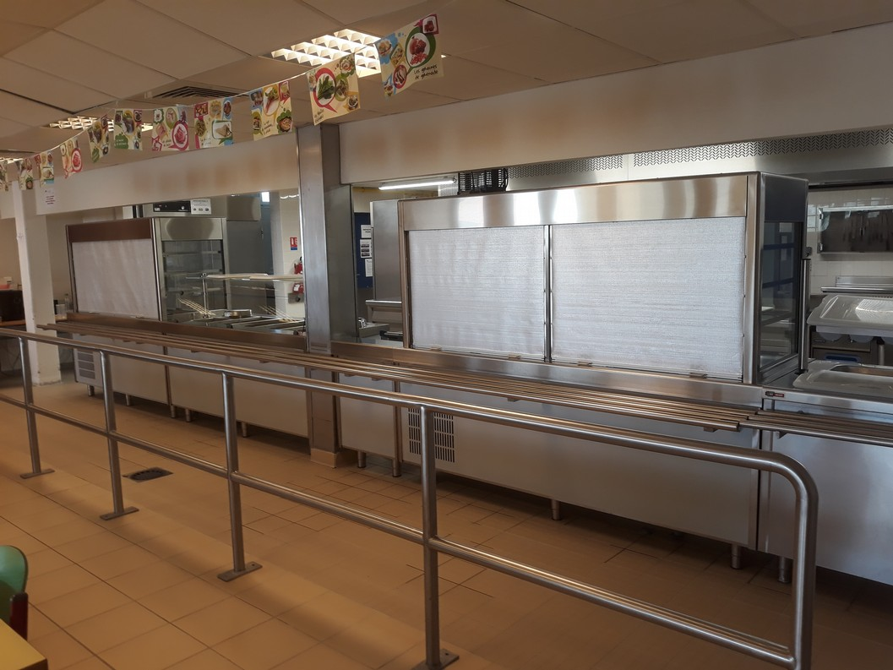
School catering
Capacity: 200 students – healthy meals

Slide 9
The aims of our school
To transmit knowledges and skills
To help students to define their guidance
To train future citizens

Slide 10
School is also ...
Success for all
Health education
Cultural openness
Workshops
(lunch break, holidays)
Sports activities (UNSS, swimming)

