Slide 1
Sastamala's lack of "pull power"
By Milla, Aino, Sandra, Emma, Veeti and Alexander

Slide 2
The problem
The problem in Sastamala is that young people move to another city to study and work, and do not return to Sastamala. In addition to this, a large part of the population in Sastamala are old people, so the town has to provide them with services through taxes. The problem is that young people do not return, Sastamala's taxation suffers and the city does not receive revenue in the same way as expenditure.

Slide 4
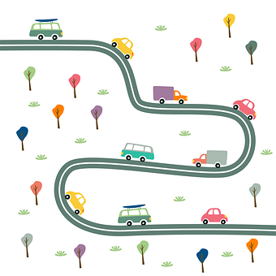
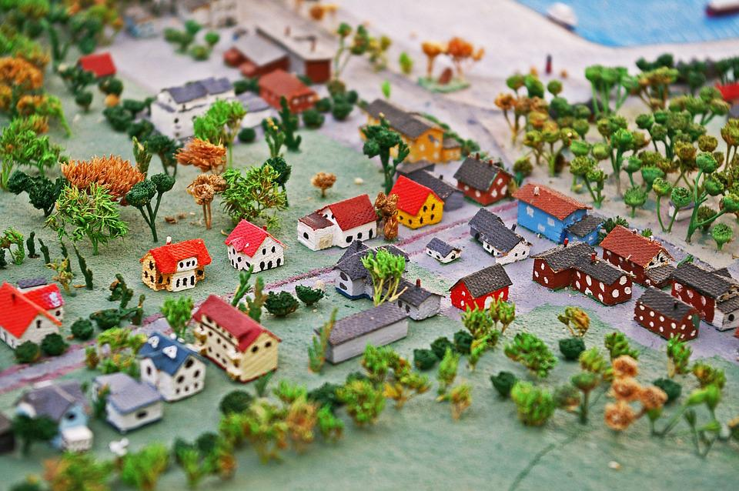
Examples
Some consequences:
age distribution changes → too little number of people of working age and big number of retirees
increasing need for welfare services, municipality/town can’t provide that that effectively
more taxes to pay
less families with children, schools being closed
Some leaving reasons:
further studies
work
bigger cities’ other opportunities
Notes:
Sandra:
some leaving reasons:
…as said, most of the graduated students leave to study in a bigger city, where the universities and polytechnics are
and people in a working age may find a job they want, from out side of Sastamala.
Also the bigger cities’ other opportunities attract: more places to go or experience, for example, in a free time and perhaps there is also better public transport
some consequences
age distribution changes → relatively increasing number of pensioners and too little number of people of working age → that leads to increasing need of welfare services
(maaseudulla asuvien määrän väheneminen,) urbanisation can be one reason of leaving to bigger cities. (people move from countryside)
for that, the local taxes would perhaps go higher in the future, to afford the welfare services
and when there is less families with children, there isn’t need for that many schools which leads to closing schools, but closing more schools can make the Sastamala’s pull power even weaker
(young people moving away after finishing school, services declining due to lack of tax payers etc. etc.)
Sastamala is relatively small town, with about 24 000 inhabitants (2020)
It is predicted that Sastamala’s population will decrease with approximately 10,8 per cent between 2018–2040.
(Eniten alle 24 vuotiaiden väheneminen)
it is also predicted that there is relatively increasing number of pensioners, (I tell some possible consequences in a minute, but first…)

Slide 5
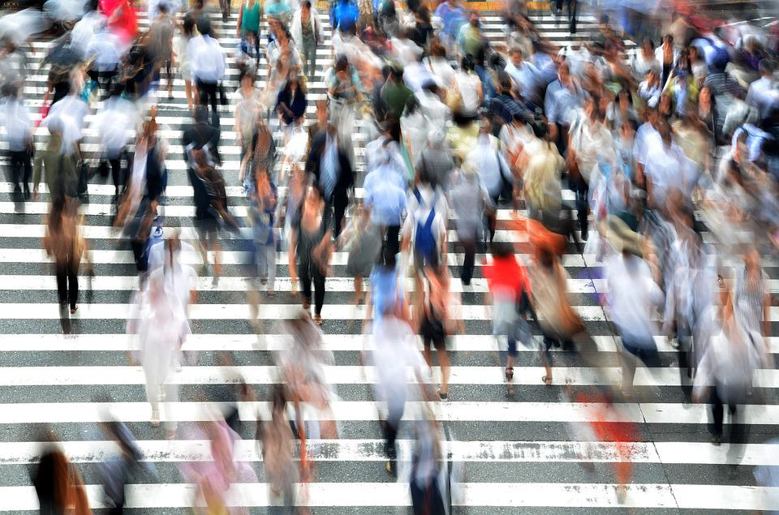
Solutions to make people stay in Sastamala
Sastamala should be more independent and support entrepreneurship
Transport links should be easier and wider to use for large centers
The outskirts of Sastamala should also be supported
Notes:
-Services are disappearing from Sastamala and that is why people are going elsewhere to get them. If there were better support for entrepreneurs in Sastamala, there could be more services and workplace’s. The support could be, for example, financial or material. In addition, it would also increase migration profits because people are interested in various services
-As has been said, people do not stay in Sastamala because they leave most to work or study. However, many apply for the city of Tampere near Sastamala. If public transport routes were improved, people would be able to live in Sastamala and work better in Tampere. In addition, also more and more students could go to university from Sastamala
-The area of ​​Sastamala is really wide. In many respects, the side areas in Sastamala receive less attention and cannot be developed either. Therefore, people don’t move in those areas, and the rest people prefer to leave from there

Slide 6
Interview (Tapio Rautava, administrative manager in Sastamala)
Q: How do you get young people to come back after studying?
A: Job and services should be available in or close to the city
Q: What would increase the pull power of Sastamala?
A: Good services, transportation and positivity in Sastamala
Q: What is the yearly migration rate in Sastamala?
A: Unfortunately lately there has been more people moving out of Sastamala than in Sastamala, but last year it changed the other way around and we hope that it will stay like that.
Q: Is the birth rate good in your opinion?
A: It is definitely too low and should be higher so that for example schools will have kids to go.

Slide 7
Interview (Jarkko Malmberg)
Q: How do you get young people to come back after studying?
A: It is essential to find a job in Sastamala or its immediate vicinity. Relocation in particular is considered just when starting a family. Sastamala offers a safe and diverse living environment.
Q: What would increase the pull power of Sastamala?
A:Good transport links are especially important for trains. Private services are also important. Development and positivity is important in the municipality
Q: What is the yearly migration rate in Sastamala?
A: Migration has turned positive, but before that migration was unprofitable for a long time
Q: Is the birth rate good in your opinion?
Last year, 165 children were born in Sastamala. There was an increase in birth rates for the third year in a row, but I would like to see close to 200 children a year in the future.
Notes:
We were interviewed two person due to the city of Sastamala. First we interviwed in Tapio Rautava who is administrative manager in Sastamala. Second we interviewed Jarkko Malmberg who is (Kaupunginjohtaja????) in Sastamala ci

Slide 8
Sources
Aluekehittämisen konsulttitoimisto MDI. “Sastamalan väestöennuste vuosille 2018–2040”. Available at: https://www.sastamala.fi/sastamala/liitetiedostot/editori_materiaali//35720.pdf?name=Sastamalan_vaestoennuste_vuosille_2018-2040. Accessed: 5/1/ 2022
Lipand, Sandra 2021. Picture of Sastamala
Geralt 2018. Picture “Säästää Säästöpossu Raha”. Pixabay. Available at: https://pixabay.com/fi/photos/s%c3%a4%c3%a4st%c3%a4%c3%a4-s%c3%a4%c3%a4st%c3%b6possu-raha-kolikot-3402476/
Geralt 2015. Picture “Horisonttiin kaupunki vaihteet”. Pixabay Available at: https://pixabay.com/fi/illustrations/horisonttiin-kaupunki-vaihteet-831048/
KRiemer 2018. Picture “Miniatyyri kaupunki”. Pixabay available: https://pixabay.com/fi/photos/miniatyyri-miniatyyri-kaupunki-3589682/
Rizaaprilliana46 2021. Picture “Autoja Tie Katu”. Pixabay available: https://pixabay.com/fi/vectors/autoja-tie-katu-kuljetus-5970663/
Clker-Free-Vector-Images 2014. Picture “Magneetti Horse Shoe Pylväät”. Pixabay Available at: https://pixabay.com/fi/vectors/magneetti-horse-shoe-pylv%c3%a4%c3%a4t-312777/
B_Me 2014. Picture “Jalankulkijoita Ihmisiä Kiireinen”. Pixabay Available at: https://pixabay.com/fi/photos/jalankulkijoita-ihmiset-kiireinen-400811/
mohamed_hassan 2017. Picture “Rahoittaa Kirjanpidon Säästöjä”. Pixabay Available at: https://pixabay.com/fi/illustrations/rahoittaa-kirjanpidon-s%c3%a4%c3%a4st%c3%b6j%c3%a4-2837085/
Notes:
vuosiluvut pixabayhin

