Slide 1
Bad Cannstatt
- The oldest district of Stuttgart

Slide 2
The oldest settlements were hundreds of years ago.
It was official founded in Roman times.
The buildings you can see today were from the middle age.
Notes:
Einziger stadtteil mit Altstadt -> recht schön
- Wichtig für stadtbild stgt
2

Slide 3
Earlier in the time
It was surrounded by 7 castles. Six of them were destroyed in 1287.
1310 and 1312 Bad Cannstatt was destroyed in the citizen war
In 1330 it officially turned from a village into a city -> it had its own city wall
Nowadays it is the oldest and largest district of Stuttgart -> most important district with a view to history
It is known for its old town and its beautiful old buildings

Slide 4
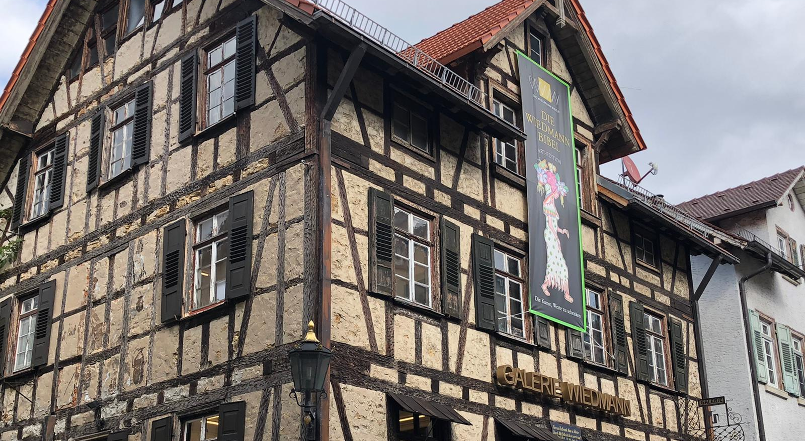
Special things that happened in Bad Cannstatt
Because of Gottlieb Daimler it was the birthplace of motorcycles and automobiles
Willy Wiedmann drew the Bibel for the first time
It has the oldest train station of Baden – Württemberg
First railway of Württemberg
First motorized tram in the Europe
It has one of the richest mineral water springs sources in Europe
It was a health resort for royal families

Slide 5
This old town is important for Stuttgart, because….

Slide 6
sources
https://www.stuttgarter-zeitung.de/inhalt.geschichte-von-bad-cannstatt-vom-fischerdorf-zur-stadt.11540ba5-c02f-4c3d-90d9-6d25dbbbc2f8.html
https://www.cannstatt-blog.de/p/geschichte.html
https://www.stuttgarter-nachrichten.de/inhalt.von-kelten-koenigen-und-kurgaesten-stuttgarts-historie-beginnt-in-bad-cannstatt.73837985-c73f-4a82-968e-ab71962531be.html
https://www.stuttgart.de/rathaus/stadtbezirke/badcannstatt/
last check 11.10.2020, 15:50 h

