Slide 1
Does the combination of traffic & culture work?
The culture mile of Stuttgart
Urban story by Conny, Anabel & Lena

Slide 2
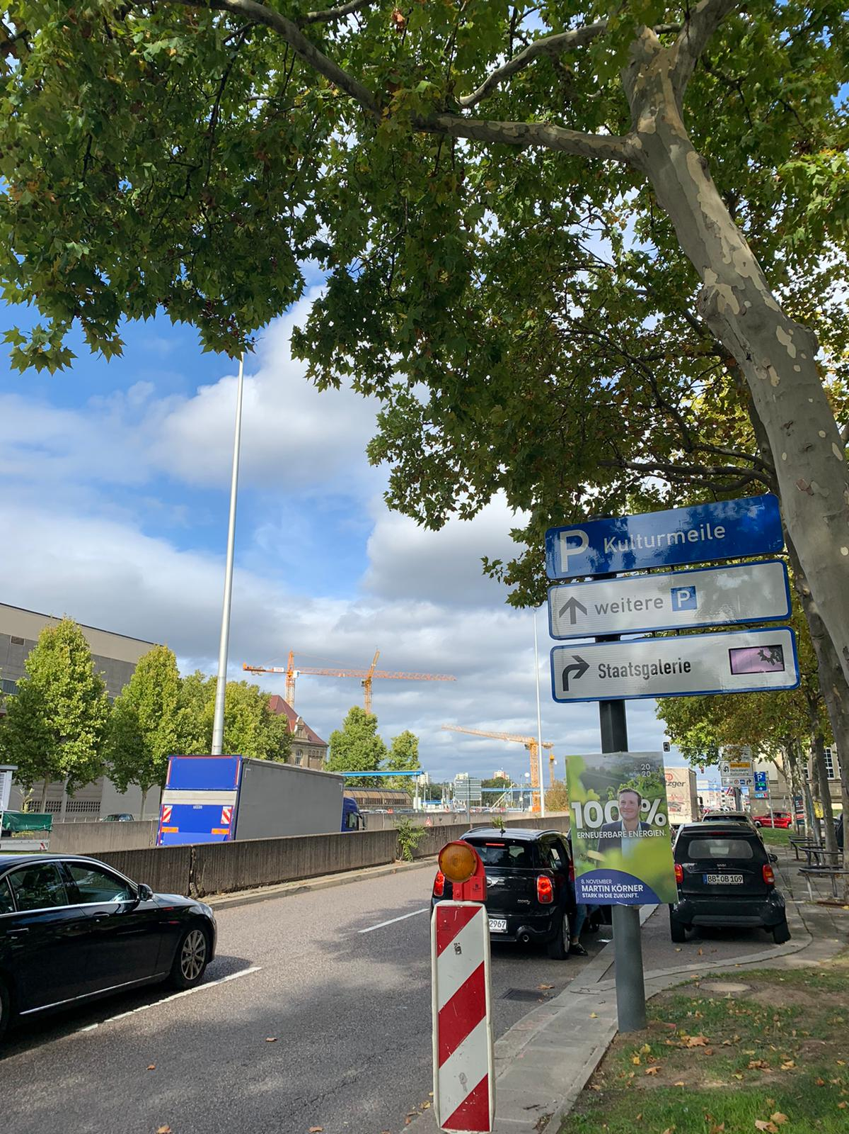
in the center of Stuttgart
cultural quarter along an eight-lane street

Slide 3
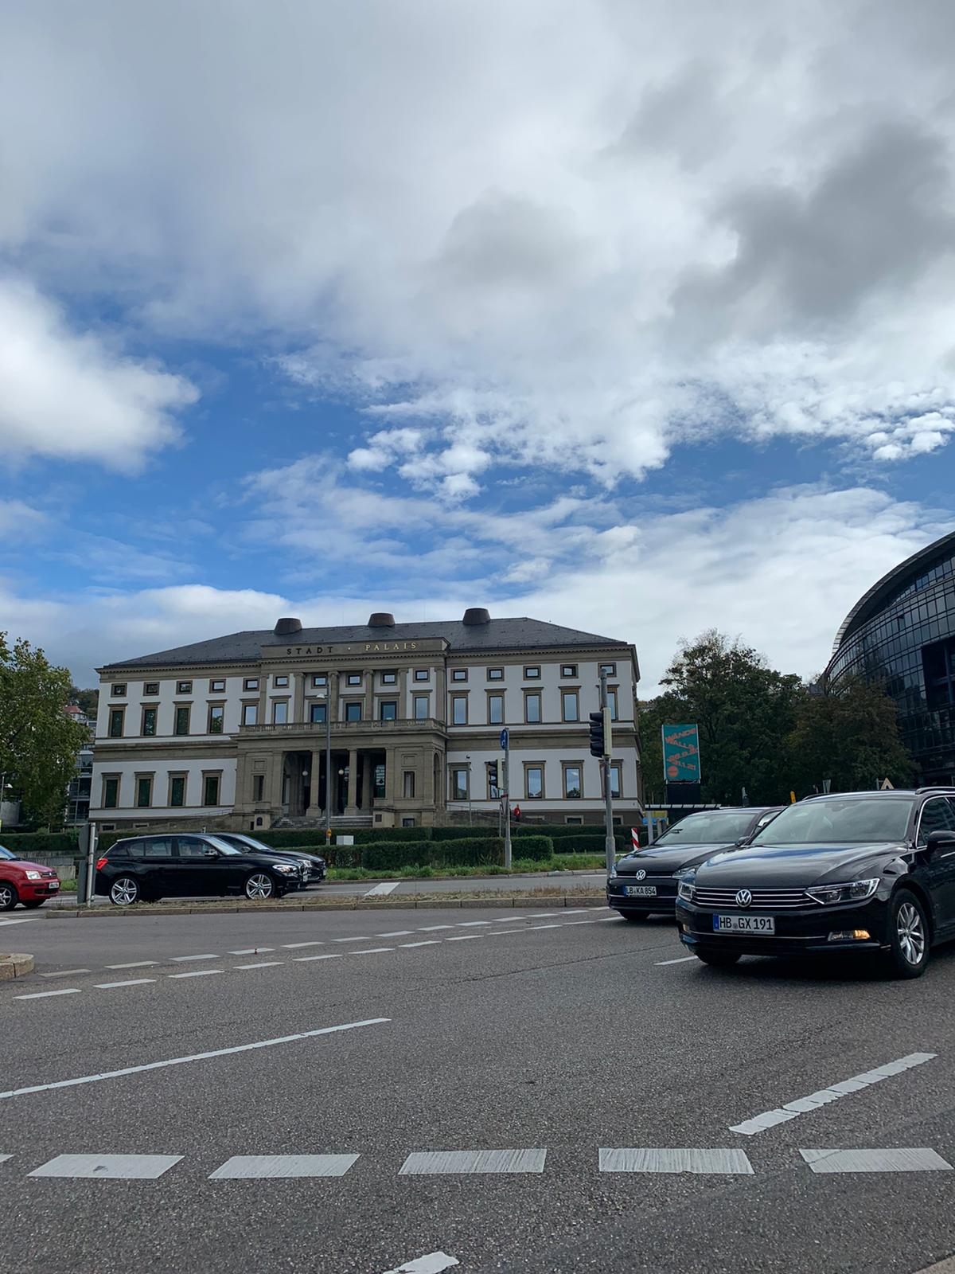
a lot of traffic noise
hard to find street crossings

Slide 4
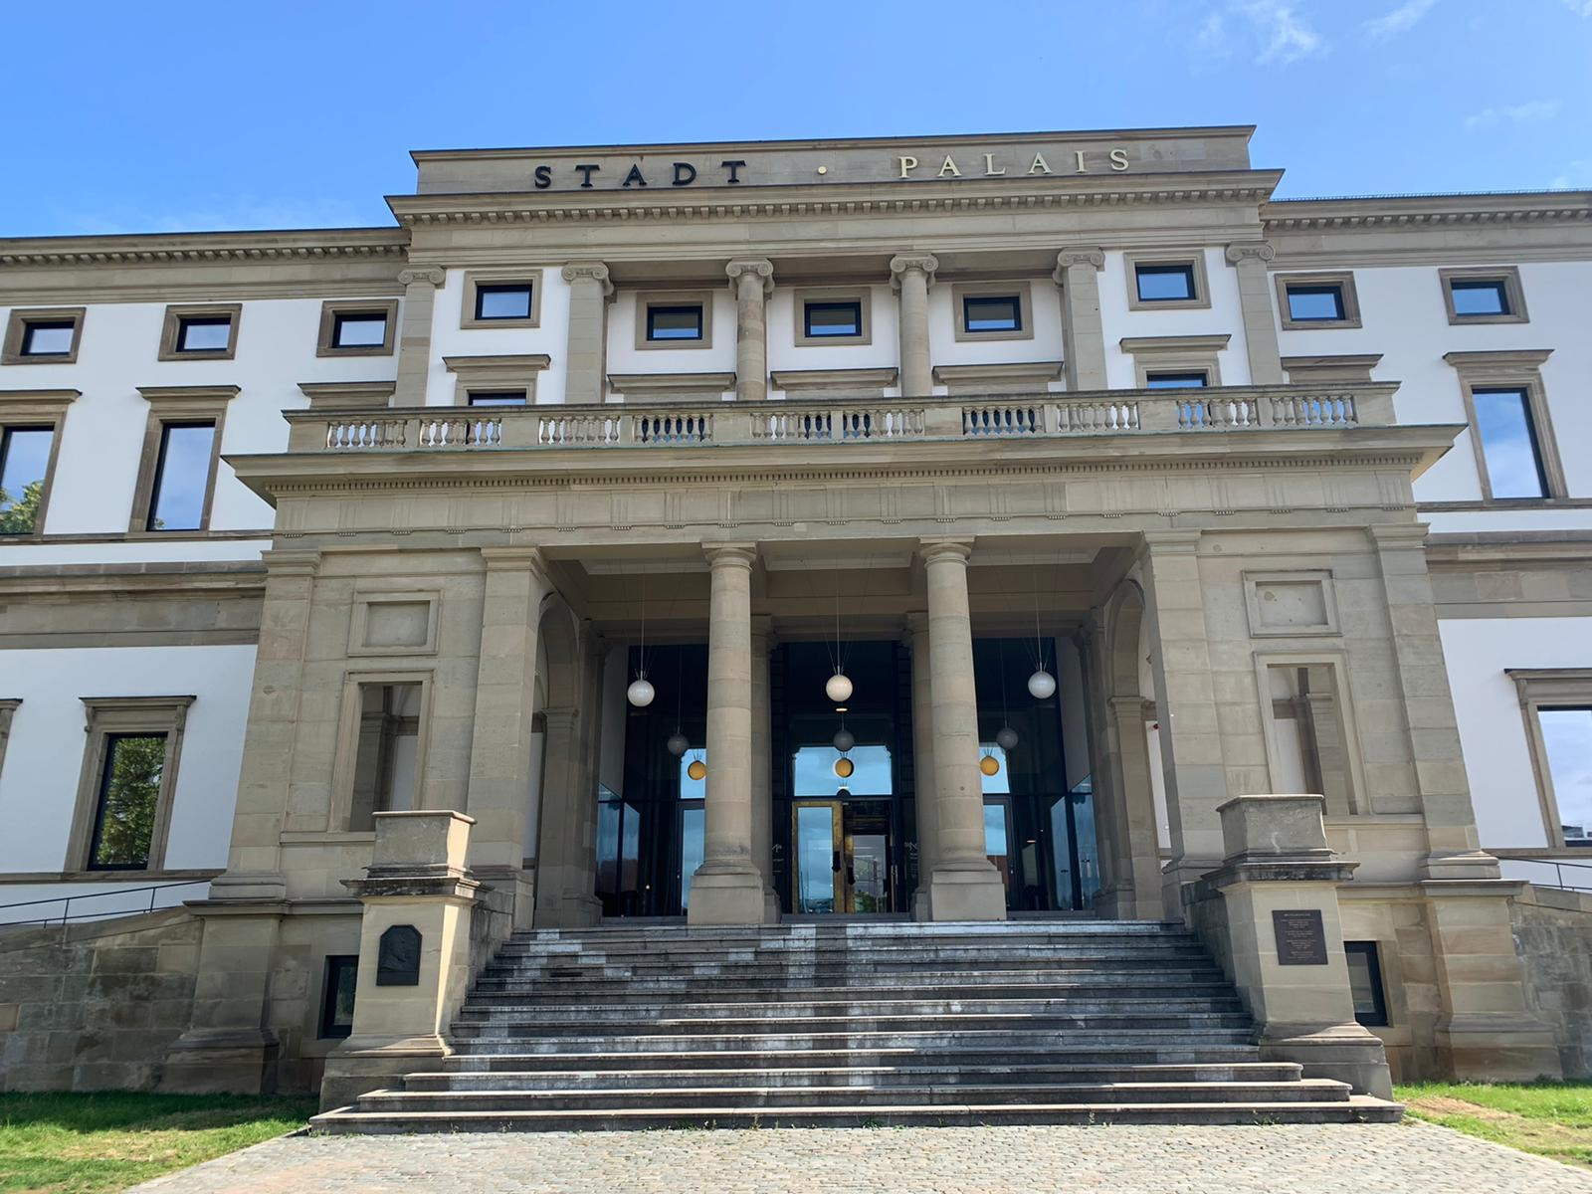
former residence of King Wilhelm II;
nowadays museum of the city's history (‘‘Wilhelmspalais“)

Slide 5
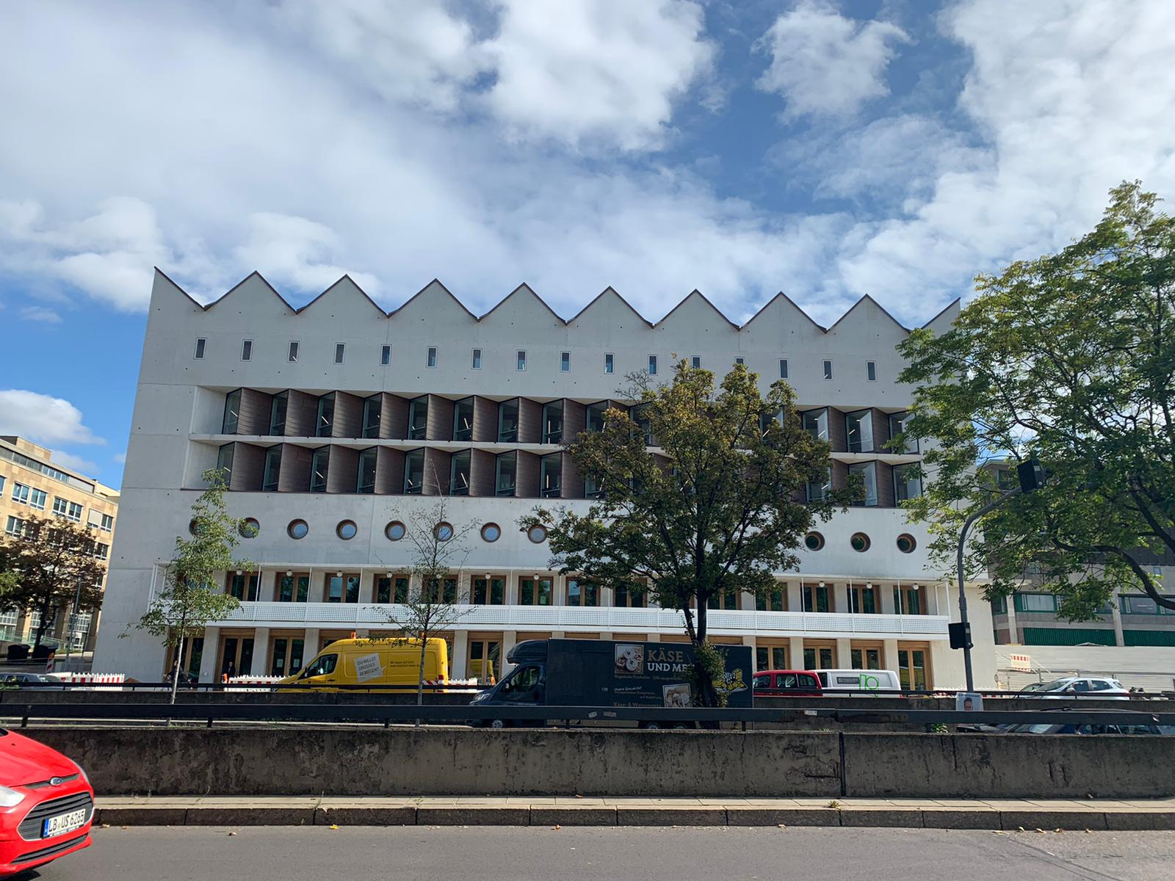
academic universal library (‘‘Landesbibliothek“)

Slide 6
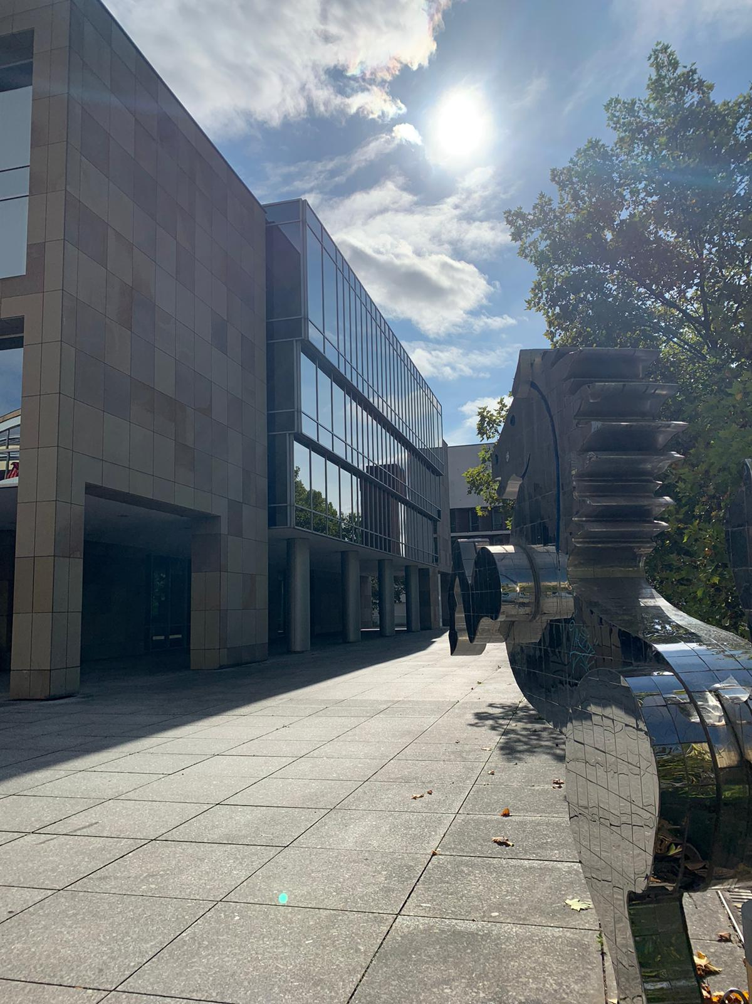
part of the state parliament (‘‘Haus der Abgeordneten“)
more than 200 offices for the members of the parliament

Slide 7
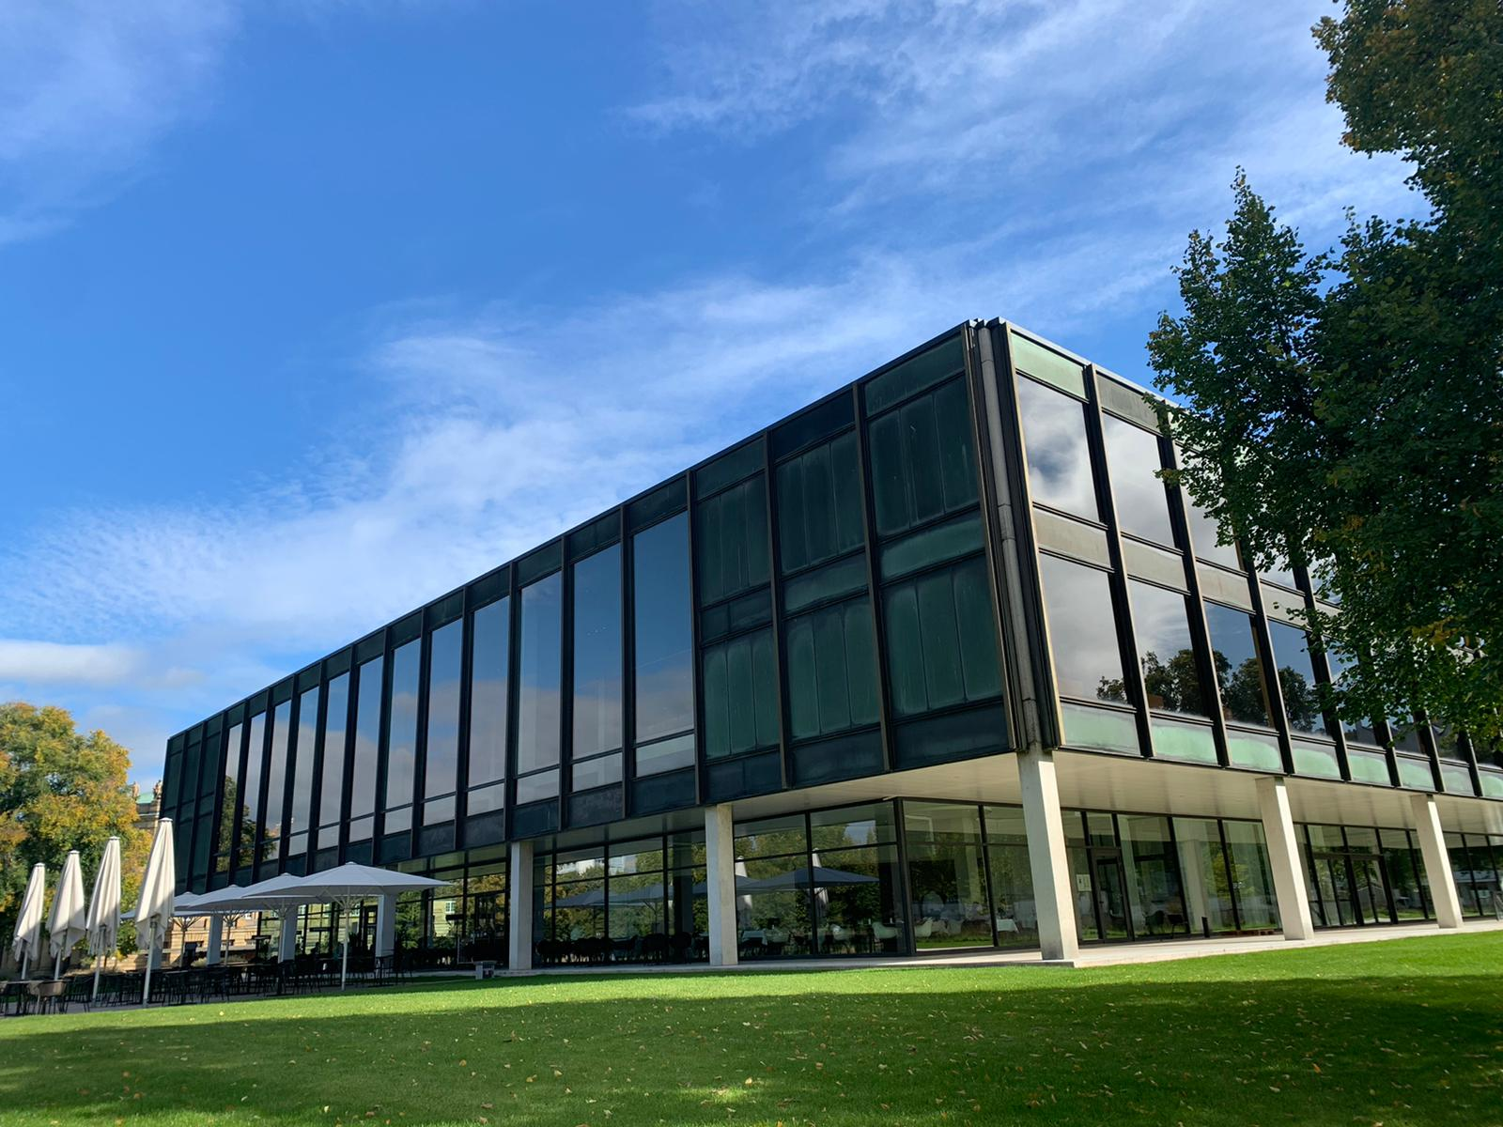
first new constructed state parliament (‘‘Landtag“) since the second world war

Slide 8
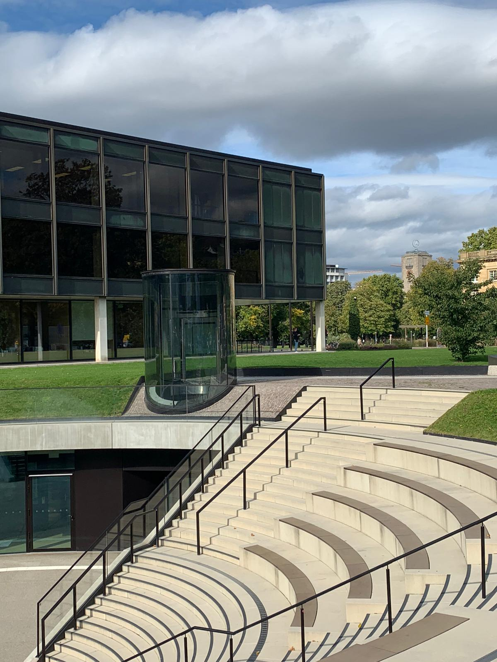
citizen- and mediacenter
location of press and political events

Slide 9
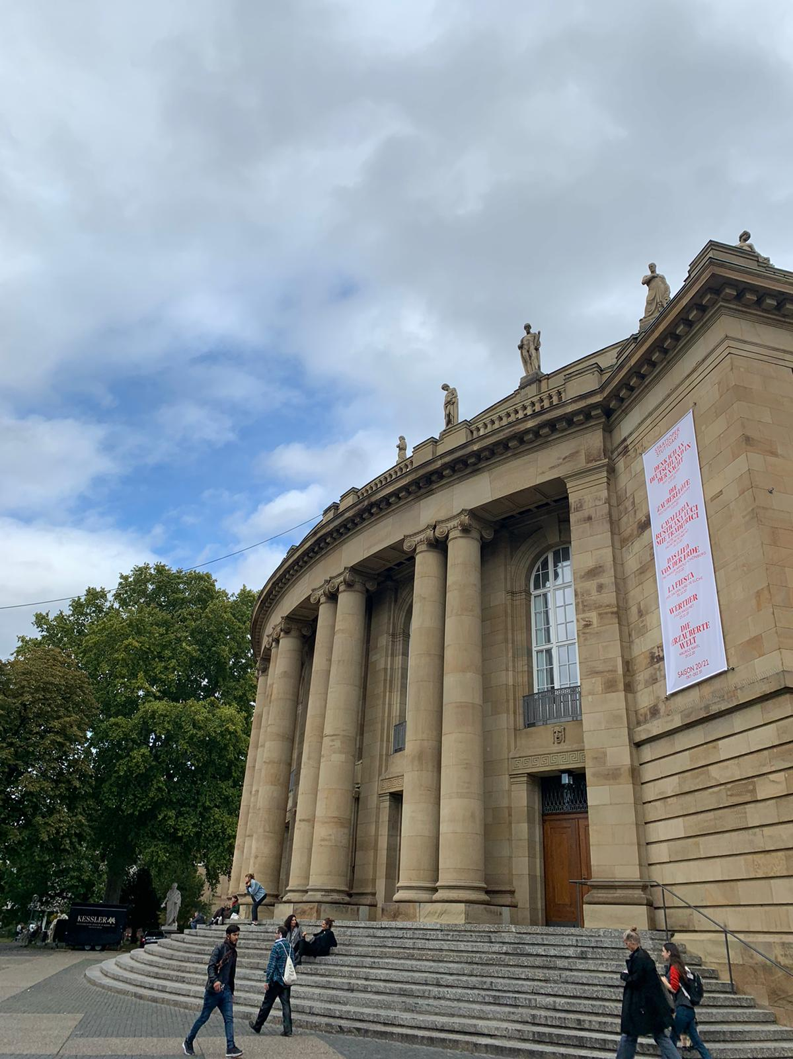
state theatre (‘‘Staatstheater“)
divided into opera, ballet & perfomance house

Slide 10
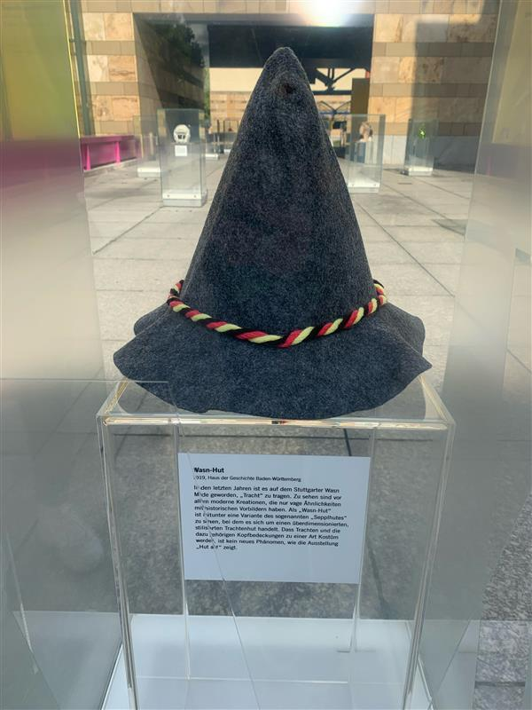
country‘s history museum (‘‘Haus der Geschichte“)

Slide 11
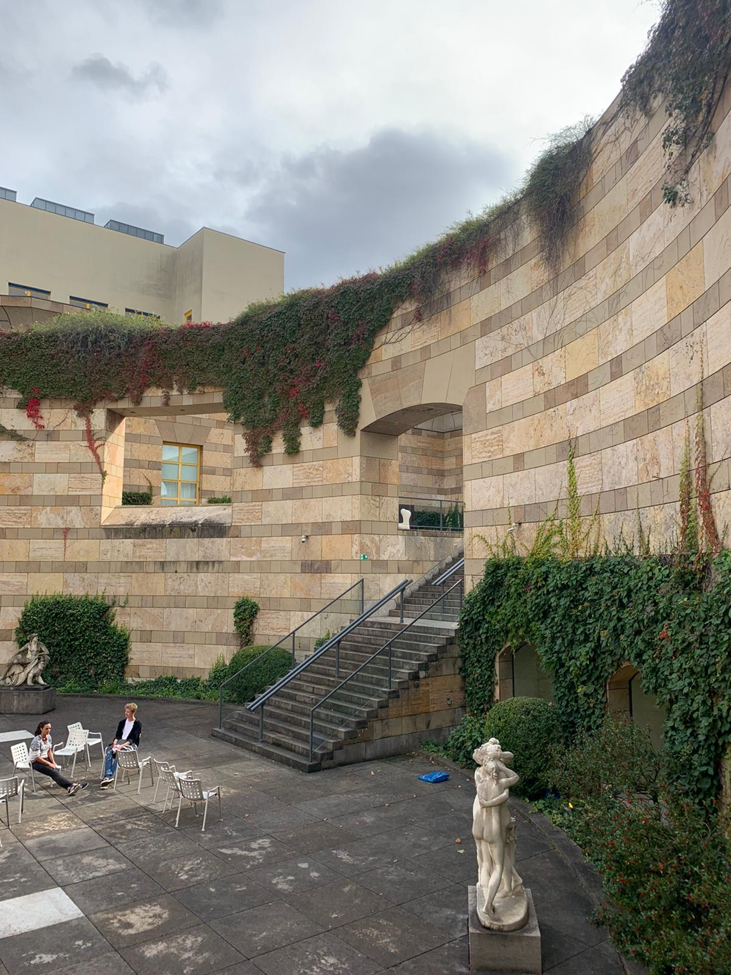
old building of the art museum (‘‘Staatsgalerie“)
opened in 1843

Slide 12
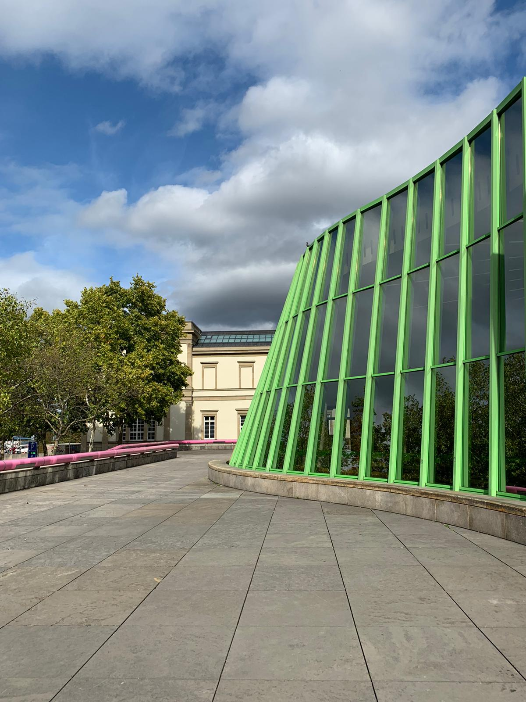
new building of the art museum (‘‘Staatsgalerie“)
opend in 1984

Slide 13
Reconstruction plan
more nature (trees, plants,…)
additional road crossings
expansion of cultural facilities
reduce traffic -> improve living conditions

Slide 14
Sources
https://www.bba-online.de/aktuell/meldungen/aufbruch-stuttgart-architekten-workshop/
https://www.stadtpalais-stuttgart.de/ueber-uns/konzeption-stadtpalais
https://www.landesarchiv-bw.de/de/landesarchiv/standorte/hauptstaatsarchiv-stuttgart/47272
https://www.wlb-stuttgart.de
https://www.landtag-bw.de/home/der-landtag/parlament/landtagsgebaude/haus-der-abgeordneten.html
https://www.stuttgarter-nachrichten.de/inhalt.kulturmeile-stuttgart-initiative-schlaegt-opern-neubau-und-reduzierte-b14-vor.04cf3552-dab9-4cbd-b7e8-5ce0f51db656.html
https://www.stuttgarter-nachrichten.de/inhalt.spaziergang-durch-stuttgart-1942-einmal-die-kulturmeile-auf-und-ab.5375a61a-d5a3-4341-a459-cf5bdc977b6b.html?reduc
Landtag-bw.de
https://www.staatstheater-stuttgart.de
https://stuttgart-meine-stadt.de
https://www.stadtlexikon-stuttgart.de
https://www.1000dokumente.de
https://www.freunde-der-staatsgalerie.de/
https://www.hdgbw.de/
Pictures made by Lena, Anabel and Conny ☺

