Slide 1
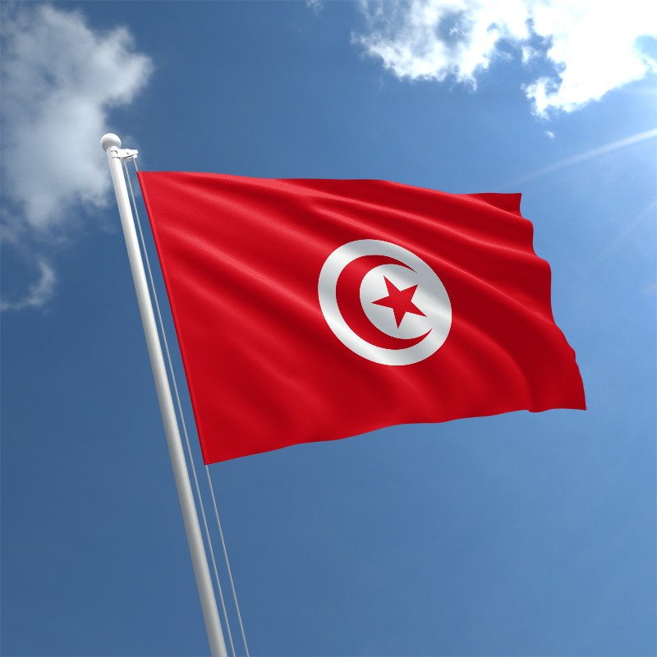
UNESCO WORLD HERITAGE SITES IN TUNISIA

Slide 2
Tunisian culture is a product of more than three thousand years of history and an important multi-ethnic influx.
Ancient Tunisia was a major civilization crossing through history; different cultures, civilizations and multiple successive dynasties contributed to the culture of the country over centuries with a varying degrees of influence.
Among these cultures were the Carthaginian - their native civilization, Roman (Roman Africans), Vandal, Jewish, Christian, Arab, Islamic, Turkish, and French, in addition to native Amazigh.

Slide 3
There are 8 UNESCO World Heritage Sites in Tunisia. This list is comprised of 7 cultural sites and 1 natural site.
Amphitheatre of El Jem (1979)
Archaeological Site of Carthage (1979)
Dougga / Thugga (1997)
Kairouan (1988)
Medina of Sousse (1988)
Medina of Tunis (1979)
Punic Town of Kerkuane and its Necropolis (1985)
Ichkeul National Park (1980)

Slide 4
Amphitheatre of El Jem (1979)
The Amphitheatre of El Jem in El Djem, Tunisia is an oval amphitheater that is listed as one of the UNESCO World Heritage Sites in Tunisia. This structure was built in 238 AD and is one of the best preserved Roman ruins in the world.
The construction of this amphitheater by the Roman Empire was no different from many other similar structures that the Romans have built – as a venue for spectator events. With a capacity of 35,000, this is one of the biggest amphitheaters in the world.
The structure is made out of stone blocks that are built on a flat ground. The state of preservation of the amphitheater is highly impressive especially given the date when it was originally built.

Slide 6
Archeological Site of Carthage (1979)
The Archaeological Site of Carthage is one of the cultural UNESCO World Heritage Sites in Tunisia. It was built by the Phoenicians on a hill with an overlooking view of the Gulf of Tunis and its surrounding plains. This archaeological site was considered of universal value because of its mixture and diffusion of various cultures in one place. From the Phoenic-Punic, to the Romans and Paleochristians, each of these cultures left behind traces of how they lived to form the unique archaeological landscape at the site.
The archaeological site of Carthage consists of several notable properties including the Acropolis of Byrsa, Punic tophet, the Punic ports, the Antonine baths, Malaga cisterns, and many more

Slide 7
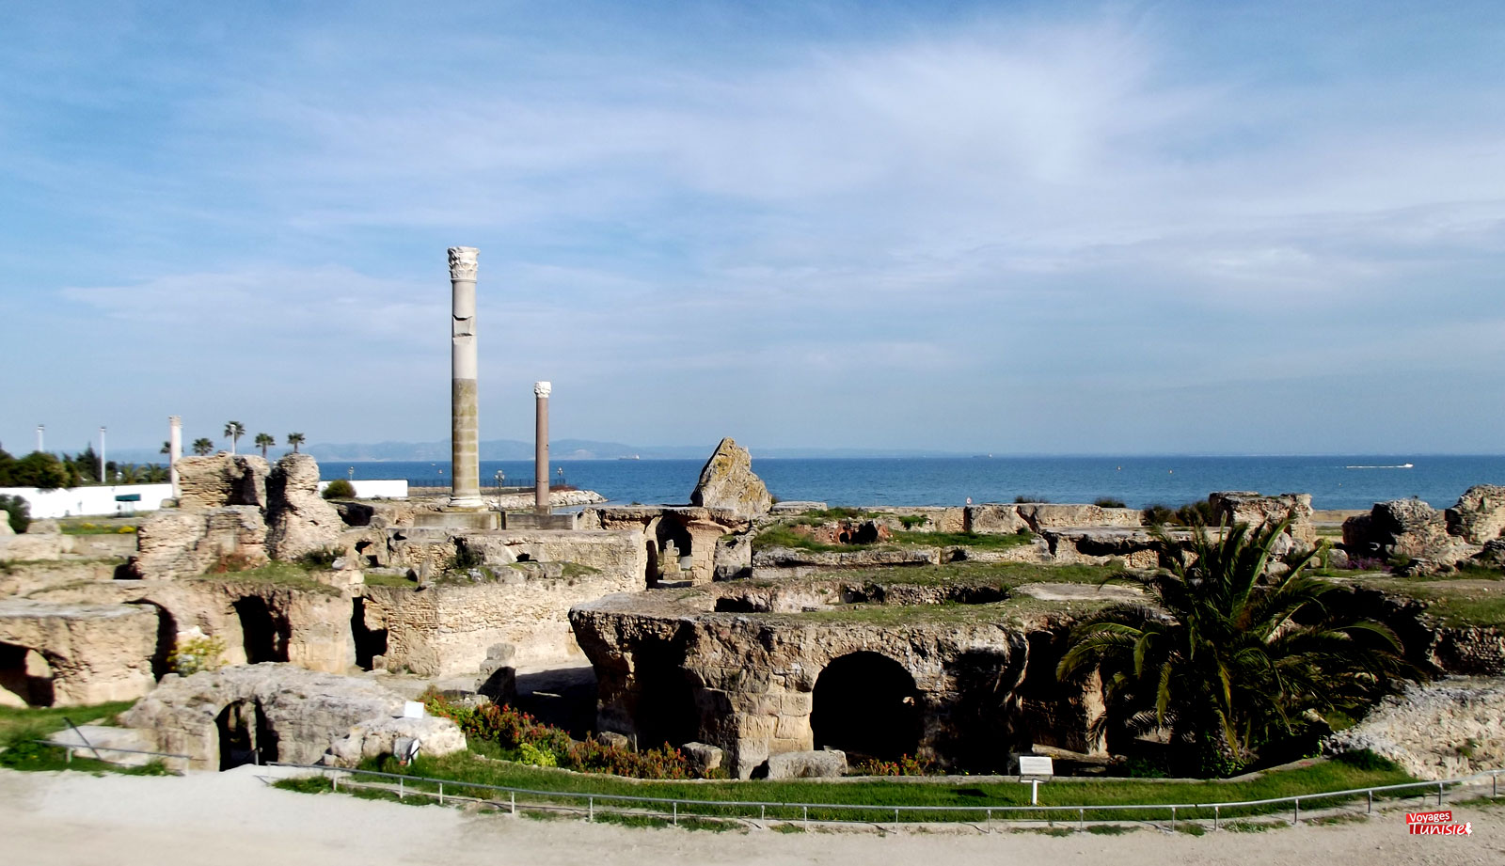
Archeological Site of Carthage (1979) Archeological Site of Carthage (1979)
Archeological Site of Carthage (1979)

Slide 8
Dougga / Thugga (1997)
Dougga, also known as Thugga, is an ancient Roman city in Tunisia. It falls under the cultural category in the list of UNESCO sites in Tunisia. This property located in northern Tunisia spans 65 hectares in land area. It was inscribed by UNESCO as a world heritage property in 1997.
When UNESCO listed Dougga as a world heritage, it cited the fact that Dougga represents the best preserved Roman small town in the North African region. The site is located in a somewhat remote location, which contributed to its preservation as it is free from the modernization and urbanization in the center of the city. Unlike Carthage, another UUNESCO site in Tunisia, Dougga has not undergone any major rebuilding or reconstruction.

Slide 9
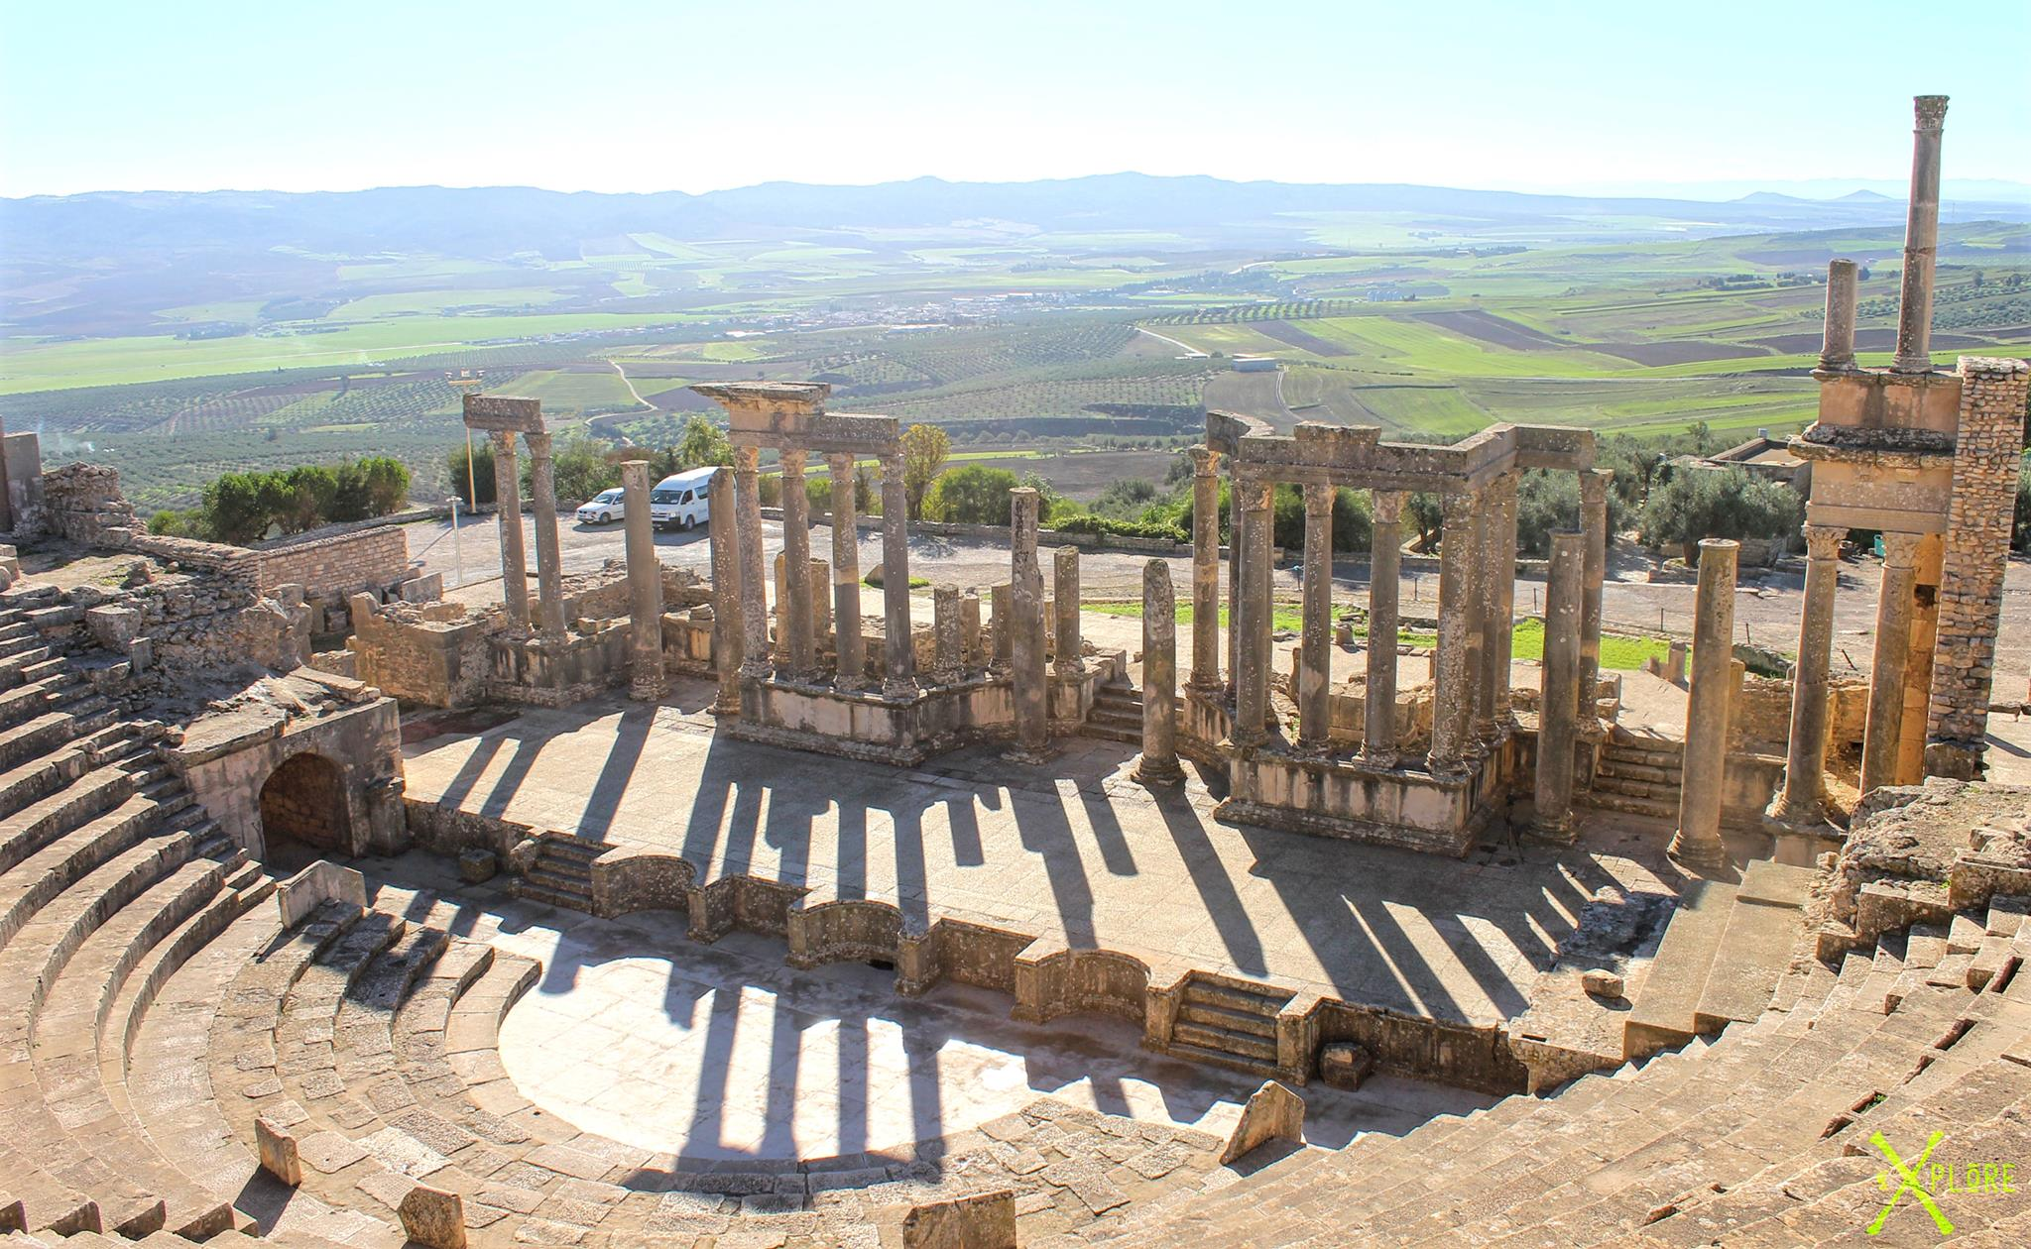
Archeological Site of Carthage (1979) Archeological Site of Carthage (1979)
Archeological Site of Carthage (1979)

Slide 10
Kairouan (1988)
Kairouan is the capital of its namesake governate in Tunisia. The city was founded during the late 7th century by the Umayyads. From 661 to 680, it became the center for Sunni Islamic scholarship and Quranic learning. Hence, this brought in a lot of Muslims from various parts of the world to travel to Kairouan. This was the third destination in terms of the number of Muslim travelers, next only to Mecca and Medina. The holy Mosque of Uqba is also located in the city of Kairouan, which further cemented the status of the city as a pilgrim destination for those of the Muslim faith.

Slide 12
Medina of Sousse (1988)
The Medina of Sousse is another cultural site recognized into the list of UNESCO World Heritage Sites in Tunisia. The reason for its inscription is because this Medina quarter is the typical example of the architecture during the early centuries of Islam. The property includes structures such as the Great Mosque of Sousse, Kasbah and the fortifications in the area. Currently, you will also find the Archaeological Museum of Sousse in the Medina of Sousse.
The Medina of Sousse is also an outstanding archaeological site. The medina was established at the dawning of the Islamic civilization, which provides a glimpse into the earliest architectural works in line with the Islamic conquests. Second, the location of the medina also deemed it necessary to establish defensive structures to guard against piracy and plunder.

Slide 13
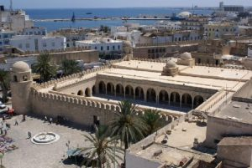

Slide 14
Medina of Tunis (1979)
The Medina of Tunis is located within the capital of Tunisia. It was added to UNESCO’s list of world heritage properties in 1979. The Medina is home to about 700 monuments from the Almohad and Hafsid periods. These monuments included mosques, mausoleums, madrasas, palaces and many other structures.
The medina was founded in the late 7th century until it developed in the Middle Ages. It was during the Hafsid period wherein the medina (known as it is today) developed its current form. Around this time, the monuments (some of which are still standing today) are built and they showcase a combination of styles from various influences including Ifriqiya, Oriental and Andalusian styles. In fact, many of these monuments have a close resemblance to Roman and Byzantine monuments.

Slide 15
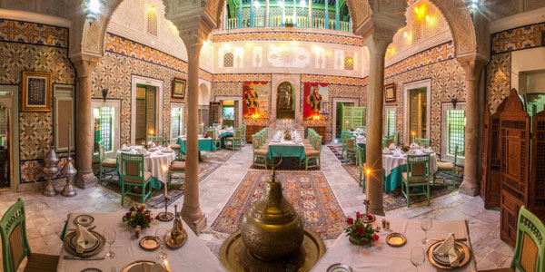

Slide 16
Punic Town of Kerkuane and its Necropolis (1985)
Located in northeast Tunisia, the Punic town of Kerkuane is a Phoenician city that was abandoned after the first Punic War in 250 BC. This town was not rebuilt by the Romans. For this reason, the state in which it was left in has been preserved to what it is today as it is about 400 years ago. This is also the same reason why it was recognized as one of the UNESCO World Heritage Sites in Tunisia.
There were several excavations that were performed in this town and these enabled archaeologists to find coins and other types of ruins. These ruins were dated back to the 4th and 3rd centuries BC. The layout of the town is still visible and you will find the walls to former houses. These houses were constructed using a standard plan and showcases a bit of town planning even for such an ancient time in history. There are also mosaics, columns and other well-preserved ruins within this town.

Slide 17
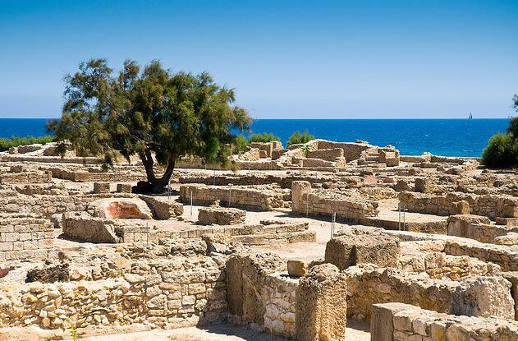

Slide 18
The Ichkeul National Park)
The Ichkeul National Park is the only natural site in this list of UNESCO World Heritage Sites in Tunisia. This park is valuable because it serves as an important stopping-over point for various species of migratory birds every year. Located in the northern part of Tunisia, the park is located close to the shore of the Mediterranean Sea. The Ichkeul Lake is an integral part of the park’s premises. In the lake, you will find pink flamingos, ducks, storks and geese.
At one point, this national park was listed as one of the World Heritage Sites in Danger. Since the construction of dams in the park, it has limited the amount of freshwater inflow to the lakes and marshes within the park. For this reason, the fresh water plant species have been dominated by the salt-water plant species. This resulted in an imbalance in the ecological makeup of the park, which greatly reduced the population of migratory birds that come into the park each year. These migratory birds depended on many of the plant species that were found in the park, of which many of them had been lost due to the construction of the dam.

Slide 19
