Slide 1
NETIQUETTE
is network etiquette,
Internet + Etiquette

Slide 2
What is Netiquette ?
The etiquette of cyberspace
A set of rules for behaving properly online.

Slide 3
Why is Netiquette important ?
It establishes good behavior while on the net
There is a real person on the other end of your message

Slide 4
Types of Netiquette
basic
Of sending
Of replying
Of confidentially

Slide 5
Netiquette basics
Help the newbies
Research before asking
Remember emotions

Slide 6
NETTIQUE OF SENDING
Be brief
Use white spaces
Use descriptive subject lines
Stay on-topic
Be careful sending attachment
Copy the minimum number of people

Slide 7
Netiquette of replying
Acknowledge important communications
Replying and forwarding
Summarize for the group
Check current information before replying
Reference past communications

Slide 8
Netiquette of confidentially
Don’t publish other’s email addresses
Never send what you don’t read
Remember archiving
Respect copyright

Slide 9
10 BEST RULES OF NETIQUETTE

Slide 10
1st Rule
Remember the Human
Remember that you are talking to a real person when you are online.
Stand up for your self , but don’t hurt others feelings
Remember : your chats can be saved and emails can be forwarded
Never know where your conversation may end up

Slide 11
2nd rule
Follow the same rules online that you follow in real life
Behave the same way online that you do in real life.
Remember that you can get caught doing things you should not be doing online just like you can in real life.
Breaking the law is bad netiquette

Slide 12
3rd rule
Know where you are in cyberspace.
Always take a look around when you enter a new domain when surfing the web.
Get a sense of what the discussion group( forum ) is about before you join it : ( lurk before you leap ) .

Slide 13
4th rule
Respect other people’s time and bandwidth.
Remember people have other things to do besides read your email. You are not the center of their world.
Keep your post and emails to a minimum by saying what you want to say.
Remember everyone won’t answer your questions.

Slide 14
5th rule
Make yourself look good online
Remember to always check your spelling and grammar before posting.
Always know what you are talking about and make sense saying it.
Be polite and pleasant to everyone.

Slide 15
6th rule
Share expert knowledge
Ask questions online
Share what you know online.
Post the answers to your questions online because someone may have the same question you do.

Slide 16
7th rule
Help keep flame wars under control
Netiquette does not forbid flaming.
Netiquette does however forbid people who are flaming to hurt discussion groups by putting the group down.

Slide 17
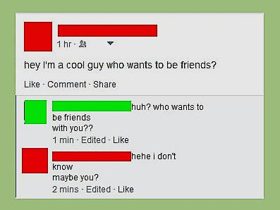
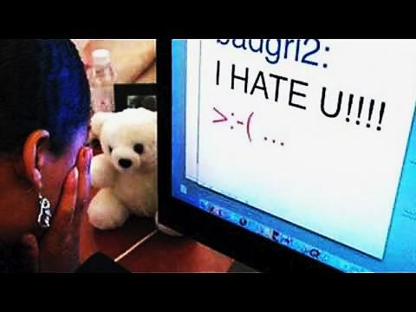
7th rule

Slide 18
8th rule
Respect other people’s privacy
Do not read other people’s mail without their permission.
Not respecting other people’s privacy is a bad Netiquette

Slide 19
9th rule
Don’t abuse your power.
Do not take advantage of other people just because you have more knowledge or power than them.
Treat others as you would want them to treat you

Slide 20
10th rule
Be forgiving of other people’s mistakes.
Do not point out mistakes to people online.
You still need to have good manners even though you are online and can not see the person face to face.

Slide 21
Emails etiquette
Check your email daily
Delete unwanted messages.
Keep messages in your box to a minimum
Mail messages can be downloaded and save for future references.
Never assume that your Email can be read by no one but yourself.
Remember there are always be lurking( catching ) around online

Slide 22
Ten Commandments of Computer Ethics
Never do it
use computer to harm people.
interfere with other people’s work.
Snoop ( spy ) around other people’s files.
use a computer to steal

Slide 23
use a computer to bear false witness
use or copy software.
use other people’s computer resources.
appropriate other people’s intellectual output.

Slide 24
You have to
think about the social consequences of the program you write.
use a computer in ways that show consideration and respect.

Slide 25
Netiquette
Remember the Ten rules of Netiquette and the Ten commandments for computer Ethics while you are online and you will not have any problems.

Slide 26
Let’s remember these tips
Netiquette Rules
Be
Universal
Always identify your self
Be patient with newcomers
Do not type all in capital letters for emphasis
Remember that the written word is hard to interpret
Be brief whenever possible
Make a good
Impression
Do unto others as you’d have others do unto you
Don’t break any law
Be careful not to use rude or bad langauge online

Slide 27
Many thanks for your attention
Let’s follow the quiz on the TwinSpace

