Slide 1
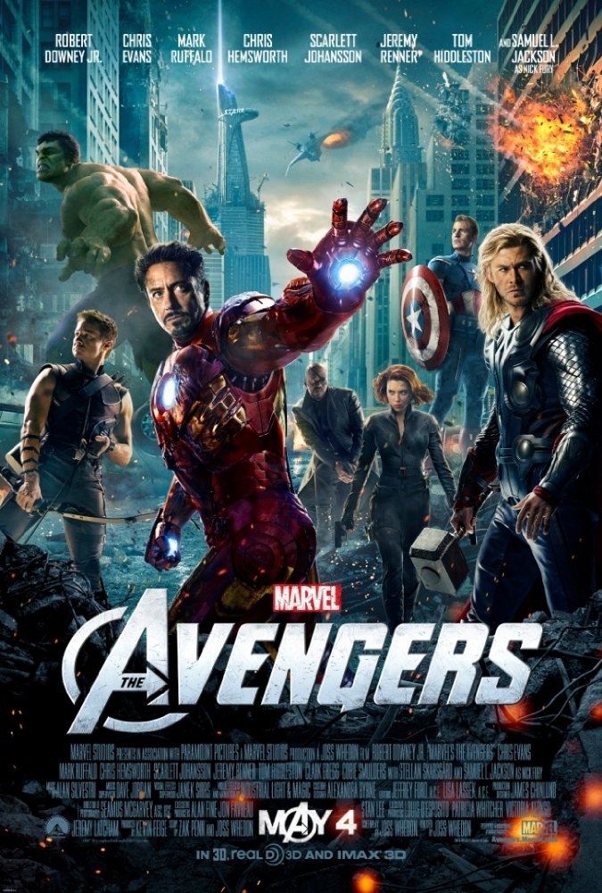
The Avengers
Eliška veškrnová

Slide 2
Basic information
*Avengers: Endgame is a 2012 American superhero film based on the Marvel Comics superhero team the Avengers, produced by Marvel Studios and distributed by Walt Disney Studios Motion Pictures.
*It is directed by Joss Whedon
*It is produced by Kevin Feige
*It is baset on „The Avengers“ by Stan Lee and Jack Kirby

Slide 3
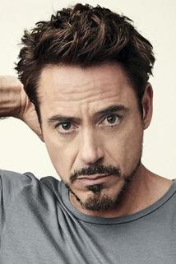
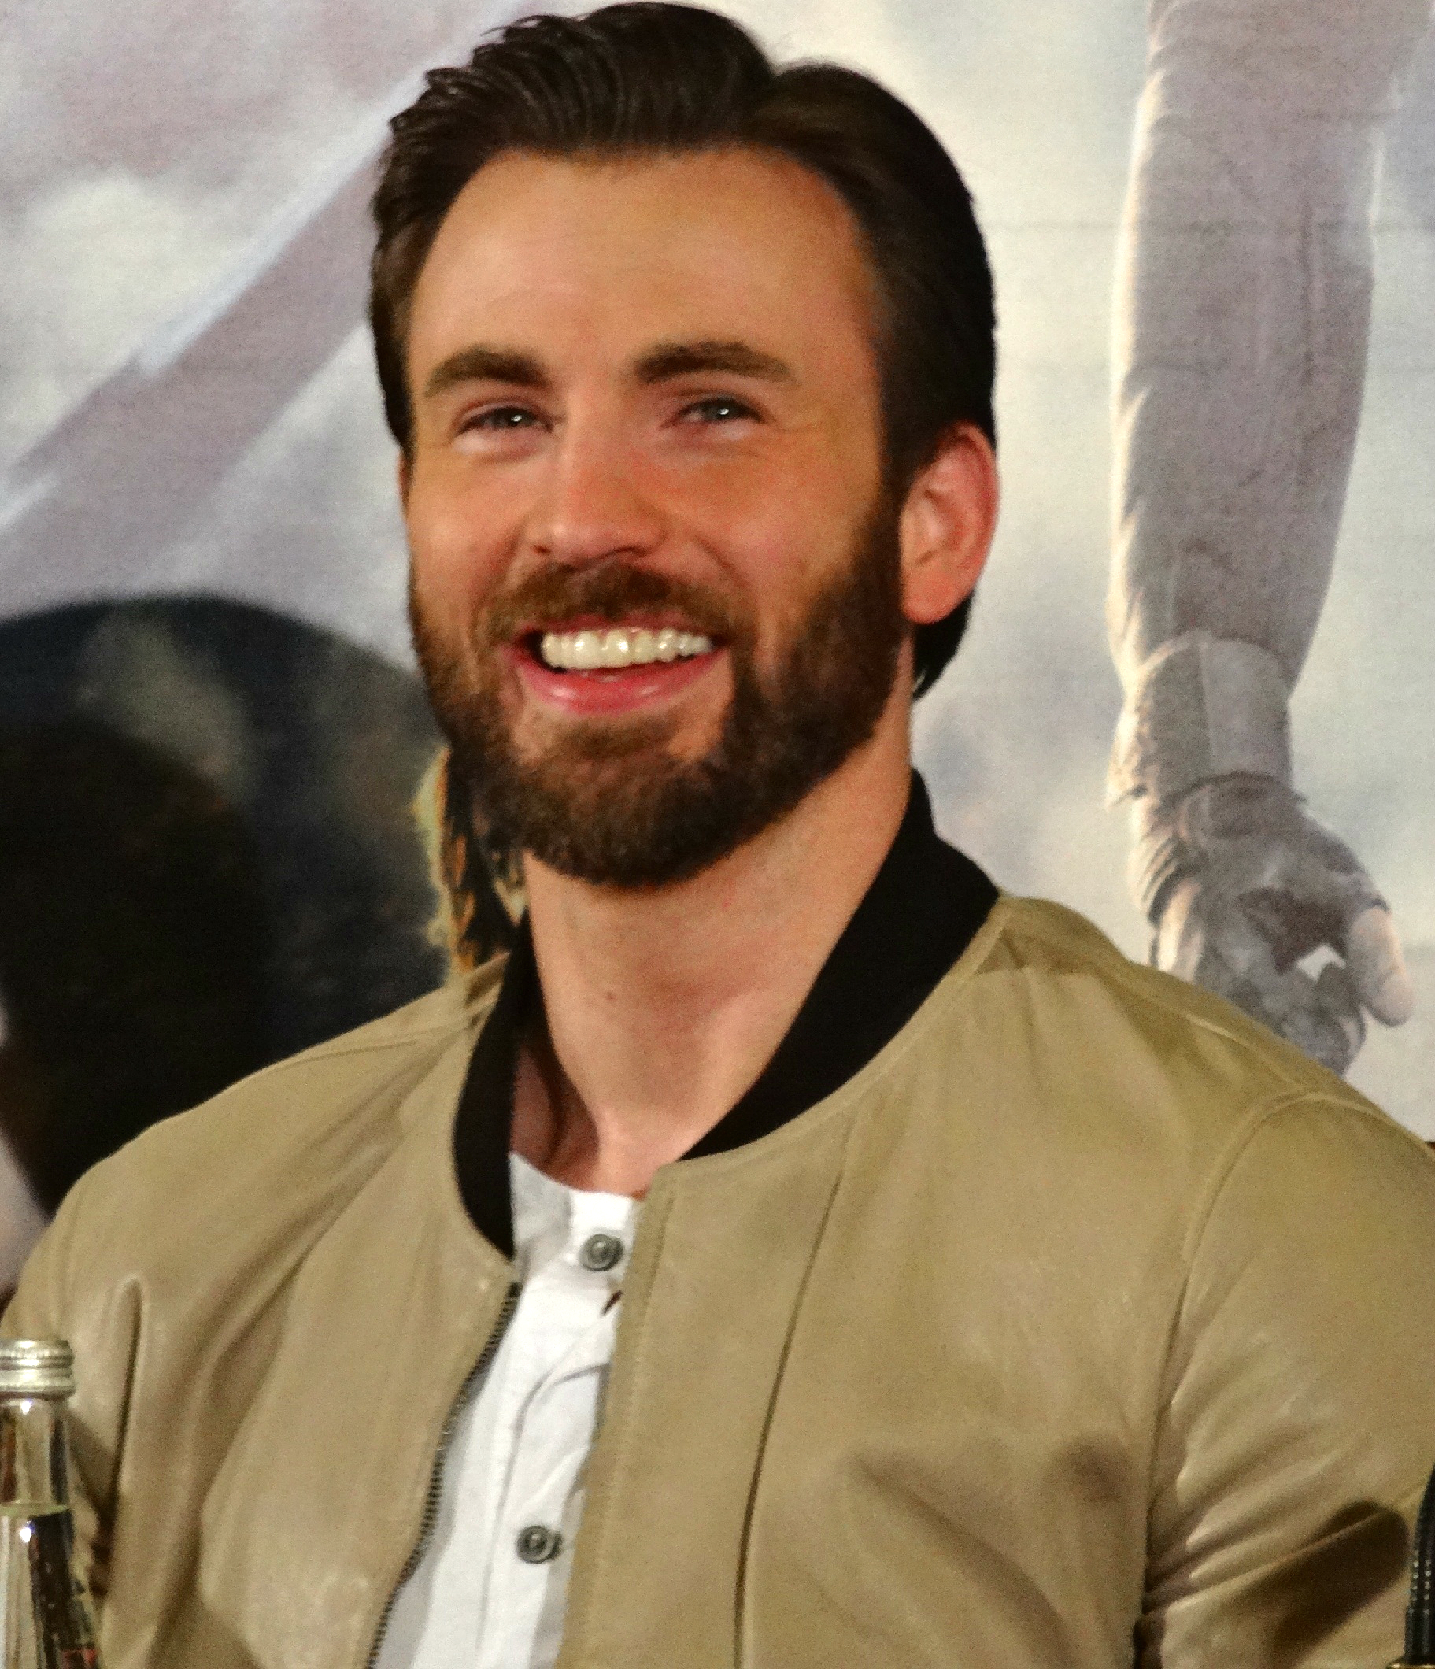
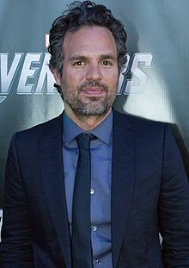
Main actors
Robert Downey Jr.
Chris Evans
Mark Ruffalo

Slide 4
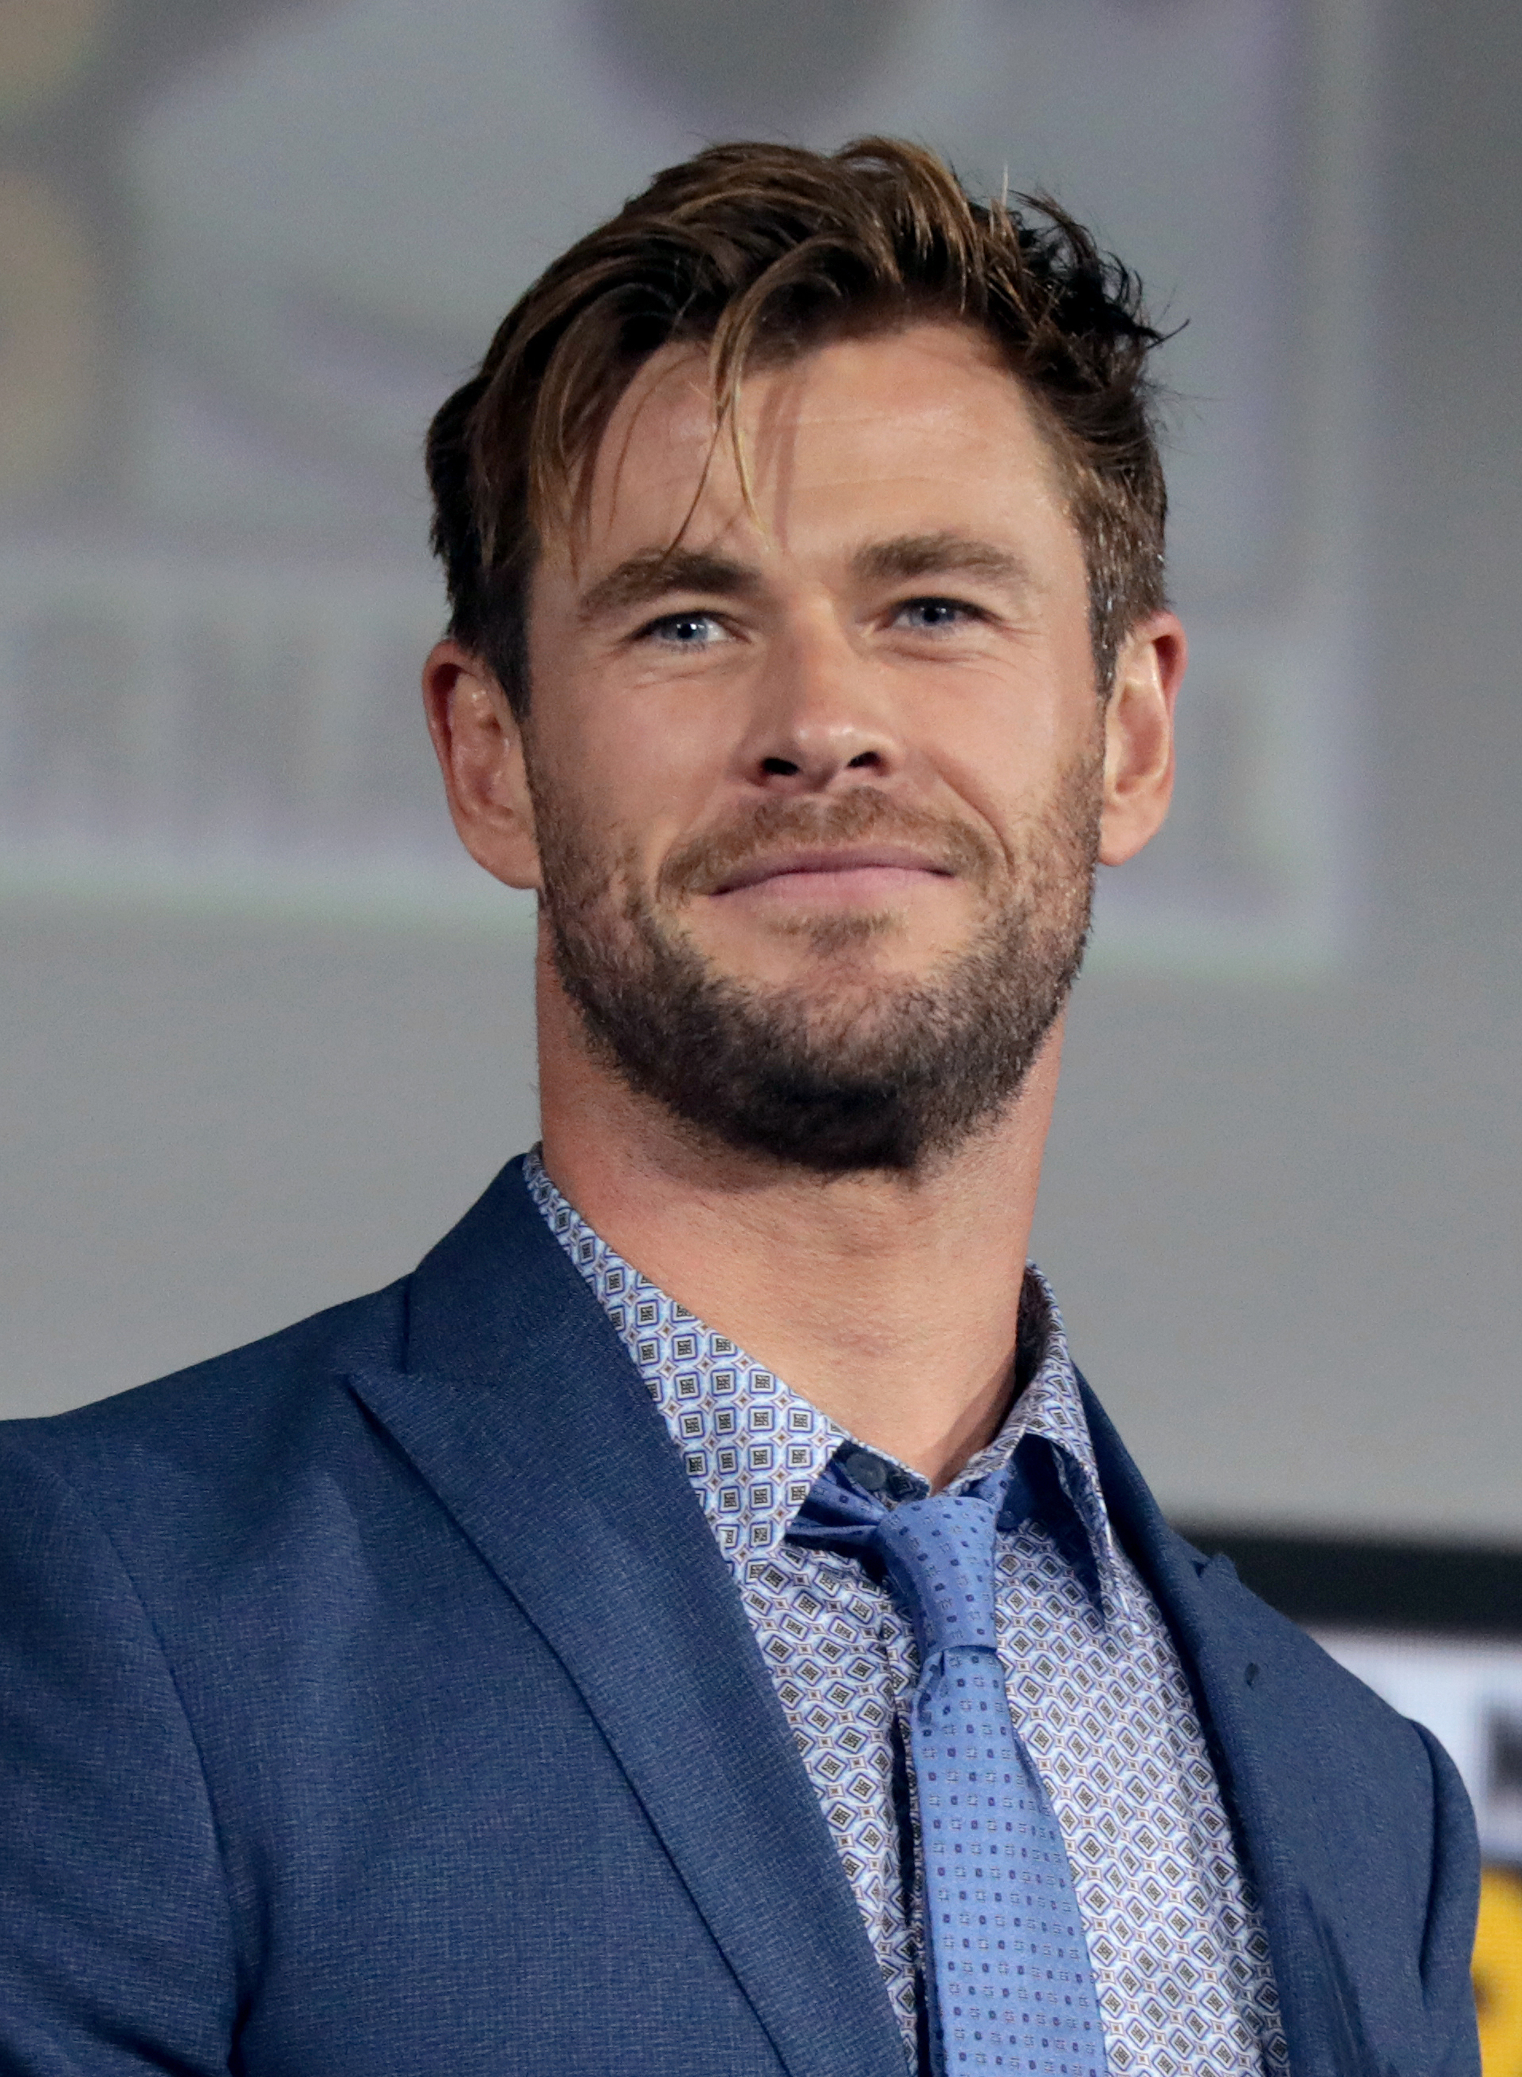
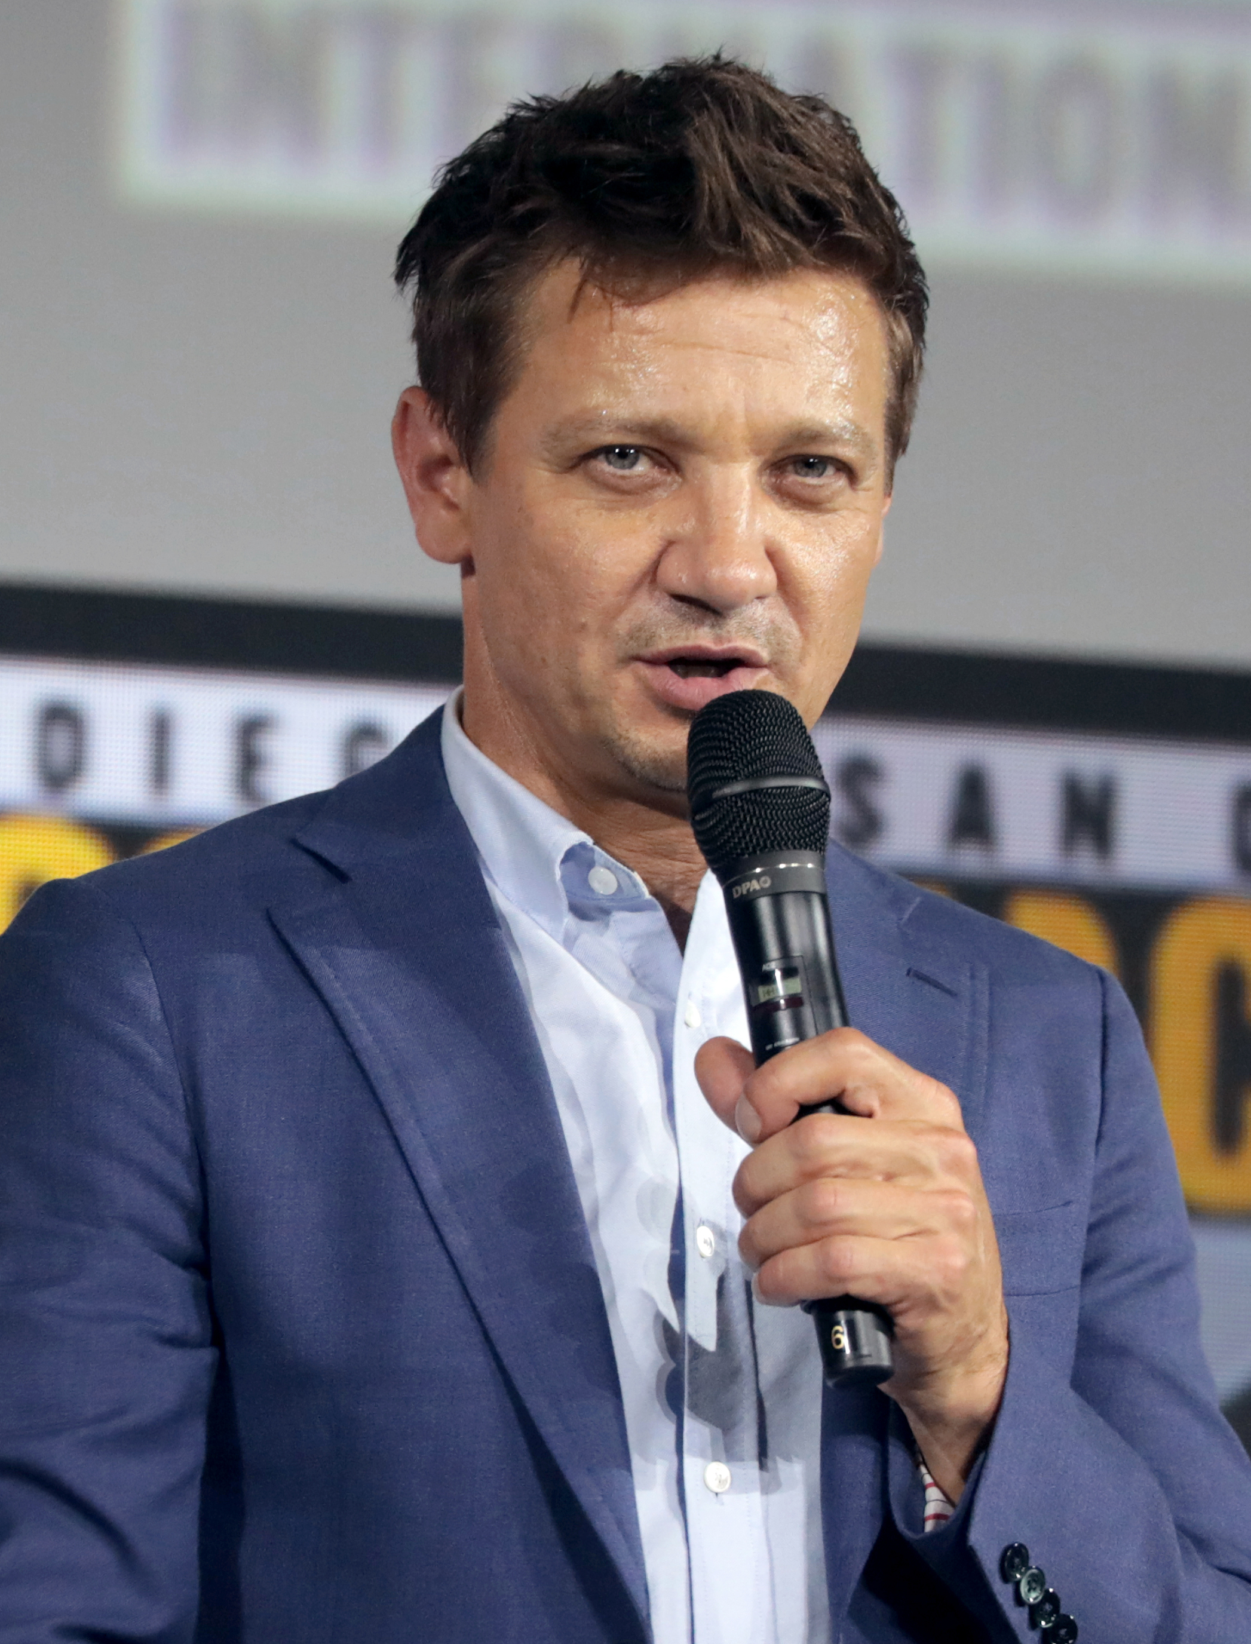
Chris Hemsworth
Scarlett Johansson
Jeremy Renner

Slide 5
Plot I.
*Place: It is placed in paralel universe and in the same time it is placed in New York
*Plot:
-The Asgardian Loki wants to control the planet Earth, so he steals Tesseract which is a thing that helps him call in his army.
-The Avengers try to stop him. They are Americans superheroes – Thor, Captain America, Black Widow, Iron Man, Hulk, Hawkeye.

Slide 6
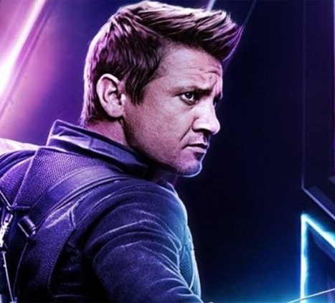
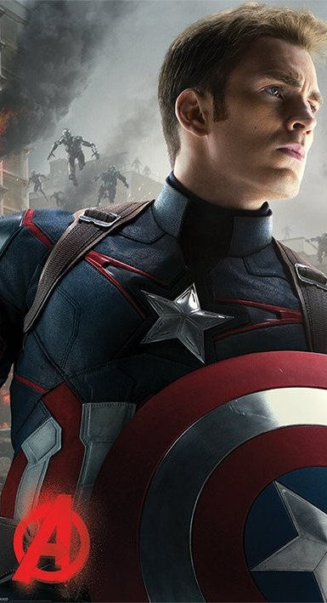
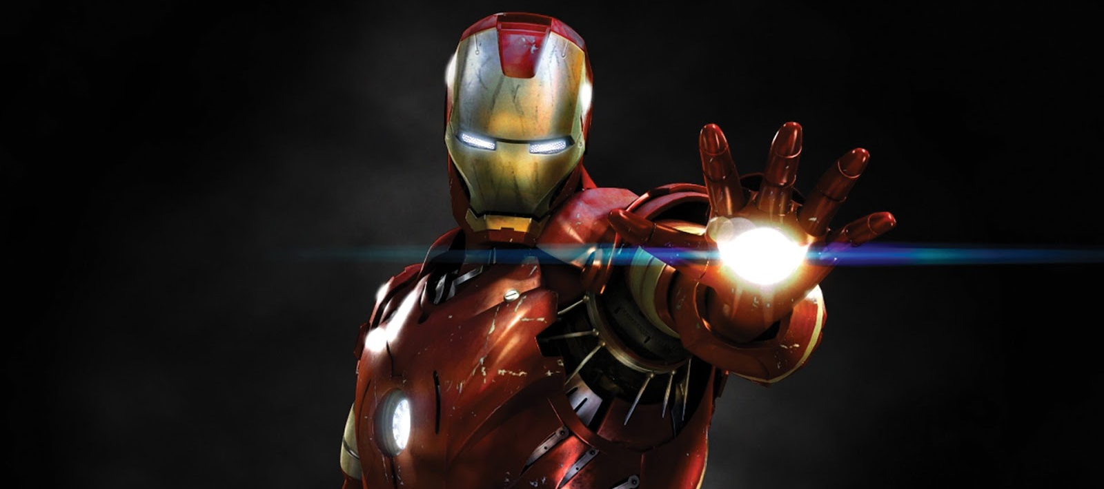
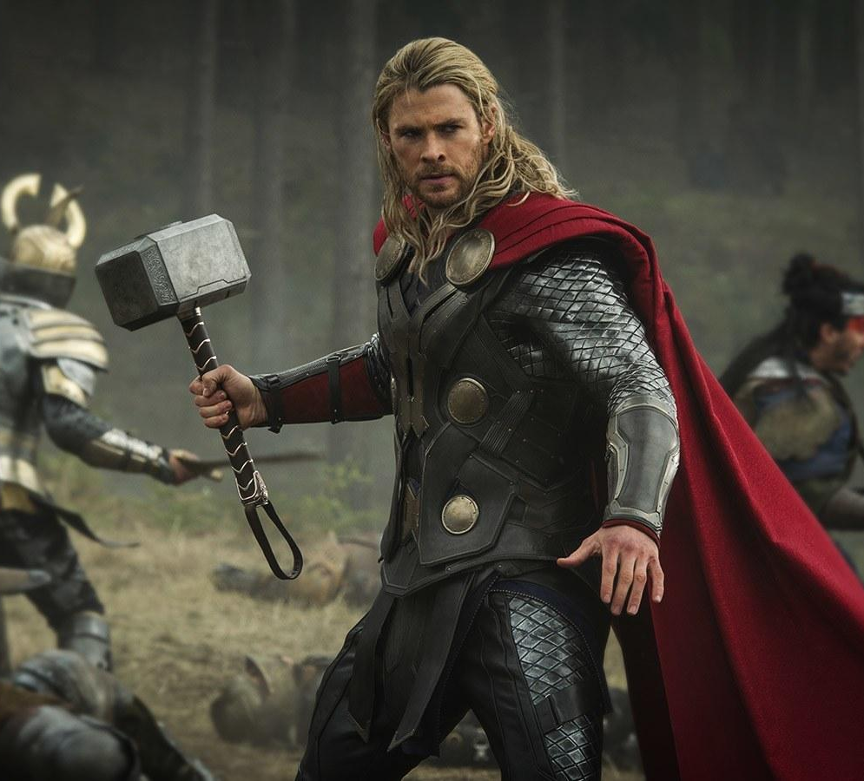
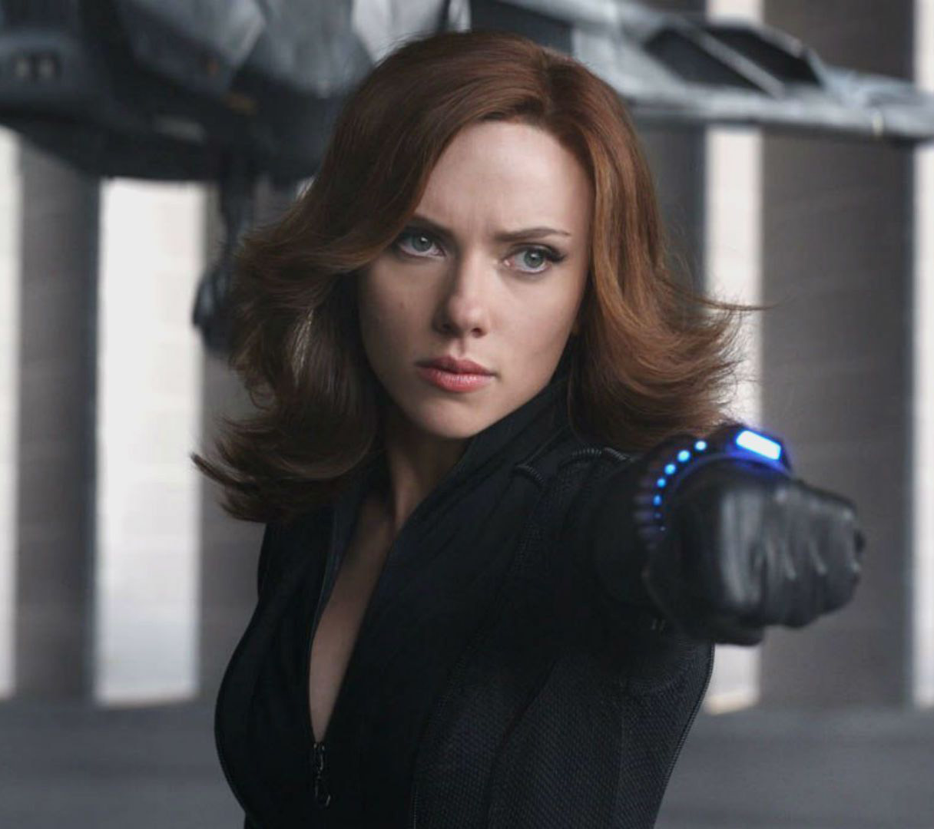
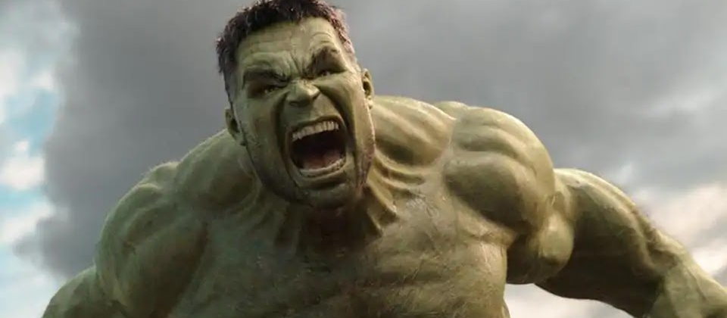

Slide 7
Plot II.
*When Loki steals Tesseract he takes with him some agents of S.H.I.E.L.D. including Hawkeye.
*The Avengers tries to get him back and they will succeed.
*Loki brings his army to the Earth. The Avengers will fight them and the will win.
*Thor will take his brother Loki back home and punish him.

Slide 8
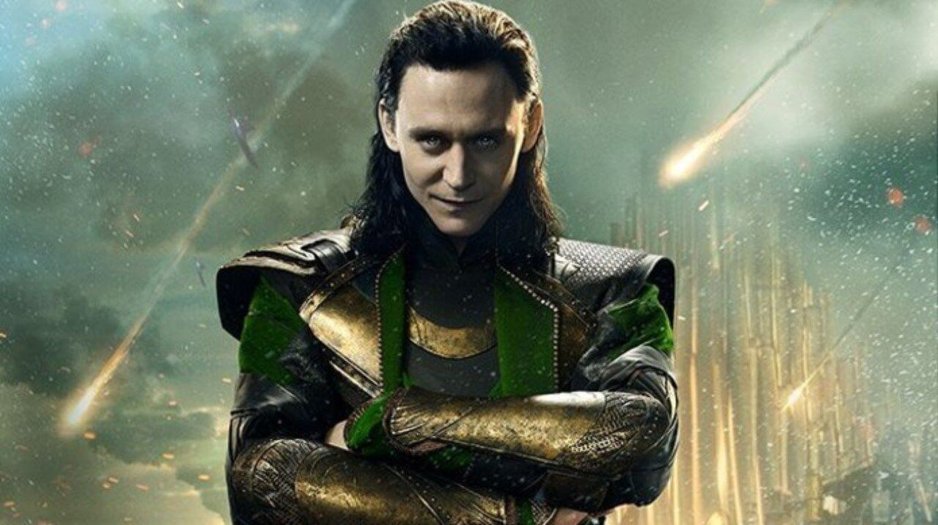
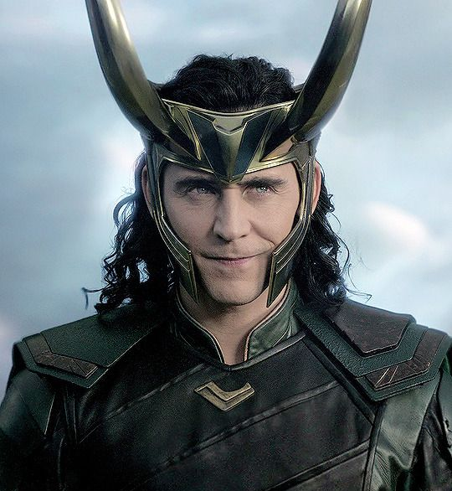
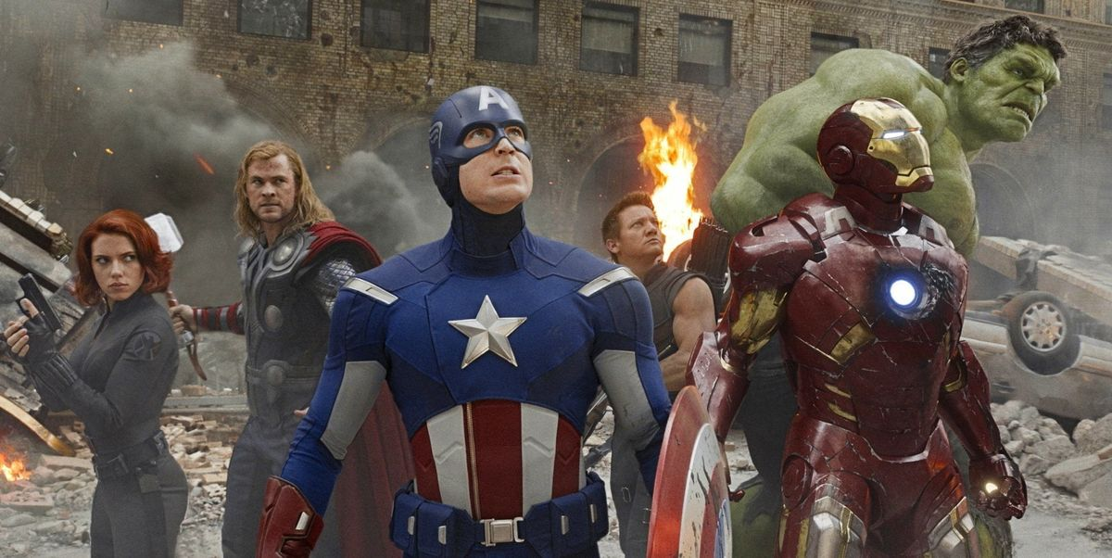

Slide 9
Why i choose this film?
*I choose this film because it is a sci-fi and I love this type of films.
*I watched previous parts so I wanted to see this one.

Slide 10
My opinion
*I like this film very much.
*I would recommend it to everyone in my age.
*I like it because it isn´t boring and there is a lot of action.

