Slide 1
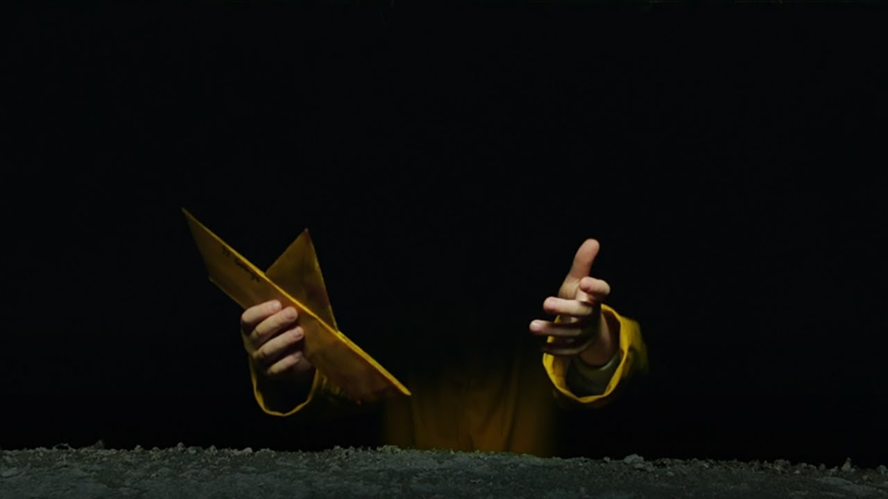
IT chapter 1 (2017)
Laštíková Anna

Slide 2
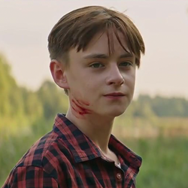
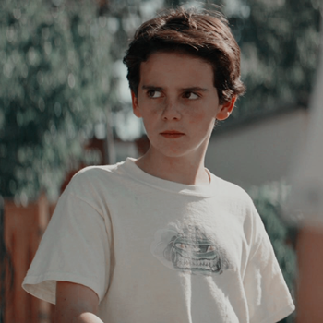
Jaeden Martell - Bill Denbrough
Cast:
Jack Dylan Grazer - Eddie Kaspbrak

Slide 3
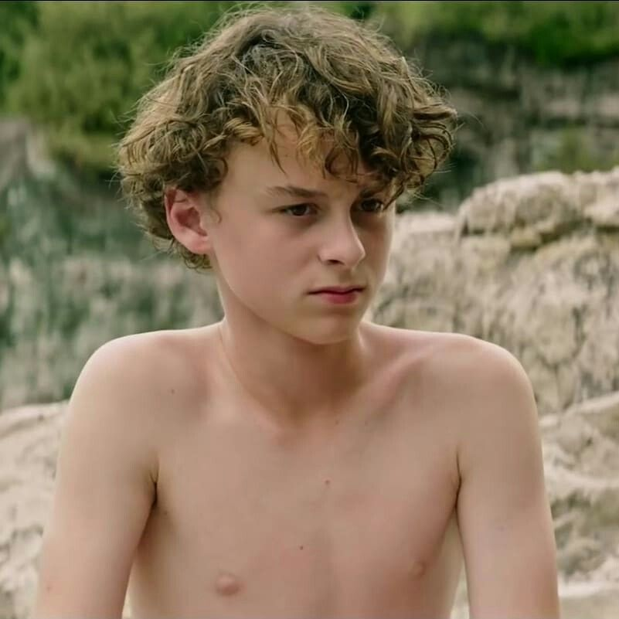
Finn Wolfhard - Richie Tozier
Wyatt Oleff - Stanley Uris

Slide 4
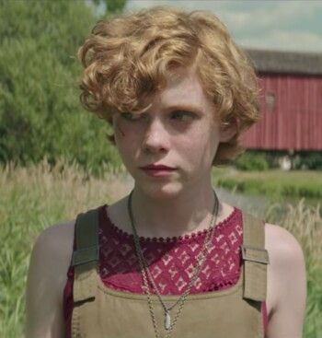
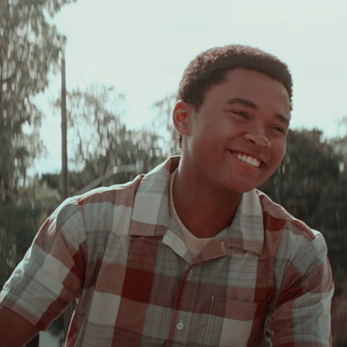
Sophia Lillis - Beverly Marsh
Chosen Jacobs - Mike Hanlon

Slide 5
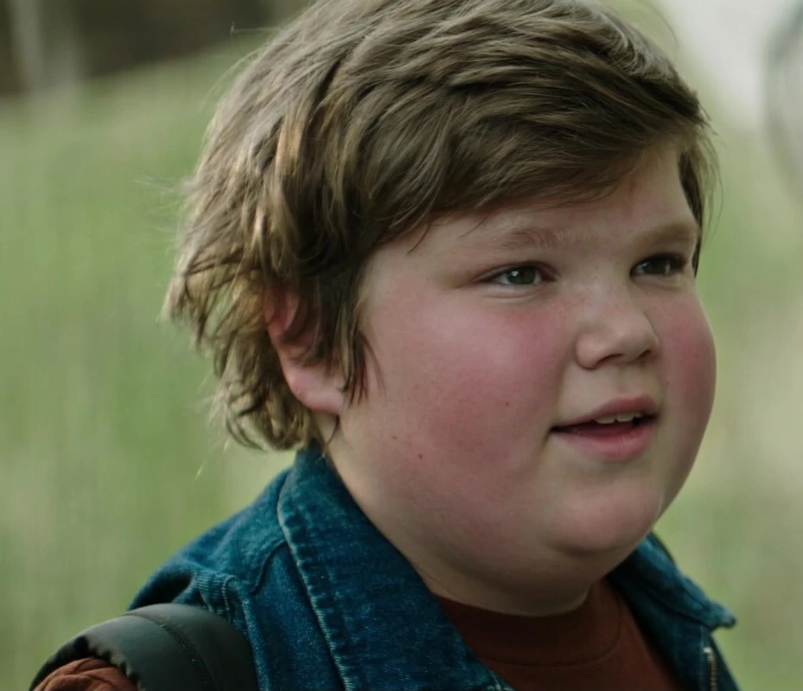
Jeremy Taylor - Ben Hanscom

Slide 6
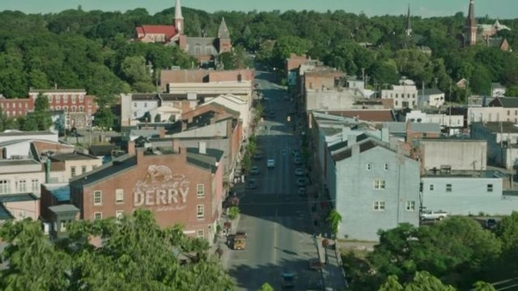
LOCATION
The story takes place in Derry, Maine

Slide 7
STORY
It all started in October 1989, when Billy's brother Georgie get lost. A bunch of bullied kids band together to destroy a monster that disguises itself as a clown and feeds on children from their small town

Slide 8
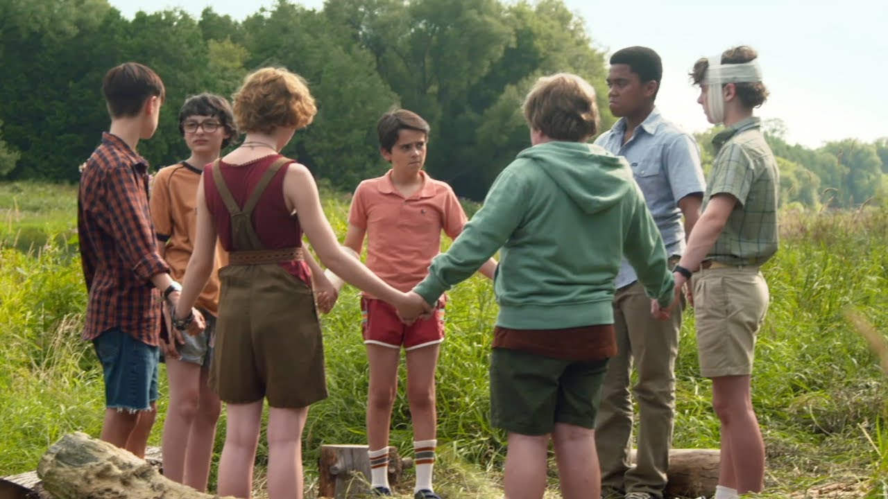
I chose this movie because it's my favorite. I've watched it so many times and i always enjoyed it.

