Slide 1
Jak vytrhnout velrybě stoličku
Rostislav Křenek

Slide 2
Main actors
Thomas Holy
Jana Preissova
Frantisek Nemec
Vlastimil Harapes
Jana Ditetova

Slide 3
Movie content
The film tells the story of an accidental meeting between ballerina Anna and her restless son Vasek and Anna's longtime love, chief of the mountain service and climber Lubos.
Eight year old Vasek lived alone with his mother. His father died in Annapurna under an avalanche. Vasek was looking for a substitute father. When neither the janitor nor the gymnast passed, Vasek tried it over the dog. He has one dream and that is to go to the mountains with his mother. But my mother is a ballerina and it is not easy to release her from the theater. In the end, however, it succeeded and they went to the Giant Mountains.
And there, for the first time, Vasek stood on skis, which ended in an uncontrollable frantic ride down the slope. At the bottom, at the Mountain Service station, he collided directly with the Chief of the Mountain Service, Lubos, from whom a climber emerged. But there was a change in the theater and my mother had to leave. Vasik ran after Lubos and persuaded him to keep him in the mountains until his mother returned. During that time, he not only learned to ski, but also found out that Luboš was on Annapurna, as was his father. In the evening, out of curiosity, Luboš asked Vašek about the details of his father. They know Anna. She was here on New Year's Eve years ago. And then everyone returned from the special expedition to Annapurna, no one left under the avalanche. It turns out that Vašek is Lubos's son.
In the spring, Lubos came to Prague. In a faint moment, he told Vasek that he was his dad. Vasek was angry that he hadn't even come to see him in eight years. His mother explained in vain that Lubos did not know that he had a son. In the end, Vasek and his dad settled down and Vasek could not wait for the summer holidays to experience new adventures with his dad.

Slide 4
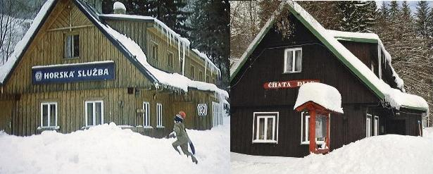
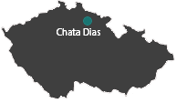
Film place
The well-known family film with the magical Thomas Holy was also shot in 1977 at the DIAS cottage in Spindleruv Mlyn. There was a Mountain Service station, where Vasek's father, the Chief of the Mountain Service, the climber Lubos, served.
DIAS Cottage in film DIAS Cottage today Place

Slide 5
End
I chose this movie because it amused me and I like it.

