Slide 1
RECENZE FILMU
Laštíková Viktorie

Slide 2
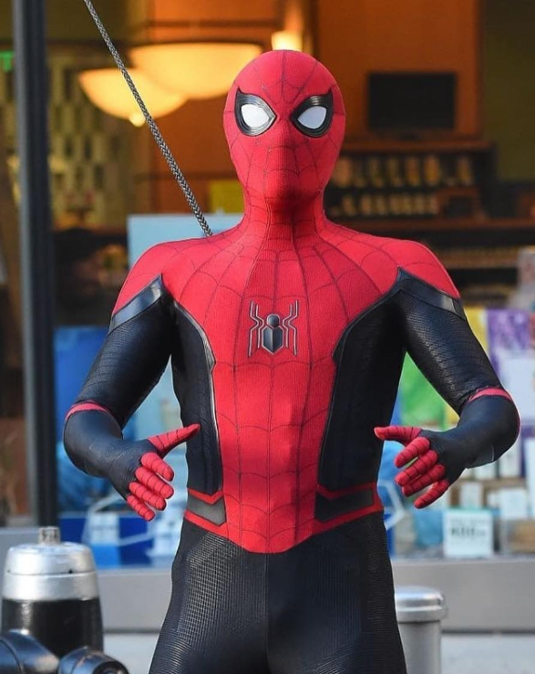
SPIDER-MAN DALEKO OD DOMOVA (SPIDER-MAN FAR FROM HOME)
MAIN CHARACTERS AND ACTORS:
Tom Holland Spider-Man(Peter Parker)

Slide 3
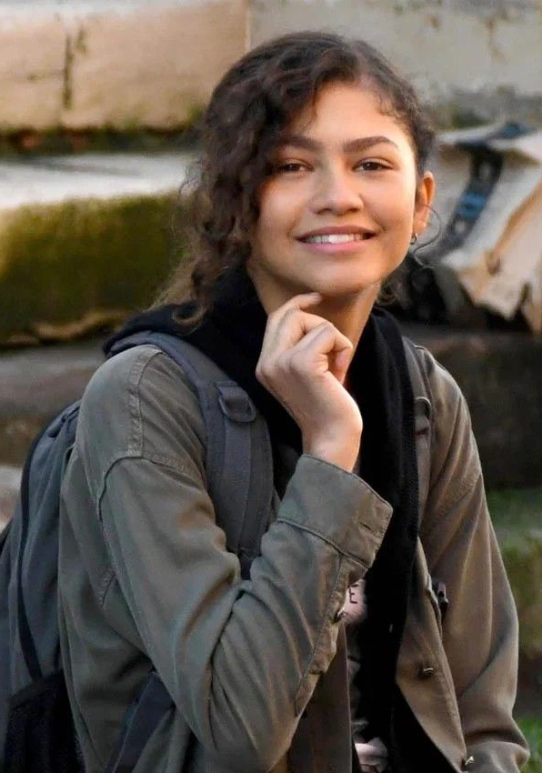
Zendaya Coleman Michelle “M”J Jones

Slide 4
Jake Gyllenhaal Mysterio

Slide 5
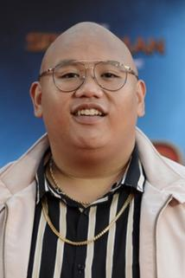
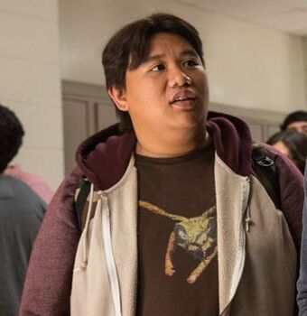
Jacob Batalon Ned Leeds

Slide 6
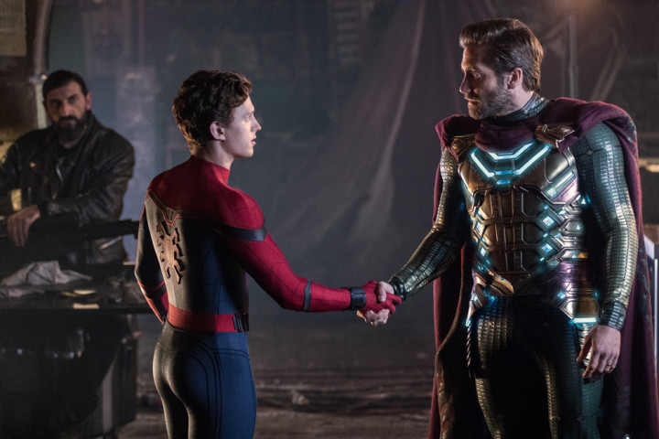
FILM CONTENT
Our superhero will go on holiday to Europe with his friends Ned, MJ and others. Peter's plan to leave superheroism for a few weeks and enjoy himself will soon take over, as Agent Nick Fury crosses Spider-Man's path. He wants Peter to help him find out why giant elementals are attacking the old continent. He forces him to unite with the superhero Mysterio, but after a while it turns out that it was all a scam, the superhero (mysterio) becomes a superpadouch. Spider-Man and Nick Fury try to stop him.

Slide 7
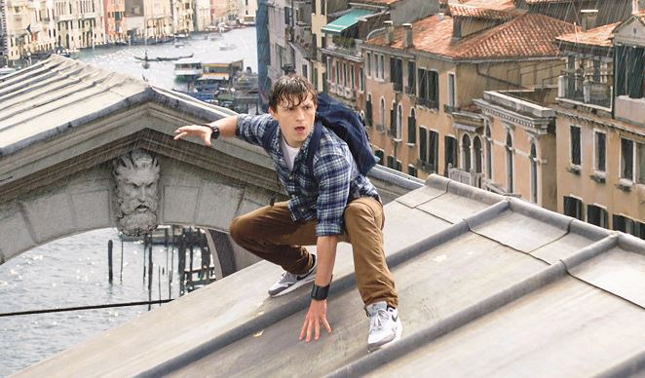
FILM LOCATIONS
London, Czech Republic (Prague), New York, Italy

Slide 8
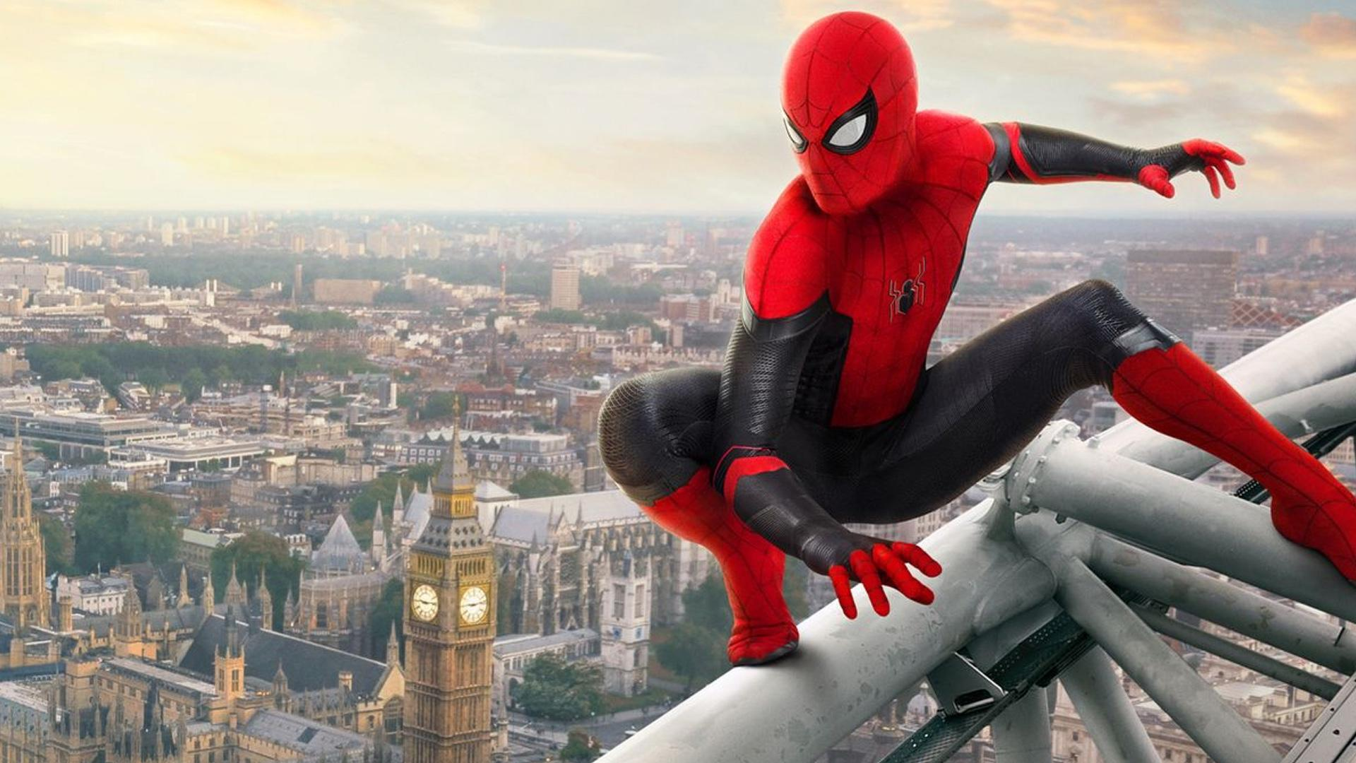
SPIDER-MAN FAR FROM HOME
I chose this movie because it is my favorite movie. I like it because I like that type of movie. And overall, I like the actors who play there.

