Slide 1
Iron Man1
Šimon Wrožyna

Slide 2
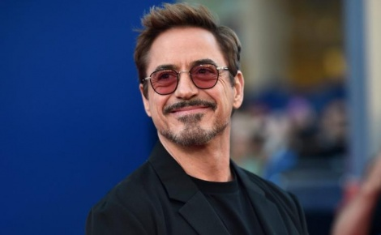
The main characters
Robert Downey (Tony Stark/iron man)
Gwyneth Paltrow (Pepper Potts/ assistant Tony Stark)

Slide 3
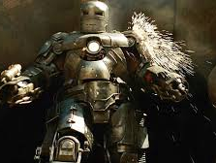
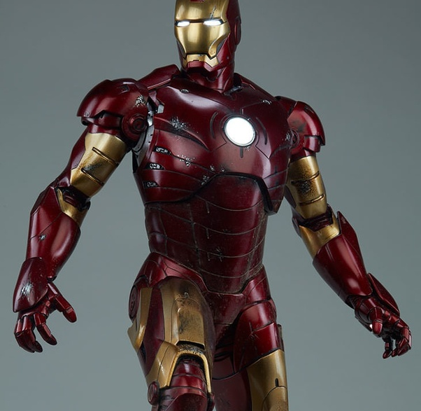
Give the movie
Tony Stark makes weapons for the soldiers, but he'll get away with it because a grenade vibrated next to him and then he was captured. to survive, he created a miniature arc reactor, then made robotic armor, and then escaped his armor at best. blah blah blah and so on. and then he fights with the villain and defeats end.
+ I liked the film was action and funny. - The villain is uninteresting. another great movie.
F for iron man

