Slide 1
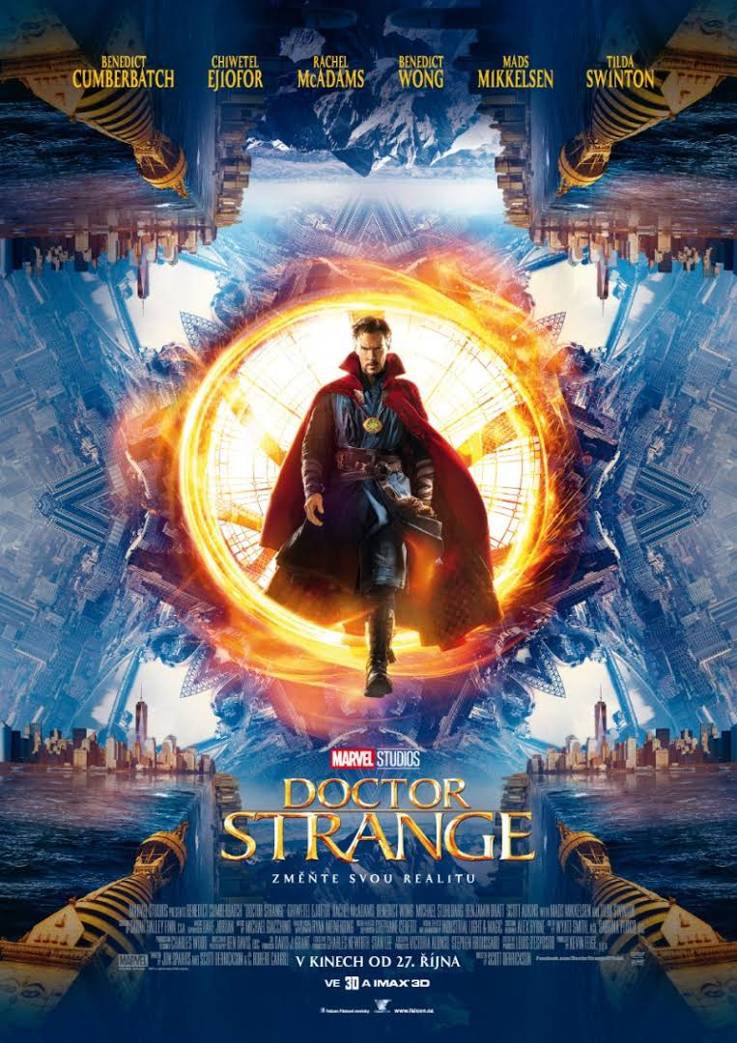
Doktor Strange (Doctor Strange)
Adam Olšar
7.B
8.6. 2020

Slide 2
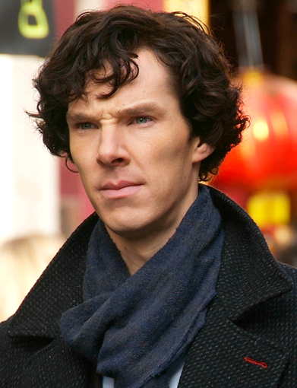
actors
Benedict Cumberbatch, Rachel McAdamsová, Tilda Swintonová, benedict wong, Mads Mikkelsen.

Slide 3
Film content
Dr. Stephen Strange is a brilliant but arrogant and conceited neurosurgeon. However, a car accident will cause him a serious hand injury and his career as a neurosurgeon is ruined. Desperate, he decides to find solace in learning ancient magic and hopes to use this magic to find a cure. This effort will swallow all his fortune and make him homeless. Everything changes when he learns about a powerful ancient magician living in the Himalayas. Strange goes to the mage and becomes his apprentice. A strange group led by Master Kaecilius attacks an librarian and snatches a sheet from a special book. The doctor is taught magic to help him with his injuries. When he learns magic, he likes the flying cloak. And then he learns that a kind of artifact has been stolen that can control time. The doctor has to get this artifact back, but he finds out that it was stolen by Master Kaecilius, but the doctor strange gets it back and thus saves the world.

Slide 4
Why this movie
I chose Doctor Strange because I like movies from the marvel group. I saw Doctor Strange for the first time in the avangers series, so I downloaded this film and looked at it, and at that time I liked it, I even have a Dr. Strange figure at home.

