Slide 1
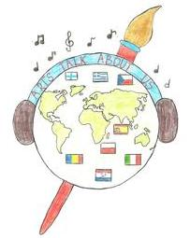
Lesson for Joensuu school, Finland
CZECH FOLKLORE DANCES
for project:
ARTS TALK ABOUT US

Slide 2
A) Folklore costumes, dances and songs
The Czech Republic has a rich tradition of
folklore songs and dances.
The folklore costumes changed during time
and in the last century people slowly stopped
wearing them.
Nowadays, we can admire folklore costumes
in museums or during folklore festivals.

Slide 3
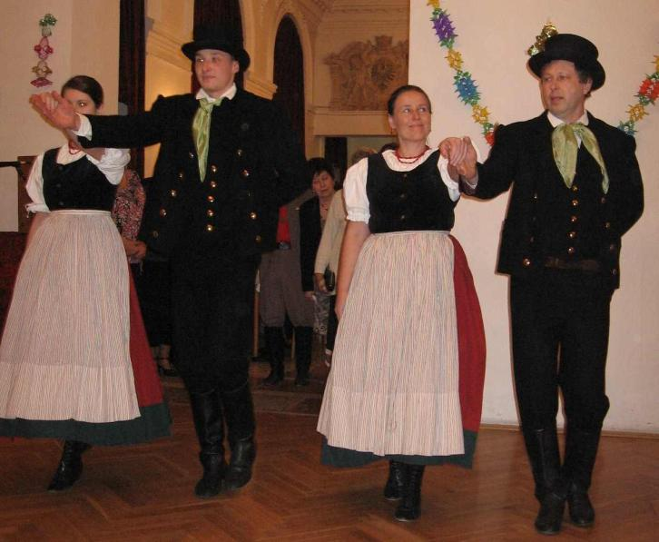
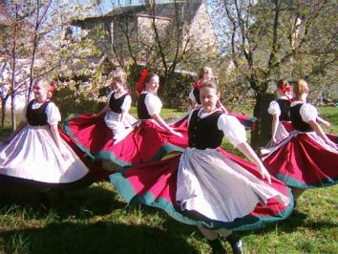
A) Folklore costumes, dances and songs
Almost every village and town has its own folklore costume which was usually decorated with ribbons, flitters or embroidering.
A folklore costume from Bohumin, a little town near Ostrava city, was very simple. A coloured scarf was worn over the black vest. That´s why it was not decorated. The red skirt is made of wool and it is very heavy.

Slide 4
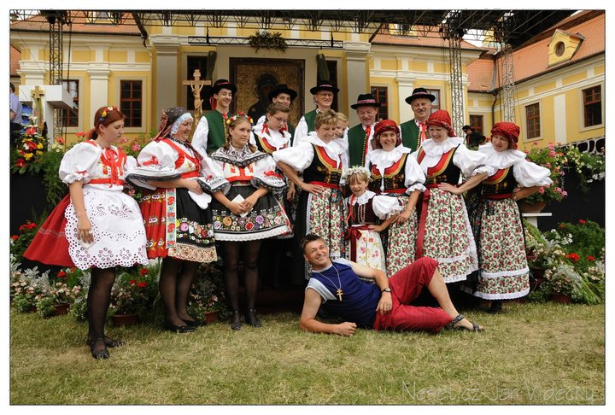
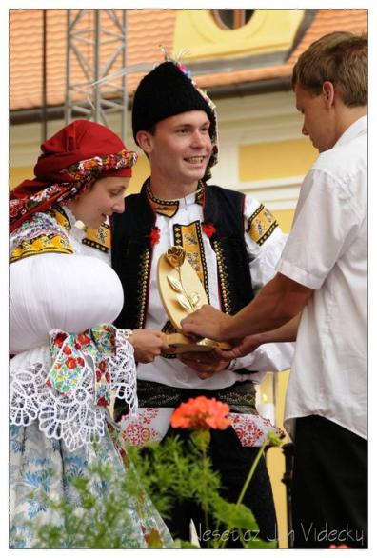
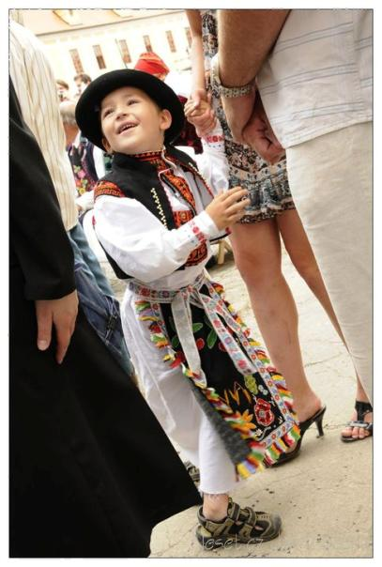
South Moravian villages have fertile fields, it is shown in the rich costumes.

Slide 5
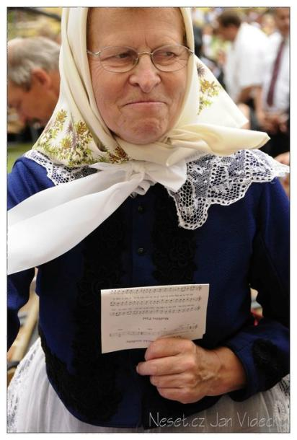
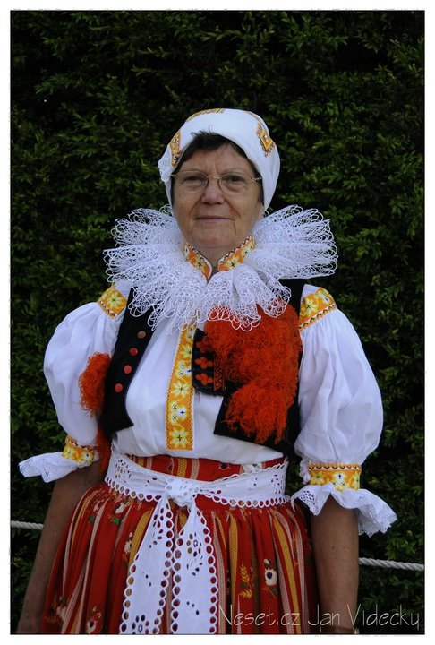
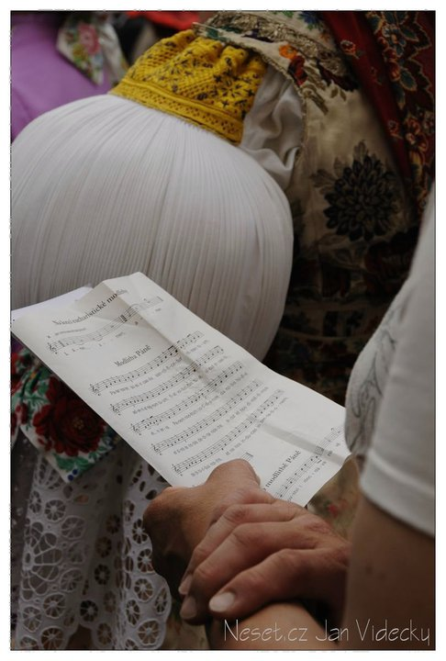
All parts of the costumes were carefully decorated. Study the details of a scarf, a collar, a cap, and a sleeve.

Slide 6
Other folklore costumes from my region

Slide 7
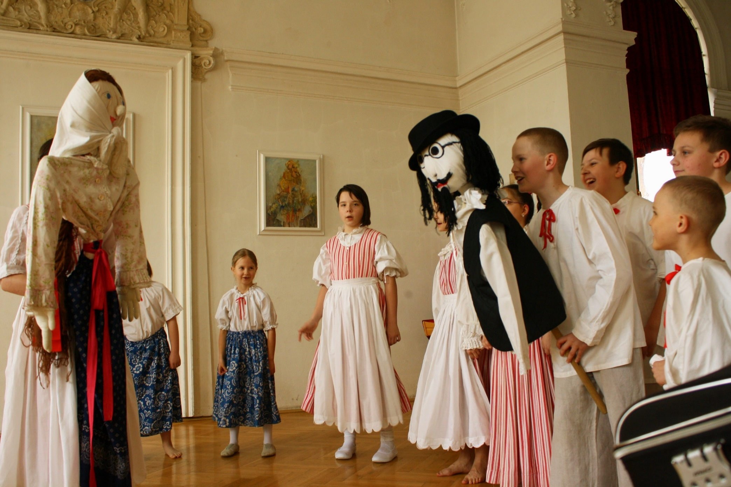
Children´s costumes from Ostrava region
Our school keeps the tradition of ending winter by throwing its symbol „Morana“ into the river.

Slide 8
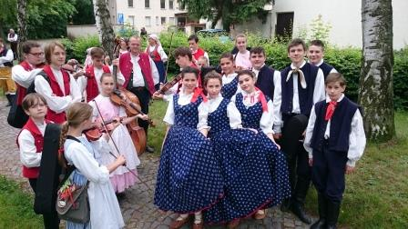
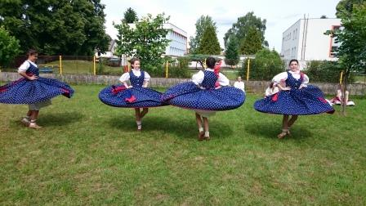
Another children´s costumes from our region
Our school took part in VI. National Sokol folklore groups parade in Slatiňany in June 2016 with dance Zezulenka.
You can see our music group from Háj ve Slezsku in Opava costume.

Slide 9
Place of origin of the „BABSKÝ“ song
Ostrava is a city situated on a border between Moravia and Silesia region, it is very close to Poland and Slovakia.
GERMANY
POLAND
OSTRAVA
AUSTRIA

Slide 10
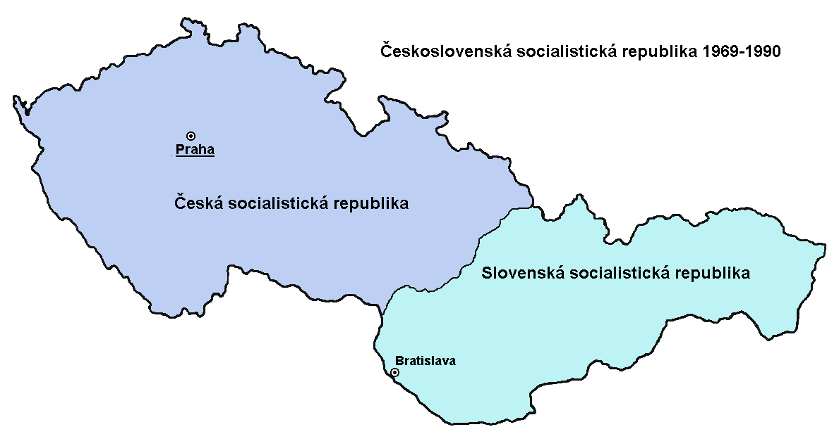
B) Historical background of the song
People who worked in Ostrava´s factories were coming from the surrounding villages and even from Slovakia which was part of the former Czechoslovak Republic. They brought their traditions, dances and songs with them.
Czechoslovakia 1918 - 1993
CZECH AND MORAVIA PART
SLOVAK PART

Slide 11
C) Geographical background
We will teach you a special song and dance called BABSKY which means OLD WOMEN´s. It is a kind of "Czardas" which women from both sides of the Czech and Slovak border used to dance in the pub "U Janošča" in the Beskydy Mountains near the village Bílá, which means white. Women used to sing this song late at night when men got tired and decided to have a drink or a chat.
KELČOVSKÉ SEDLO,
NEAR „BÍLÁ“ VILLAGE
IN THE BESKYDY MOUNTAINS
CZECH AND MORAVIA PART
SLOVAK PART

Slide 12
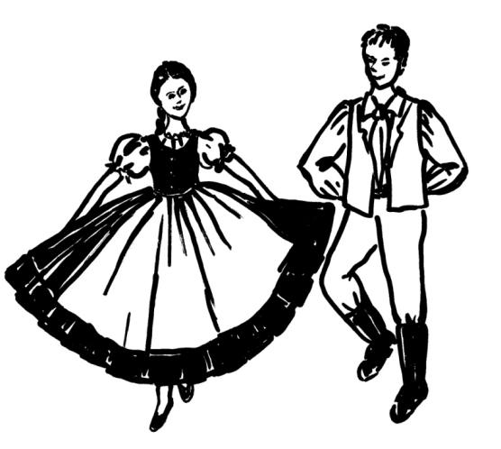
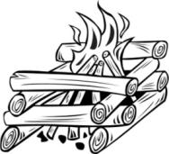
1) Read the Czech words and guess their English meaning. Then write these words in your language.
1) Na ohnišču –
2) Oheň –
3) Horí –
4) Moju –
5) Milu –
6) Hlava –
7) Bolí –
8) Hlava boli -
9) Včera –
10) Večer –
11) Včera večer –
12) Zahorela –
a) beloved
b) evening
c) fire
d) got a fever
e) has got a headache
f) head
g) hurts
h) in the fire ring
i) is burning
j) last night
k) my
l) yesterday

Slide 13
Check your answers:
1) Na ohnišču – h) in the fire
2) Oheň – c) fire
3) Horí – i) is burning
4) Moju – k) my
5) Milu – a) beloved
6) Hlava – f) head
7) Bolí – g) hurts
8) Hlava boli - e) has got a headache
9) Včera – l) yesterday
10) Večer – b) evening
11) Včera večer – j) last night
12) Zahorela – d) got a fever

Slide 14
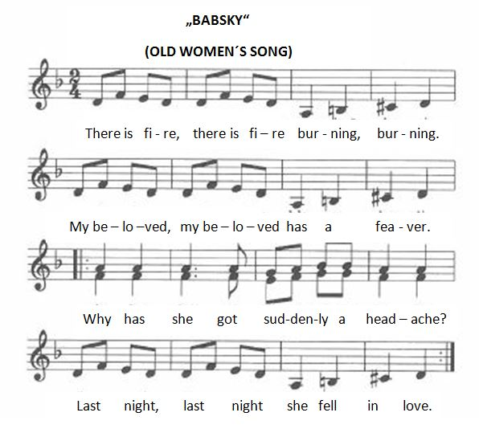
2) Read the English version of the song. It is not the exact translation; some words are different than in the old Czech song so that it is possible to sing it in English version too.

Slide 15
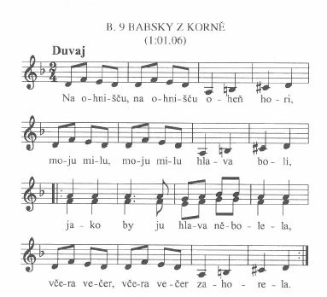
3) Listen to the song. Then read slowly the Czech words. Finally learn to sing and dance the song.

Slide 16
D) Description of the dance
This dance has a special character; the pace during the three stanzas gets faster. Women usually sang one stanza and then danced, sang another stanza and danced and the last part was the fastest. Each pace corresponds to a different kind of dance step. It is danced in a circle; dancers are facing inward, holding their hands crossed behind their backs. It is possible to change directions.

Slide 17
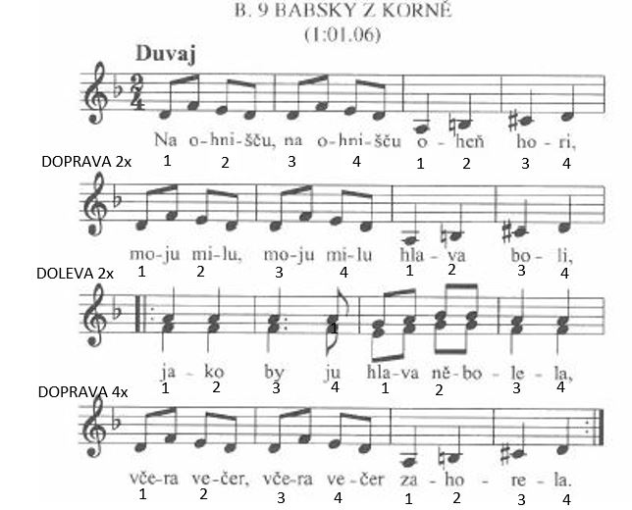
E) Rhythm for the slowest part
1 = step with 1 leg, bent knee of standing leg 2 = slow moving of the other leg
3 = the second leg touches floor, bent knees 4 = straighten both legs

Slide 18
F) Watching the video
G) Practice of the dance
H) Practice of the song

Slide 19
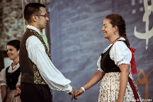
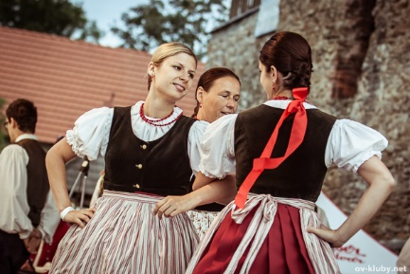
2) „PÁSALA VOLKY“ DANCE and SONG
1) Pasala volky na bukovině,
měla se sebou skřipky jedině.
Oj, grala, zpivala,
svoje sive volky pasala.
2) Pasla je, pasla, až je ztratila;
Co ja neščasna, coch porobila!
I chodi a plače:
Kdo mi tež ty moje volky navrati!
1) She grazed cows in an oak wood,
she had the violin with her.
Oi, she played, sang,
grazing her grey cows.
2) She grazed them, grazed them until she lost them;
What I, poor girl,have done!
She walks and cries:
Who can return me my cows!

Slide 20
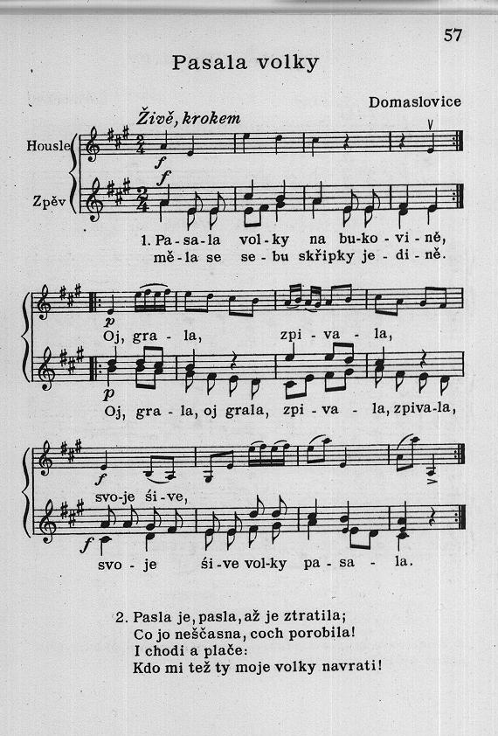
Watch the video
Dance description:
Pupils (a boy with a girl) hold with right hands in pairs and stand oposite in a line.
They make 8 steps to the right of the classroom, the hands swing with the odd step in the direction of the movement. The last step is with accent.
Then they do the same and return to the left side of the classroom.
Refrain:
3 jumps – Girls: right leg goes to the partner, left leg goes back, change, change. 3 jumps – left leg goes to the partner, change, change
Boys start with their right leg to the partner
They cross their right elbows and walk a circle around themselves.
Repeat the 3 jumps, 3 jumps, circle

Slide 21
3) „KDYŽ JSEM CHODIL DO ŠKOLY“ DANCE and SONG
Když jsem chodil do školy,
učil jsem se litery:
Jedna, dvě, tři, čtyři,
To jsou moje litery.
2) Jedna, dvě, tři, čtyři, pět.
Cos měl Janku na oběd?
Zemáky pečené,
byly málo maštěné.
1) When I went to school,
I learned the letters:
One, two, three, four,
These are my letters.
2) One, two, three, four, five.
What was your lunch, Johny?
Roasted potatoes,
they were not buttered enough.

Slide 22
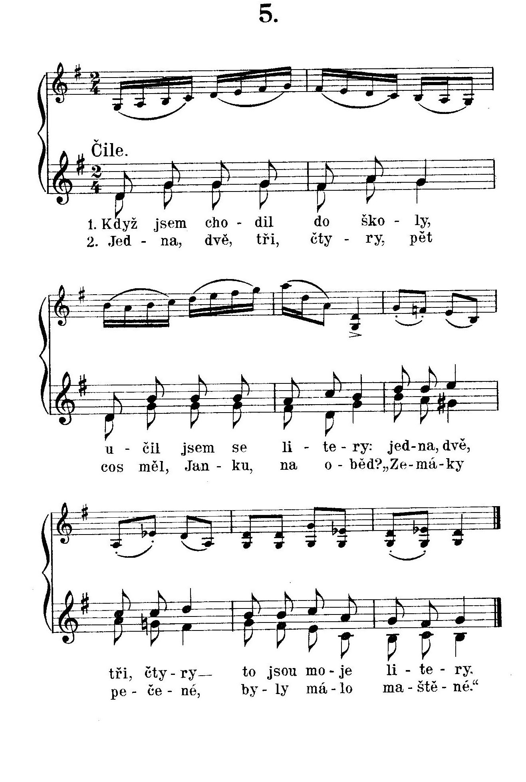
Watch the video
Dance description:
Make a circle, hold with hands.
Pupils move to the right with 8 steps, right leg starts. Then they move 8 steps to the left, left leg starts.
4 steps to right, 4 steps to the left
Girls hands in the waist, boys behind the back and with 2 little jumps they spin 360° and do 3 stamps on a spot.
Pupils make again the big circle, hold hands and move 4 steps to the right and 4 steps to the left.
Everybody spins 360° with 2 little jumps and 3 stamps.
Second stanza:
The same, or we can start to the left, or pupils stand in a line or they make pairs and hold their hands and swing them with the odd steps.

Slide 23
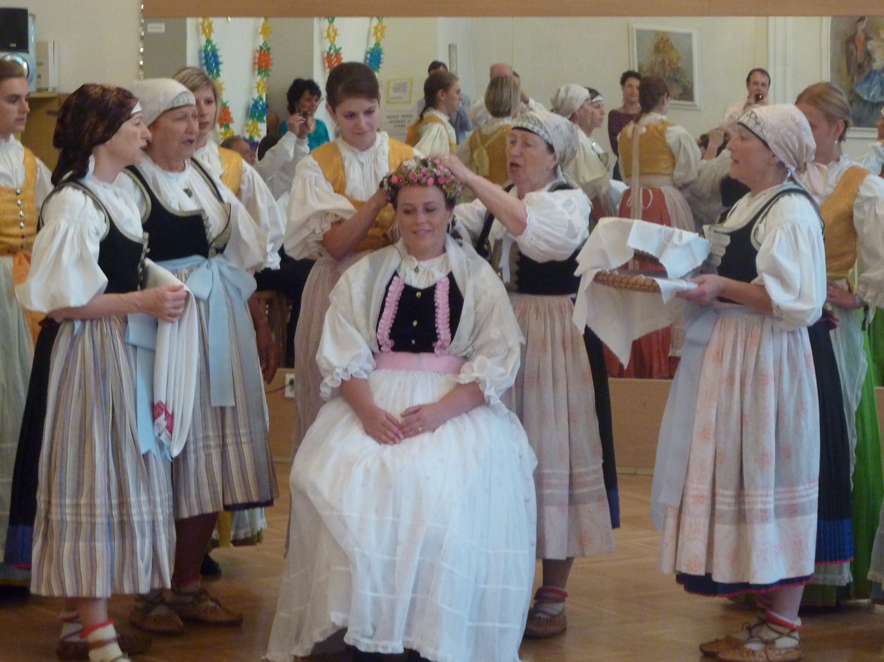
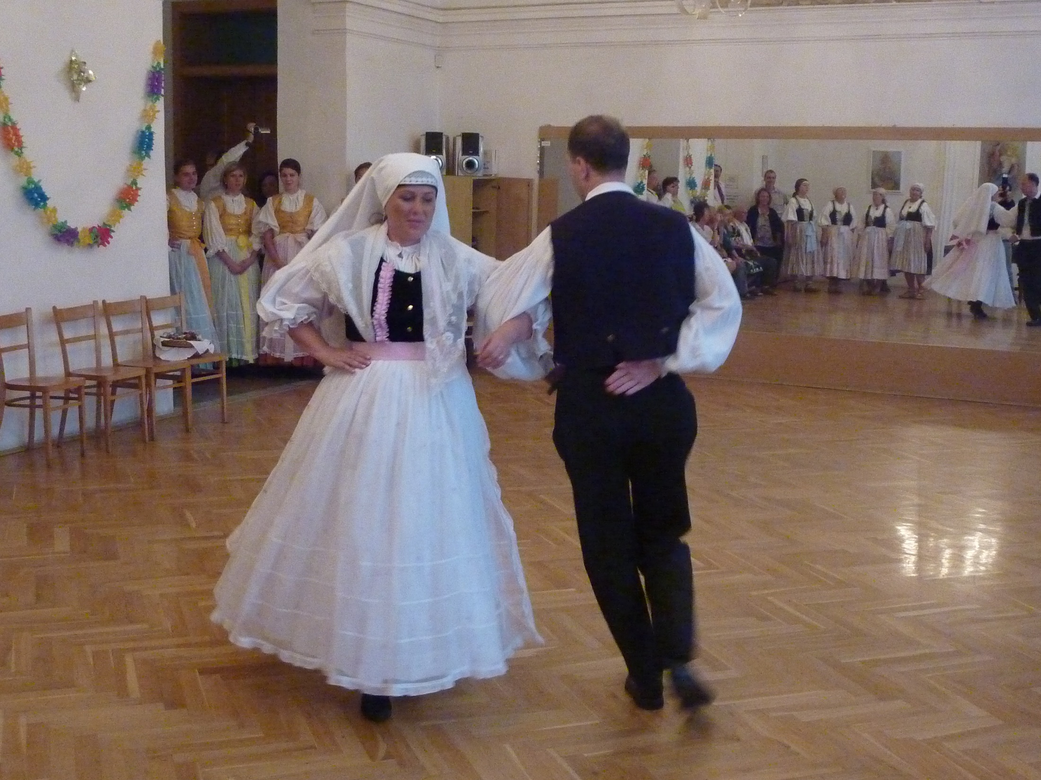
4) „ŠÁROŠ “ - wedding DANCE
Watch the dance
Pupils will dance in pairs. They need to learn to run with little steps, to pass with their back, a boy kneels and the girl runs around, to make a gate, to run in trains.

Slide 24
5) „TĚŠIŇOK “ DANCE and SONG
Pod těšínským mostem, teče voda skokem, němožu ju zastavit. 2x
Měla jsem milého, rozhněvala jsem ho, němožu ho udobřit. 2x
2) A já za ním půjdu a ho prosit budu, by se na mě nehněval. 2x
Že je mé srdečko, zarmucené všecko, aby mi ho rozebral. 2x
1) Under the Teschin bridge, the water flows and jumps, I can´t stop it. 2x I had a boyfriend, I made him angry, I can´t make him my friend again. 2x 2) And I will go to him and ask him not be angry with me. 2x Because my heart sad and he must fix it. 2x

