Slide 1
BIOLOGY LESSON INFORMATION ABOUT ROSES
Crosscurriculum project „The Rose´s Story“
Part of Erasmus+ KA219 project ARTS TALK ABOU US
Created by Mgr. Šcerbová for class 4. C

Slide 5
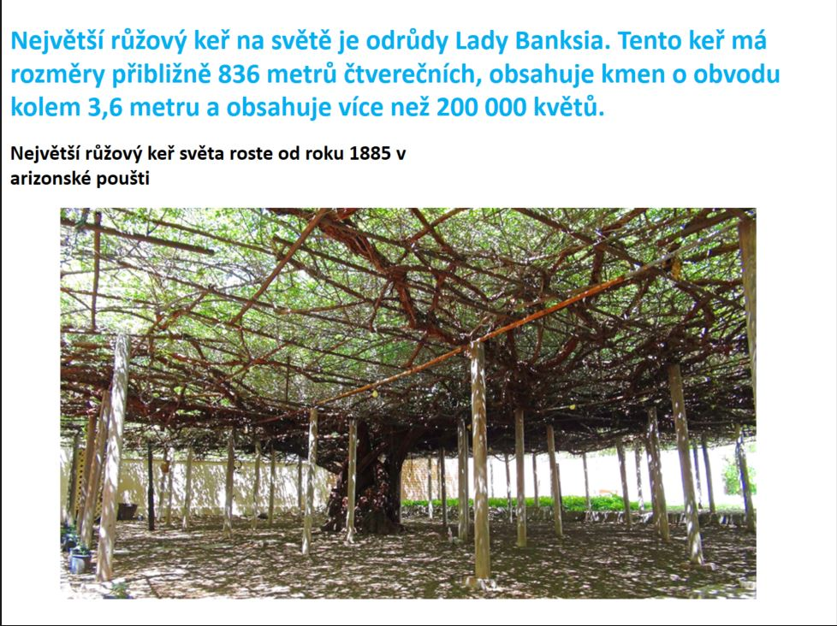

Slide 11
