Slide 1
Constantine
Karin Mikulcová 7.B

Slide 2
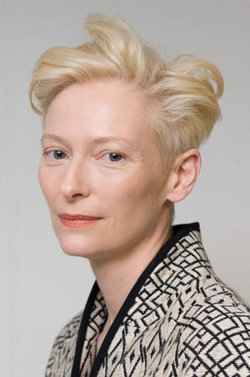
Main Actors
Keanu Revees
(John Constantine)
Rachel Weisz
(Angela Dodson)
Tilda Swinton
(Angel Gabriel)

Slide 3
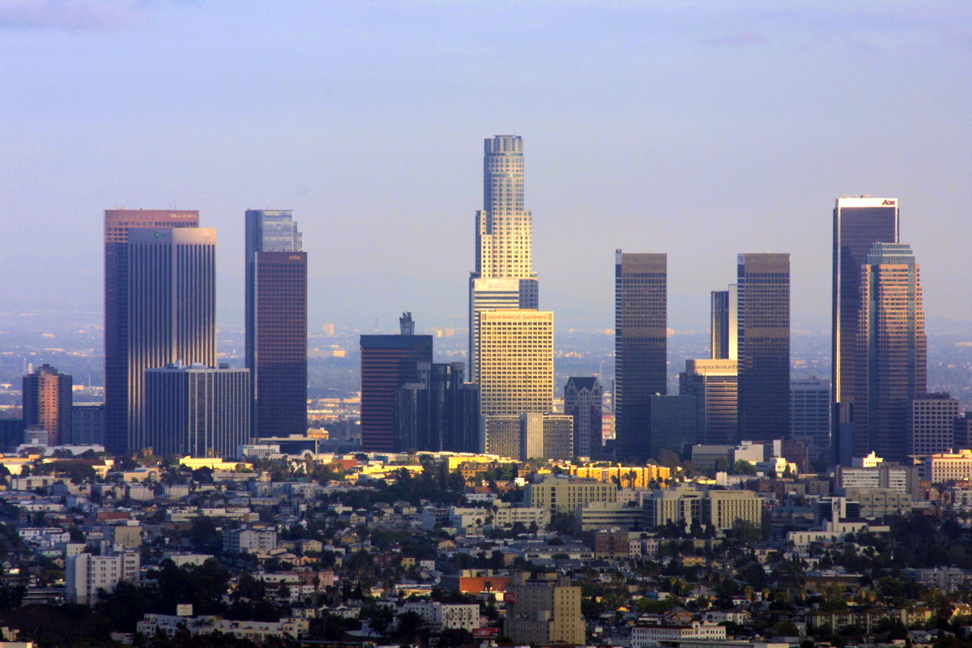
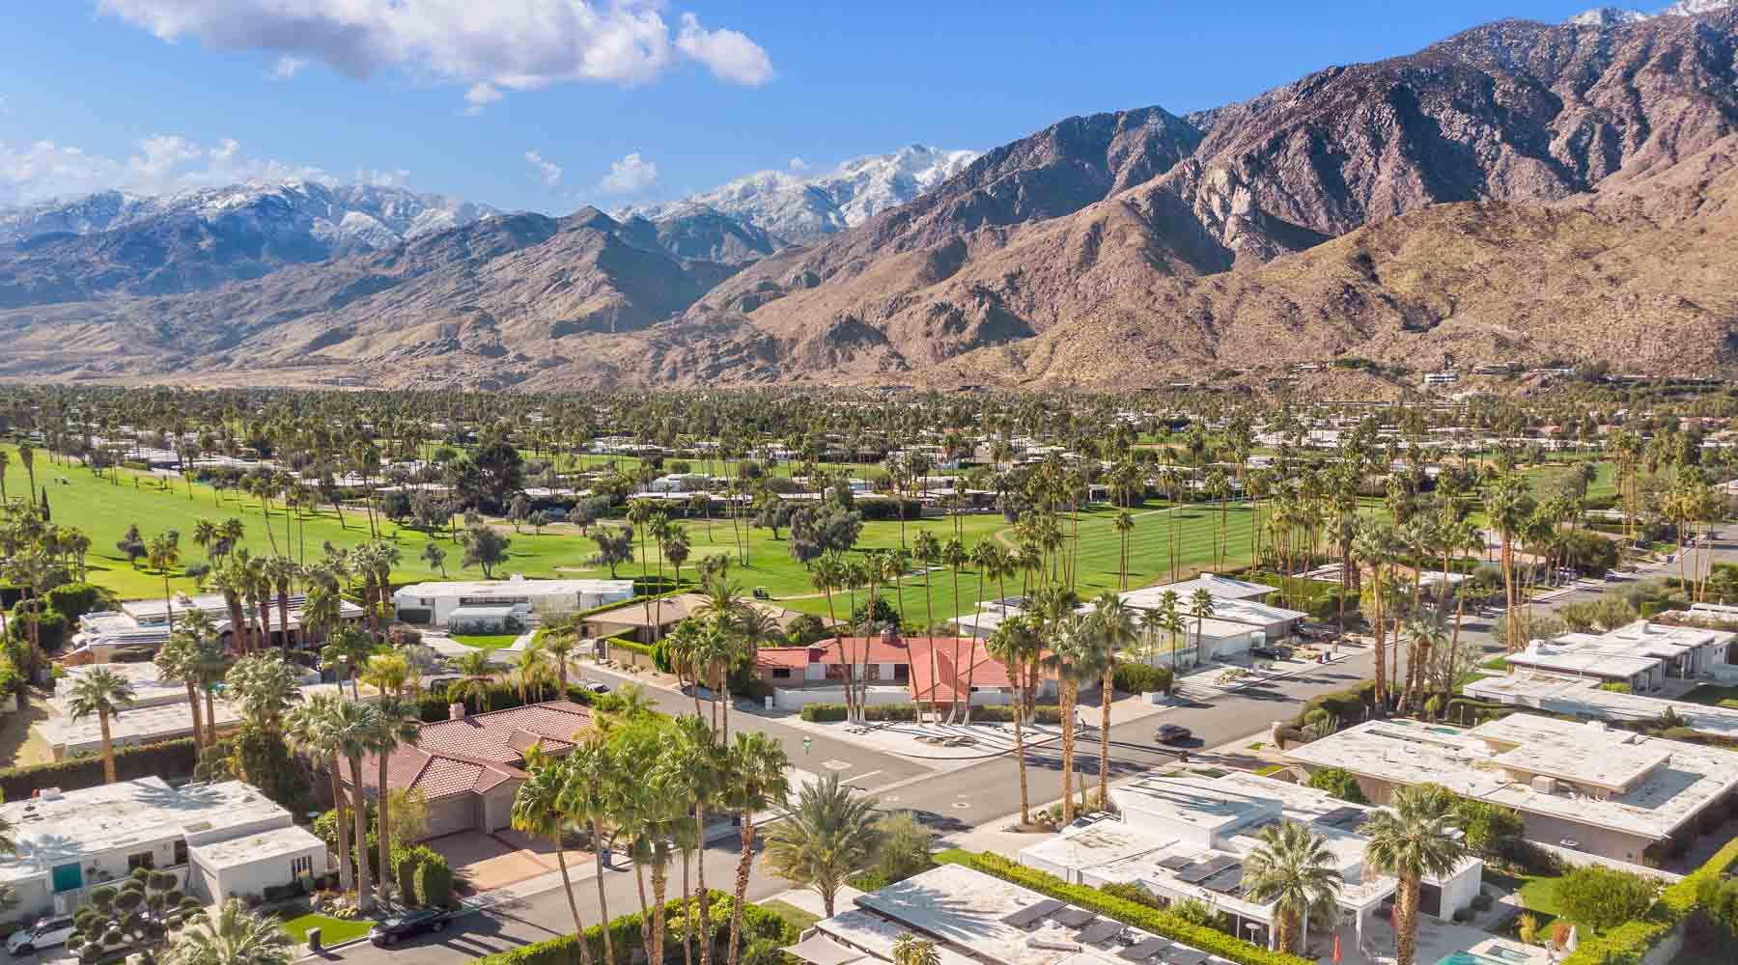
Constantine filming locations
Constantine was filmed in Los Angeles and Palm Springs in United States of America.
Los Angeles
Palm Springs

Slide 4
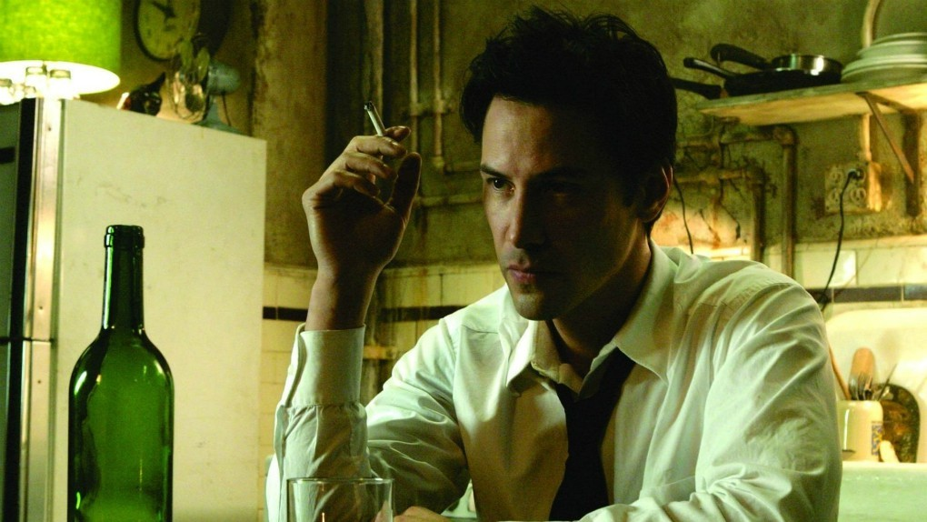
Movie Review
Constantine (2005) is american action fantasy thriller. Keanu Reeves plays John Constantine, a chain-smoking, depressed demon-hunter who is dying on cancer. Since he was a child, he has been able to see half-angels and half-devils walking among us. Suddenly, against the rules, actual demons are starting to break into our plane of existence. And their actions are somehow tied to the mysterious suicide of detective Angela Dodson’s (Rachel Weisz), an L.A police detective, twin sister. Together, John and Angela must find a way to stop the apocalypse.

Slide 5
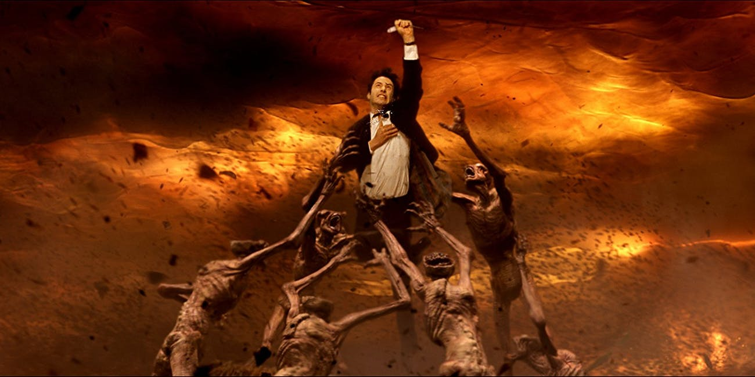
Why i choose this film ?
This film is one of my favourite. Not only that Keanu Reeves plays in it, but in my opinion it's one of the best supernaturals movies. All of the actors did amazing job in portraying the grim world afflicted by demons with impending apocalypse.

Slide 6
And thats all, hope you like it !

