Slide 1
THE AVENGERS
My favourite movie

Slide 2
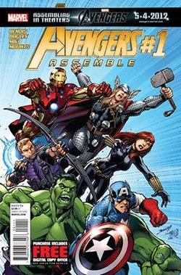
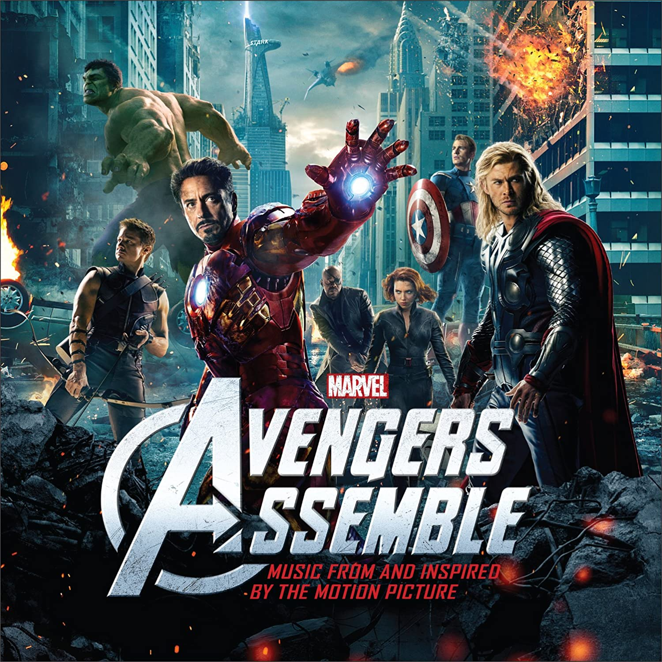
Year of release: 2012
Director: Joss Whedon
Based on comic books by: Stan Lee, Jack Kirby, Don Heck
Cast (major roles): Robert Downey Jr., Jeremy Renner, Scarlett Johansson, Chris Evans, Samuel L. Jackson, Chris Hemsworth, Mark Ruffalo, Tom Hiddleston

Slide 3
About movie
The Avengers is an American superhero film based on the Marvel Comics superhero team of the same name. Produced by Marvel Studios and distributed by Walt Disney Studios Motion Pictures, it is the sixth film in the Marvel Cinematic Universe (MCU).
Plot: The secret company named S.H.I.E.L.D. with director Nick Fury assembles six superheroes: Iron Man, Captain America, the Hulk, Thor, Black Widow and Hawkeye to battle Thor's adoptive brother Loki, who attempts to subjugate humanity by leading an invasion by the extraterrestrial race known as the Chitauri.
The movie takes place mainly in New York.

Slide 4
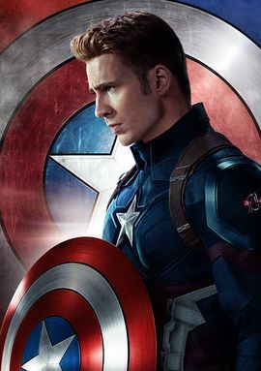
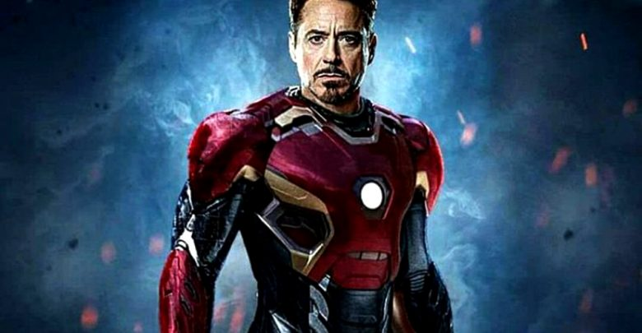
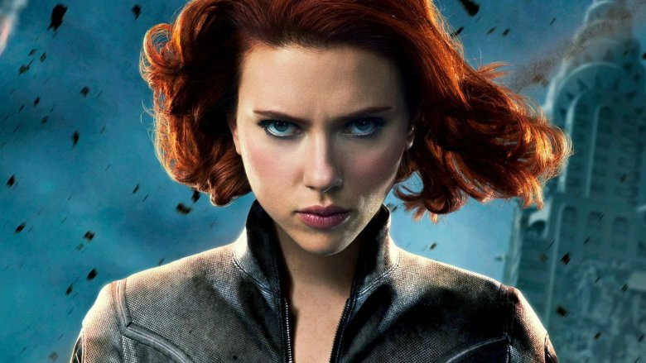
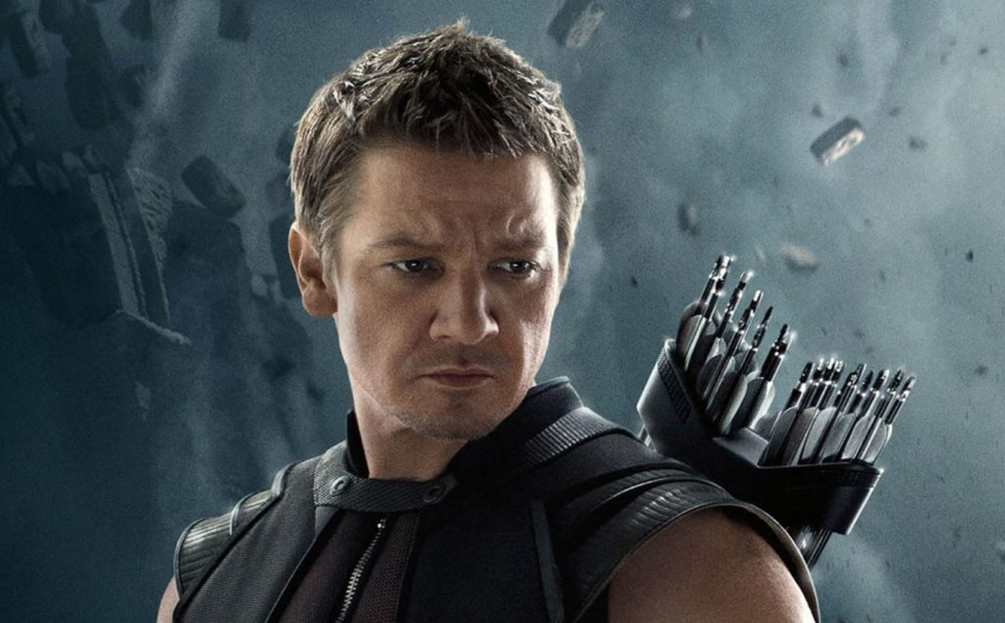
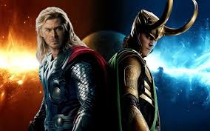
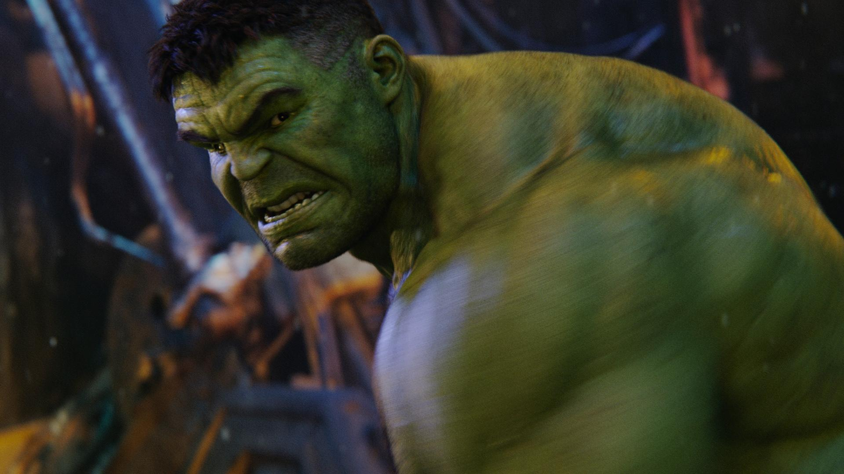
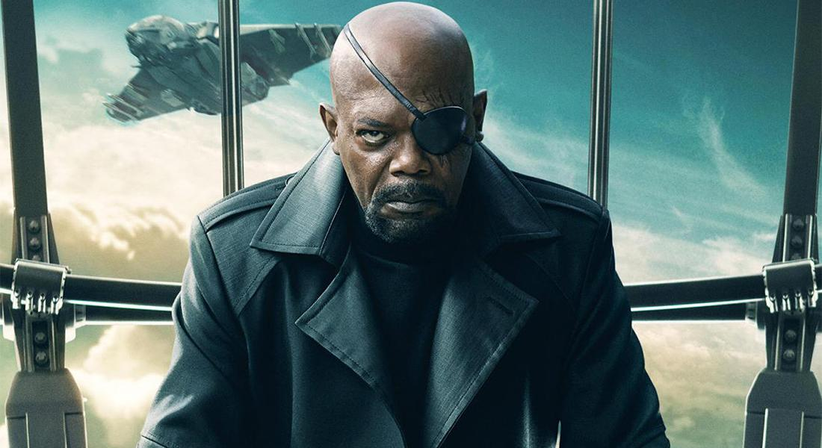
Main characters
Iron Man (Robert Downey Jr.) Captain America (Chris Evans) Black Widow (Scarlett Johansson) Hawkeye (Jeremy Renner)
Thor and Loki (Chris Hemsworth and Tom Hiddleston) the Hulk (Mark Ruffalo) Nick Fury (Samuel L. Jackson)

Slide 5
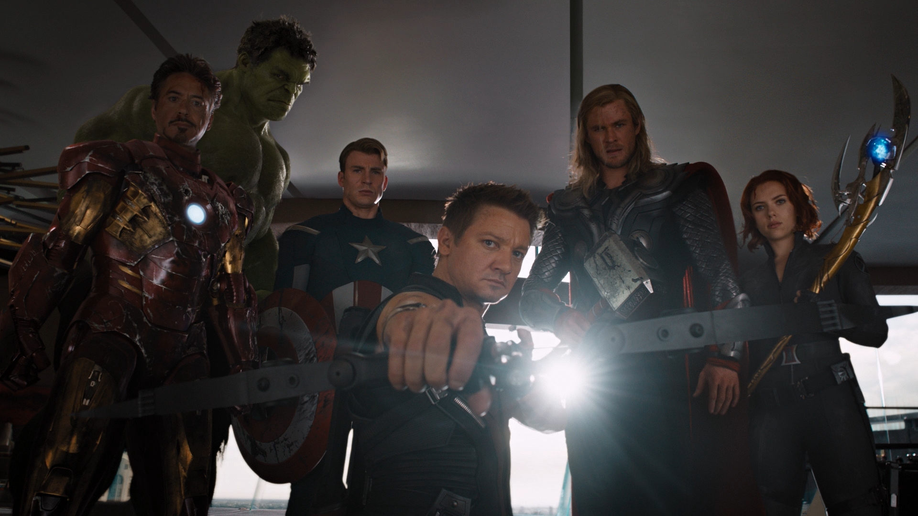
Why do I like this movie?
I like this movie because it has awesome and original plot, interesting characters and amazing effects. There’s also a lot of action and sometimes there are funny or really touching scenes. This movie is just a one piece from big cinematic universe and the end of the series is awesome and very emotional.
I’d say there’s no thing I dislike in this movie.

Slide 6
Kateřina Gorolová 9.A 12. 6. 2020

