Slide 1
K2 –Cooperation for innovation and the Exchange of Good Practice
Strategic Partnerships for Schools Only
Programului ERASMUS +
Contract de finantare – 2017-1-ES01-KA219-038401_3
TITLUL PROIECTULUI
“Arts talk about us”
2017-2020
Şcoala Gimnazială,,General Dumitru Dămăceanu” Cosmeşti presents you

Slide 2
The Romanian legend

Slide 3
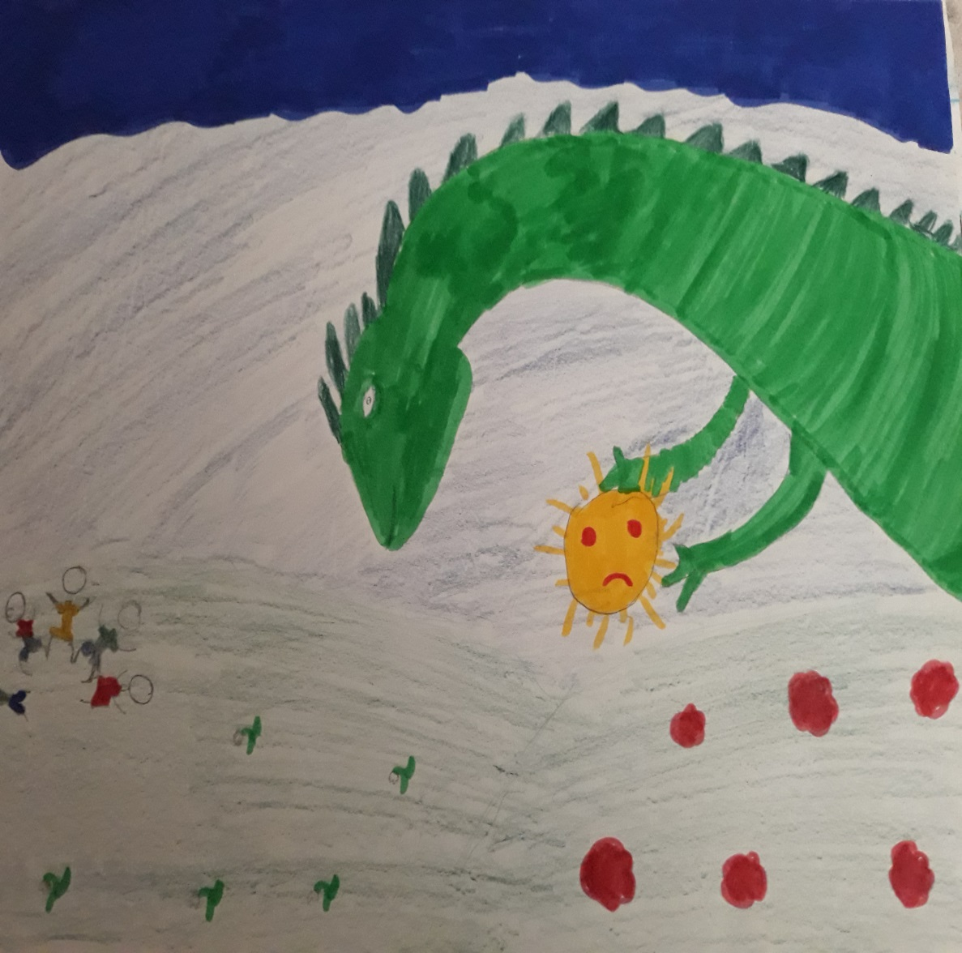
One day, the sun descended into a village, at the dance of the Romanian ring, with the face of a son. A dragon kidnapped him and put him in a dungeon. People were sad. The birds did not sing, the sources did not pass, and the children did not laugh. No one dared to confront the dragon.

Slide 4
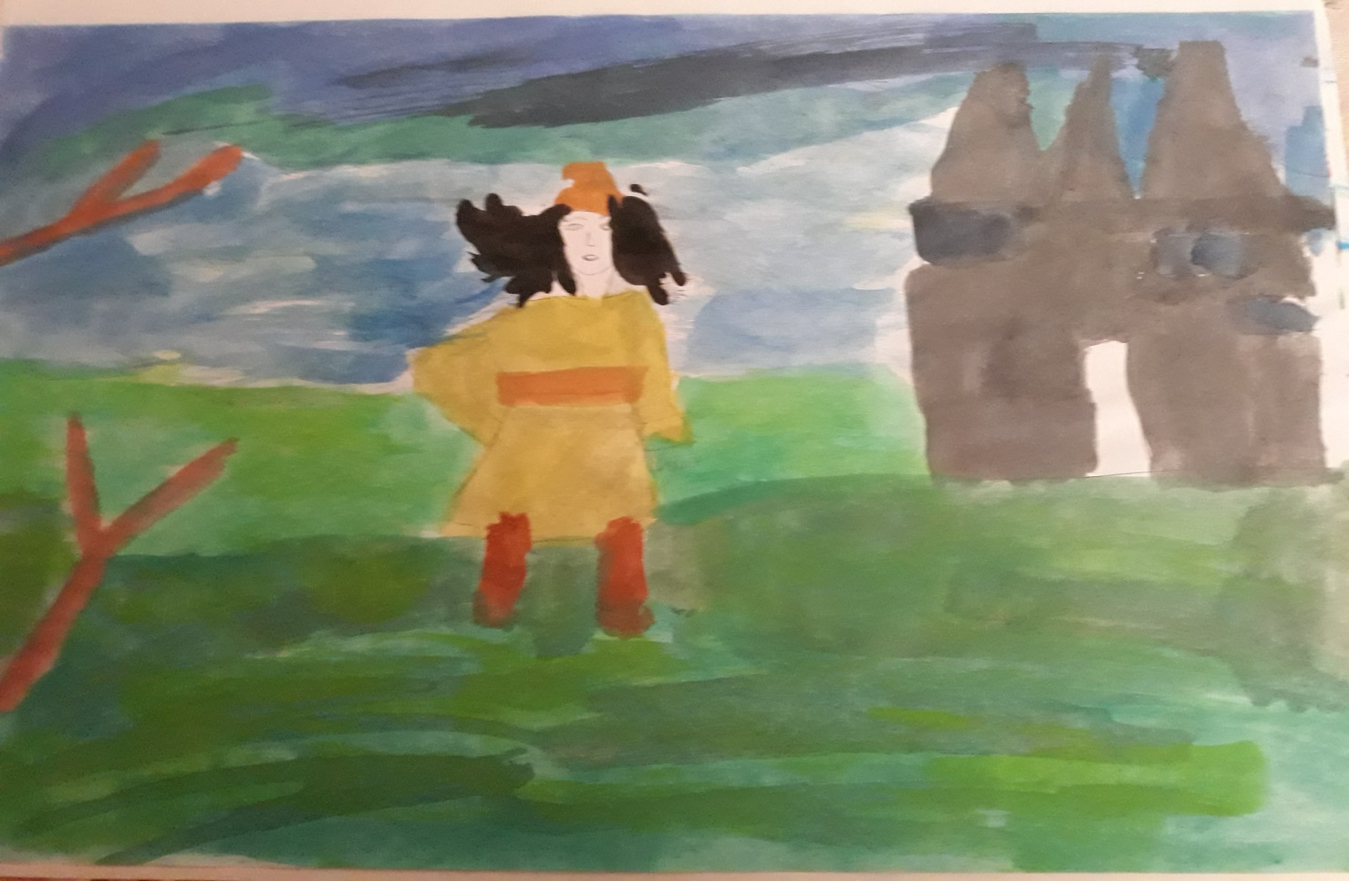
One day, a young man decided to leave to save the sun

Slide 5
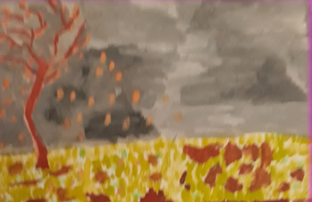
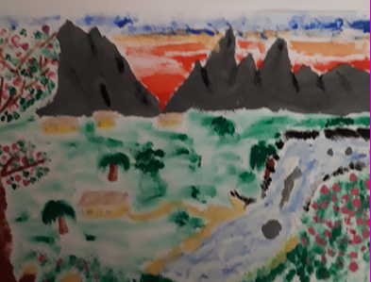
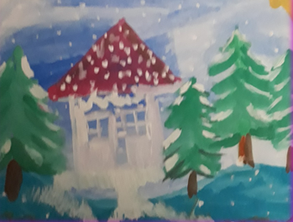
His journey took him three seasons:
autumn
summer
and winter

Slide 6
He found the castle of the dragon and they began the fight. They faced many days until the dragon died.

Slide 7
His warm blood drained in the snow. While the young man was struggling with death, white flowers were arising: snowdrops – the messengers of spring. Even the last drop of blood drained on the immaculate snow. He died.

Slide 8
March is the month when people start looking for the first snowdrop as a sign of the spring arrival. It is the moment when the cold begins to weave with the sun-beams, the dark with light and after a long and harsh winter, the life, the spring and the sun win. This victory of the revival and regeneration is invoked by the amulet that we give it to the beloved people as a small sign that we want to bring them happiness and luck.

Slide 9
Since then all the young men knitted two small tassels: a white tassel and a red one. They offer to their girlfriends or to close friends. The red means love for all that is beutiful recalling the young man’s blood. The white symbolizes the health and the purity of the snowdrop, the first flower of spring.

Slide 10
Since then all the young men knitted two small tassels: a white tassel and a red one. They offer to their girlfriends or to close friends. The red means love for all that is beutiful recalling the young man’s blood. The white symbolizes the health and the purity of the snowdrop, the first flower of spring.
The amulet is offered as a symbol of spring arrival. The custom of the amulet is actually a sequence from a ritual scenario of renewal of the time and the year, too. The significance of the amulet remained the same over time: it is a symbol of spring, the return to life. Every year the 1st of March gives us the hope, the optimism and the faith to have a better life.

Slide 11
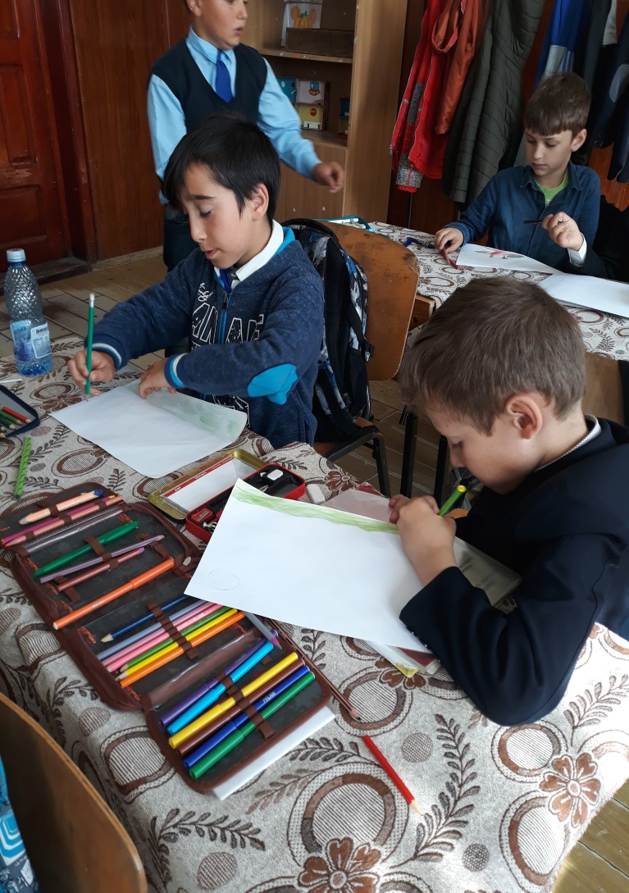
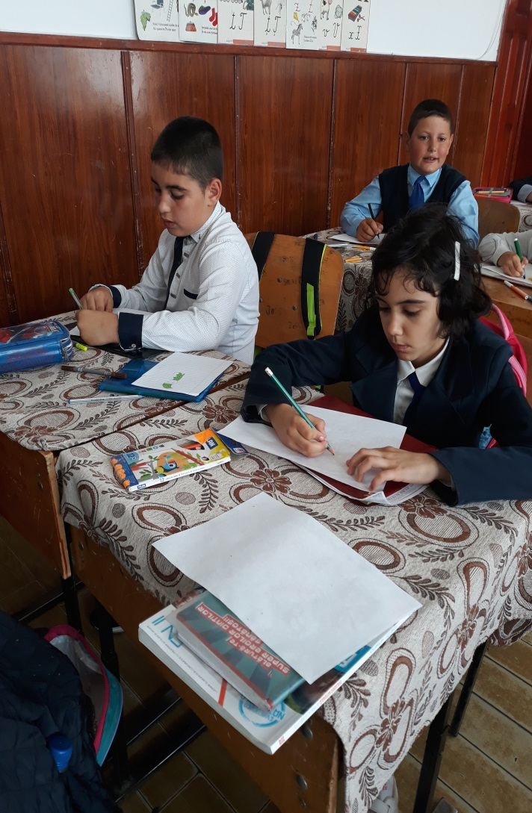
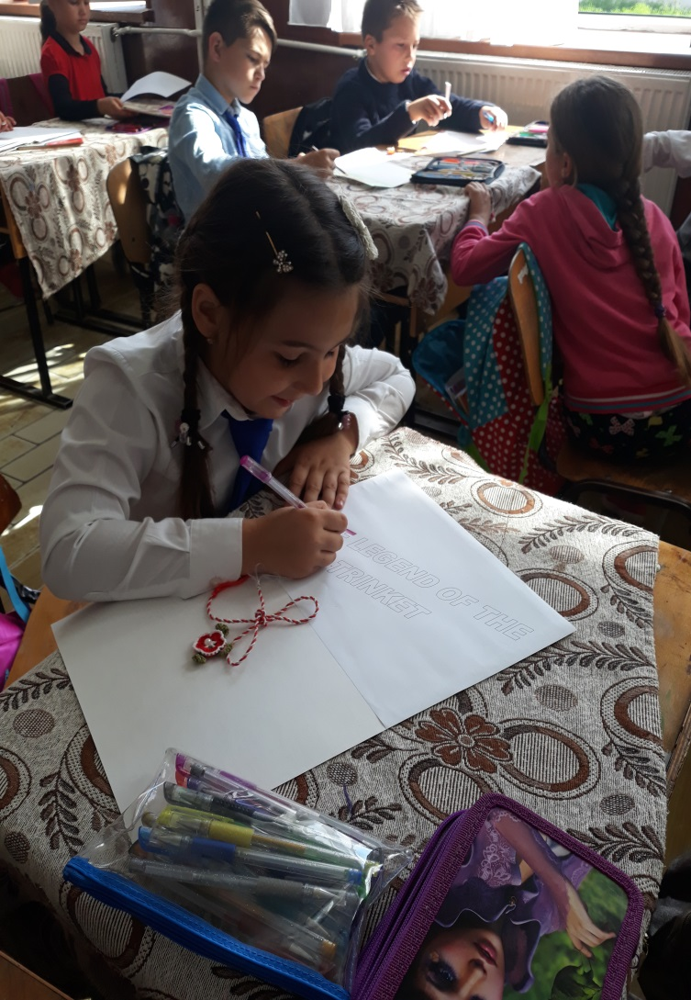
Made by teacher Ionica Axene and the students (3th grade) of the Gymnasium School „GENERAL DUMITRU DAMACEANU”, COSMEŞTI-2018

