Slide 1
HUNGER GAMES
JULIE SEMANIV
8.B

Slide 2
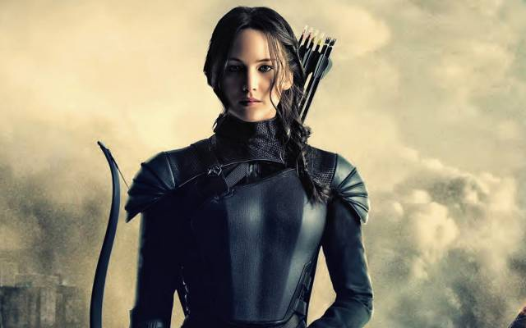
DETAILS
Hunger Games is an American adventure film made in 2012 based on the book Arena of Death.
As of 2013, it earned over $ 691 million worldwide.
The main character, Katniss Everden, was played by Jennifer Lawrence, and the other cast were Liam Hemsworth and Josh Hutcherson.
Earth - United States of America
Original name – The Hunger Games

Slide 3
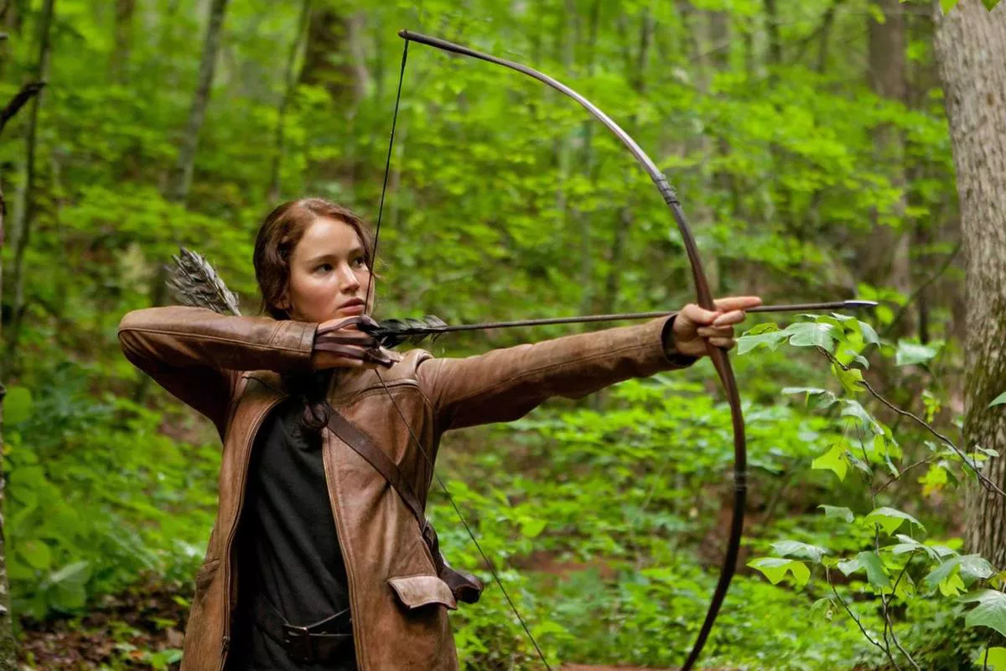
FACTS
The story takes place in the post-apocalyptic future in the land of Panem, where designated boys and girls between the ages of 12 and 18 must fight in the Hungry Games.
An annual event that is filmed live and screened in all regions and in which the "chosen ones" have to fight to the death until there is one winner left.

Slide 4
CONTENT
In the ruins of the former North America lies the land of the Lord with the capital Capitol and twelve surrounding counties.
The main characters Katniss and Peeta belong to the twelfth and the Capitol rules them with a cruel and hard hand.
Hunger games is a show where every year they choose one boy and one girl from 12 regions.
Katniss and Peeta were drawn into the games. Haymitch from the twelfth county, a former winner of the games, was elected as their mentor, but he eventually became bitter and became an alcoholic.

Slide 5
GAME
Before they fight for life and death, all players must train in the hall, where they will gradually perform and gain points from the audience.
The next day, the fighters will be released into the arena where they attack and kill.
Katniss and Peeta broke the rules of the game and a break occurred. What happened ? I recommend watching this movie

Slide 6
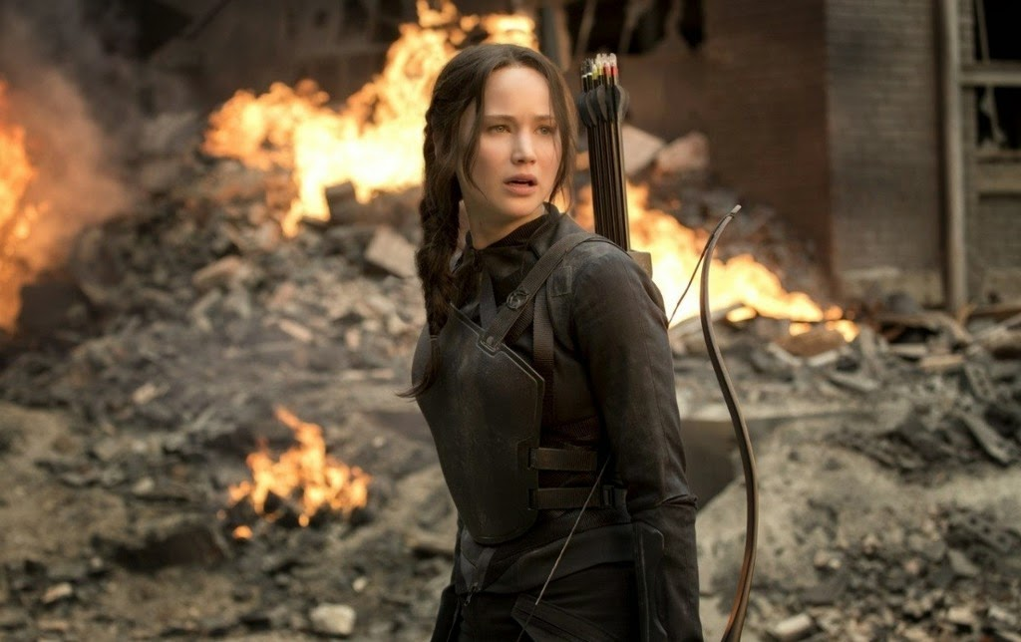
MAIN ROLE AND MY OPINION
I chose this movie because it is one of my favorites. I really enjoy this film, especially the first part. I've seen the movie about four times and I'm never bored.
main actors
Jennifer Lawrence
Josh Hutcherson
Liam Hemsworth
Woody Harrelson
Elizabeth Banks
Lenny Kravitz
Stanley Tucci
Donald Sutherland

