Slide 1
Harry Potter and the Philosopher´s Stone
Presentation Prepared by Martin Rusek

Slide 2
Main Actors
Daniel Radcliffe - Harry Potter
Ema Watson – Hermione Grander
Rupert Grint – Ron Weasley
Alan Rickman – Severus Snape
Robbie Colrtane - Hagrid
Michael Gambon – Albus Dumledore

Slide 3
Story
Young Harry finds out hes a wizard, later he goes to school of wizards. Here he learn some spels. Then the main villian appeared, his name was Voldemort. Fortunately Harry beat him, and everything went well.

Slide 4
Hogwarts
Hogwarts is a school in a „different dimension“
He learns magic here
This school looks like a huge castle

Slide 5
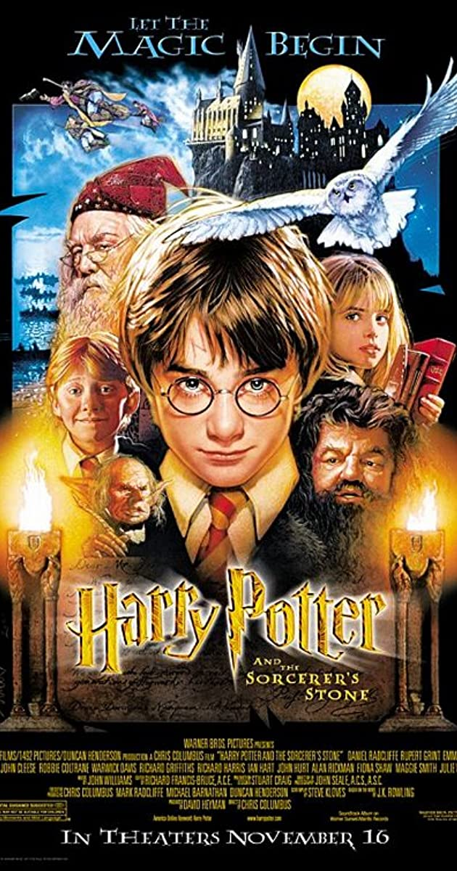
Why i chose this movie
Overall, this movie series is my whole childhood, I started the firts part because its just the start.
The first part of Potter is probably the most enjoyable, and quietest part of whole series at all, so it is also suitable for younger viewers.

