Slide 1
Folk costumes

Slide 2
Characteristics
The Czech Republic has a rich tradition of folklore songs and dances.
The folk costume is clothing that is characteristic for a certain region.
The folk costumes in the Czech Republic were typical clothing of the ordinary people.
They changed during the time. For example, the oldest skirts were long, and later they were shortened. In the rich areas the costume is more colourful. In the poor areas, the costumes are very simple.
In the last century people slowly stopped wearing traditional costumes.
Nowadays, we can admire folklore costumes in museums.
People wear them during traditional celebrations and festivals. This tradition is stronger in the eastern part and in Moravia.

Slide 3
South of Czechia - BLATA
The Blata folk costume is worn in the region between České Budějovice, Tábor, Jindřichův Hradec and Vodňany. It is area extended as far as Moravia and into Czech villages in Austria. It is a very large area.
Consequently, there are many differences among various regions. The most visible are the embroidery patterns.
The Blata costume, especially the women’s costume, is richly decorated with embroidery. For decoration were used beads, little coins and sequins (lentejuela in Spanish).
Women also richly decorated the large scarf which they wore on the head. It was tied over a three-part bonnet (gorra in Spanish), with an embroidered ribbon.
Typical colour for men´s costume were dark green and dark blue.

Slide 4
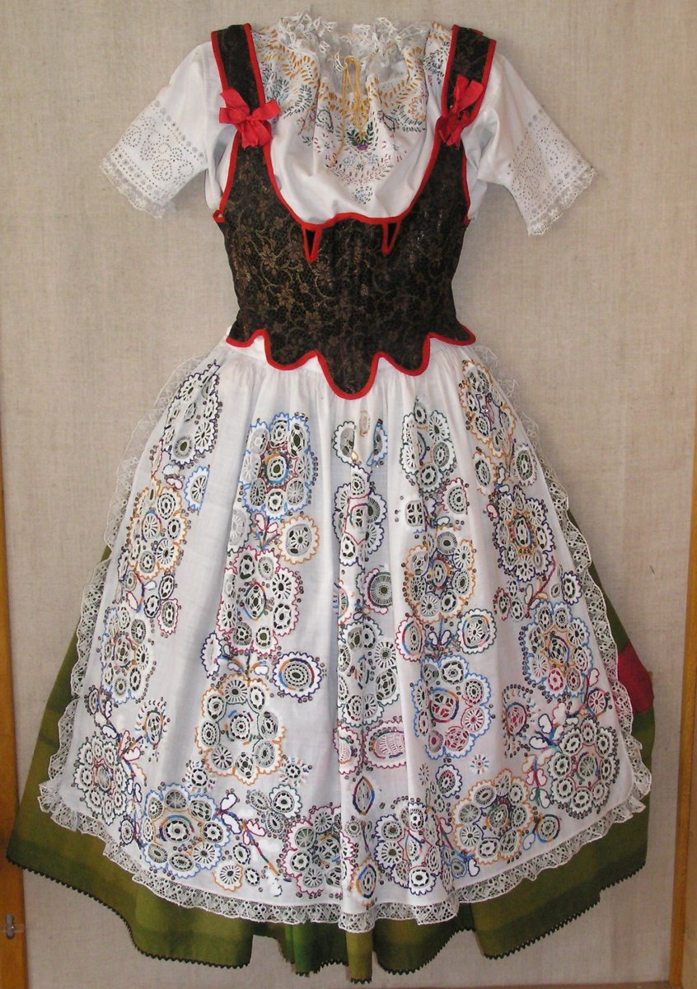

Slide 5
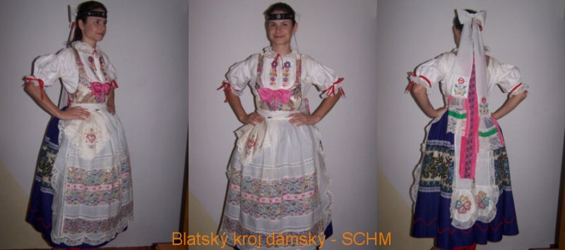

Slide 6
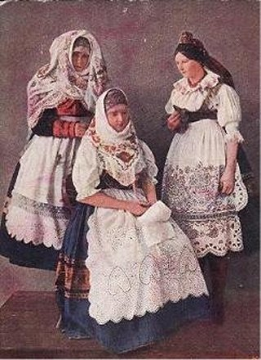

Slide 7
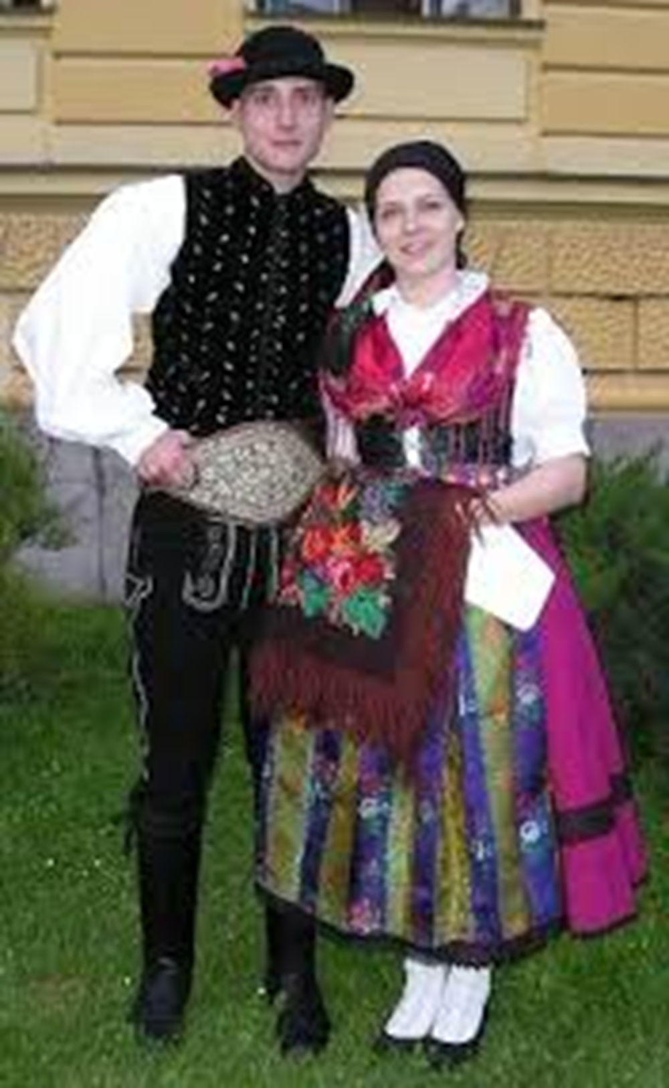
South Czechia - DOUDLEBY
Doudlebsko is the southernmost Bohemian region. It borders the Blata region in the north, and Austria and Germany in the south.
The costume is simple and plain because this region was very poor.
The female costume consisted of a close-fitting undershirt, on which there was a shirt with traditional sleeves. A coloured silk scarf, which every woman took pride in, was over the shoulders.

Slide 8
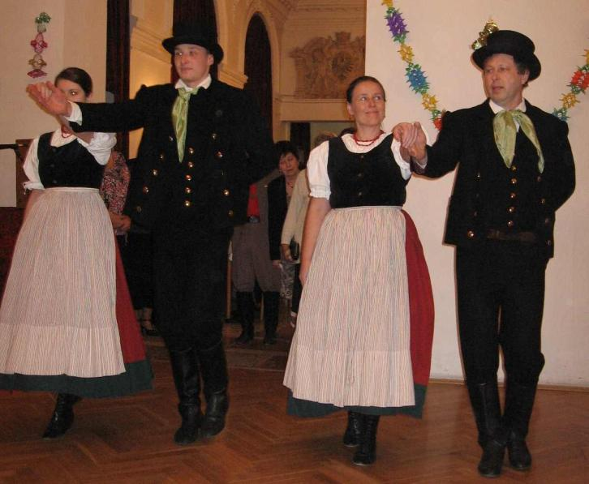
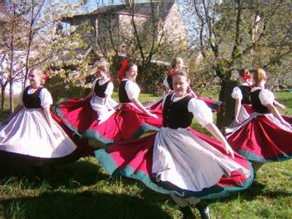
Folklore costumes, dances and songs
Also in almost every village or town, people used to wear clothes typical for that place. The folklore costumes were often decorated with ribbons, flitters, and embroidering.
Simple folklore costume from the Bohumin, a little town near Ostrava city. Women used wear coloured scarves over their shoulders and the black vest was fully covered. That´s why it is not decorated. The red skirt is made of wool and it is very heavy.

Slide 9
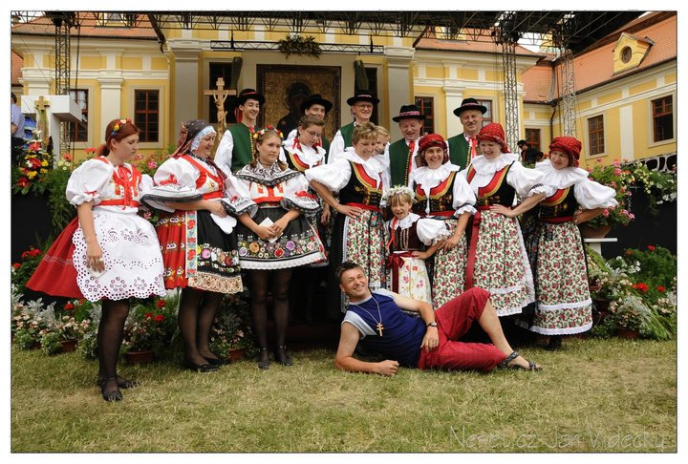
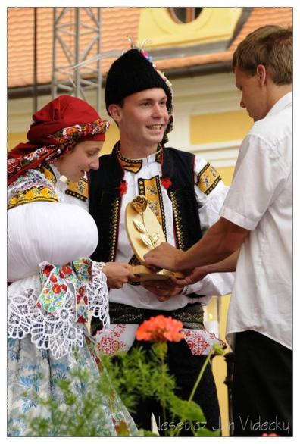
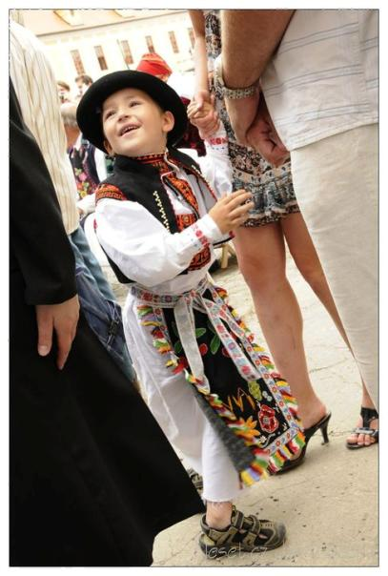
South Moravian villages have fertile fields, it is shown in the rich costumes.

Slide 10
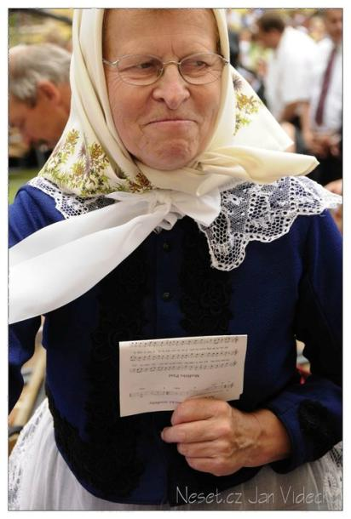
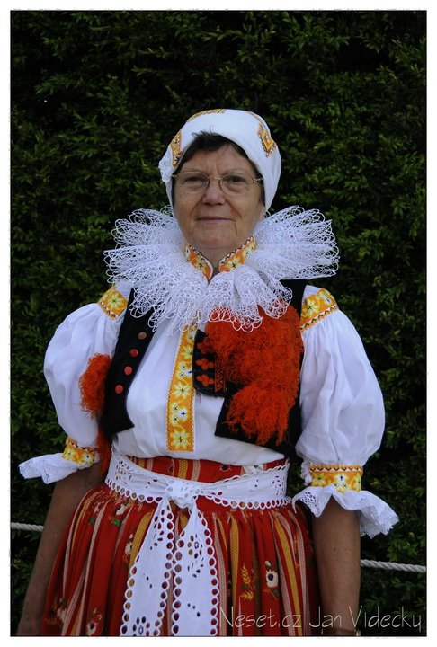
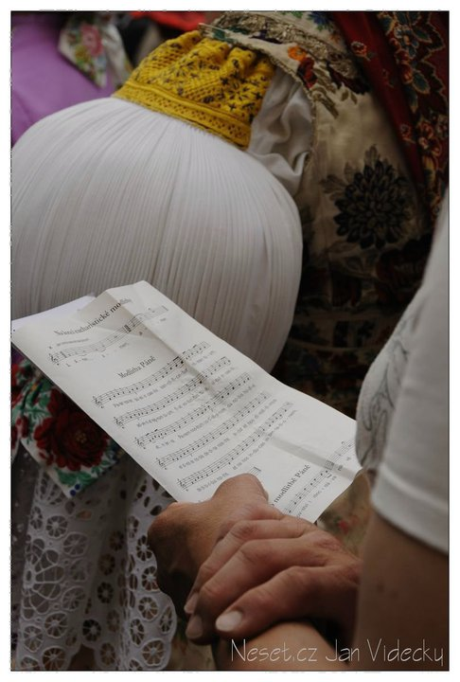
All parts of the costumes were carefully decorated. Study the details of a scarf, a collar, a cap, and a sleeve.

Slide 11
Other folklore costumes from our region

Slide 12
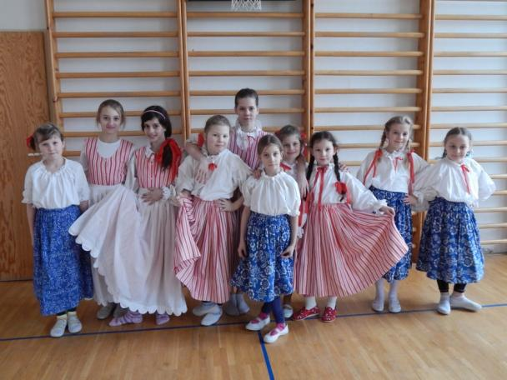
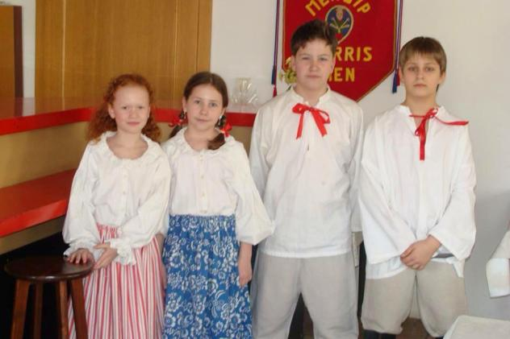
Children´s costumes from Ostrava region
Our school keeps the tradition of ending winter by throwing its symbol „Morana“ into the river.

Slide 13
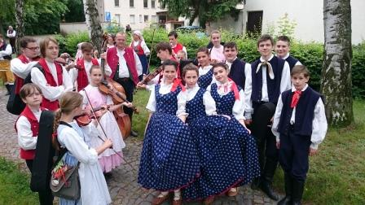
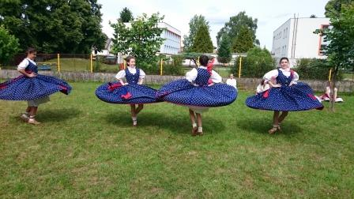
Another children´s costumes from our region
Our school took part in VI. National Sokol folklore groups festival in Slatiňany in June 2016 with dance Zezulenka.
Pupils were wearing Orlova costume.
The music band was from a nerby Music shool and they were wearing the Opava costume.

Slide 14
2) WHEEL BARREL POLKA
Read the English and Spanish version of the song written by a Czech composer Jaromír Vejvoda in 1927.
It became very popular during World War II.
Soldiers from all armies sang it.
It is not the exact translation of the Czech original.
Czech version is about love. The words are sad and there is a nice contrast with the happy melody.

Slide 15
Names in other languages
Basque: Gora ta gora beti
Chinese: 啤酒桶波尔卡/啤酒桶波爾卡
Croatian: Rozamunda
Czech (original): Škoda lásky
Danish: Hvor er min Kone
Dutch: Rats, kuch en bonen
Finnish: Tonttujen joulupolkka, Böömiläinen polkka
French: Frida oum Papa
German: Rosamunde
Hungarian: Sej-haj Rozi
Italian: Rosamunda
Japanese: ビヤ樽ポルカ
Latvian: Rozamunde
Norwegian: Hvor er min kone
Polish: Banda or My młodzi, my młodzi, nam bimber nie zaszkodzi.../Szkoda miłości
Portuguese (Brazil): Barril de chope
Russian: Розамунда
Spanish: Polka del Barril, Polca de la Cerveza or Barrilito de Cerveza
Swedish: Ut i naturen

Slide 16
English lyrics – Stanza 1 to 4
1) There's a garden, what a garden, only happy faces bloom there
And there's never any room there for a worry or a gloom there
2) Oh there's music and there's dancing and a lot of sweet romancing
When they play the polka they all get in the swing
3) Every time they hear that everybody feels so tralala
They want to throw their cares away they all go lah-de-ah-de-ay
4) Then they hear a rumble on the floor, it's the big surprise they're waiting for
And all the couples form a ring, for miles around you'll hear them sing

Slide 17
English lyrics - Chorus
Roll out the barrel, we'll have a barrel of fun
Roll out the barrel, we've got the blues on the run
Zing boom tararrel, ring out a song of good cheer
Now's the time to roll the barrel, for the gang's all here

Slide 18
Polca del barril de cerveza
1) Hay un jardín, ¡qué jardín!
Sólo florecen caras felices ahí
Y nunca hay espacio
Para las preocupaciones o la tristeza
2) Oh, ahí hay música y bailes
Y mucho dulce romance
Cuando tocan la polca
Todos se unen al swing
3) Cada vez que escuchan el um-pa-pa
Todos se sienten tan tra-la-la
Quieren botar sus preocupaciones
Y todos cantan "la-di-ah-di-ey"
4) Entonces escuchan un temblor en el suelo, el suelo
Es una gran sorpresa que están esperando
Y todas las parejas arman un anillo
Por millas alrededor, los escucharás cantar:

Slide 19
Polca del barril de cerveza - CHORUS
Rueden el barril, tendremos un barril de diversión
Rueden el barril, tenemos al blues en fuga
Zing, bum, tararel,
Canta una canción de buenos ánimos Ahora es hora de rodar el barril
pues toda banda está aquí
Da-da-da-da, da-da-da-da …

Slide 20
Polca del barril de cerveza - END
Cuando escuchan un temblor en el suelo, el suelo-o-o-o
Es una gran sorpresa que están esperando
Y todas las parejas arman un anillo
Por millas alrededor, los escucharás cantar:
Zing du da du ding da-do-do-dey
Ruédenlo, ruédenlo, rueden el barril
Dam-dam-da da-da da-dat ...
Canten una canción de buenos ánimos
Pues la banda entera está aquí
Ruédenlo, ruédenlo
Hagamos la polca del barril de cerveza

Slide 21
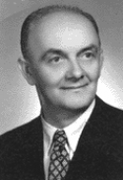
CZECH original words
1) Kvetou růže kdo ti za to může žádnej už ti dneska nepomůže 2) Kvetou zvadnou lístečky z nich spadnou jako slzy moje na tu trávu chladnou 3) Teče voda dokola se točí to jsi nelitoval modré oči 4) já bych byla pro tebe jen žila Že mou lásku zklameš to jsem netušila CHORUS:
Škoda lásky kterou jsem tobě dala škoda slzí které jsem vyplakala |: Moje mládí uprchlo tak jako sen ze všeho mi zbyla v srdci mém vzpomínka jen :|

