Slide 1
The Sleeping Knights in the Blaník Hill a Czech legend
Created by Czech Primary School
Kosmonautu 15 for project
Arts Talk About Us

Slide 2
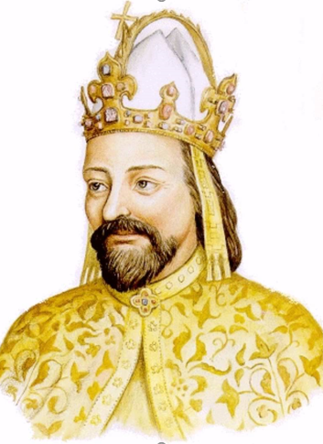
The old legend about the knights who are sleeping in the Blaník Hill was first told to the king Charles by a blind man.

Slide 3
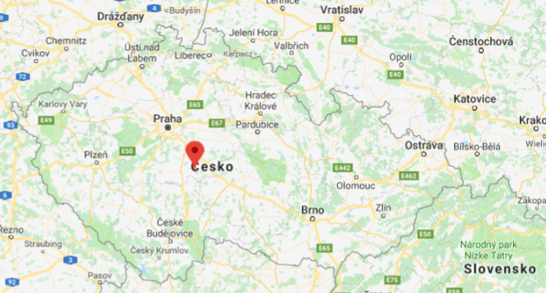
The Blaník Hill is in the Central Bohemian region. It is located about 10 kilometres south of Vlašim, near Louňovice.

Slide 4
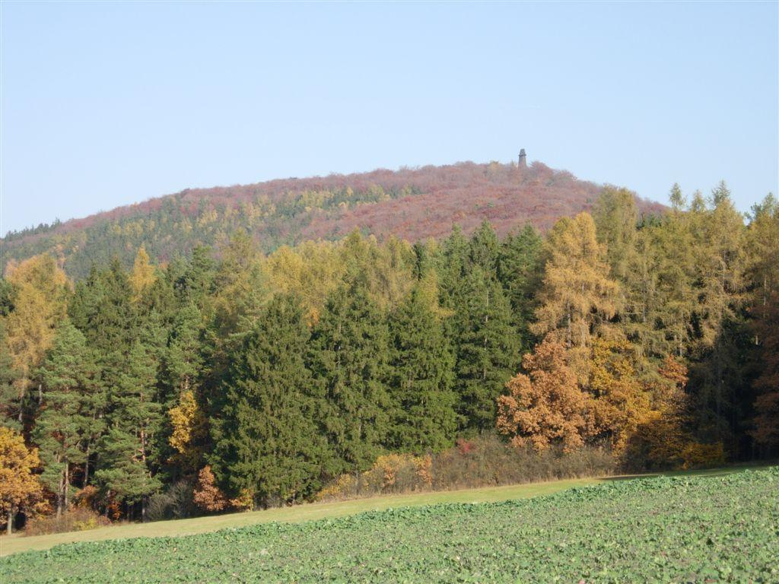
The Blaník Hill is 638 metres high.

Slide 5
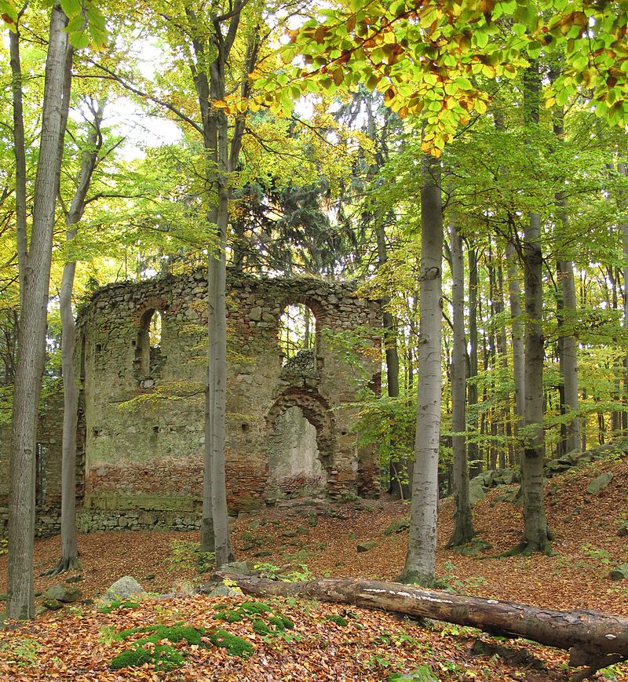
On the top of the hill Blaník,
there are old stones and ruined walls of a castle.

Slide 6
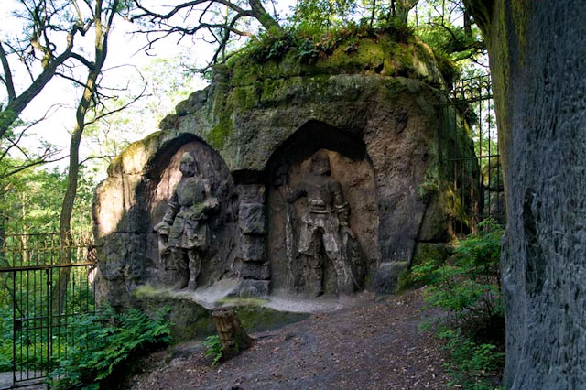
Under the walls, in the hill, there are armed knights, “Saint Wenceslas´s Army”.

Slide 7
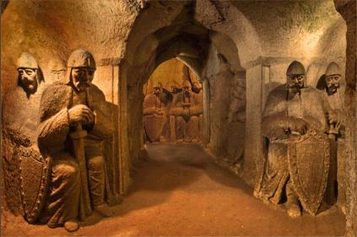
They are waiting for a day when the Czech nation will need their help.

Slide 8
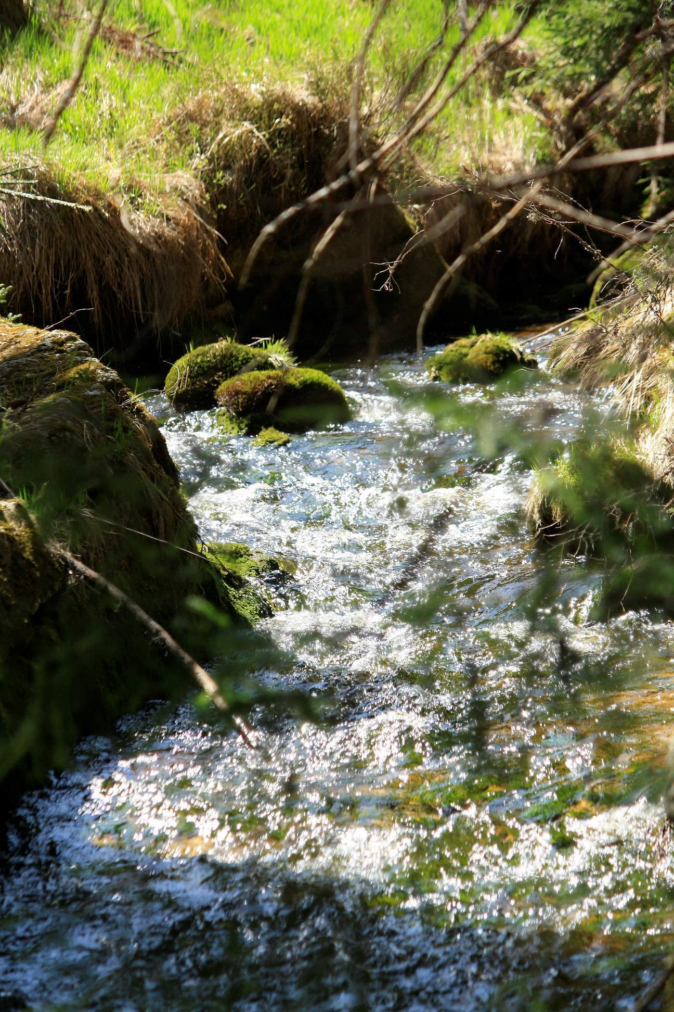
Under the stone peak of Blaník, in eastern side there is a rock. There is the entrance to the hill, and there is a spring.
Knights´ horses drink water from this spring when they go out from Blaník at night in the moonlight.

Slide 9
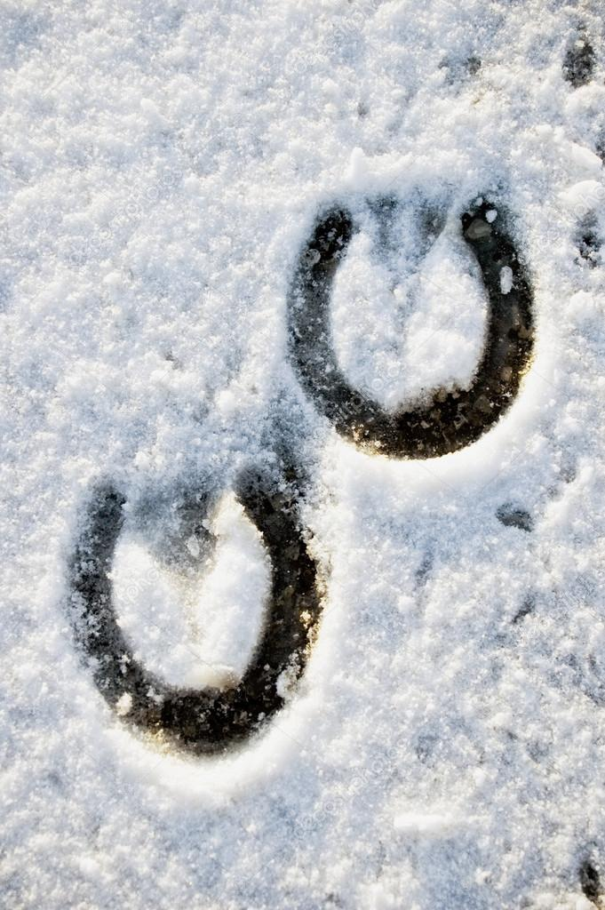
At night people can hear horse riding.
In the morning, there is silence again, and knights, their horses, everything goes again into the hill.
Only one memory will stay there:
prints of hoofs.

Slide 10
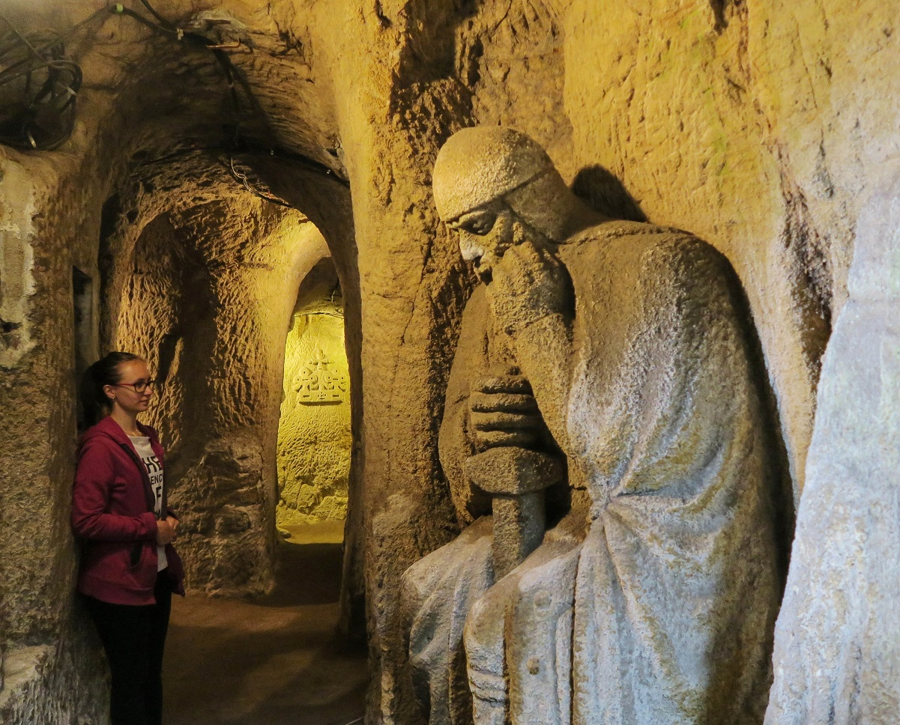
One day a girl was standing in front of Blaník, and suddenly, one knight appeared in front of her. He told her, if she wanted to go with him to clean in the hill. She went with him.

Slide 11
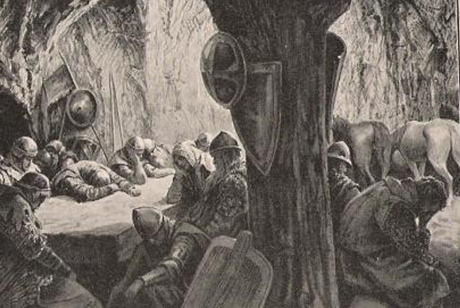
There was deep silence. By the walls there were horses, and at a table there were knights. They were sleeping. The girl went in, and she looked round, but nobody moved.

Slide 12
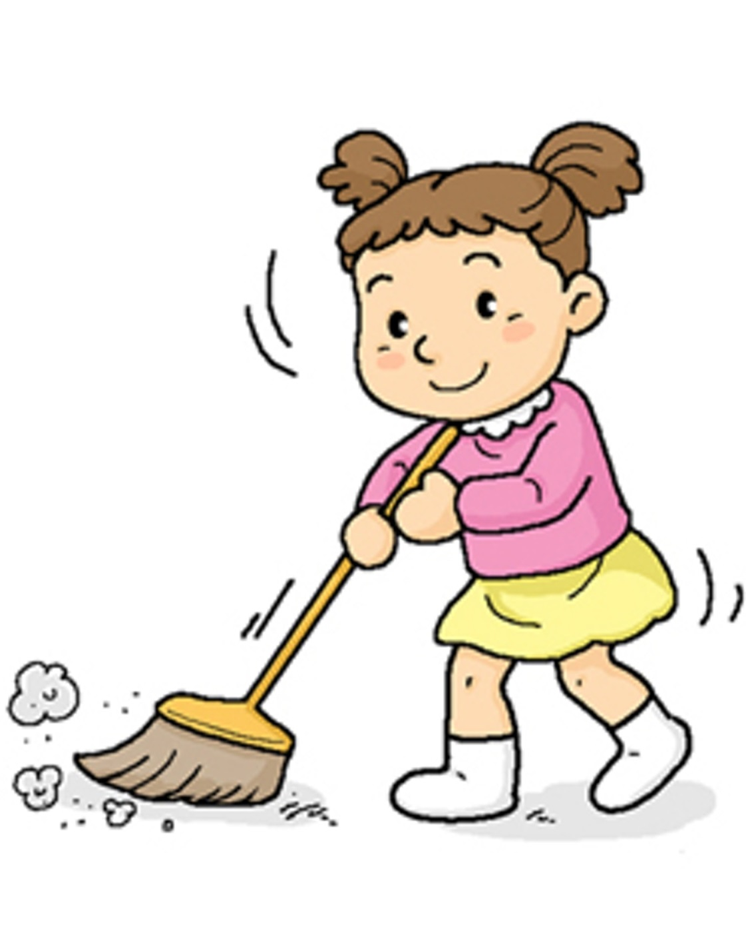
She started to sweep the floor. She cleaned everything in a moment. Then she went home.
People asked her, where she had been for such a long time. She was surprised, so she told them that she arrived at the same time as usually.

Slide 13
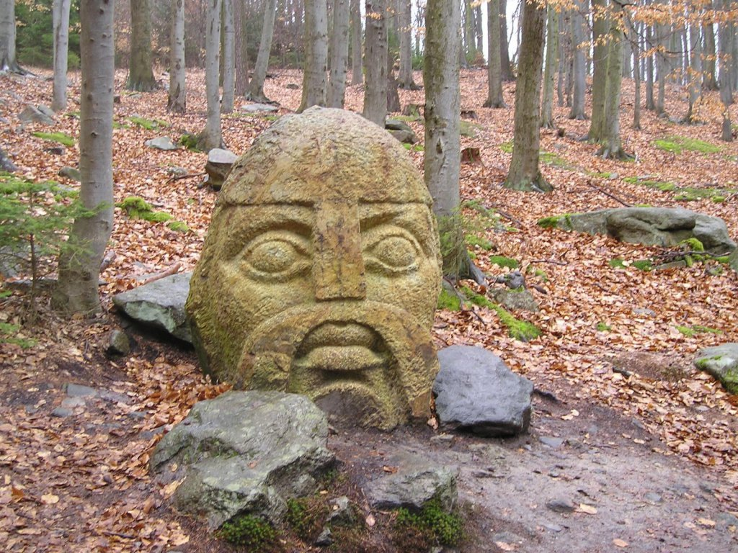
But she spent one year in the Blaník Hill.

Slide 14
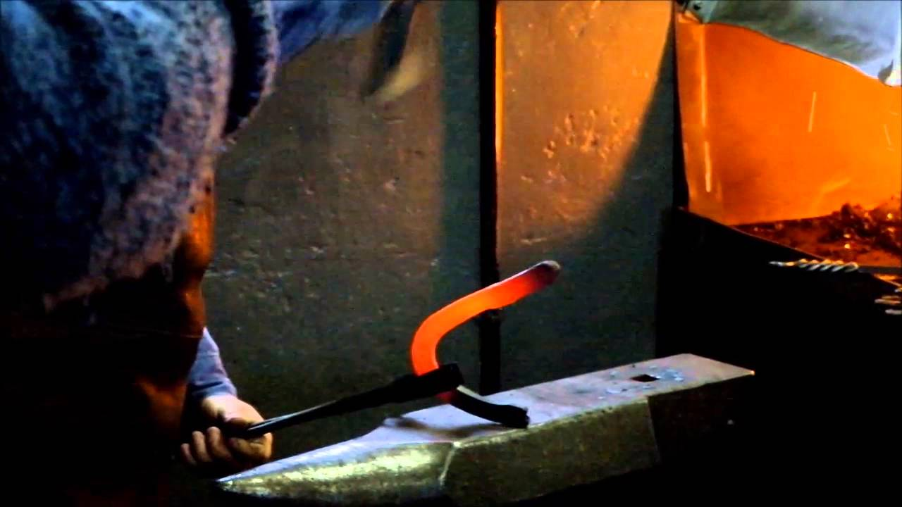
Another day, one knight invited a blacksmith from Louňovice village.

Slide 15
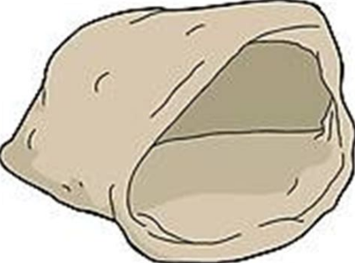
When he finished his work, the knight gave him a bag with rubbish. The blacksmith was angry, and he spilled the bag.

Slide 16
When he came home, he told this story and he found in the bag three ducats. He went back in front of the hill, but there was no ducat.

Slide 17
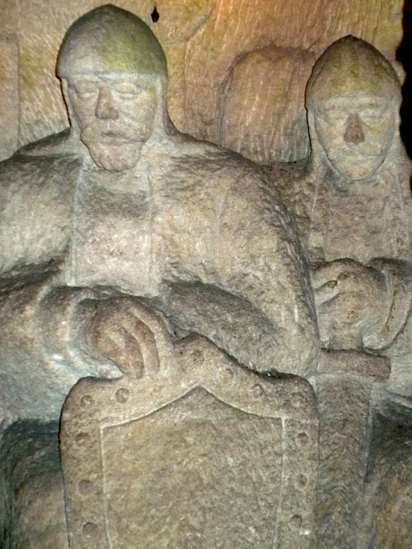
Saint Wenceslas´s army is sleeping.
It isn´t still time to wake them up.
The time will come, when Czech people are in the biggest danger.

Slide 18
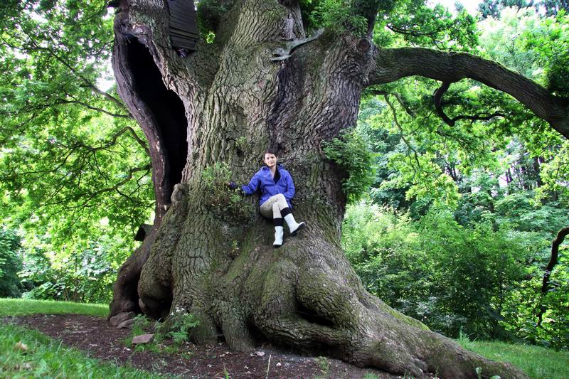
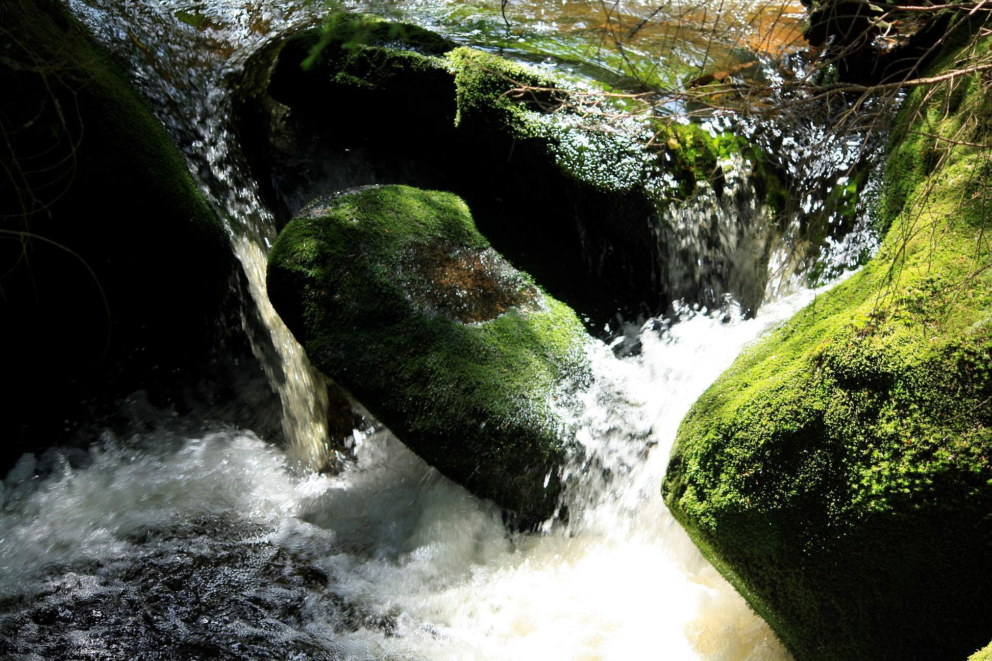
On the top of the hill a dry oak will become green
and the spring by a rock will run down the hill.

Slide 19
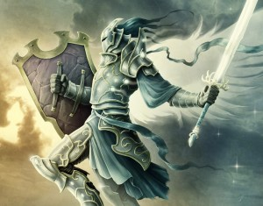
A big battle will be in the landscape near Blaník. Czech people will defend against the strongest enemies.

Slide 20
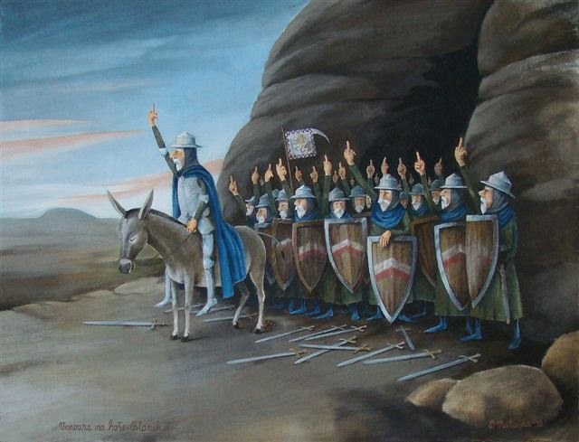
In that specific time Blaník will open and the knights will go to help Czech people.
Saint Wenceslas will ride a white horse and he will be the commander.

Slide 21
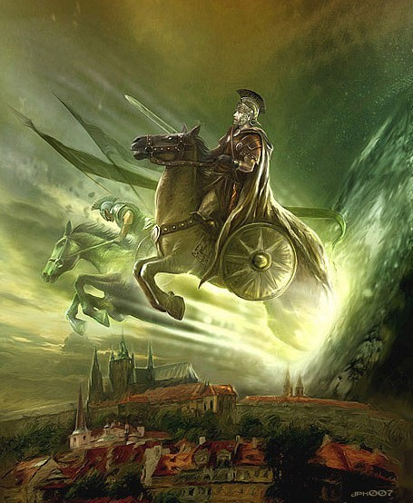
The enemies will be scared and go to Prague, and there will be the end of the battle.
The fight will be furious, blood will run from Prague Castle down to Charles bridge.

Slide 22
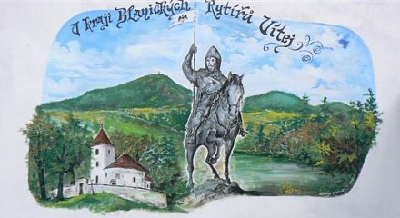
And Saint Wenceslas on the white horse with a standard in his hand will expel all the enemies from our country.

