Slide 1
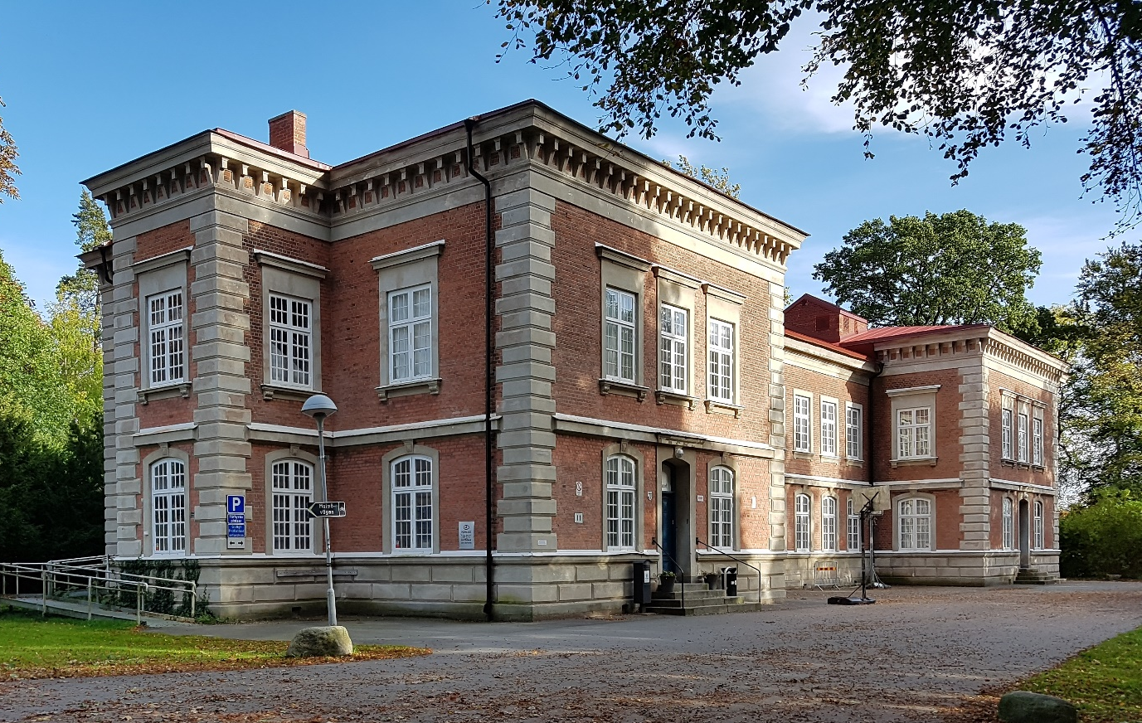
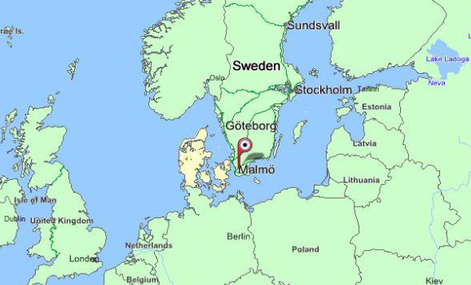
ICT in Romania
Swedish team
Notes:
Hello and Welcome to our presentation as you can see we are the Swedish Team.
First we like to say Thank you Romainia for a worm and lovely welcome. Special thanks to Alina that worked so hard
In the picture you can se our school
We have around 200 students and in our school we have 2 Programs
1 Technology program
2 Elecricity and energy program with focus on Network Solutions

Slide 2
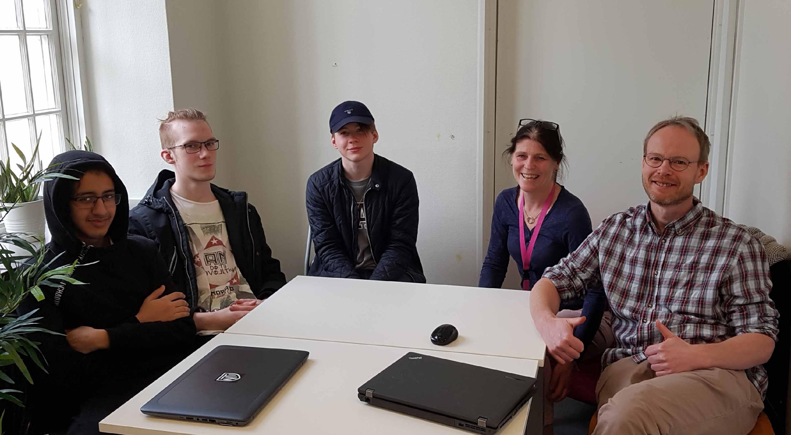
From NTI Lund
Niclas Andersson
Carin Hansson
Hooman Amiri
Daniel Lundquist
Tobias Olofsson
Notes:
Presentation av elever och lärare
I’m a teacher in Programing and WebbDevelopment
SpecialPedagoge and teacher in Matematics

Slide 3
Agenda (Sorry, we don’t have Biology as a subject in our school. Therefor we are going to present some digital apps we use in our programs )
Digitalisation in Sweden and in the school Overrole.
Wordpress Another way to present student work to the World…. . (Workshop)
Webbtool A webbtool to form groups in a classroom. Made by our sister school in Helsingborg. (Workshop)
Arduino Learn how to program flashing lamps in Arduion. . (Workshop)
Kahoot Play and share engaging quizzes.
Notes:
Sorry, we don’t have Biology as a subject in our school. Therefor we are going to present some digital apps we use in our programs
30% of the Internet is powered by Wordpress.
A webbtool to form groups in a classroom. Made by our sister school in Helsingborg.
Learn how to program flashing lamps in Arduion
How to play and make quizzes with Kahoot

Slide 4
Swedish Gouverment
Digitalisation
"The government decides on national digitalisation strategy for the school system Sweden will be the best in the world to take advantage of the potential of digitalisation. "
(http://www.regeringen.se/pressmeddelanden/2017/10)
Notes:
It is important for our shool that the students become comfortable how to navigate in a digital world.
It is also importent to understand that in areas like Artificial Intiligence and Internet of things is where the new jobs are created.

Slide 5
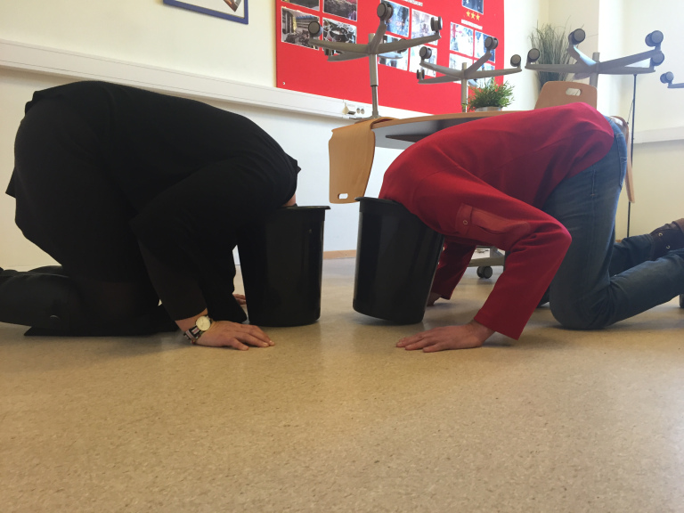
Digitalisation
Digitalisation of the school is not something you can choose!
So, make sure to make a good solution out of it!

Slide 6
Wordpress
A different approach
www.erasmusbiology.wordpress.com

Slide 7
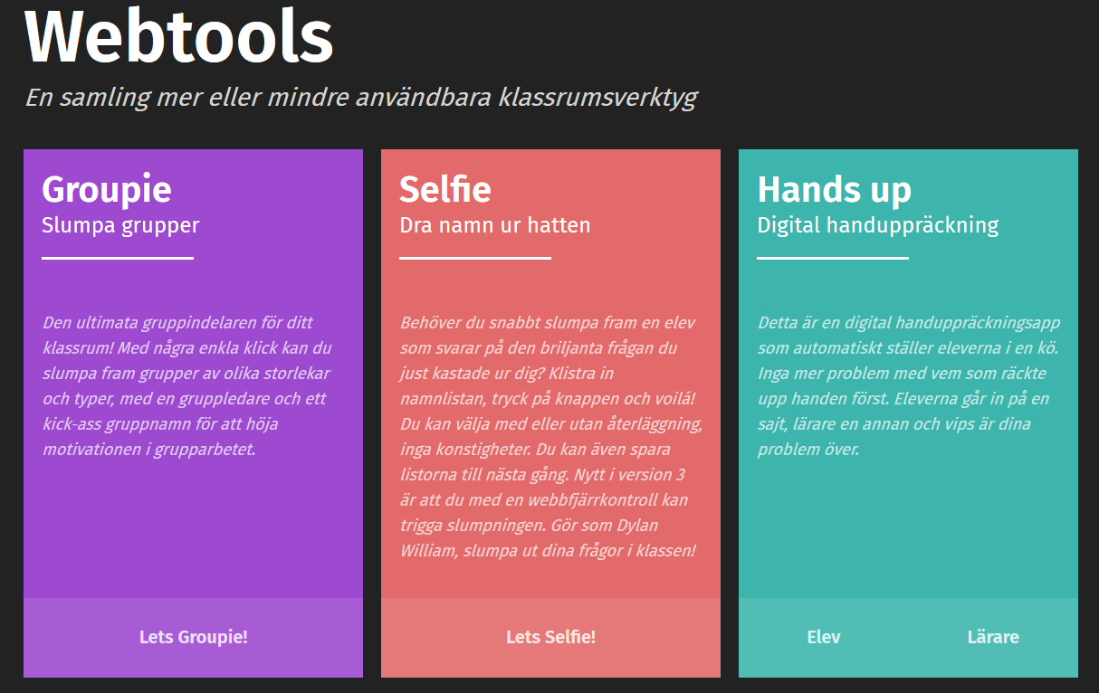
Webbtool
https://webtools.itgonline.se/

Slide 8
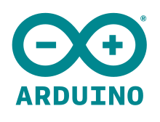
Arduino
Arduino is a open-source electronics platform based
on easy-to-use hardware and software.
The microcontroller on the board is programmed
using the Arduino programming language.
What can you program with Arduino?
https://www.youtube.com/watch?v=JE6_1Wkvg7w

Slide 9
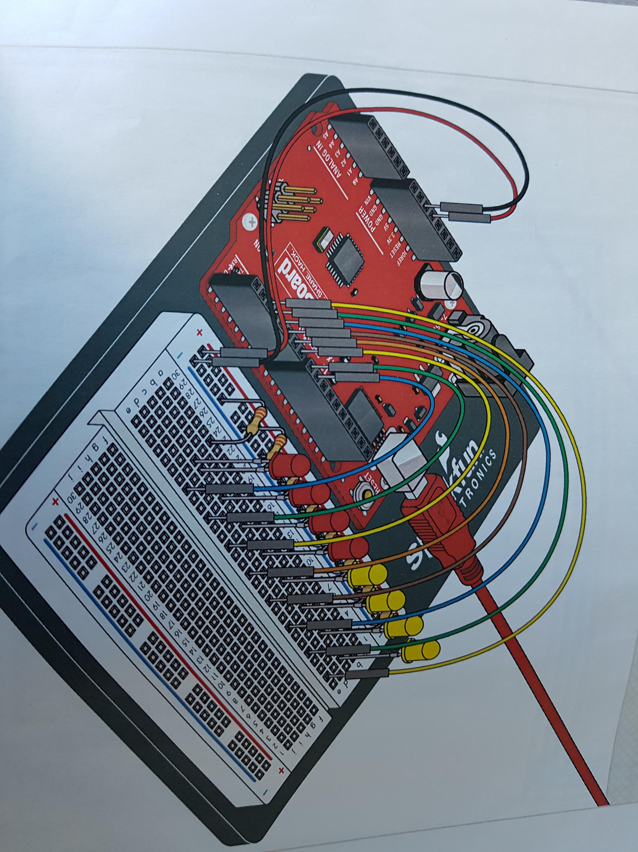
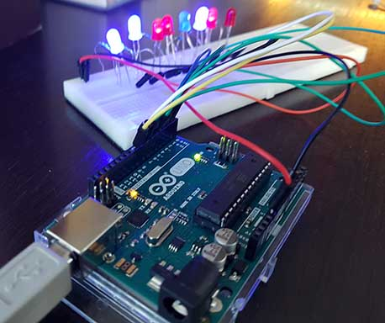
Arduino Workshop

Slide 10
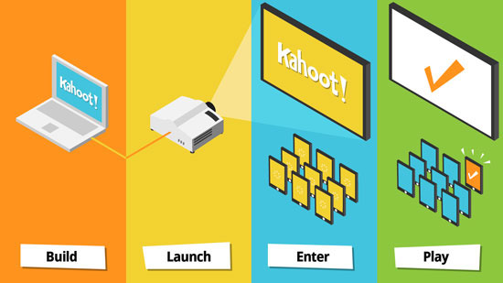
Kahoot
https://kahoot.it/
Notes:
https://create.kahoot.it/details/biology-organ-functions-basic/e5c5692b-9535-48c8-9c8a-24a670909d75?_ga=2.202893588.44284952.1523610227-999280250.1523610227&deviceId=252352a3-d933-4b94-bf68-9032ddd1e865R

Slide 11
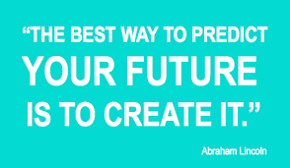
Thank you!

