Slide 1
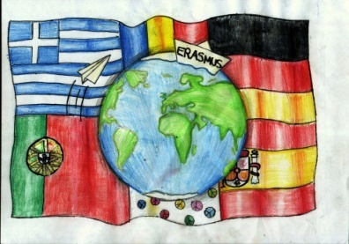
Odyssey- Migration and its Influence on Teens

Slide 2
Gymnasium Neue Oberschule , Braunschweig,Germany
3rd Gymnasio of Kalamata Kalamata, Greece
EBI Francisco Ferreira Drummond, Terceira Portugal
Colegiul Economic Buzău , Romania
IES Luis Seoane, Pontevedra, Spain
"This presentation has been prepared exclusively for educational purposes under the Creative Commons Attribution (Attribution, Share Alike) . No infringement is intended. It is the outcome of a student project, and does not necessarily represent the views of the 3 Gymnasio of Kalamata or any other individuals referenced or acknowledged within the presentation.

Slide 3
COMING INTO THE EU
Via Greece

Slide 4
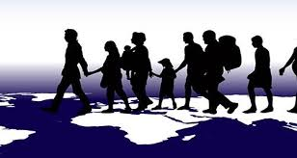
Migration in Europe.
Mostly illegal
Through the vast shorelines of Spain, Italy and Greece

Slide 5
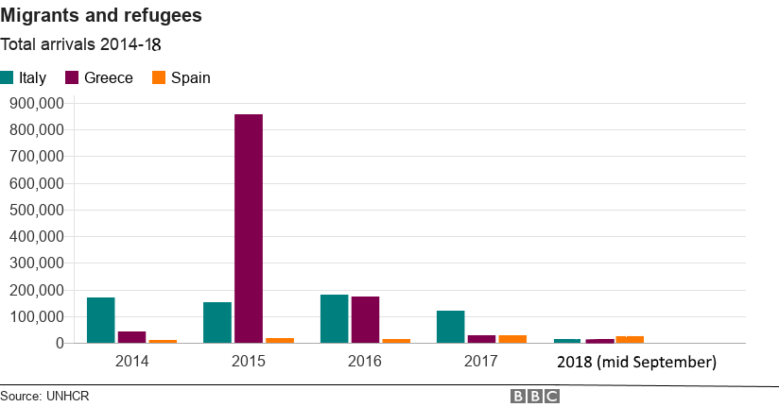
In numbers.

Slide 6
What is Asylum and how is it granted?
Asylum is protection or safety, especially that given by a government to people who have been forced to leave their own countries for their safety or because of war
Law (L) 4375/2016 in April 2016
http://www.refworld.org/docid/573ad4cb4.html

Slide 7
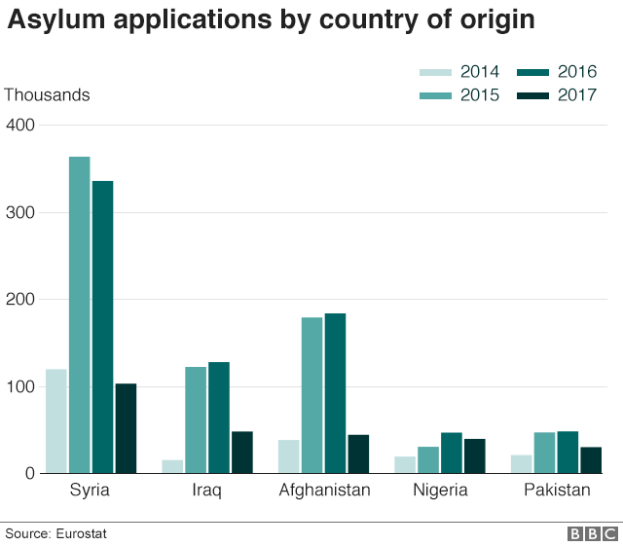
Syria, Iraq, Afghanistan, Nigeria and Pakistan. Eritrea, Somalia, Bangladesh, Iran and a number of Sub-Saharan countries
.

Slide 8
Asylum seekers
Syria
Iran
Pakistan
Afghanistan
32.983 women
69.201 men
32.272 minors
0,5% people
over 65 years old
486 girls
3.915 boys
374 minors international protection
(others)
42.9% young people(18-24)
Unaccompanied minors: 4.401 people

Slide 11
Tthe flow of asylum seekers towards EU countries during the last years.
http://www.europarl.europa.eu/external/html/welcomingeurope/default_en.htm

Slide 12
The legislative procedure
Law 4375/2016 -General Secretariat for Reception, transposition of Directive 2013/32/EU of the European Parliament.
http://www.refworld.org/docid/573ad4cb4.html
Regular procedure
Border procedure
Fast track border procedure
Accelerated procedure
Dublin procedure

Slide 13
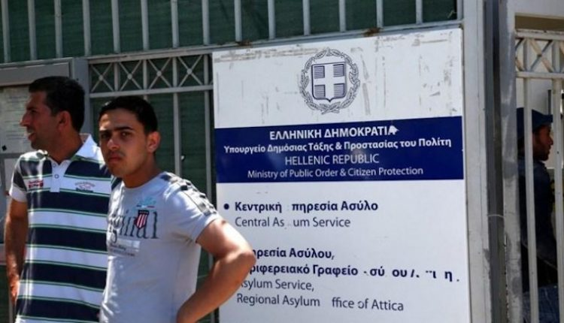
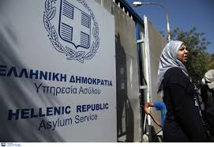
Authorization procedure for Asylum
Reception and identification services
Asylum service
Refugee authority

Slide 15
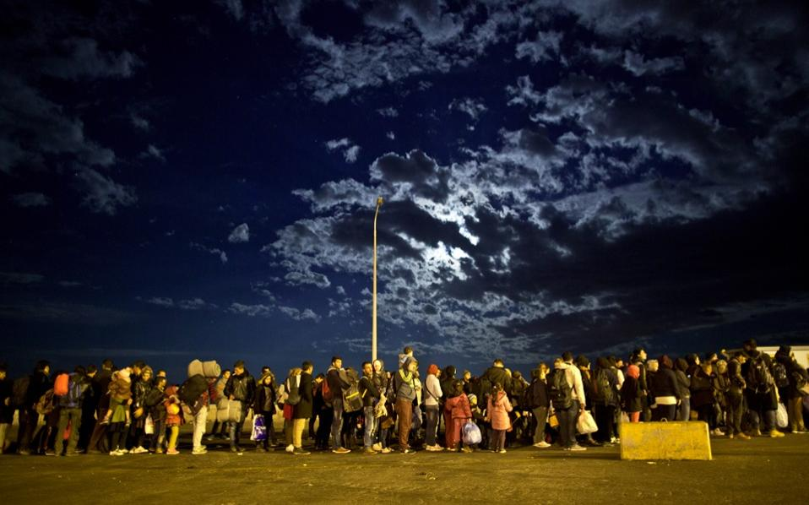
The actual procedure - Evros and the Eastern Aegean Islands

Slide 16
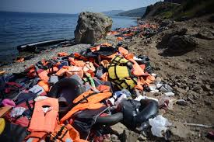
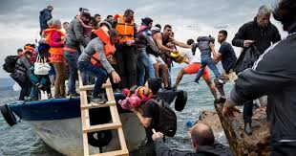
Phase 1:
Identification

Slide 17
The officials working under this agency have obligations when dealing with persons who may wish to apply for international protection.
Among the main directives are
Anyone has the right to seek asylum
Look for indications and be open-minded
Anyone can be a refugee
Pay attention to vulnerabilities

Slide 18
Be respectful, don’t judge and do not discriminate
Applicants must not be penalized on account of their illegal entry or presence
Pay attention to your body language and the way you communicate

Slide 19
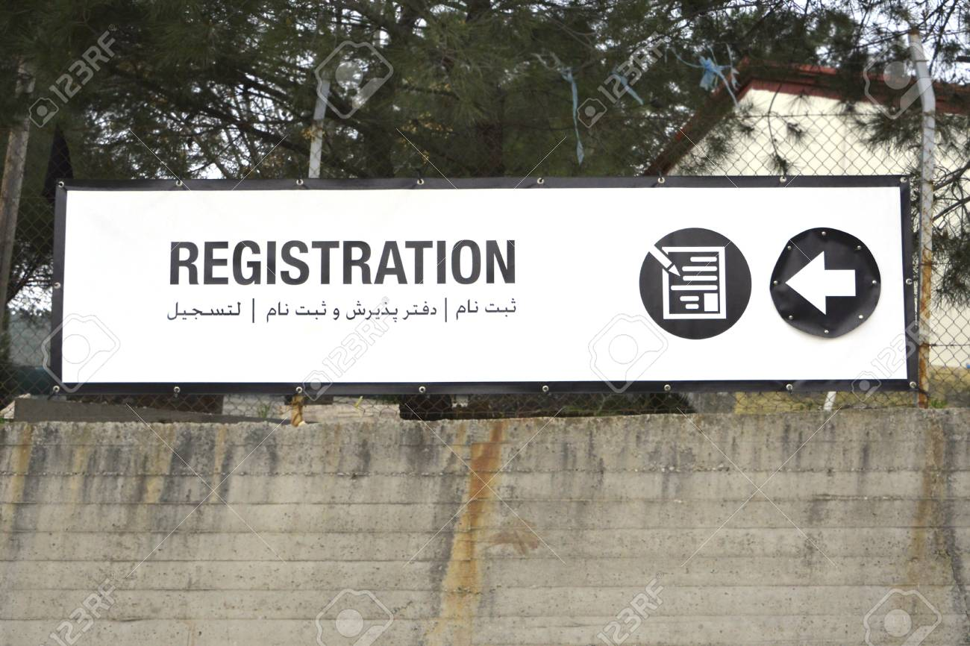
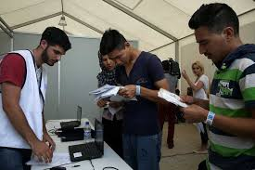
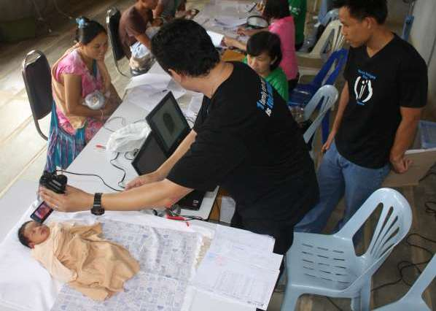
Once they have been identified, those coming into the country are registered by the Hellenic Asylum services

Slide 20
Directives given are:
Provide information about the possibility to apply for asylum
Recognize the intention to apply for international protection
If a person has expressed, in any way, a wish to apply for international protection, he/she becomes an applicant with all rights attached
Inform the applicant where and how the application may be filed

Slide 21
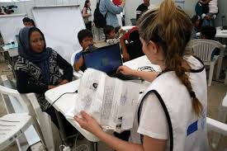
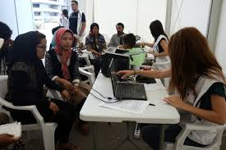
During the third stage they are interviewed by the Hellenic Asylum services. A translator is available if needed. The process then follows the legal procedure to see if they can be granted temporary asylum

Slide 22
actual application for asylum

Slide 23
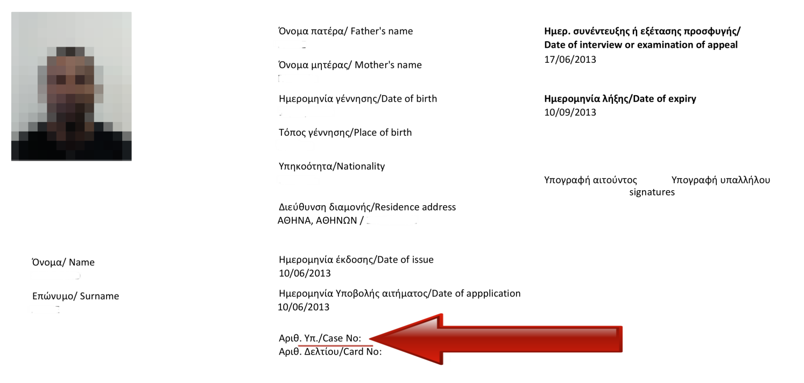
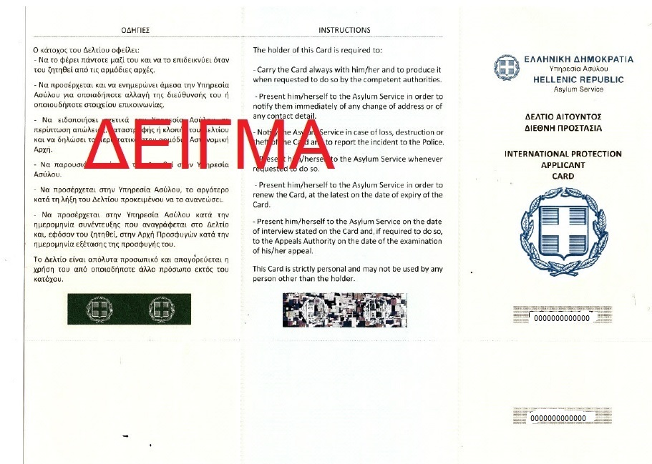
International protection Applicant card

Slide 24
When the procedure has been completed the asylum seekers follow the approved path. This means they may stay in Greece, be directed to another EU country or may even be sent back..
Outgoing Dublin requests for Greece: 2014-2017

Slide 25
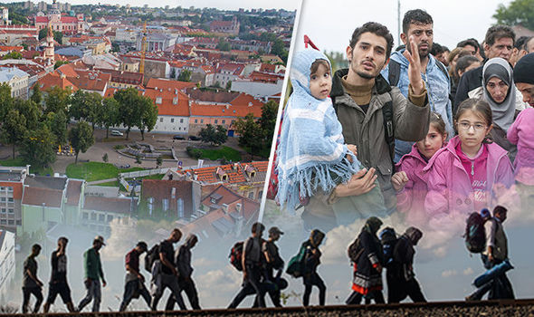
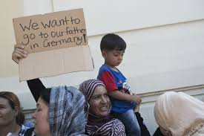
outgoing requests to other Member States under the Dublin Regulation.
7,231 requests were accepted and 2,163 rejected

Slide 26
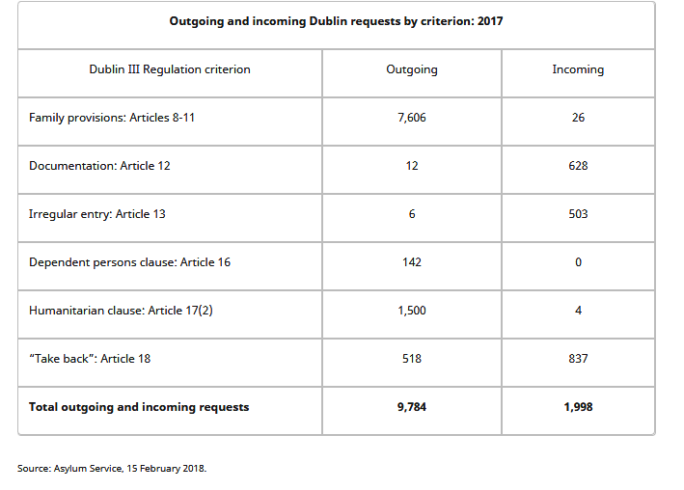
The majority of outgoing requests continue to take place in the context of family reunification:

Slide 27
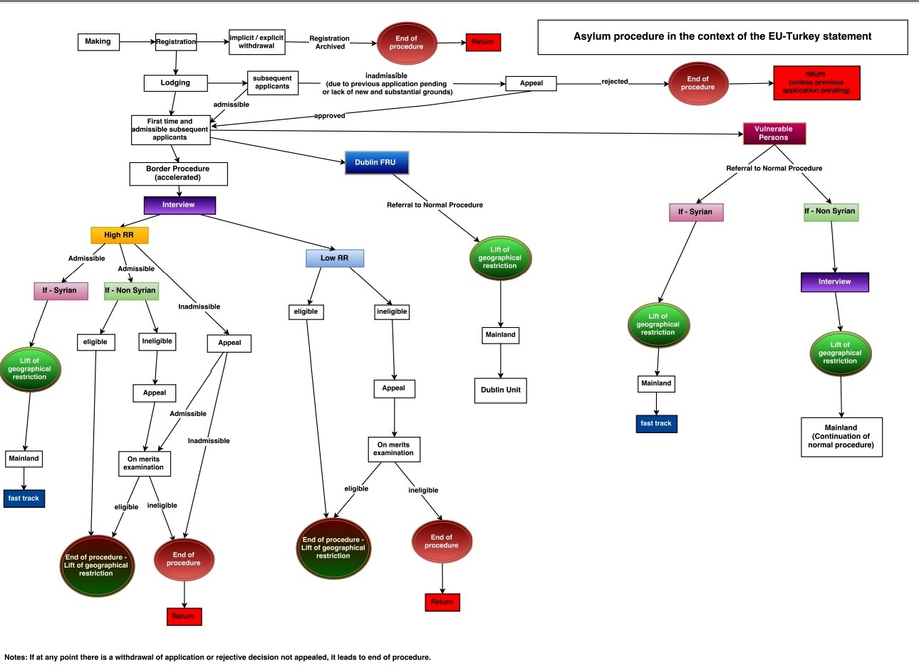

Slide 28
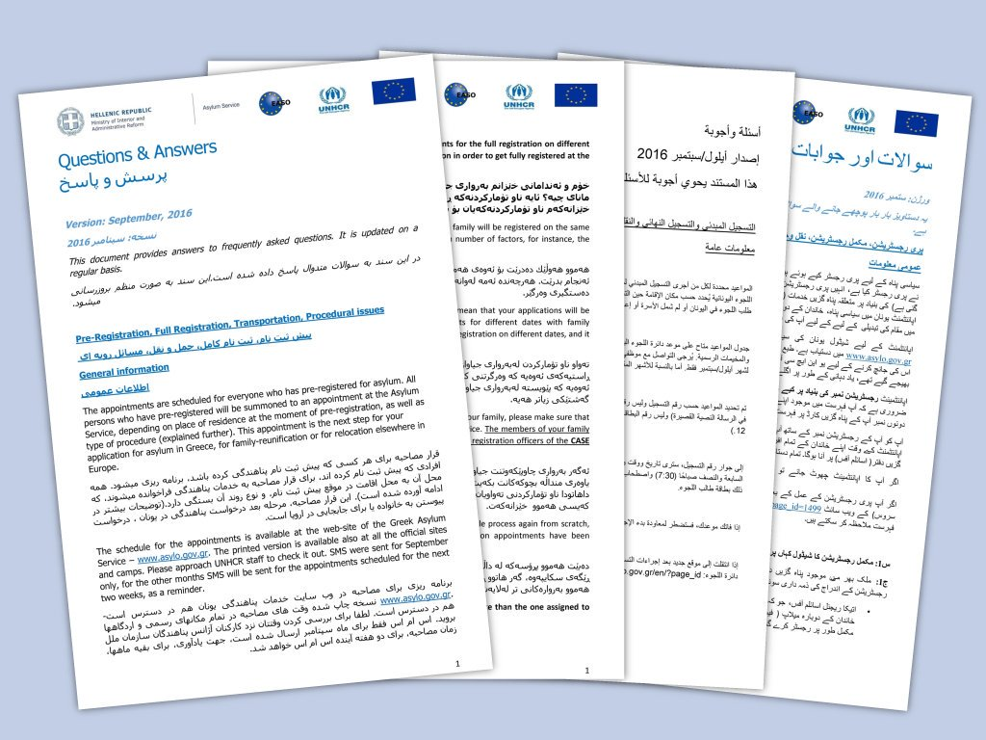
Information about refugees and Asylum seekers in Greece is translated into 5 languages.
Governments usually guarantee basic human rights and security.

Slide 29
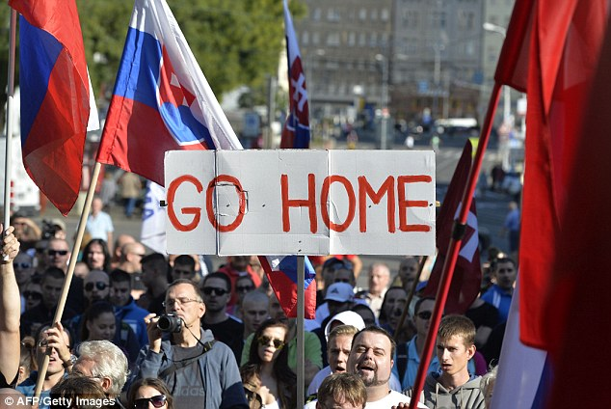
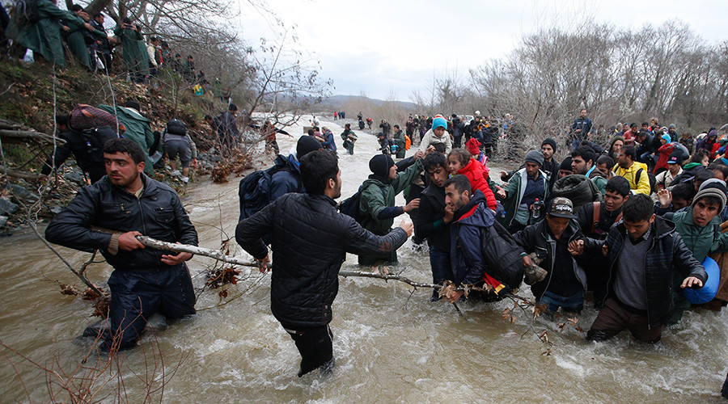
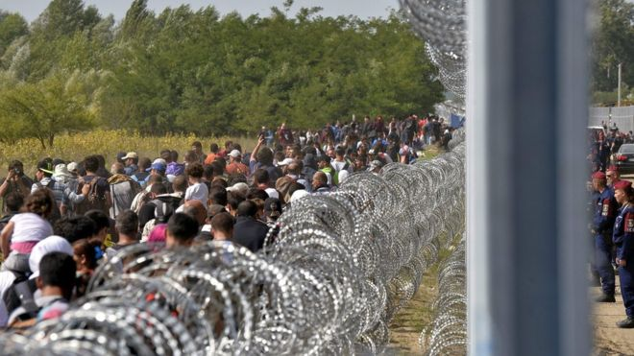
PROBLEMS THAN HAVE ARISEN

Slide 30
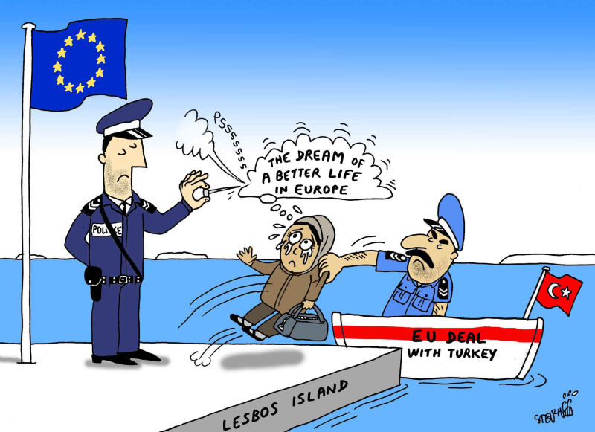
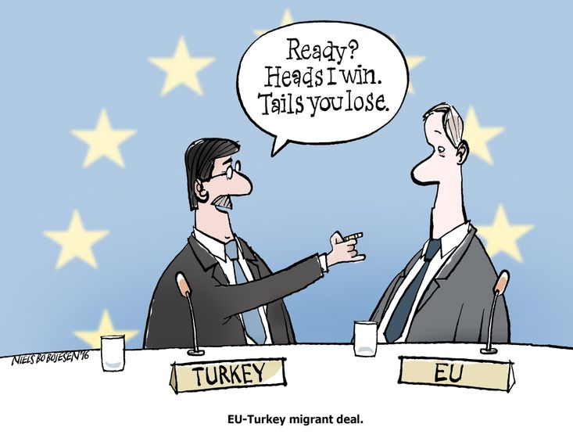
EU – Turkey Agreement.

Slide 31
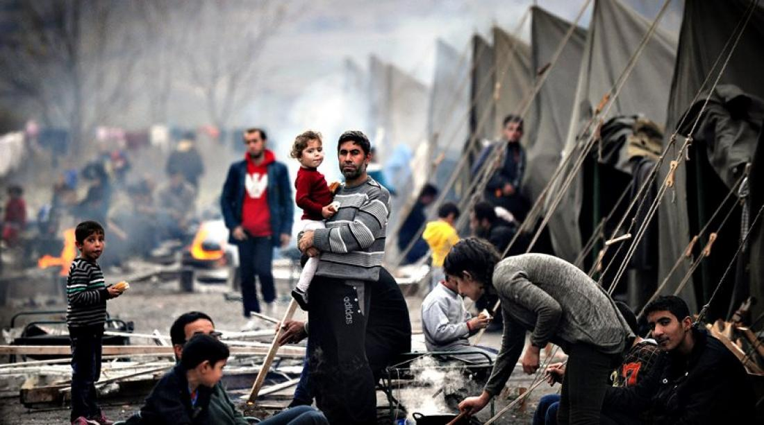
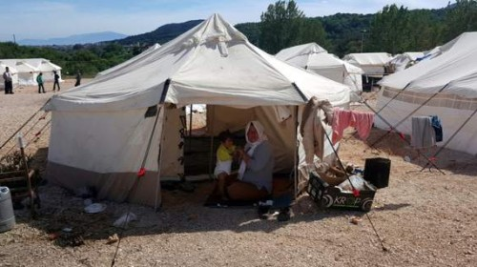
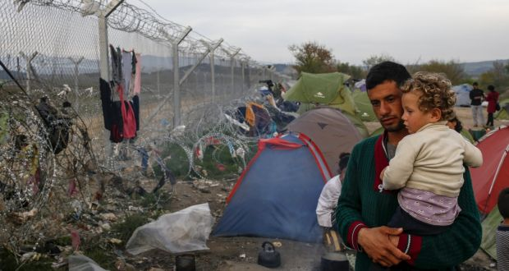
The living conditions in the hotspots

Slide 32
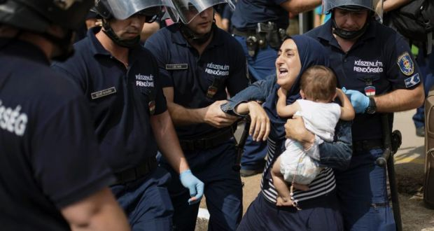
All EU countries must share the burden

Slide 33
Thank you for your attention

Slide 34
BIBLIOGRAPHY
https://www.asylumineurope.org/reports/country/greece/asylum-procedure
https://www.asylumineurope.org/reports/country/greece/overview-legal-framework
https://www.bbc.com/news/world-europe-44660699
https://tvxs.gr/news/ellada/i-diadikasia-aitisis-asyloy-plirofories-se-18-glosses
https://www.synigoros.gr/?i=foreigner.el.prosfiges-nomo8esia
http://asylo.gov.gr/?page_id=107
http://asylo.gov.gr/en/?page_id=72

