Slide 1
Asylum & Push-Pull Factors
Erasmus+

Slide 2
Push & Pull Factors
Push Factors
Pull factors
Something that makes people want to leave a place.
Push factors:
Poverty
Fear
Disasters
Unemployment
It is used to describe factors that attract people to a country, region, religion etc. It is opposite of a push factor, which involves conditions that motivate one to leave.
Potential jobs
Safer environment
Better services

Slide 4
Push & Pull factors at Greece
The most notable “push factor” for Greek immigrants were poor economic conditions prevalent in Greece during the late 19th century.
The United States economy in the late 19th/early 20th century allowed for many unskilled urban jobs to open up, perfect for immigrants.

Slide 5
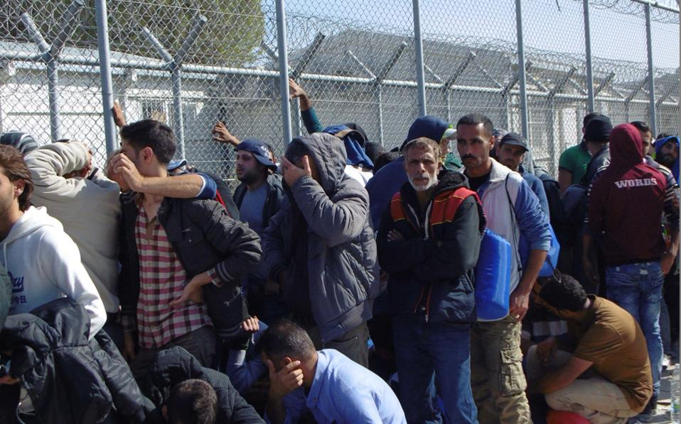
Immigrants here in Greece

Slide 6
What is an Asylum ?
The protection granted by a state to someone who has left their home country as a political refugee.

Slide 7
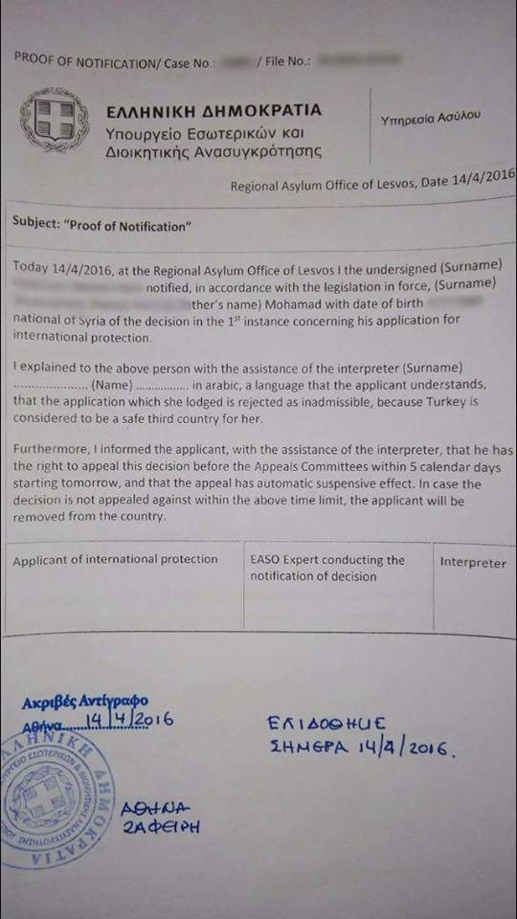
That’s a Greek Asylum

Slide 8
Who is an asylum seeker?

Slide 9
Asylum in Greece
The last 4 years 102.184 people have requested for asylum.
It required more than a year for the procedure to be completed. After the accordance between E.U- Turkey from March-11th June 2017 there was a vertical decline in migratory flows to Greece (6.000 had to go back to Turkey)
19.970 people had requested in the Greek islands. Only 881 people got international protection. 8.409 were referred for examination at their requests on the islands due to vulnerability or because it was considered that it wasn’t safe for them to go back.

Slide 10
Asylum seekers
2.678 people weren’t included in the procedure of the family reunion.
Greece according to Euro stat is the 2nd country in E.U regarding the percentage of the asylum seekers per 1 million residents (in combination with the financial problems) . It was hard to find solutions and harder to pursue policies concerning the living and integration of these people.
Syria
Iran
Pakistan
Afghanistan
32.983 women
69.201 men
32.272 minors
0,5% people
over 65 years old
486 girls
3.915 boys
374 minors international protection
(others)
42.9% young people(18-24)
Unaccompanied minors: 4.401 people

Slide 11
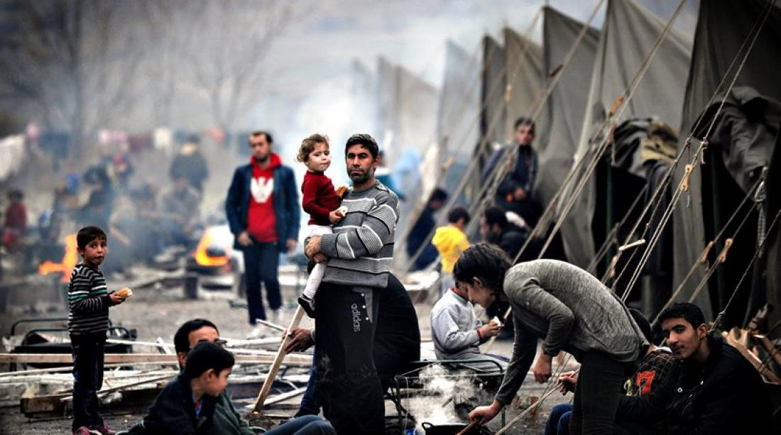

Slide 12
What happens to the refugees?
Other countries didn’t allow the access to their ground and they didn’t offer protection or held, the can convict them in an intolerable situation, human rights, safety, their life is in danger.
Information about the refugees and the Asylum seekers in Greece translated in 5 languages.
Governments usually guarantee basic human rights and the security of their citizens.
When people become refugees the safety net is lost. Refugees that are being eradicated for war or persecution are often in a very vulnerable position.

Slide 13
Authorization procedure for the Asylum
Asylum service : Operates since June 2013, 1st structure in Greece qualified for the consideration of international protection request.
Refugee authority : Second-level examination of applications rejected from Asylum services.
Reception and identification services : inauguration of a system for the reception and recording of the data and needs of those entering Greece without legal formulations including those wishing to seek Asylum.

Slide 14
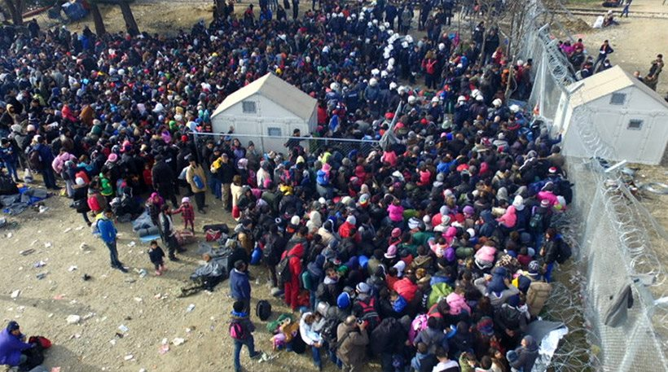
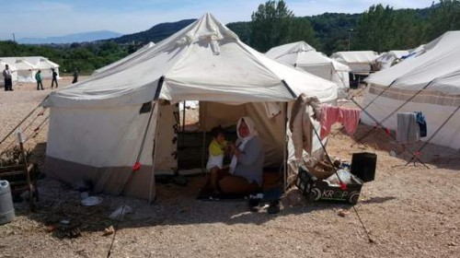

Slide 15
Access to justice
Legal Assistance
What is the procedure to get asylum
Where can you apply for Asylum
Asylum seekers often don’t meet the formal requirements under national law to be represented free of charge by a lawyer.
Everyone, needs legal assistance to ensure that :
An appropriate asylum procedure is followed
Identified vulnerabilities
Deadlines are respected
Basic living needs are met and their rights are respected.
You must submit your application in person to one of the Regional Asylum Offices on Asylum Units.
You must also submit applications for members of your family, provided that they are also in Greece and that they wish to do so.
The competent authorities to register your application are the following:
Regional Asylum Services
Asylum Units
Criminal courts
Although Greek law provides for legal aid, in practice the courts appoint lawyers only for very serious crimes

