Slide 1
MIGRATION IN THE PAST- FAMOUS GREEK MIGRANTS
Greece : 1950 - 2000

Slide 2
Gymnasium Neue Oberschule , Braunschweig,Germany
3rd Gymnasio of Kalamata Kalamata, Greece
EBI Francisco Ferreira Drummond, Terceira Portugal
Colegiul Economic Buzău , Romania
IES Luis Seoane, Pontevedra, Spain
"This presentation has been prepared exclusively for educational purposes under the Creative Commons Attribution (Attribution, Share Alike) . No infringement is intended. It is the outcome of a student project, and does not necessarily represent the views of the 3 Gymnasio of Kalamata or any other individuals referenced or acknowledged within the presentation.

Slide 3
Famous Greek immigrants
Georgios Nikolaou Papanikolaou
Maria Callas
Melina Merkouri
Arianna Stassinopoulos Huffington

Slide 4
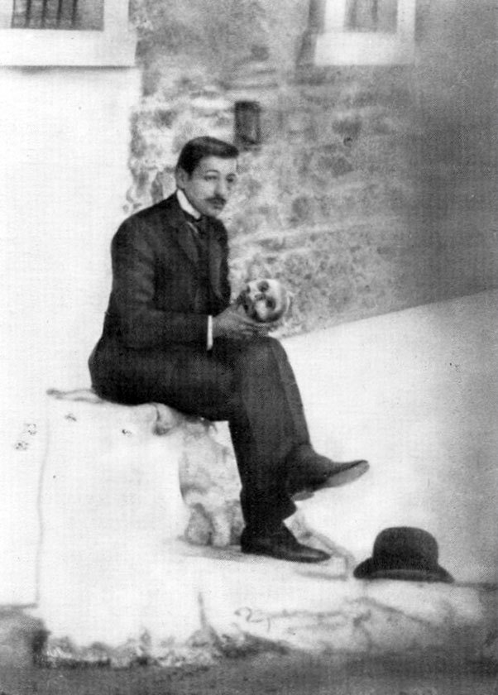
Georgios Nikolaou Papanikolaou
Born on 3 May 1883 and died on 19 February 1962) George Papanicolaou was a Greek pioneer in cytopathology and early cancer detection, and inventor of the "Pap smear".
In 1913, he emigrated to the U.S. in order to work in the department of Pathology of New York Hospital and the Department of Anatomy at the Cornell Medical College Cornell University.

Slide 5
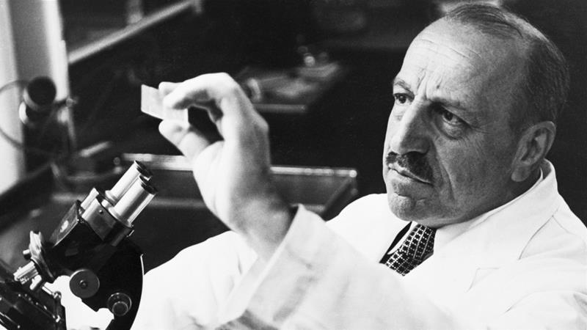
He thus became known for his invention of the Papanicolaou test, commonly known as the Pap smear or Pap test, which is used worldwide for the detection and prevention of cervical cancer and other cytologic diseases of the female reproductive system.
Papanicolaou was the recipient of the Albert Lasker Award for Clinical Medical Research in 1950

Slide 6
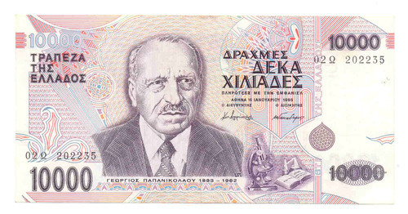
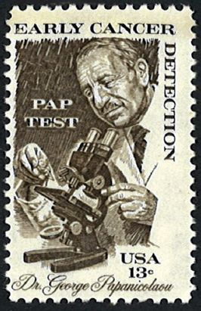
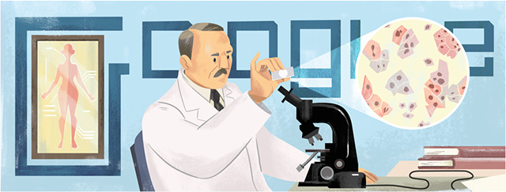
Commemorations
In 1978, Papanikolaou's work was honored by the U.S. Postal Service with a 13-cent stamp for early cancer detection.
Between 1995 and 2001, his portrait appeared on the obverse of the Greek 10,000-drachma banknote, until its replacement by the euro.]
On 13 May 2019, the 136th anniversary of his birth, a Google Doodle featuring Papanikolaou was shown in North America, parts of South America, parts of Europe and Israel.
https://en.wikipedia.org/wiki/Georgios_Papanikolaou

Slide 7
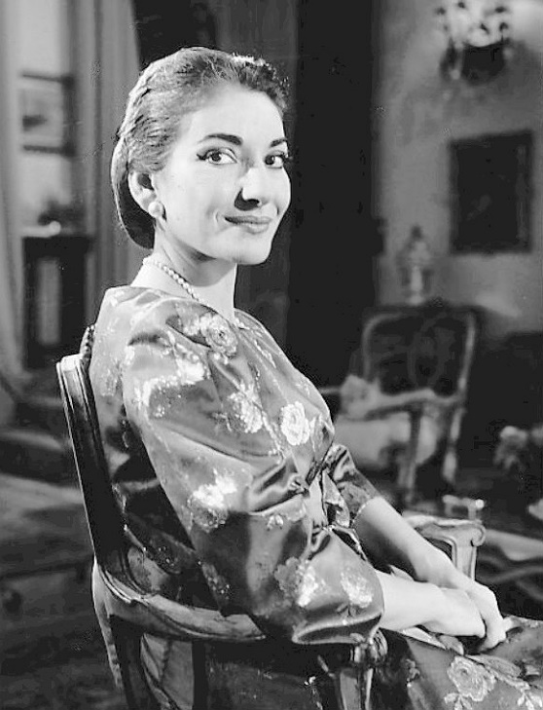
Maria Callas
Maria Callas, December 2, 1923 – September 16, 1977) was an American-born Greek soprano She was born in New York but immigrated to Greece at a vey early age.
She received her musical training in Greece at age 13 and later established her career in Italy.
She returned to the United States and reunited with her father in September 1945

Slide 8
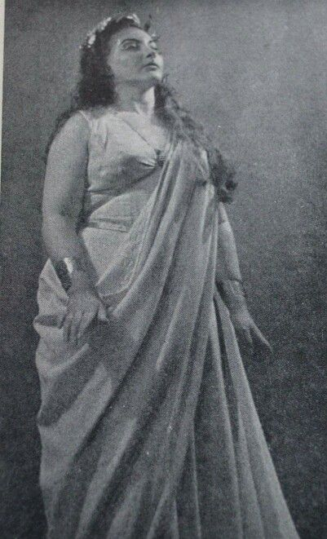
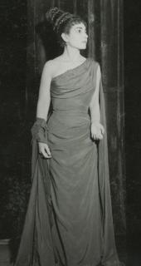
In the early years of her career, Callas was a heavy woman. She turned herself from a heavy woman into a svelte and glamorous one after a mid-career weight loss, which might have contributed to her vocal decline and the premature end of her career.

Slide 9
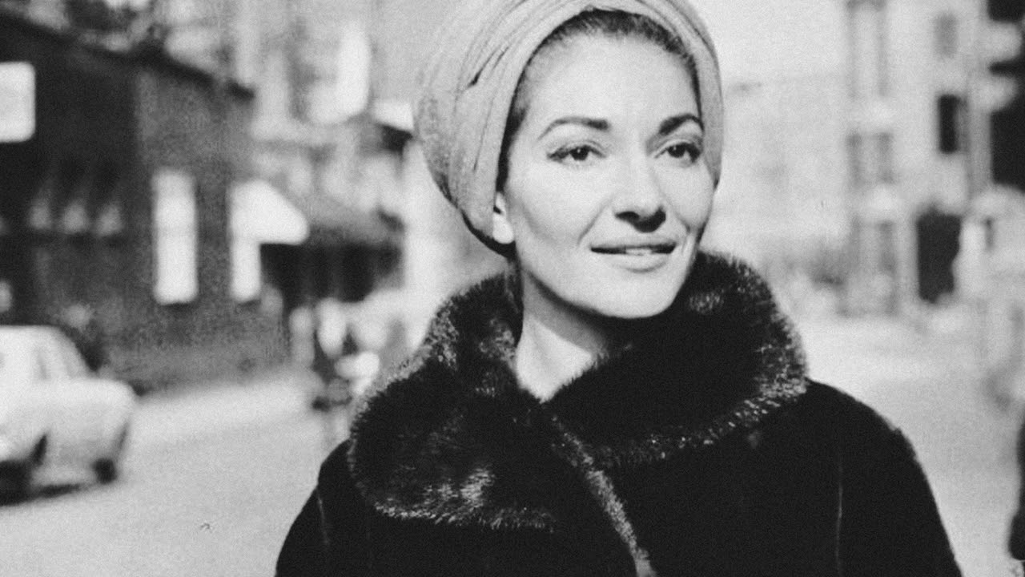
Her influence in opera was so enduring that, in 2006, Opera News wrote of her: "Nearly thirty years after her death, she's still the definition of the diva as artist—and still one of classical music's best-selling vocalists. It was her
musical and dramatic talents led to her being hailed as La Divina. According to many specials Maria was note- perfect
https://en.wikipedia.org/wiki/Maria_Callas

Slide 10
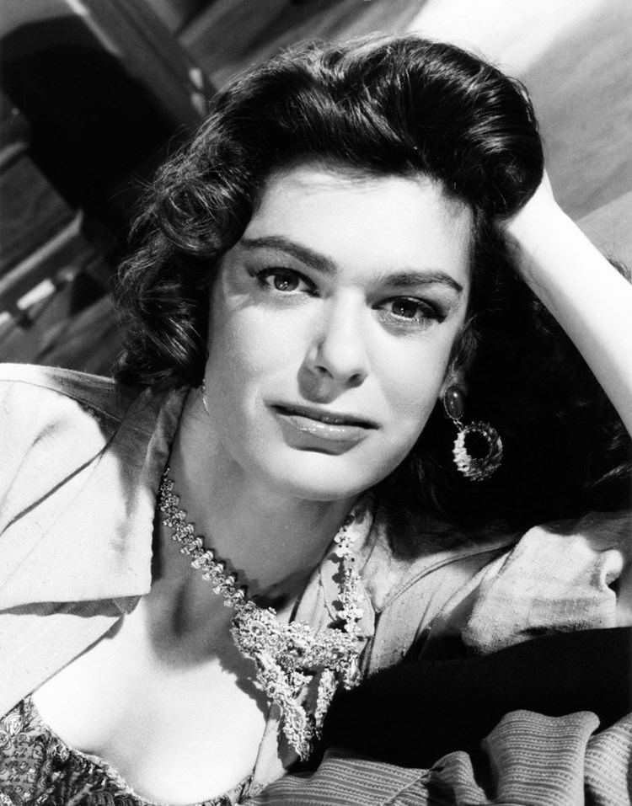
Melina Mercouri
Greek actress and Politian.
played a leading role in the struggle against the Colonel’s Junta in 1967 – 1974
Melina (the diminutive of her two names Amalia – Maria) Mercouri was born in Athens on 18 October 1920 to a family of politicians (her grand father was Spyros Mercouris – one of the most successful and popular mayors of Athens, for more than 30 years)
Info from https://melinamercourifoundation.com/en/melina-mercouri/biography-2/

Slide 11
She emigrated to Paris then the US for her acting career.
In 1960 she received the best actress prize in Cannes for “Never on Sunday”. The film also won five Oscar nominations.
Melina Mercouri combined the magic of the performing arts with the realism of politics. She was very actively involved in many aspects of social and political life, first during the struggle against the dictatorship and later, in 1977 as a Member of Parliament and, finally, from 1981 to 1989 and from 1993 until her death as Minister of Culture.

Slide 12
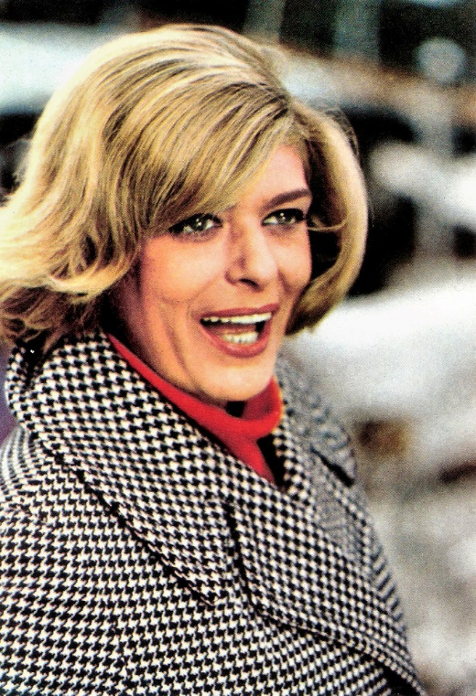
During the seven years of the dictatorship (1967-1974) she was best known for her anti -junta activity in Europe and the US.
After the fall of the dictatorship and the restoration of democracy in 1974, she settled in Greece where she continued her political activity in the Pan Hellenic Socialist Party (PASOK) to which she was a founding member.
October 1981, Melina Mercouri was appointed Minister of Culture, a post she would keep for the whole 8 years of the PASOK government, the first Minister of Culture in Greece to remain in office for so long. Amongst her wide-ranging activities at the Ministry of Culture Melina Mercouri:

Slide 13
Started the campaign for the return of the Parthenon Marbles presently in the British Museum.
– She introduced free access to museums and archaeological sites for Greek citizens as part of an overall education effort aimed at the people, youth in particular.
– She established the Municipal Regional Theatres and contributed to the creation and operation of Municipal Conservatories.
In 1983, during the first Greek presidency, she invited the Culture Ministers of the ten European Union Member States, at the time, at an informal meeting in Zappeion where she asked them to participate in a joint action to increase the people’s cultural awareness, since there was no reference to cultural questions in the Treaty of Rome. So, on her initiative the sessions of the EEC Ministers of Culture were established.

Slide 14
– One of her greatest achievements as Minister of Culture was the establishment of the institution of the Cultural Capitals of Europe, with Athens being chosen as the first capital in 1985.
– A dialogue with the countries of Eastern Europe began on her initiative when in 1988, during the second Greek presidency, she supported the idea of a cooperation between Eastern Europe and the European Union and tried to open up the borders despite the strong reservations of her European partners. The idea was implemented in 1989 with the celebration of the Month of Culture in Eastern countries.
– To link culture with education at all educational levels, by creating a new system of post-training of teachers so that in all subjects there be included cultural references..
Melina Mercouri died on 6 March 1994 at New York’s Memorial Hospital and her funeral was held, with Prime Minister’s honors, on 10 March 1994.

Slide 15
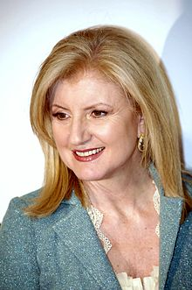
Arianna Huffington
Born on July 15, 1950 in Athens, Greece, Ariadni-Anna Stasinopoulou is syndicated columnist, and businesswoman. She is the founder of The Huffington Post, the founder and CEO of Thrive Global, and the author of fifteen books. In May 2005, she launched The Huffington Post, a news and blog site. In August 2016, she launched Thrive Global, a corporate and consumer well-being and productivity platform.

Slide 16
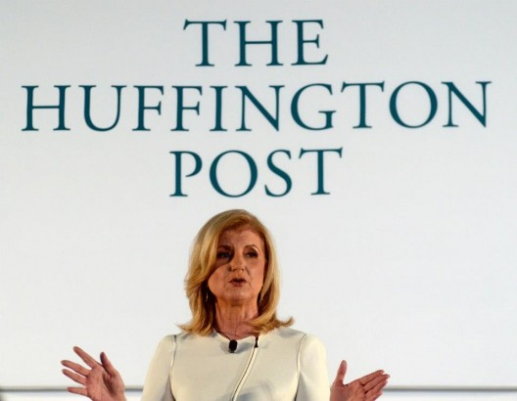
In 2009, Huffington was No. 12 in Forbes's first-ever list of the Most Influential Women In Media. She has also moved up to No. 42 in The Guardian’s Top 100 in Media List as of 2014, she is listed by Forbes as the 52nd Most Powerful Woman in the World

Slide 17
“Fearlessness is not the absence of fear. It’s the mastery of fear. It’s about getting up one more time than we fall down.” – Arianna Huffington

Slide 18
~End of presentation~
Thank you very much!

