Slide 1
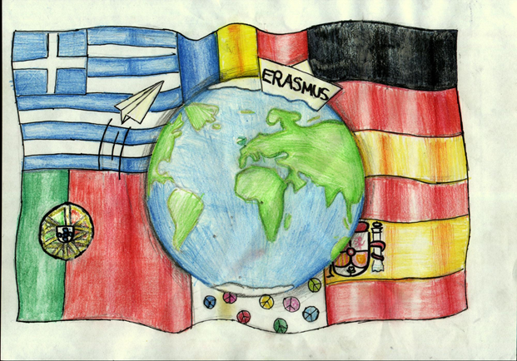
In & out Spain

Slide 2
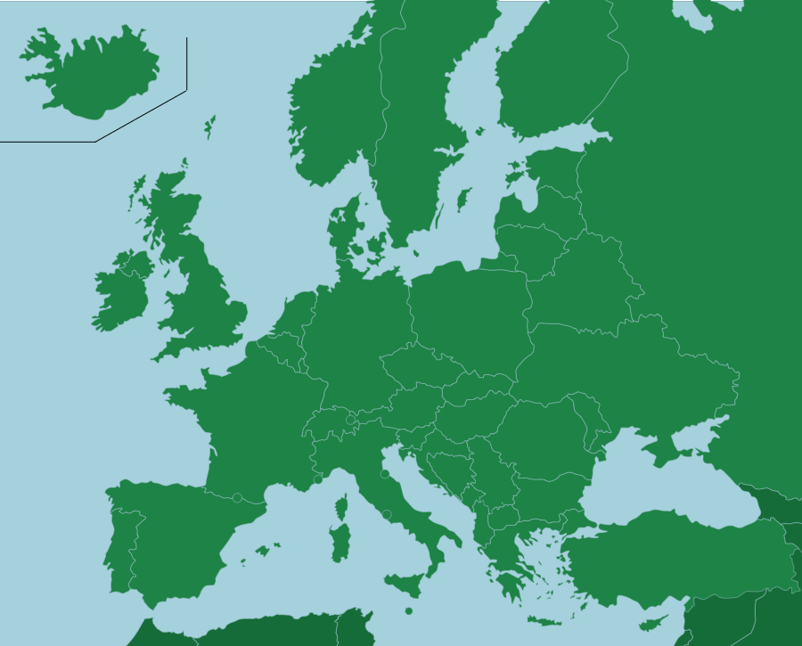
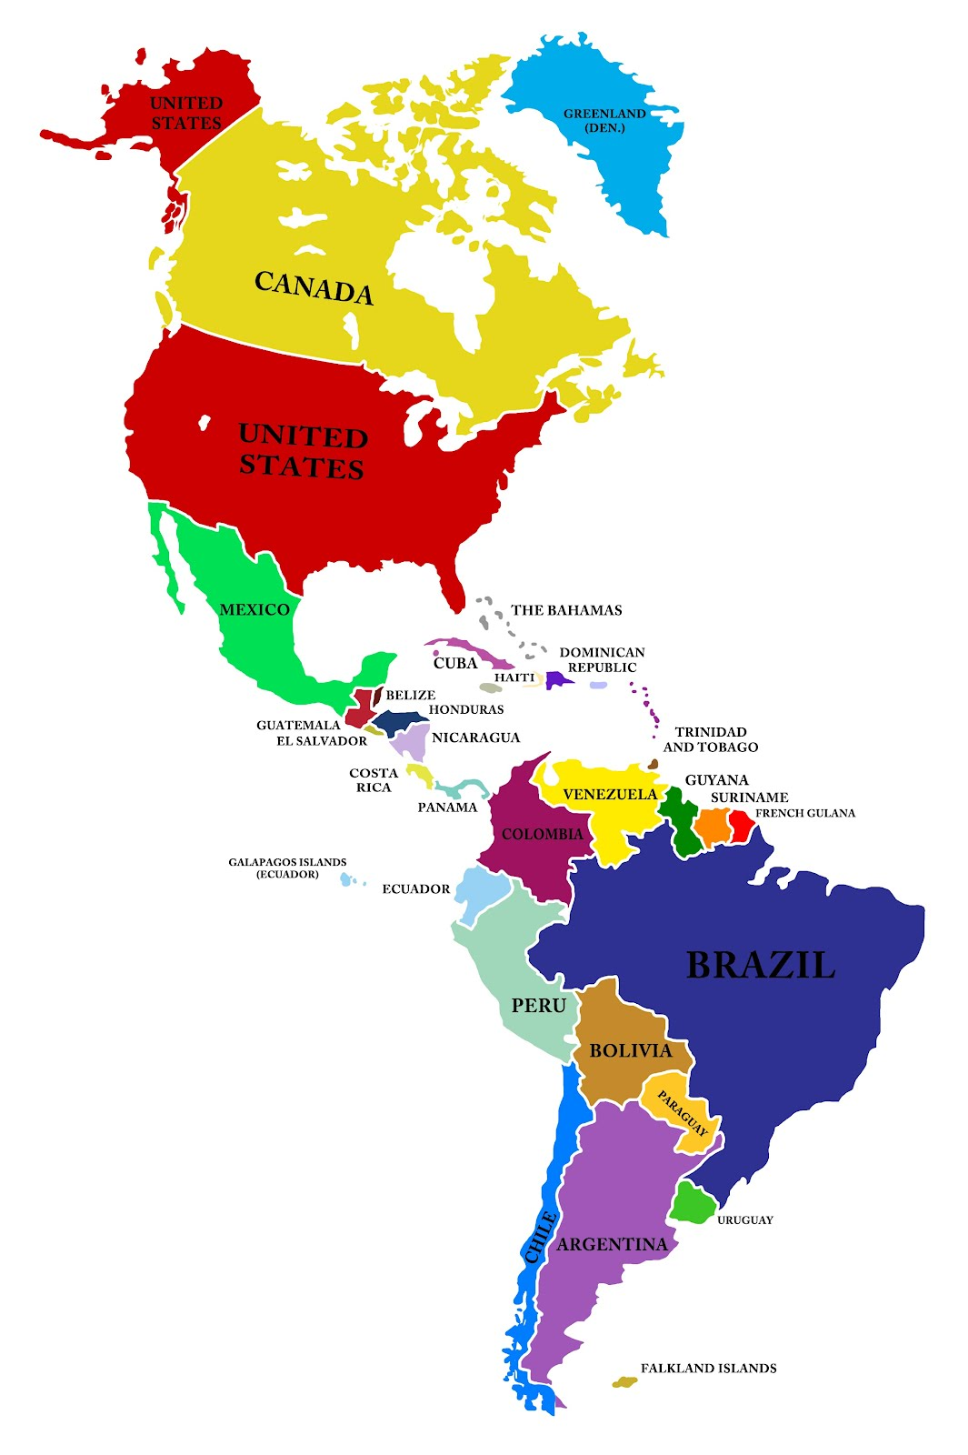

Slide 3
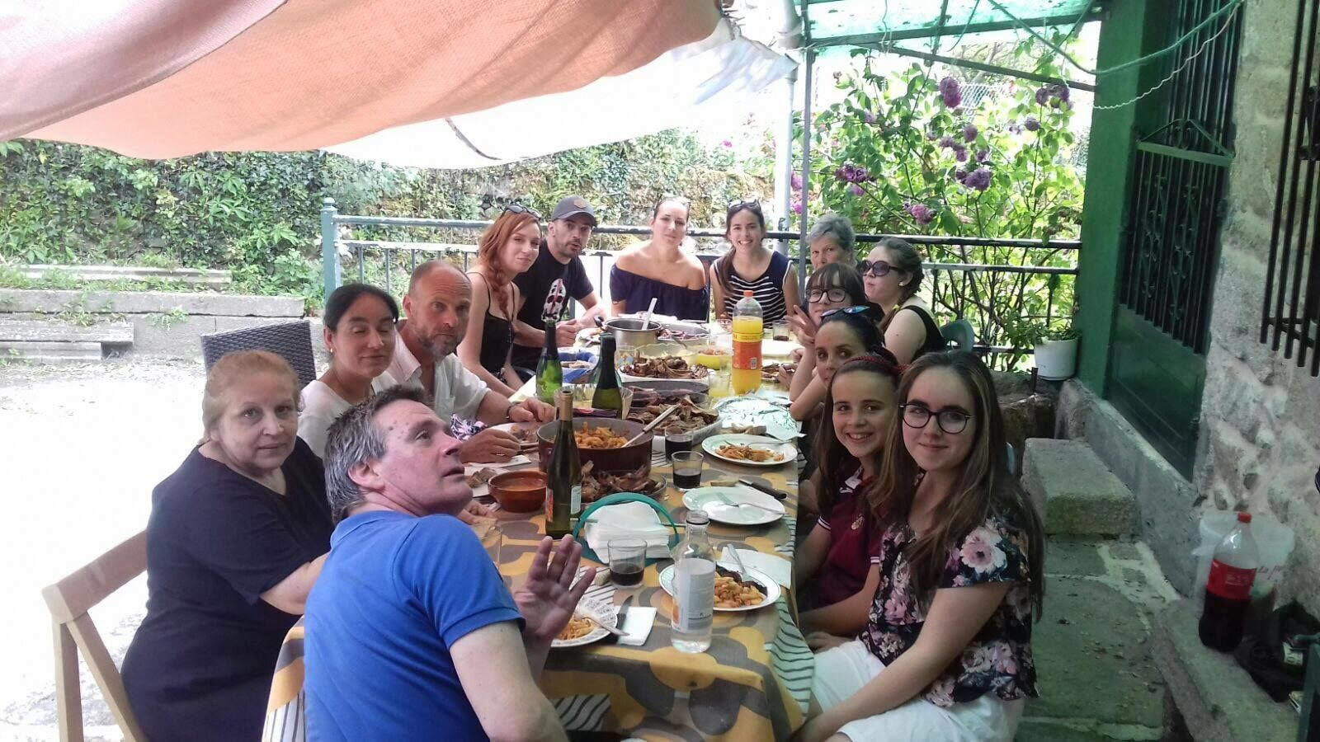
Leila and Athenea with their family in Spain

Slide 4
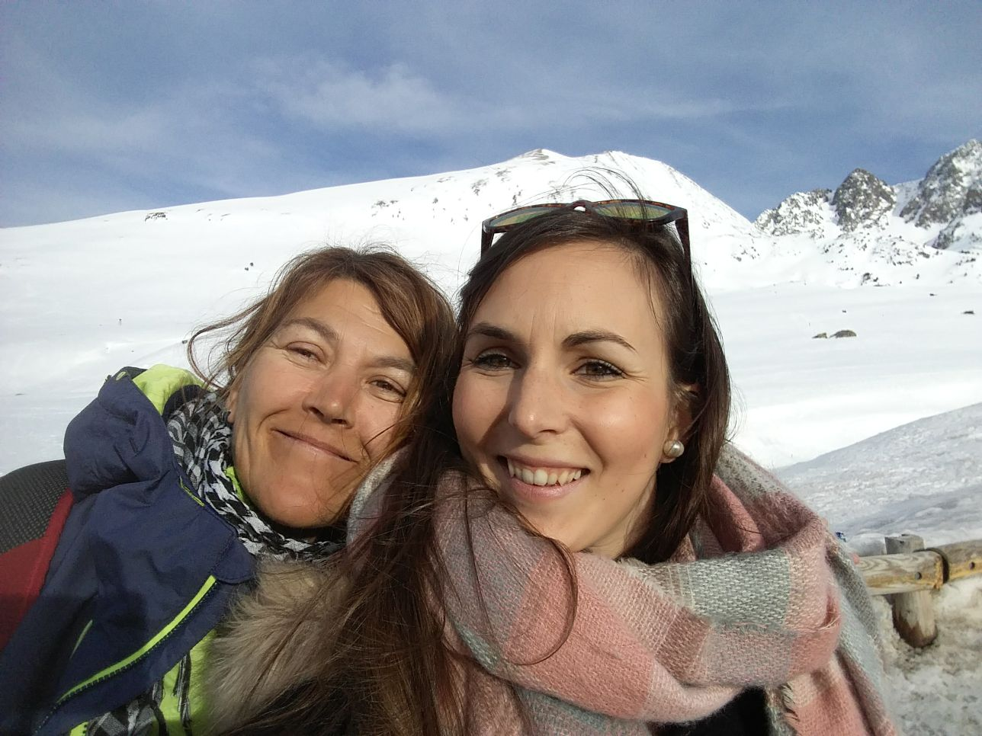
Leila and a French friend of her on holiday

Slide 5
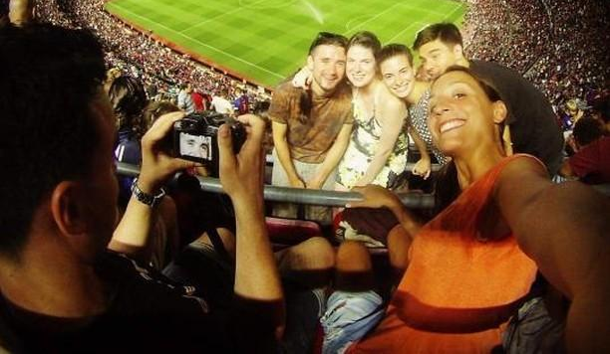
Sabela’s cousin with her friends in Germany

Slide 6
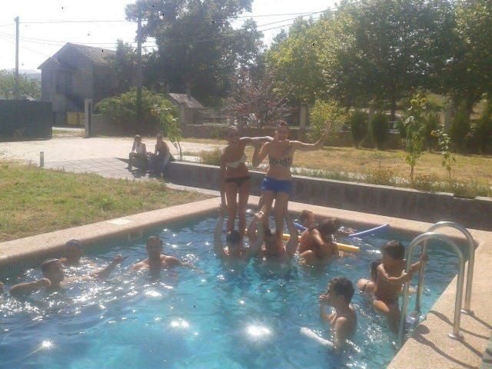
Sabela’s cousins with her family in Spain

Slide 7
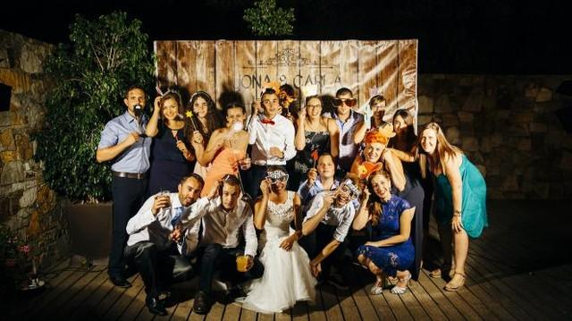
Sabela’s cousins with her family in Spain

Slide 8
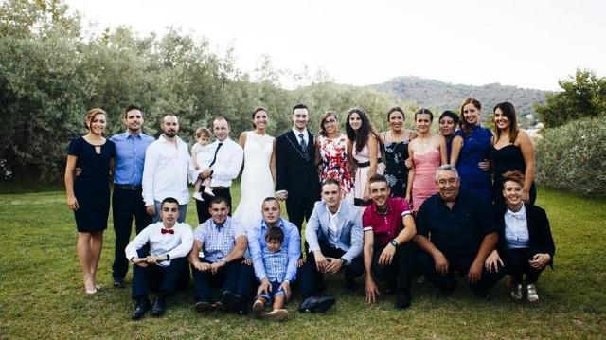
Sabela’s cousins with her family in Spain

Slide 9
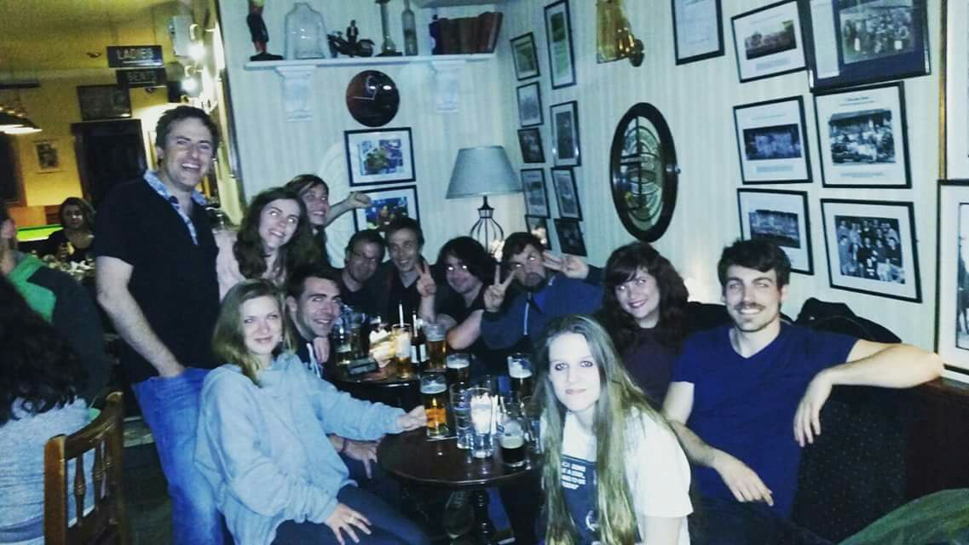
Pablo’s brother with his friends in Ireland

Slide 10
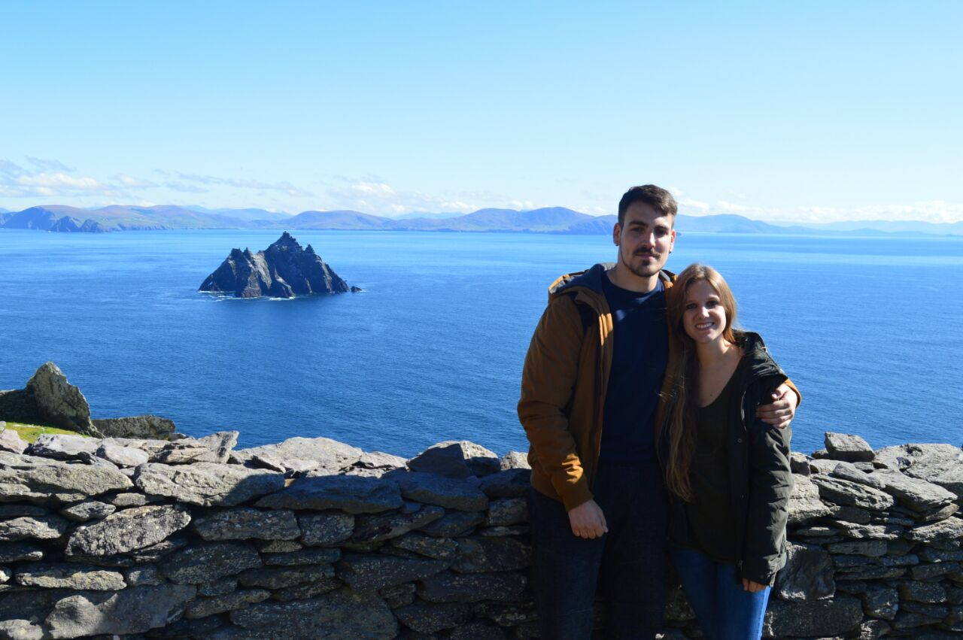
Pablo's brother with his girlfriend visiting different places in Ireland

Slide 11
BRAIN DRAIN:
young people emigrate to find a job

Slide 12
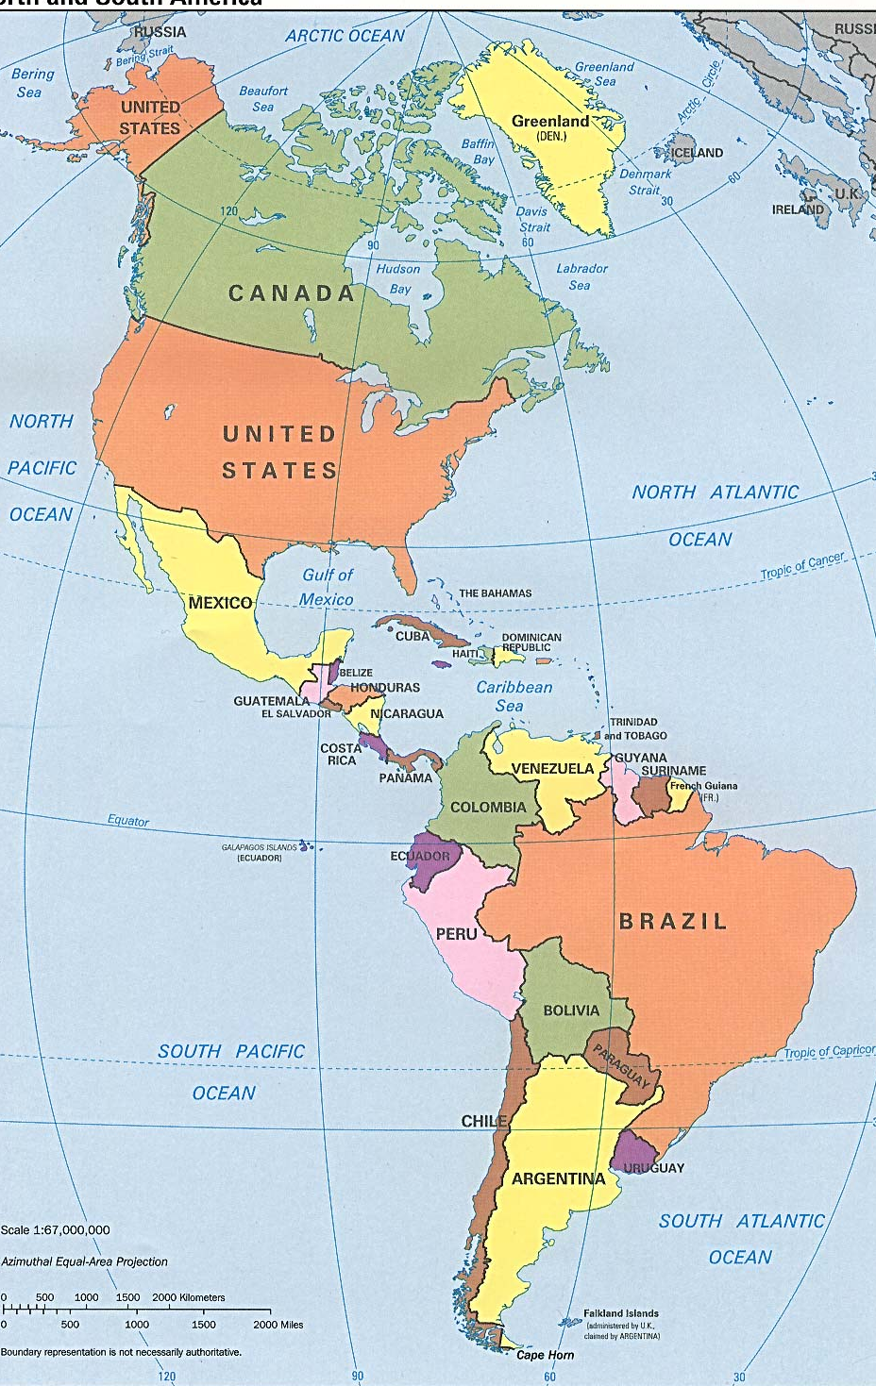
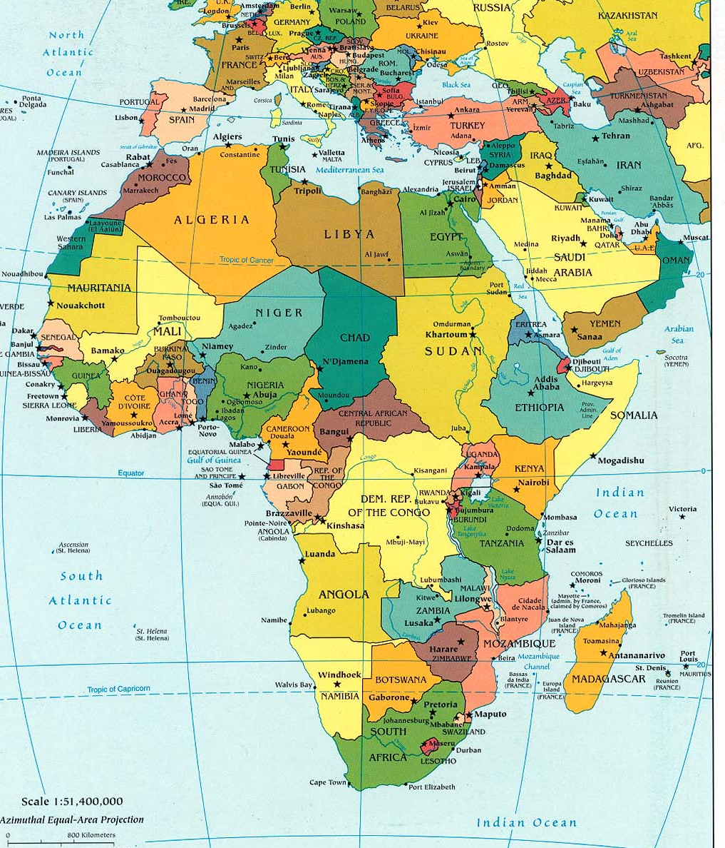
People also come to Spain to find better opportunities

Slide 13
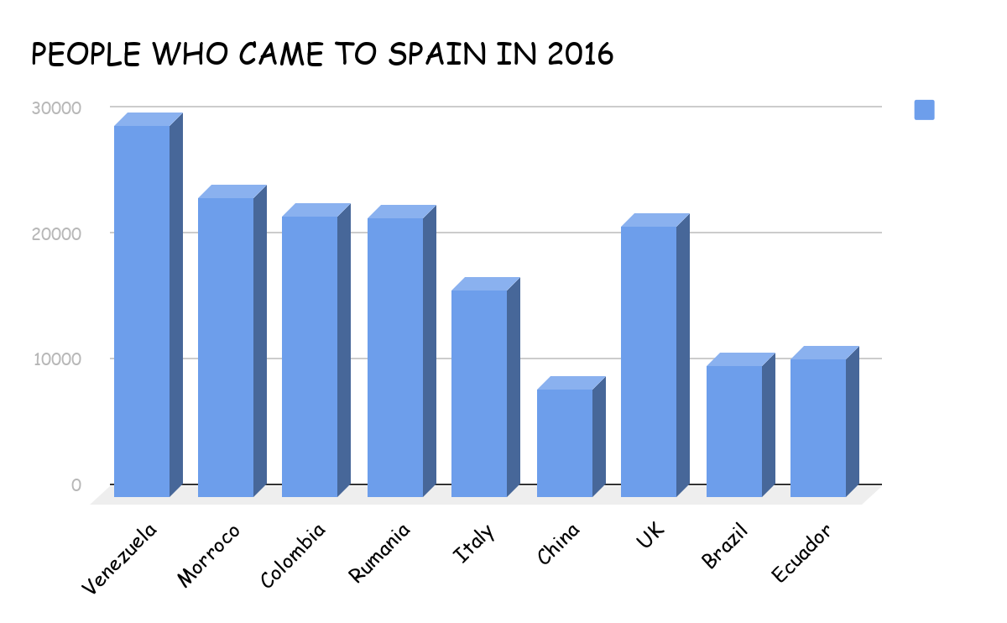

Slide 14
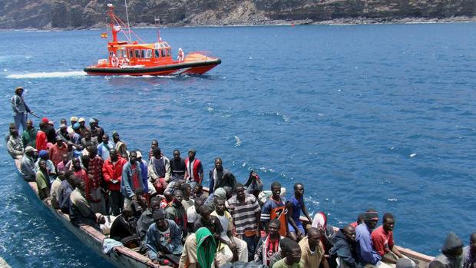
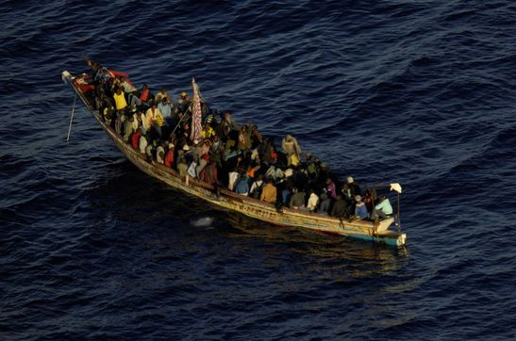
Cayucos with immigrants usually arrive at Andalucia

Slide 15
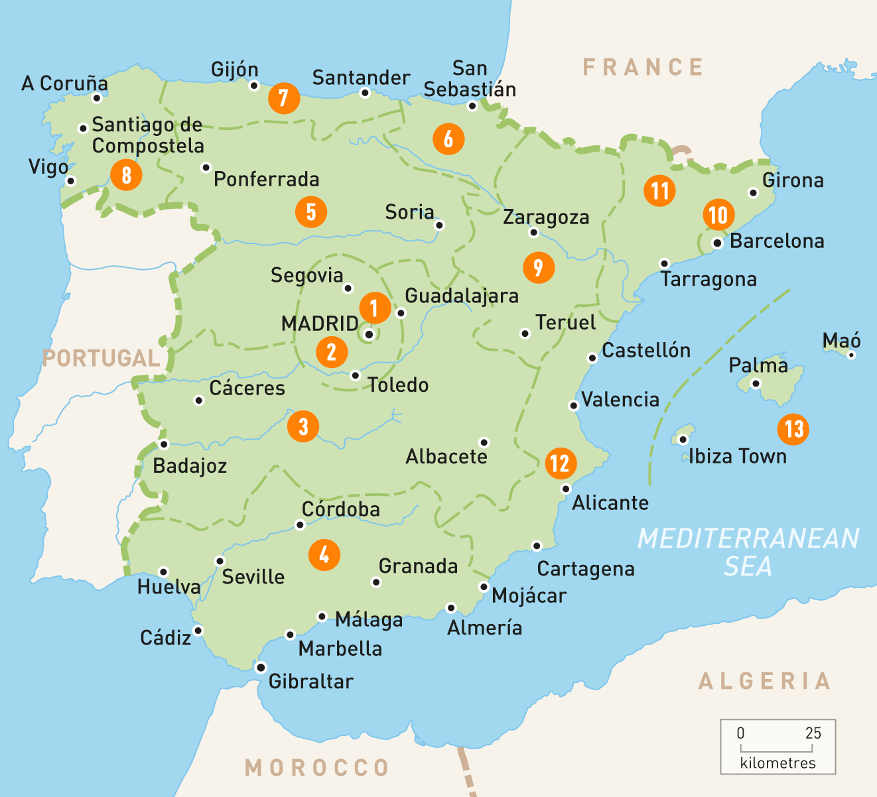
Andalucia

Slide 16
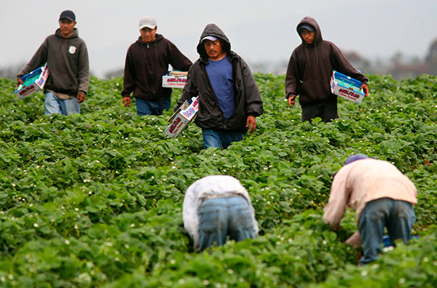
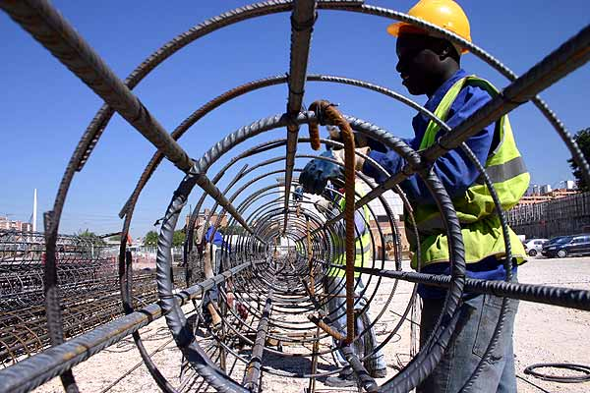
Jobs immigrants usually take

Slide 17
Thank you for your attention!!!
IES LUIS SEOANE
Pontevedra

Slide 18
Sources:
http://www.mediterraneodigital.com/images/2016/julio/inmigrantes-trabajo-campo.jpg
https://www.parainmigrantes.info/wp-content/uploads/2008/11/inmigrante_construccion.jpg
http://www.abc.es/espana/abci-interceptado-direccion-canarias-tercer-cayuco-tres-semanas-201711230350_noticia.html
https://www.roughguides.com/maps/europe/spain/
Family photos from Sabela Cendón, Pablo Abelleira and Athenea Canabal
For educational purposes only

