Slide 1
INITIAL EVALUATION OMIT
ODYSSEY- MIGRATION AND ITS INFLUENCE ON TEENAGERS
Terceira, november 2017

Slide 2
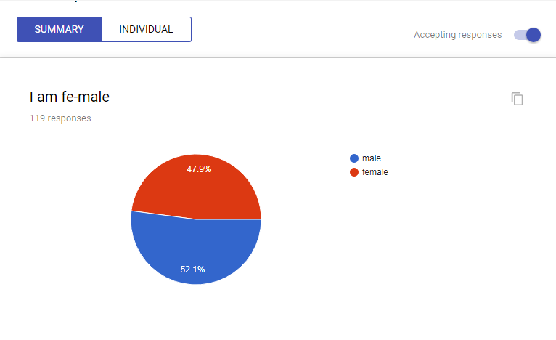
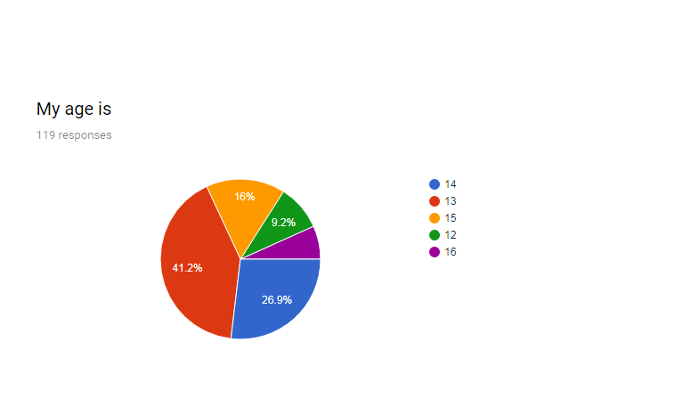
Repondents: 119 students/ 5 countries

Slide 3
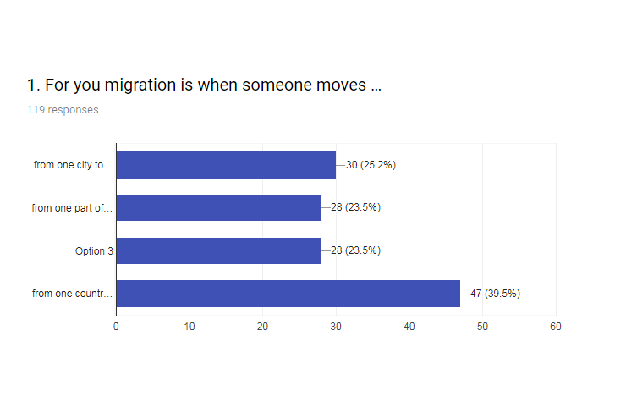
For you migration is when someone moves …
from one neighbourhood to another
From one city to another
From one part of the country to another
From one country to another

Slide 4
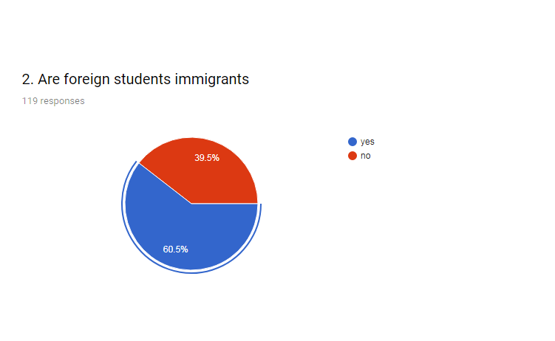
Are foreign students immigrants?

Slide 5
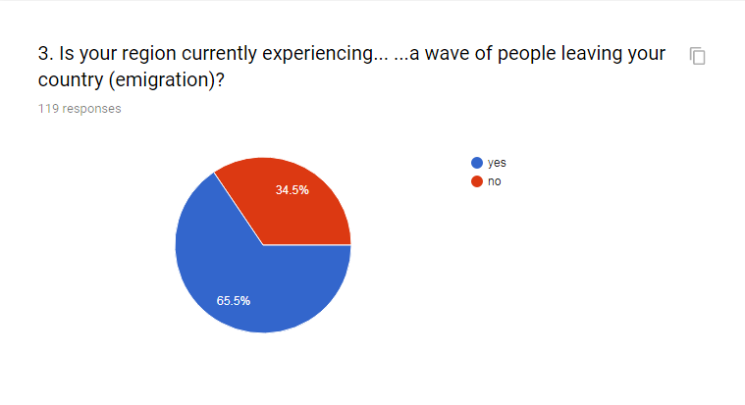
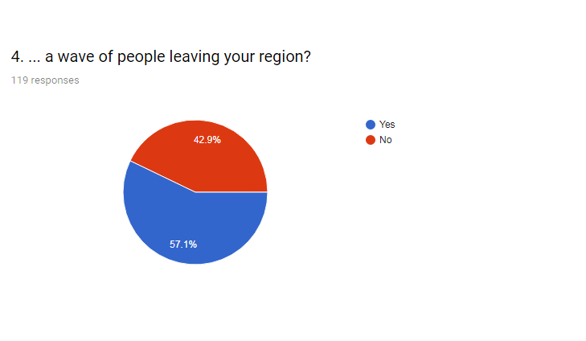
Is your region currently experiencing a wave of people leaving your country (emigration)?....a wave of people leaving your region?

Slide 6
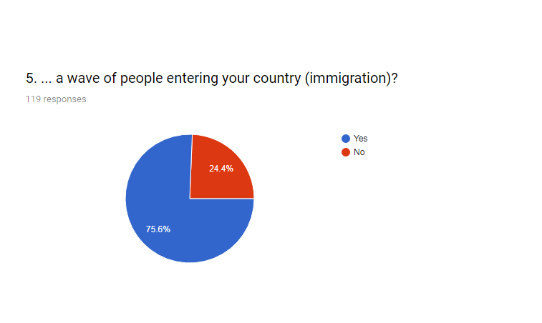
Is your region currently experiencing a wave of people entering your country (immigration)?....a wave of people entering your region?

Slide 7
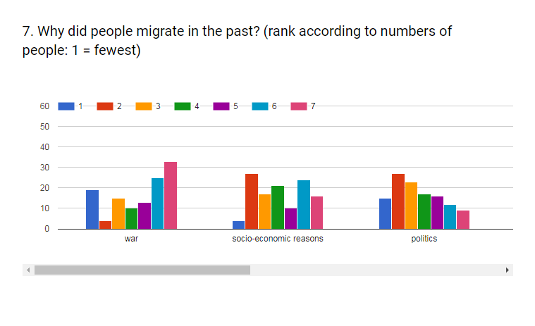
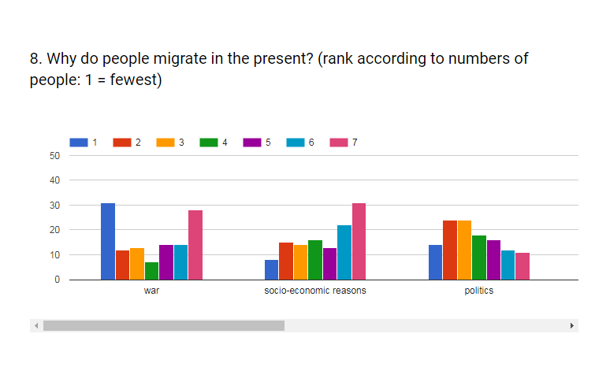
Why did people migrate in the past?
Why did people migrate in the present?

Slide 8
Do you have migrants in your recent family history?

Slide 9
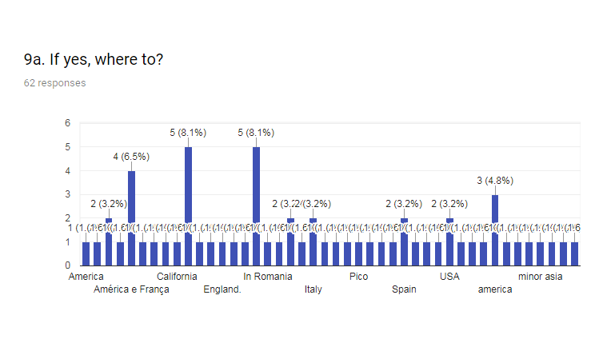
If yes, where to?...63 persons answered yes

Slide 10
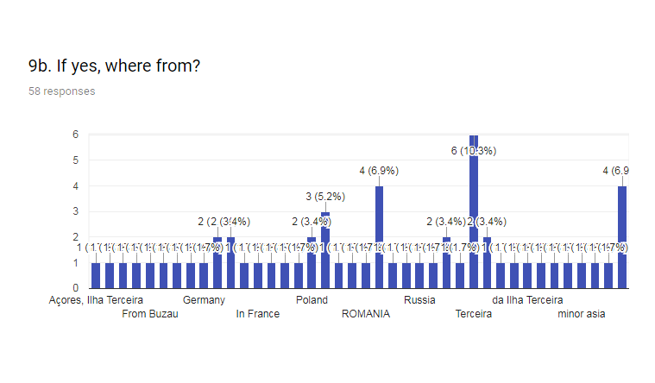
If yes, where from?...58 persons answered yes

Slide 11
What kind of people do you feel bothered by?
People of other ethnic groups
People of a different religion
People with a different skin colour
People with a different sexual orientation
People with a different political opinion
People with very different values
all of the above
None of the above

Slide 12
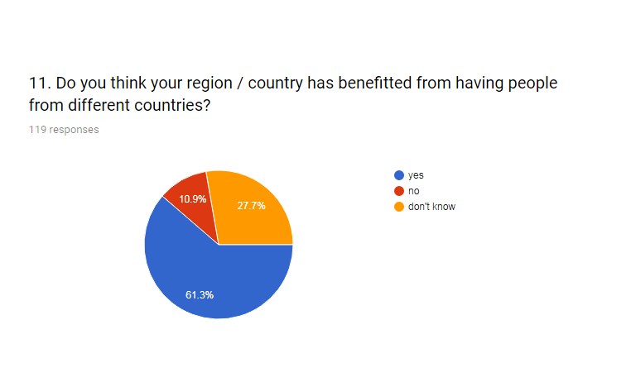
Do you think your region / country has benefitted from having people from different countries?

Slide 13
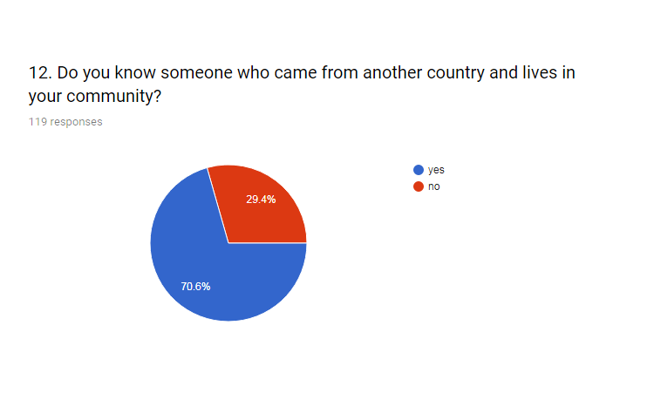
Do you know someone who came from another country and lives in your community?

Slide 14
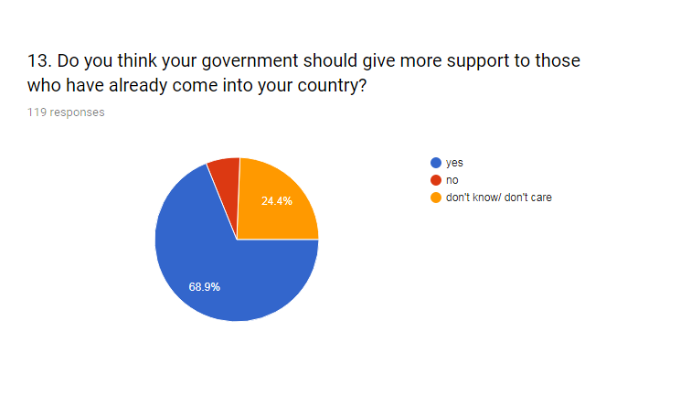
Do you think your government should give more support to those who come into your country?

Slide 15
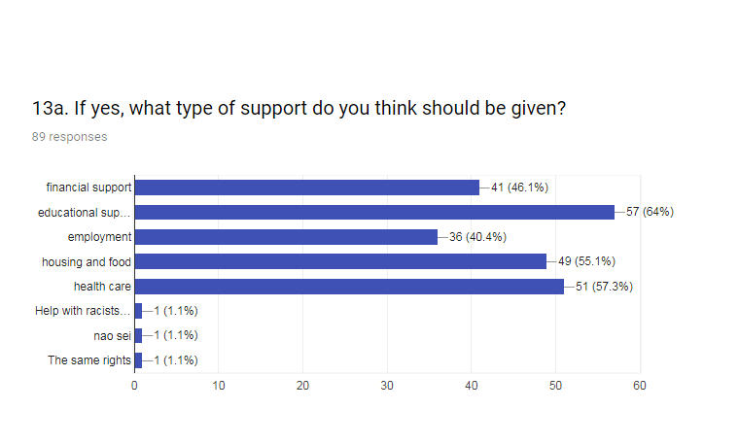
If yes, what type of support do you think should be given?
Financial support
Educational support (e.g. language courses)
Employment
Housing and food
Health care

Slide 16
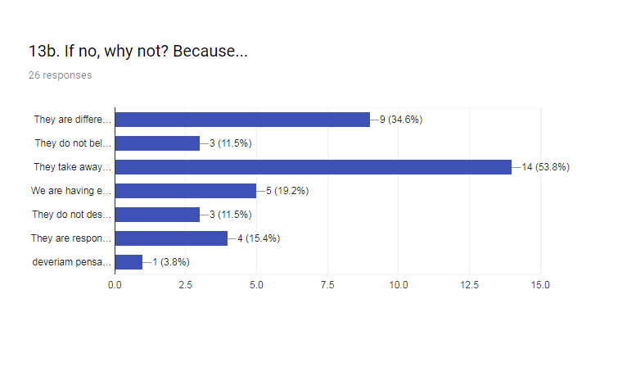
If no, why not? Because…
They are different from us
They do not belong here
They take away our jobs
We are having enough problems of our own
They do not deserve it
They are responsible for their own situation

Slide 17
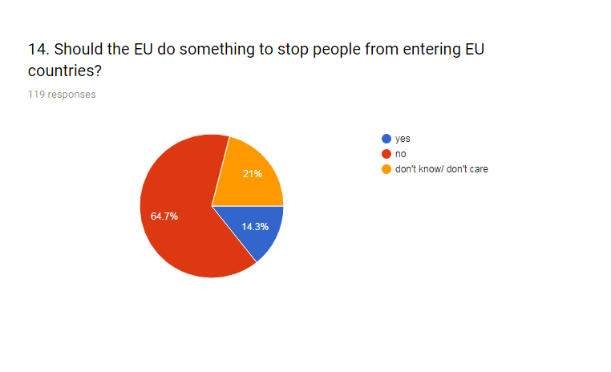
Should EU do something to stop peoples entering EU countries?

Slide 18
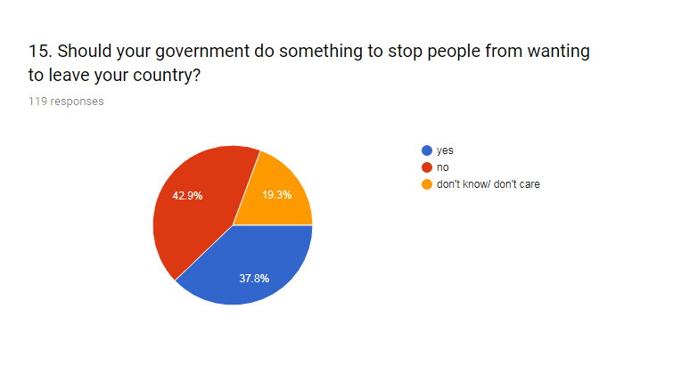
Should your governement do something to stop people leave/ come to your country?

Slide 19
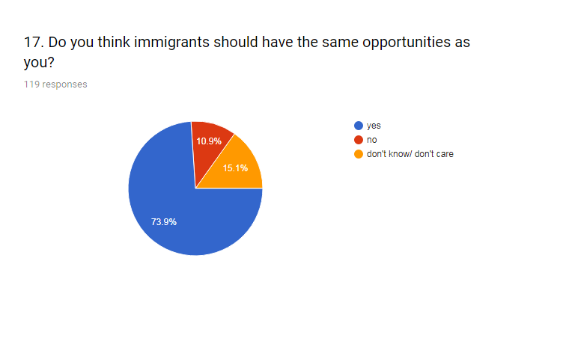
Becouse we are all the same
Becouse we are all humans
Becouse we help them integrate more easily

Slide 20
If you had the option to move to another country, which country would you choose?
USA
France
Australia
Germany
England
Iceland
Brazil
EUA
Canada

Slide 21
Why?
Beauty of the country
Better life
More chances for a good job
Better education
Family reasons
Better economy
More democracy

Slide 22
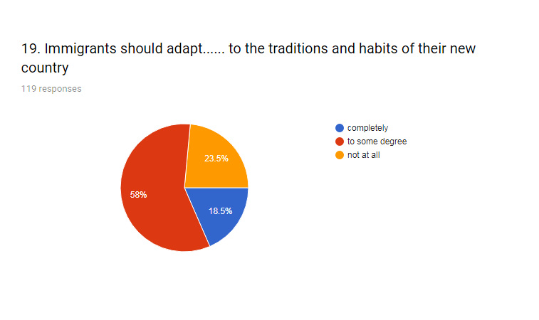
Immigrants should adapt...... to the traditions and habits of their new country

Slide 23
Why?
Belong to integration.
They should know the rules and respect them
They are not obligated to be like us
You should accept your new country traditions
You learn something new and open your mind
They don„t have to forget their own traditions
A country can„t change the traditions becouse there are new people

Slide 24
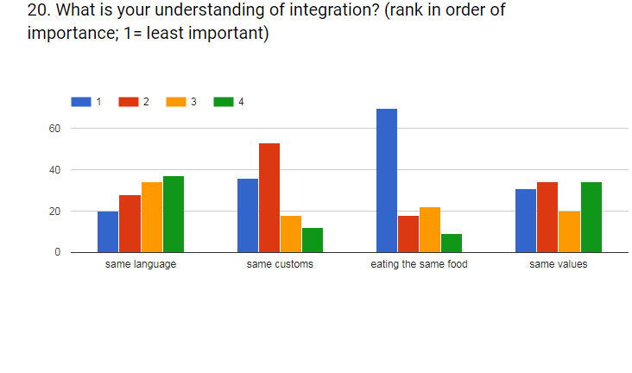
What is your understanding of integration?

Slide 25
Where should migrants live?

Slide 26
How do you think the future will be?

Slide 27
THANK YOU!!!!
"The European Commission support for the production of this publication does not constitute an endorsement of the contents which reflects the views only of the authors, and the Commission cannot be held responsible for any use which may be made of the information contained therein.”

