Slide 1
How do we know
migrant’s stories today?

Slide 2
NEWSPAPERS
RADIO AND TV
MIGRANTS’ STORIES
APPEAR IN...
THEIR OWN BLOGS

Slide 3
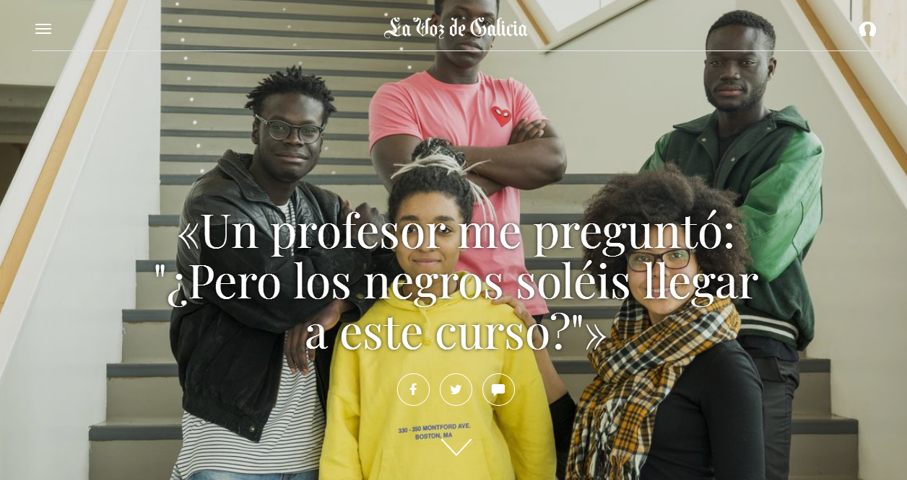
“ A teacher asked me: But do black people usually pass the A levels?”

Slide 4
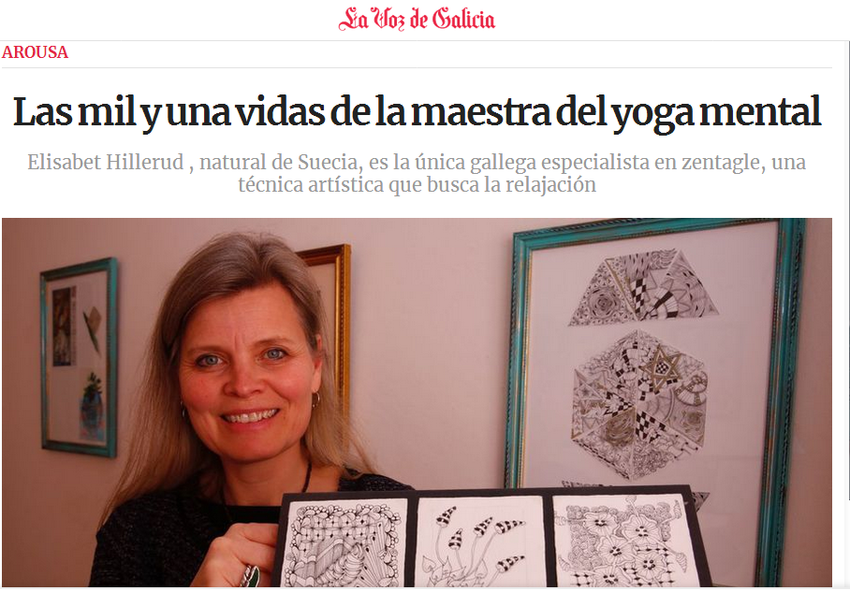
Elisabet Hillerud, from Sweden, is the only specialist in zentagle in Galicia

Slide 5
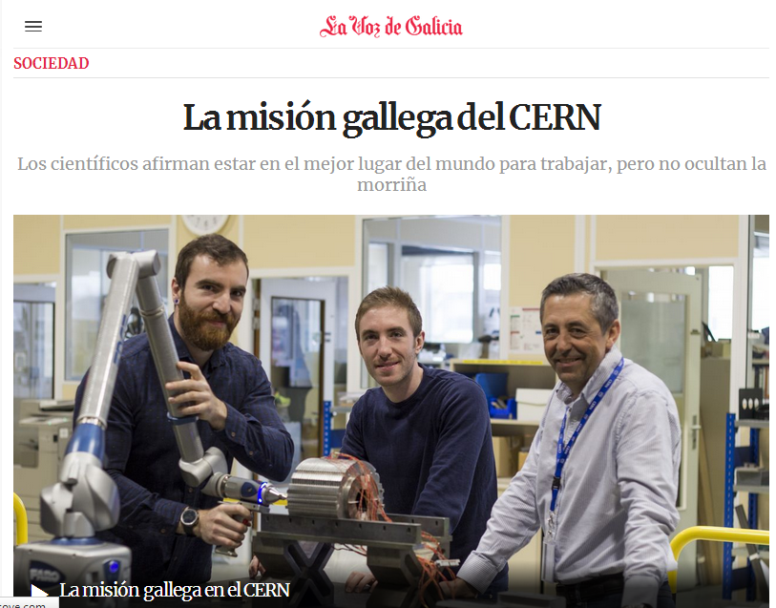
The Galicians working for the European Organization for Nuclear Research say they know they are working for the best company...but they still miss Galicia

Slide 6
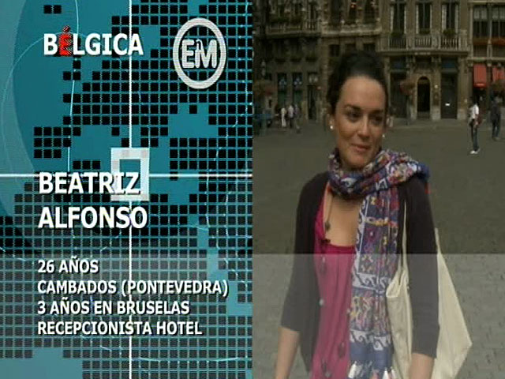
23 years old
From Antequera
1 year in Lapland
Student
TV programme interviewing Spanish people living abroad
26 years old
From Cambados
3 years in Brussels
Hotel receptionist

Slide 7
Sara Moreno writes about her life in Switzerland in her blog: living la vida en Suiza

Slide 8
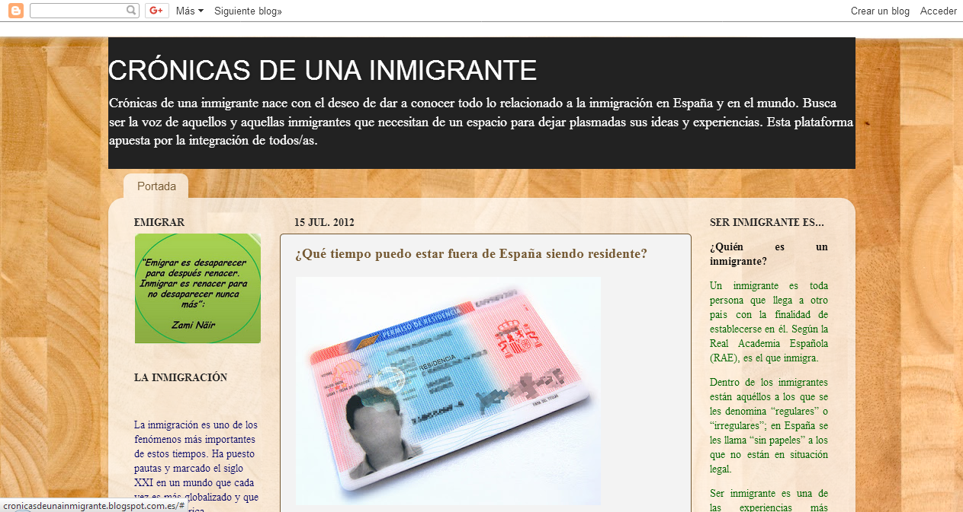
Immigrants in Spain also have their blogs: “Cronicas de una inmigrante” is one of them

Slide 9
Sources:
www.lavozdegalicia.com
http://www.rtve.es/television/espanoles-en-el-mundo/
https://lavidaensuiza.com/
https://cronicasdeunainmigrante.blogspot.com/
For educational use only

