Slide 1
Economic high school buzau
Acvarium-an experience for building the future
Students:
Manolache Cristina
Pantică Alexandru
Teachers:
Adriana Anton
Ionescu Adriana

Slide 2
Project Exercise firm- a practical learning method

Slide 3
The Exercise Firm.
The exercise firm is an interactive learning project, successfully applied by specialised teachers in techonogical highschools. It is a modern concept of interdisciplinary integration, a teaching-learning process and an amazing experience.
The goal of the exercise firm is to develop the student’s entrepreneurship skills gained in the professional training, by simulating all the actions that occur in a real economic environment.
We are also in competition with other exercise firms, which boosts us and makes everything ten times more interesting than any other course.

Slide 4
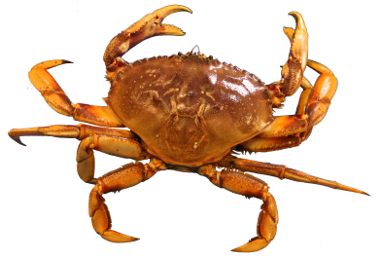
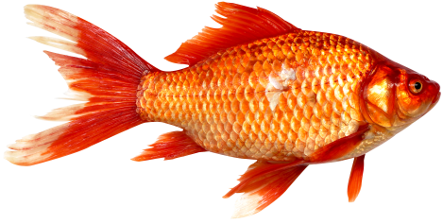
Company Presentation
F.E. Acvarium S.R.L..

Slide 5
Description of the Company
Name of the Company: F.E. ACVARIUM
Juridical Form: Private Limited Company (SRL)
Domain of Activity: Production
Object of Activity: Fish Farm

Slide 6
Acvarium was founded in October, 2017, on Buzau’s market.
Social capital:300 000 RON
Number of associates:5
We consider ourselves the ideal solution for any customer who wants a wide range of high quality products.
Our products are fresh and organic. We do not use growth hormones or additives.

Slide 7
Company Mission
We want to promote a healthy lifestyle trough a diversified consumption of fish, offering our clients the best quality products.
Company Vision
The company's vision is to become a leader on the fishery products market, so that we are the first consumer’s choice in fresh fish products.

Slide 8
Company values
Creativity
Devotion
Perseverance
Integrity
Passion

Slide 9
Strong Points
SWOT
ANALYSIS
Youth, enthusiasm.
Openmindedness towards innovation.
Affordable prices.
creativity.
Staff’s low experience.
Limited material .
financial resources.
Limited number of working hours for the E.F.
Low purchasing power.
Weak Points
Oportunities
Threats
The E.F. from Romania and from Europe is expanding.
Demand is steadily increasing.
Government grants subsidies for agricultural development.
Small competition.

Slide 10
POTENtial customers
47 restaurants from the E.F. network.
30 food stores in the E.F. network.
Individual, members in the E.F. network.

Slide 11
Company Offer Fresh Products
Product | Picture | Price | Code
Luce |  | 11,5 ron/kg | 001
Catfish |  | 17 ron/kg | 002
Carp |  | 16,9 ron/kg | 003
Crayfish |  | 26,6 ron/ kg | 004
Narrow-clawed crayfish |  | 24,5 ron/ kg | 005
Spiny-cheek crayfish |  | 20,9 ron/kg | 006

Slide 12
SPECIAL OFFERS
Fidelity Card
Crayfish in worth of 50 ron.
Purchased products in value of 600 ron

Slide 13
IDENTIFICATION DATA
Company: F.E. ACVARIUM S.R.L.
HQ : Strada Tudor Vladimirescu nr. 15 , Buzău
Registration number ROCT: J10/139/14.11.2017
CUI/ CIF: 1210015801
IBAN: RO10ROCT1110231210015801
E-MAIL: 11acvarium@gmail.com
PHONE NUMBER: 0238724247
FAX: 0238721197

Slide 14
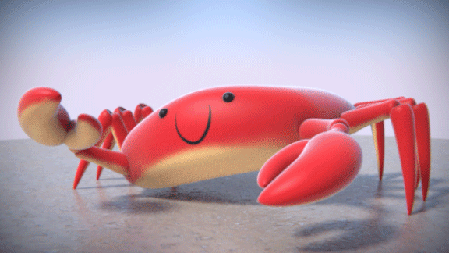
Thank you for your attention!

