Slide 1
A NEW BUSINESS A NEW VISION
Teachers: Ilie Catalina
& Catalina Postovei
Students: Dobrisan Raluca
& Tanase Claudiu
School: Colegiul Economic

Slide 2
NEW VISION
Colegiul Economic Buzău

Slide 3
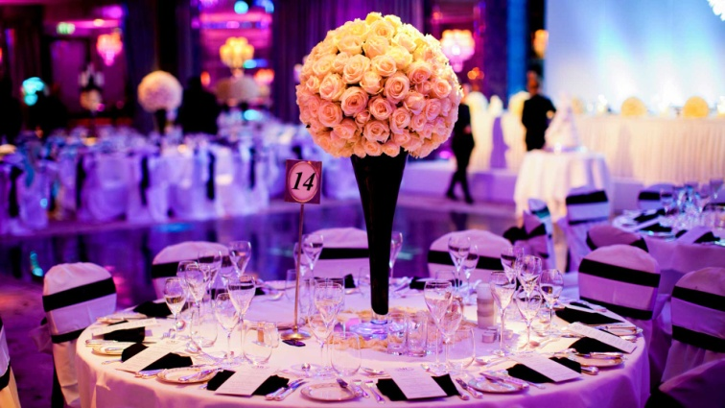
History
Founded in 2010, New Vision SRL is a private company with activity in the field of organizing events.
Thanks to over 5 years experience in this field and countless events in our portfolio, our agency comes to help those who want to have an unforgettable party guaranteeing the success of all kinds of events.

Slide 4
What do we do?
CAEN code: 9329- Other recreational and entertainment activities
We organize events at high standards, respecting the highest customer requirements to create pleasant memories.
The private events of our lives are unique moments that need a special setting, an ambience to represent us and mark the moment itself. New Vision Events is the complex that can give you a unique scenario for every event in your life

Slide 5
Our mission
Is to turn any ordinary event into a spectacular one, of good quality and good taste, and to satisfy our customers through our services. We offer our customers the opportunity to participate in various fun activities, away from the stress and fatigue specific to organizing an event on their own.

Slide 6
Our vision
We want to become market leaders, adding value to our customers with our services, highly qualified staff and advantageous contracts. We, the New Vision team, believe in the efficient organization of events and, moreover, in the irreproachable conditions of the organization process.

Slide 7
Our values
Creativity Originality
Seriousness
Responsibility Innovation Teamwork

Slide 8
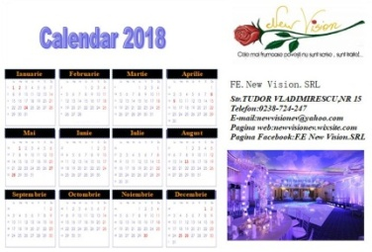
Promoting the company
Web Page
Facebook
Email:
newvision.events@yahoo.com
Means of mass media information
Radio/ TV
Internet
Flyers. Business cards, calendars
Magazines, newspapers

Slide 9
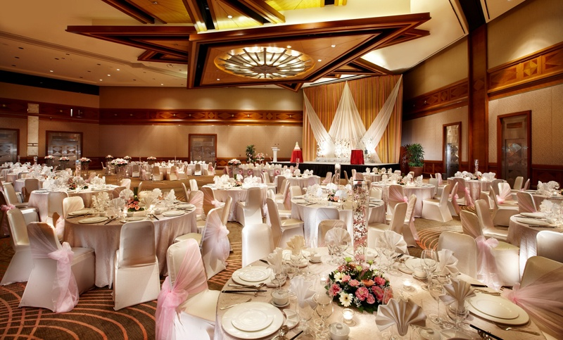
Weddings

Slide 10
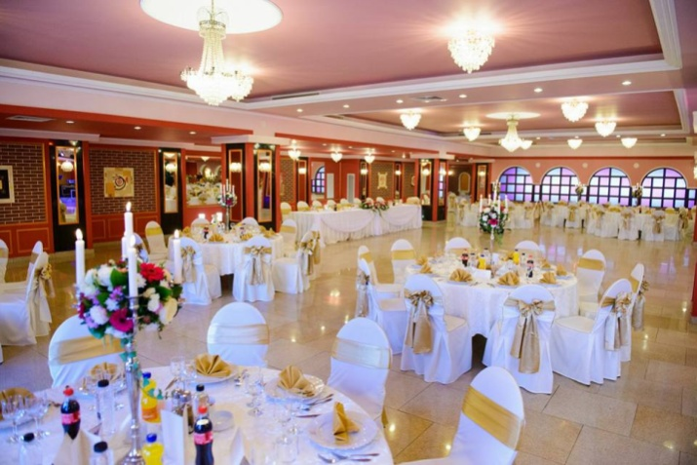
Baptisms

Slide 11
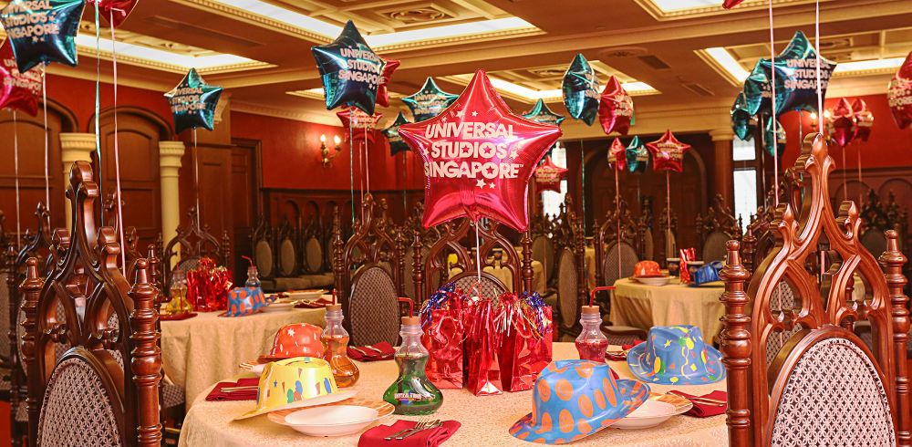
Name days

Slide 12
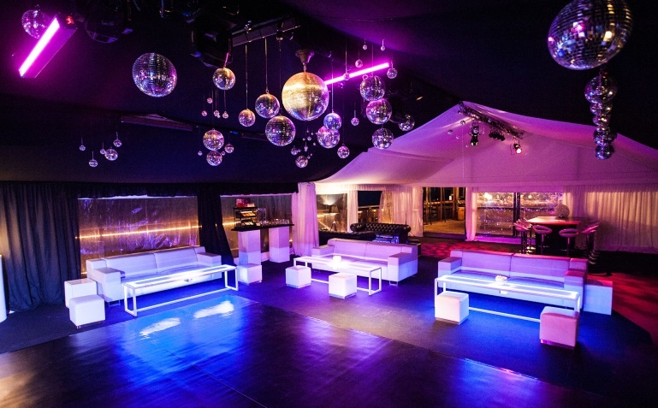
Balls

Slide 13
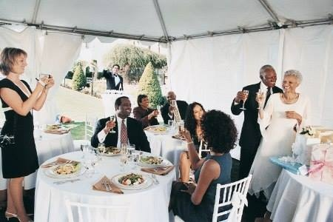
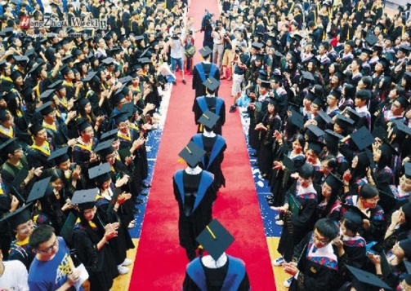
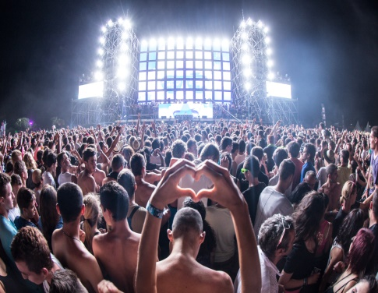
And others…
business meetings
business meetings
business meetings
Bithdays
Trainings
18 th birthday
Business meetings
Ceremonies
Festivals

Slide 14
What do customers say?
“We collaborated with this company to organize our wedding. It was just how we imagined, the team worked fast and, with the event designer, we set every detail"
Andrei and Ioana, Buzau

Slide 15
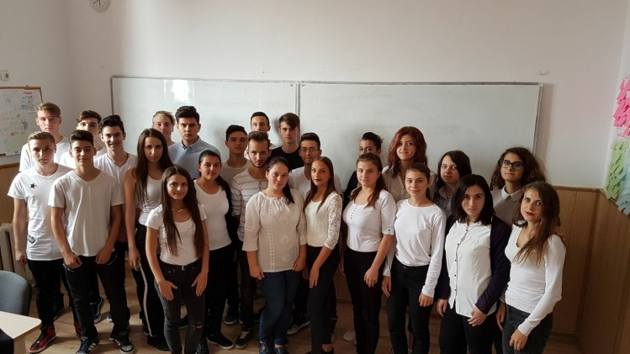
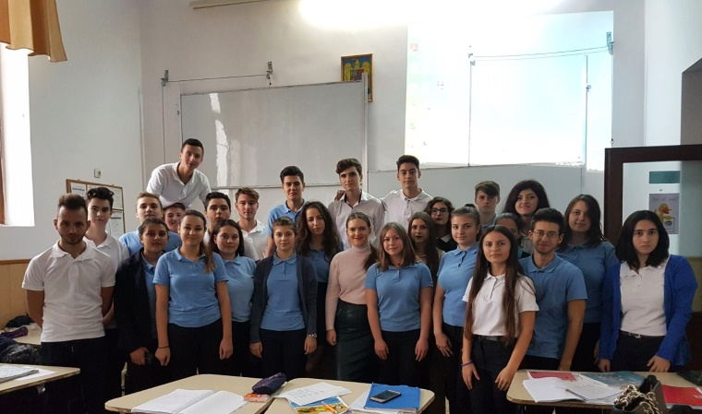
Contact us!
Phone numer: 0238 724 247
Email: newvision.ev@yahoo.com
Website: https://newvisionev.wixsite.com
Adress: 15 Tudor Vladimirescu Street, Buzău

