Slide 1
MACONDO

Slide 2
What is it like to be a teenager in a business world
F.E. MACONDO S.A
Colegiul Economic Buzău
Grade: XI D
Coordinating teachers : Cătălina Poştovei
Cătălina Ilie

Slide 3
“Happiness exists in every little drop of coffee. Live it with Macondo!”

Slide 4
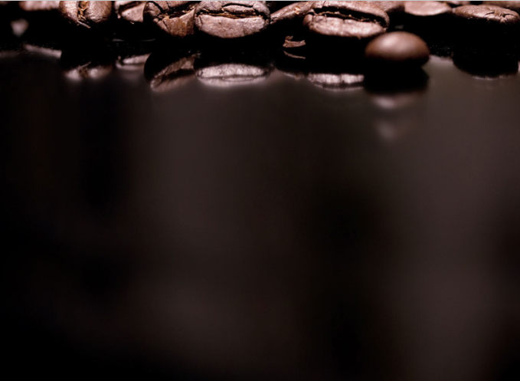
Contents
History
About us
The structure of the firm
What are we offering?
Contact

Slide 5
History
Who are we?
F.E. Macondo S.A. started its journey in 2007 and we took over in 2017.
During its journey it has won a lot of contests at national and international competitions.

Slide 6
The mission
.
We have the mission to offer goods and services of high quality and to bring them to our clients in our custom locations.

Slide 7
The vision
We aim to become market leaders, offering a growing range of products and to bring a new meaning to the concept of “drinking coffee”

Slide 8
What our business brings
Creativity
Innovation
Quality
Accessibility

Slide 9
What do we offer?
Ideas
Uber service
New outlets
Mobile-bicycle shops

Slide 10
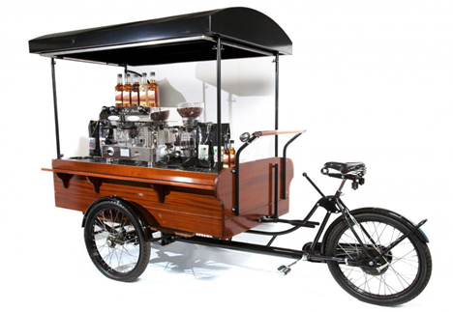
New Outlets
Bicycles specially designed for making coffee, fresh and cocktails.

Slide 11
Benefits
We create a unique offer on the market
Mobility
Reduction of pollution
We encourage others to protect the enviroment
Good offers
Good prices
we come to join the consumer

Slide 12
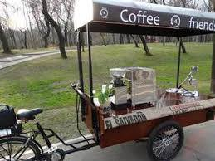
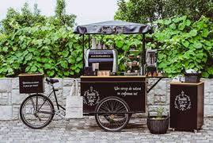
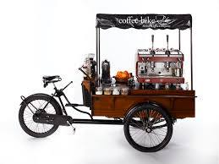
We can offer flexibility comfort, mobility and quality products

Slide 13
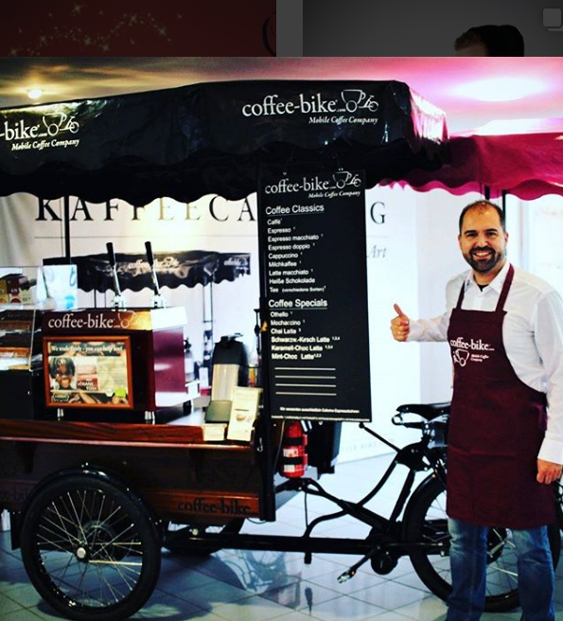
Macondo Coffee Bike
Cheap prices
Closer with the clients
Unique promotion

Slide 14
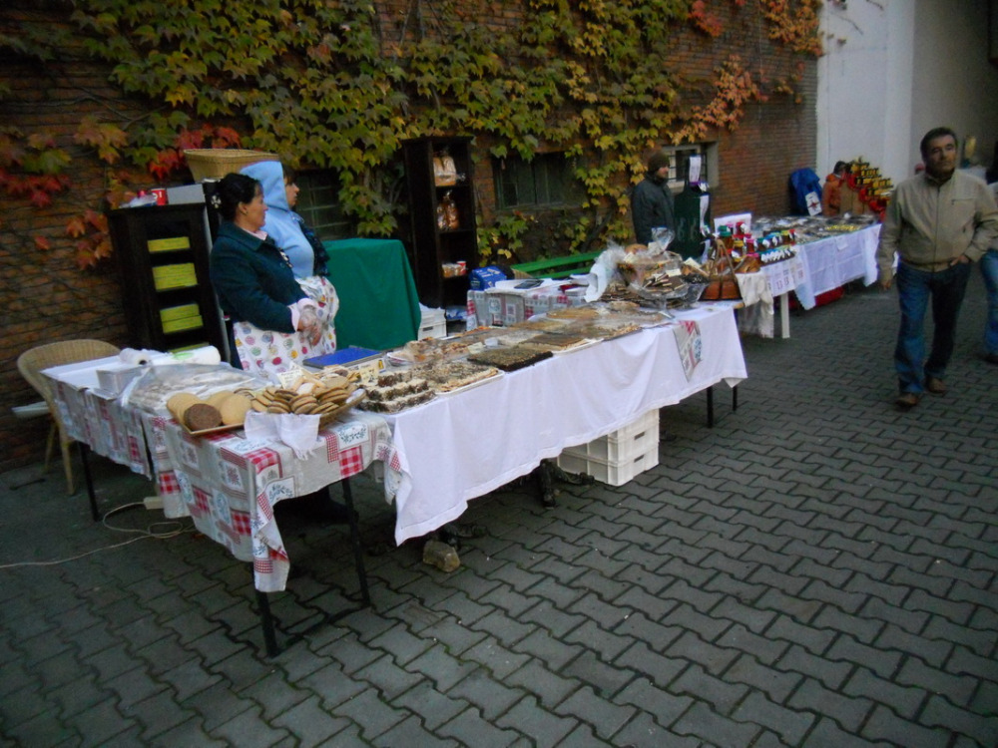
Macondo Coffee Bike can be in
Exhibitions

Slide 15
Festivals

Slide 16
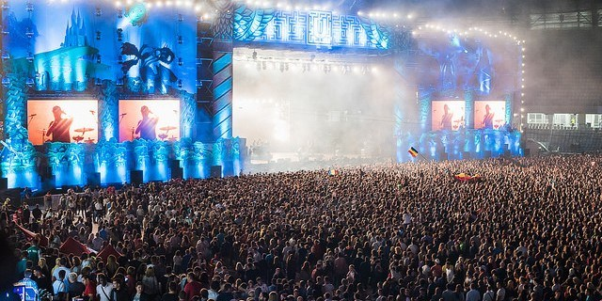
Concerts

Slide 17
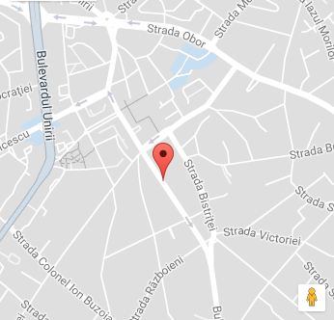
Contact
Address: Buzău,
15 Tudor Vladimirescu Street;
Phone number: 0238 724 247
Fax: 0238 721 197
Email adress: fmacondo@yahoo.com
Site: www.macondo5.webnode.ro

Slide 18
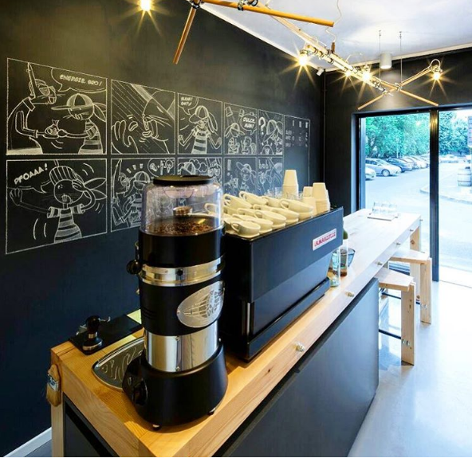
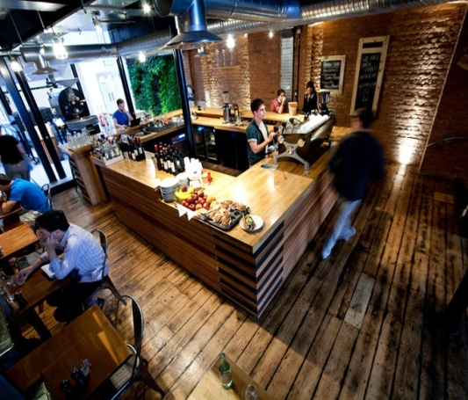
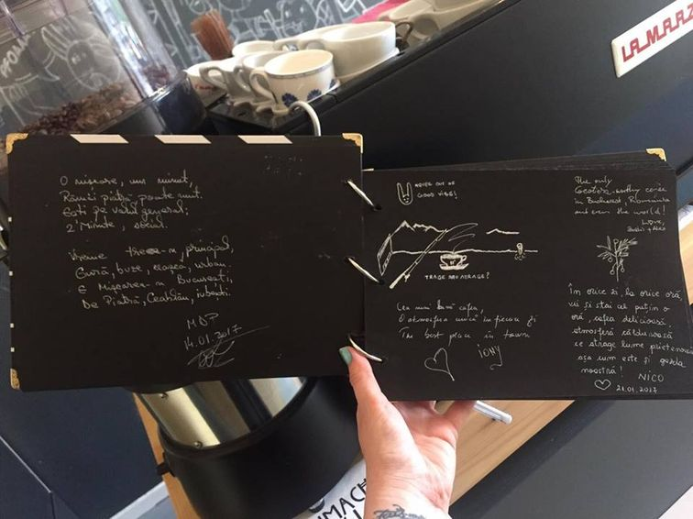
Creative places in Romania where you can drink coffee
Bucharest “Two Minutes” Coffee shop with stories and fairytales

Slide 19
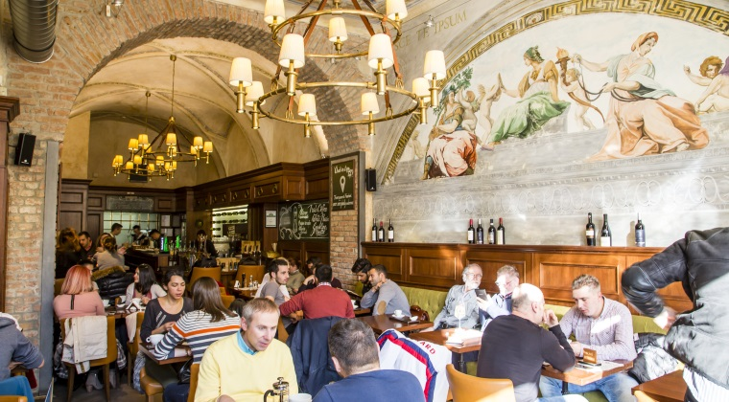
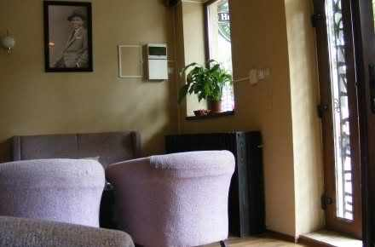
Constanta-Jazz Coffee

Slide 20
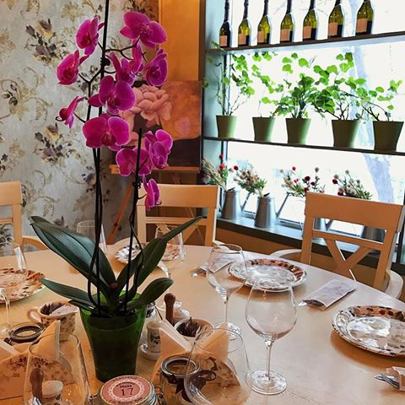
Buzau “Brasserie”

Slide 21
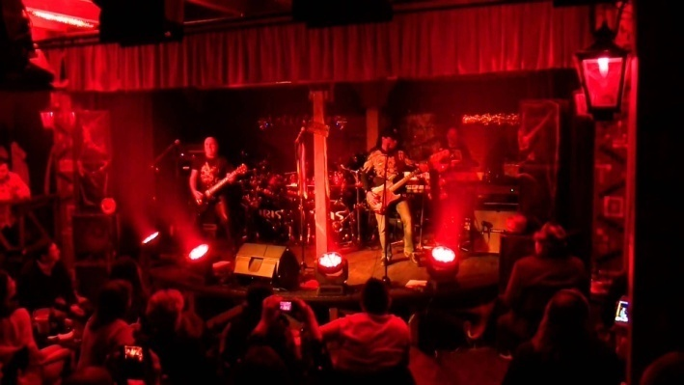
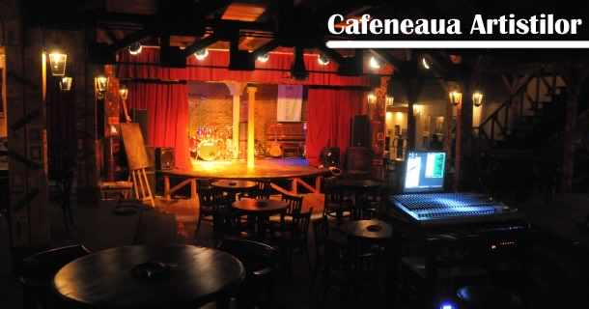
“Cafeneaua artistilor”

Slide 22
Fun fact about coffee

Slide 23
THANK YOU FOR ATTENTION!!

