Slide 1
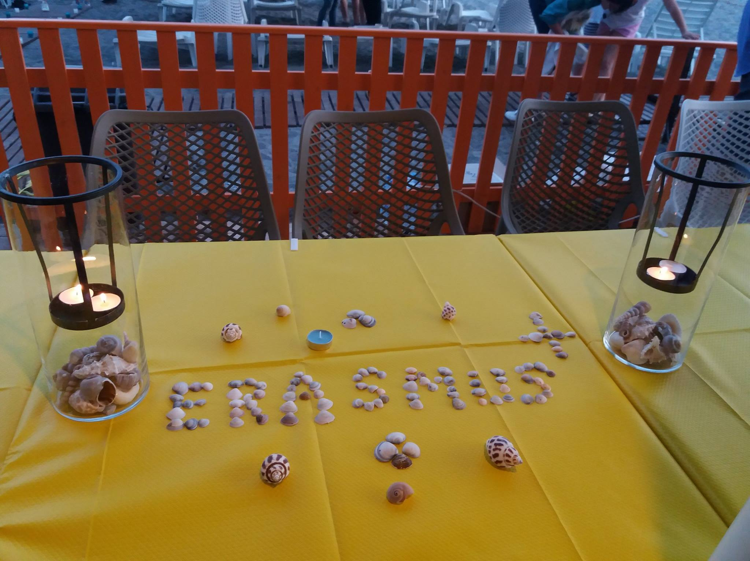
OMIT- Odyssey-Migration and it’s Influence on Teenagers
COLEGIUL ECONOMIC BUZĂU
29.05-02.06.2018

Slide 2
Partenters
Gymnasium Neue Oberschule/Braunschweig/ Germania- coordonator,
EBI Francisco Ferreira Drummond/ Angra do Heroísmo/ Portugalia,
IES LUIS SEOANE/ Pontevedra/ Spania,
3 Gymnasio Kalamatas/ Grecia
Colegiul Economic Buzău/ România

Slide 3
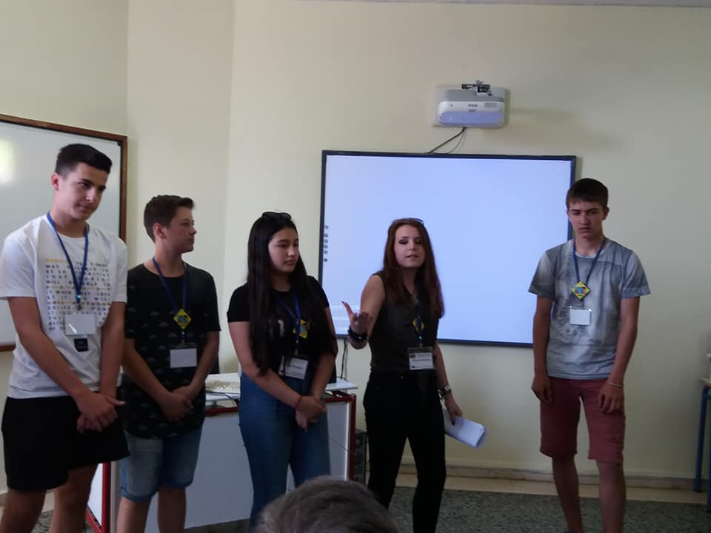
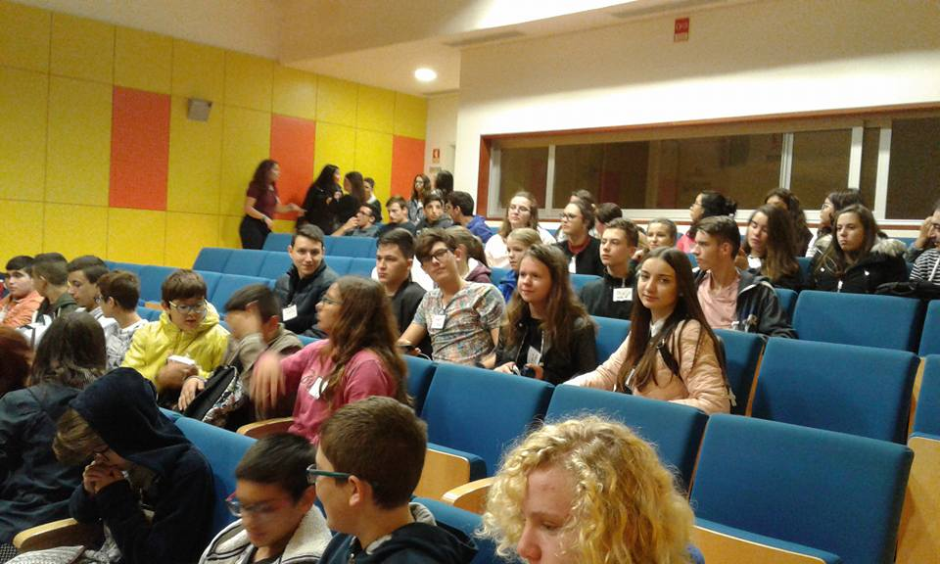
Odyssey-Migration and it’s Influence on Teenagers

Slide 4
OBJECTIVES.....for students
Developing the adequate attitudes towards otherness
Participating in European values as a source of cultural enrichment
Improving their learning skills
Improving and mobilizing their skills and abilities to take part in the digital society

Slide 5
FOR TEACHERS
Improving their digital skills for a relevant education
Proactively rethinking the curricula in a European dimension
FOR SCHOOLS
Improving their abilities of acting as European organizations, by developing projects with other institutions across Europe

Slide 6
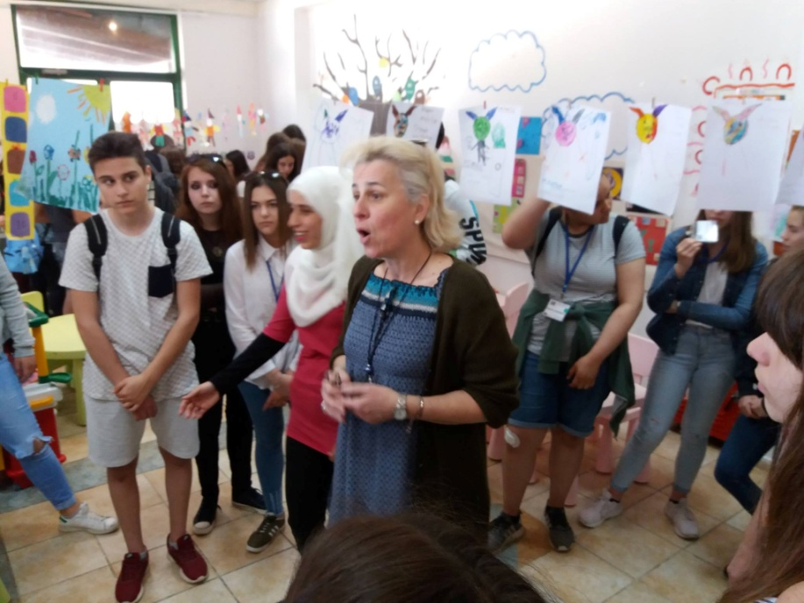
Odyssey-Migration and it’s Influence on Teenagers

Slide 7
activities
Meetings with migrants;
Workshops on the topic;
Open days at partner schools;
Meetings with local authorities that have to deal with migrants;
Research about migration in the past and in present;
Research about famous migrants.
Exhibitions at school or in local institutions or companies
Common activities with EU/UNESCO representatives
Movie projections and/or theatre performances

Slide 8
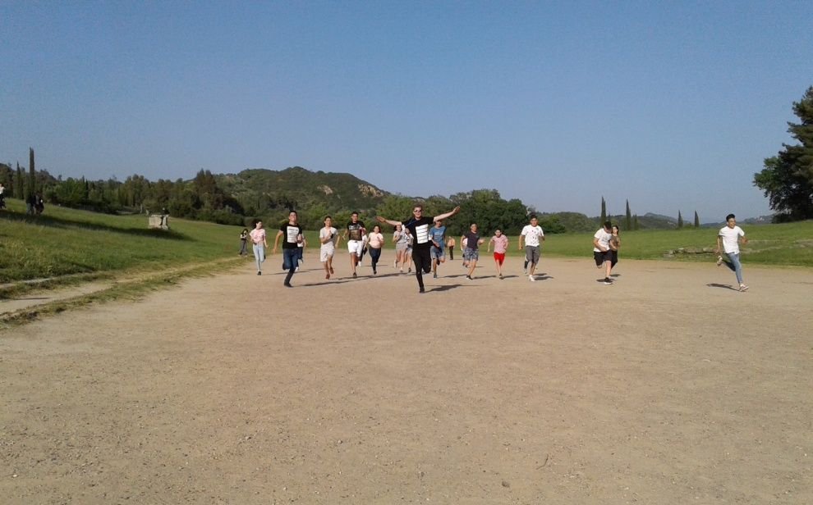
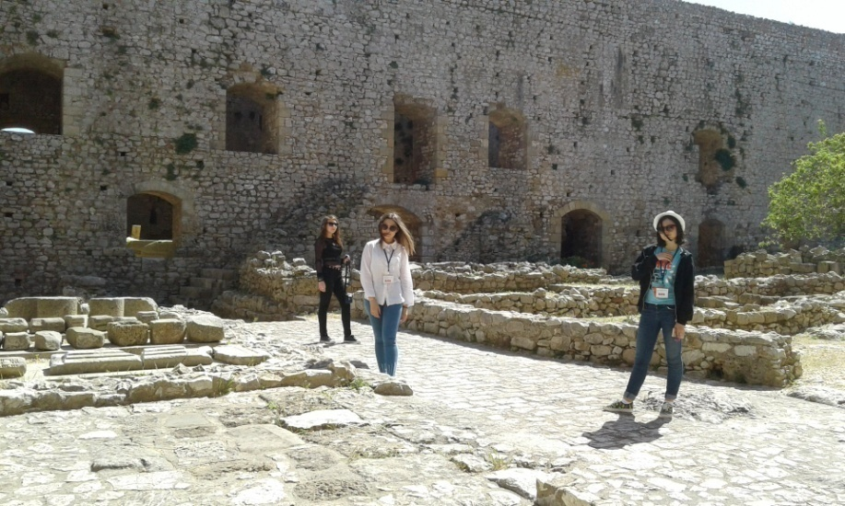
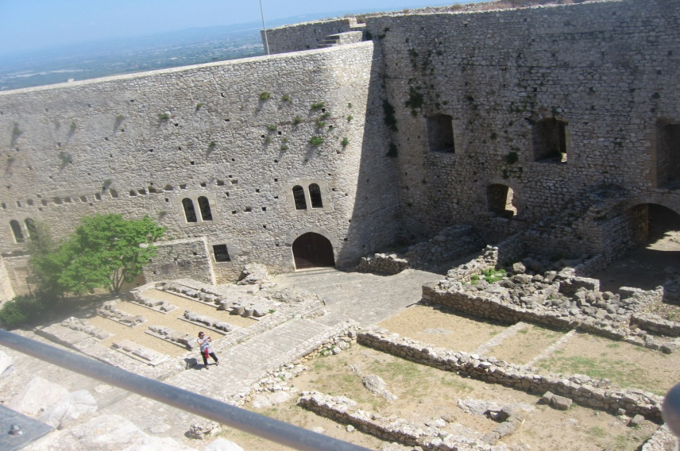
Odyssey-Migration and it’s Influence on Teenagers

Slide 9
One last aspect in the project worth mentioning is the fact that all communication will be held in English, which is a major contribution for European citizenship.

Slide 10
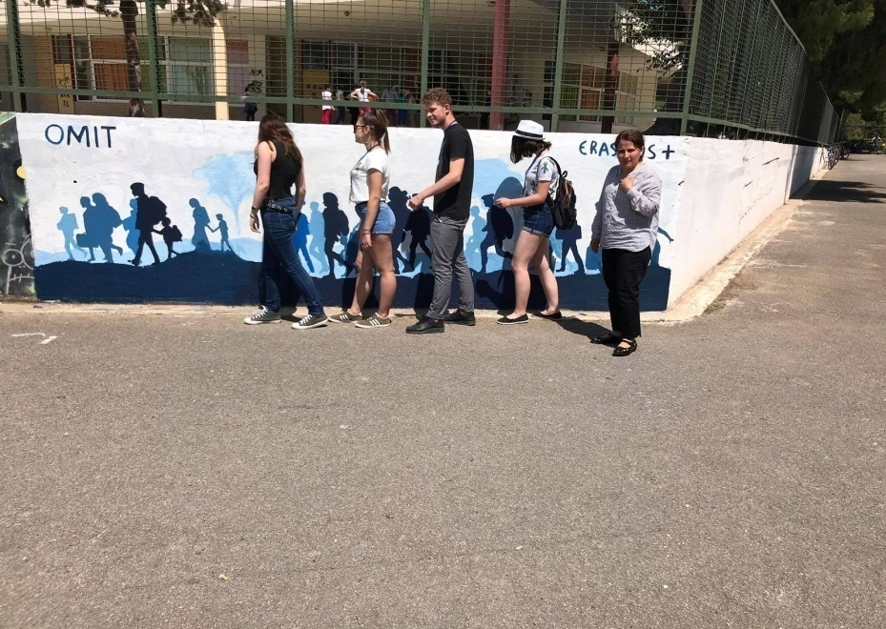
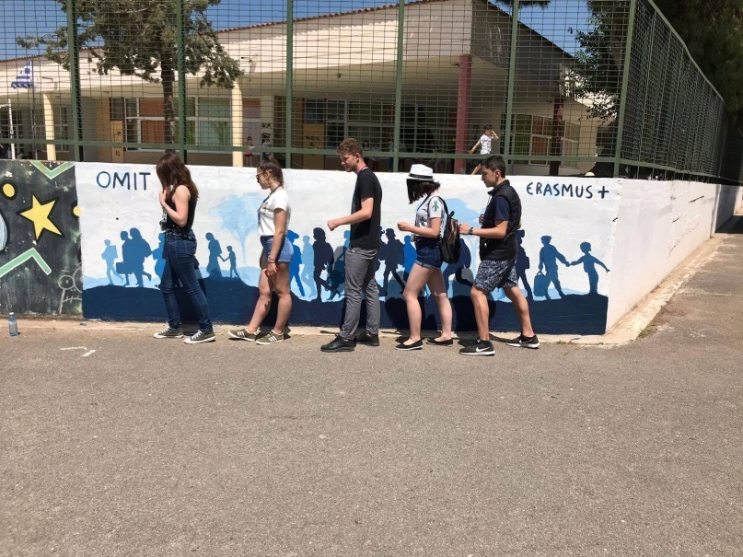
Odyssey-Migration and it’s Influence on Teenagers

Slide 11
products
Web page: http://odysseymigrationteenagers.weebly.com/
Facebook page: https://www.facebook.com/OMIT-Odyssey-Migration-and-Its-Influence-On-Teenagers-265916570585282
Twinspace: https://live.etwinning.net/projects/project/150290
Logo
Presentations
Movies
Interviews
Questionnaires
Quizzes

Slide 12
Odyssey-Migration and it’s Influence on Teenagers
BEFORE
AFTER

Slide 13
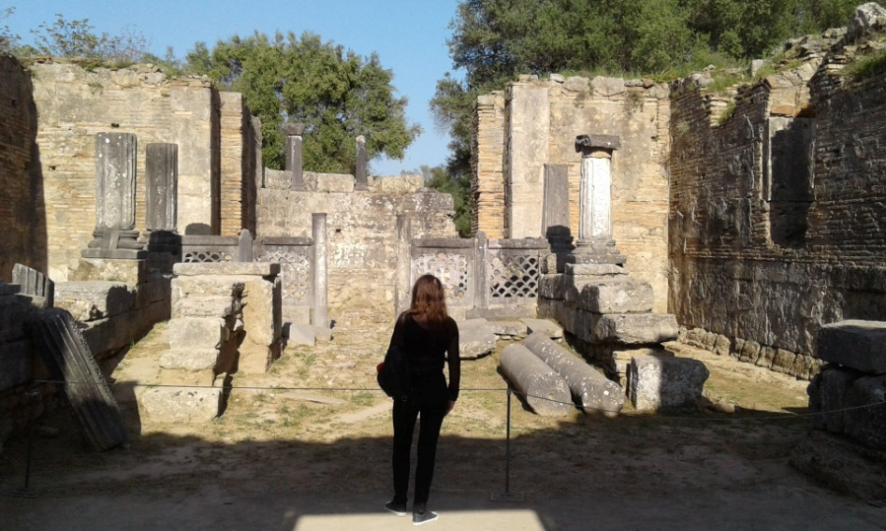
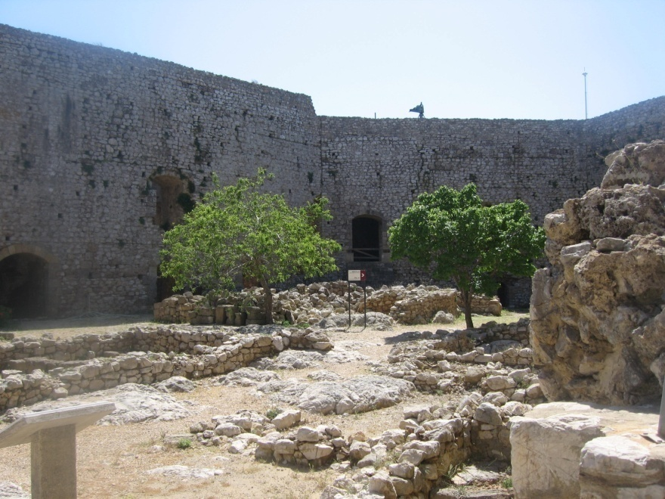
Odyssey-Migration and it’s Influence on Teenagers

Slide 14
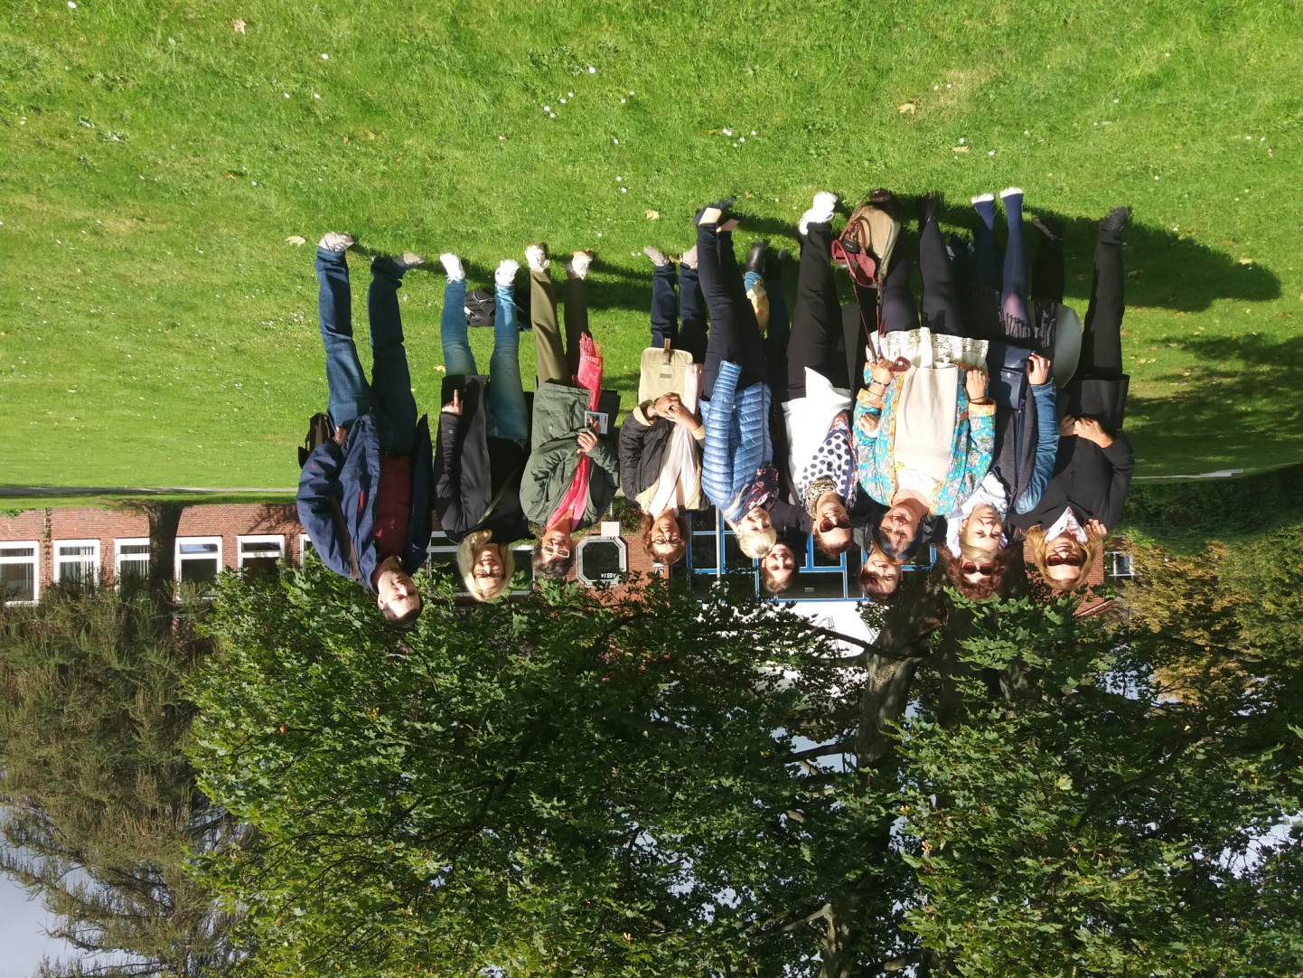
TPM Germany

Slide 15
TTLA Portugal

Slide 16
TTLA Portugal

Slide 17
Odyssey-Migration and it’s Influence on Teenagers

Slide 18
TTLA Greece

Slide 19
Odyssey-Migration and it’s Influence on Teenagers

Slide 20
Odyssey-Migration and it’s Influence on Teenagers
THE END
 | "The European Commission support for the production of this publication does not constitute an endorsement of the contents which reflects the views only of the authors, and the Commission cannot be held responsible for any use which may be made of the information contained therein."

