Slide 1
Alexandrian women (Aleksandrinke)

Slide 2
The name
The expression »Aleksandrinke« is a specific term which was invented by the local people of the Goriška region for the girls and women who worked in Egypt at the time of the most intense expansion of the phenomenon and doesn't mean the inhabitants of Alexandria.

Slide 3
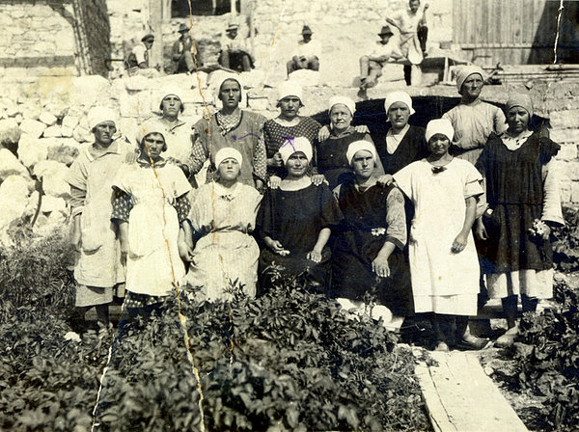
Who?
The country and middle-class girls from our area who started to work for rich European families in Egypt.

Slide 4
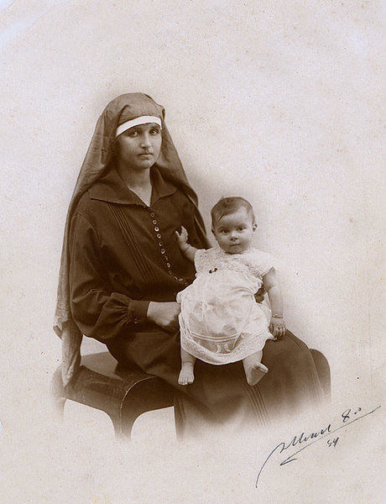
what?
cooks
maids
nannies
wet nurses
governesses
dressmakers
etc...

Slide 5
Where?
to Egypt
in the second half of the 19th century.
cities of Alexandria and Cairo.

Slide 6
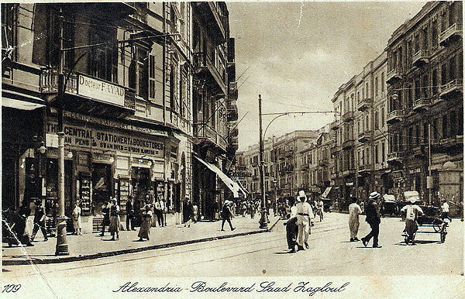

Slide 7
Why?
The reasons for this, mostly temporary, labour migration were predominantly of an economic nature.
The earnings which the women sent home either by post or at times through relatives and friends, who went home on a visit or for good, was earmarked for the family to be able to survive.

Slide 8
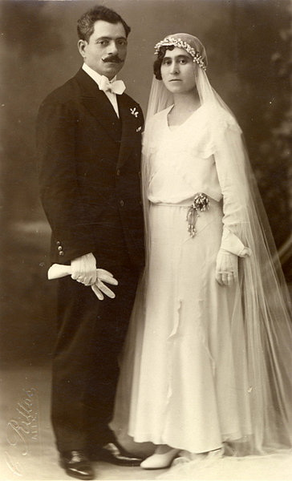

Slide 10
Story of Marija černe, the Alexandrian women from bilje

Slide 11
Written by:
Neža Jeklin
Lara Vončina
Eva Zarli
http://www.aleksandrinke.si/alexandrian/history/

