Slide 1
“Stand up” Europe’s unites against discrimination!
Analysis of results of the survey “Discrimination regarding sexual orientation and gender identity”

Slide 2
How it was done?
We divided the survey in 4 blocks:
1.Perception of discrimination regarding sexual orientation
2.Sex education and diversity
3.Rights and prejudices
4.Personal experiences and discrimination

Slide 3
In the questionnaire we asked 176 students
96 Female
79 Male

Slide 5
There are few differences by sex and religion. It may be striking that there is little difference between students who declare themselves Catholics and students who claim to be non-believers.

Slide 6
On a scale of 1 to 10, where 1 is "no discrimination" and 10 is "a lot of discrimination", what rating would you give Spain?
On a scale of 1 to 10, where 1 is "no discrimination" and 10 is "a lot of discrimination", how much discrimination do you see in your daily life?
Average
5,47
Average
3,48

Slide 7
Perception of discrimination regarding sexual orientation
It feels that there is discrimination in our country but rather less in the nearby students in their daily life.

Slide 8
General Information

Slide 9
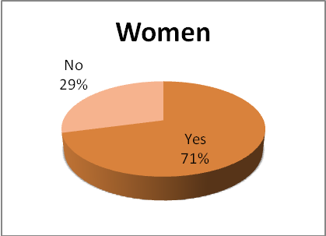
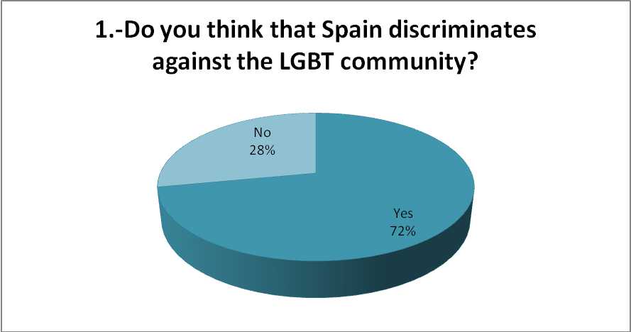
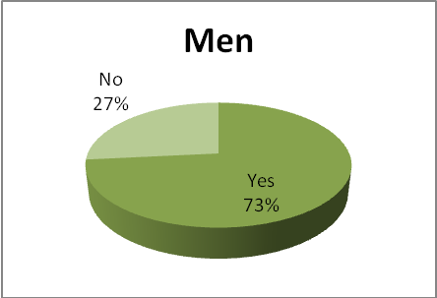
Perception of discrimination regarding sexual orientation

Slide 10
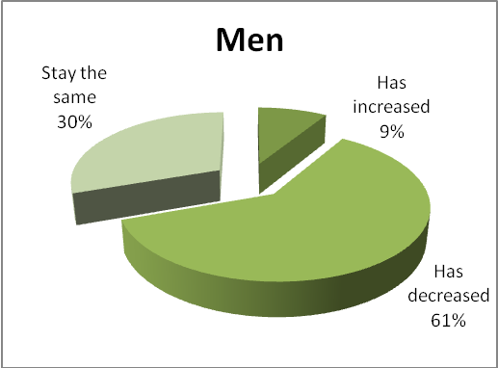
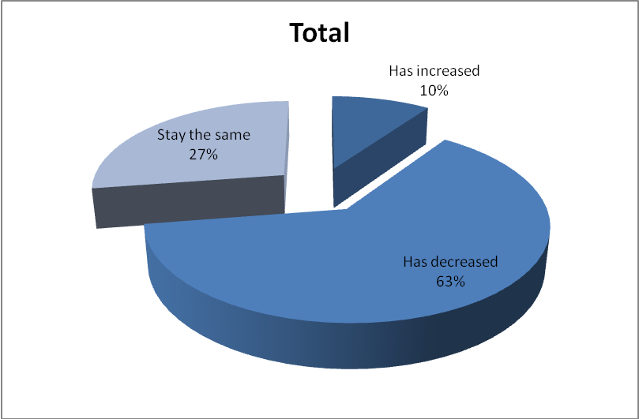
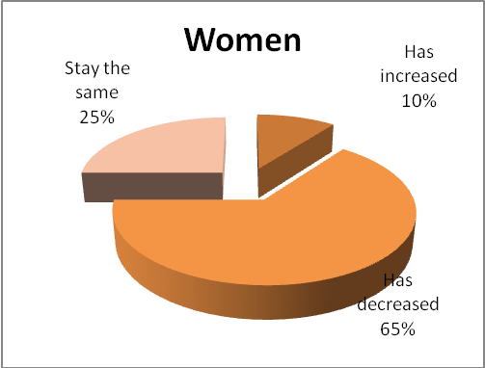
- In your opinion, has discrimination in Spain increased, stayed the same or decreased in the last 5 years?

Slide 11
Sex education is taught in the School but does not always deal with themes of identity of gender or sexual diversity.

Slide 12
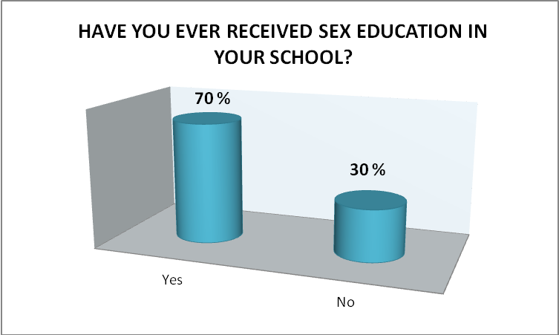
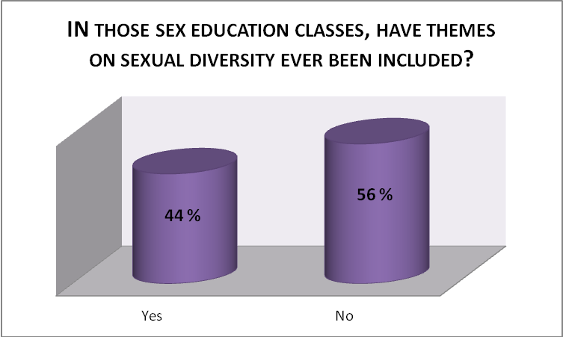
Sex education and Diversity

Slide 13
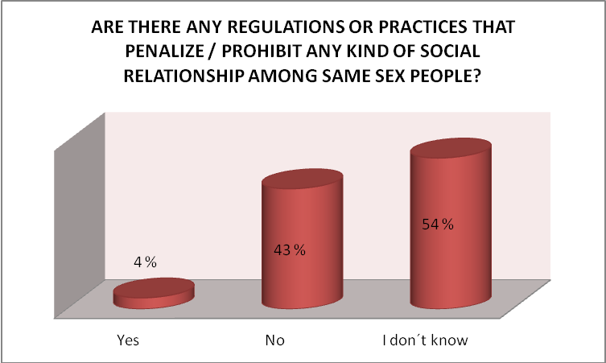

Slide 14
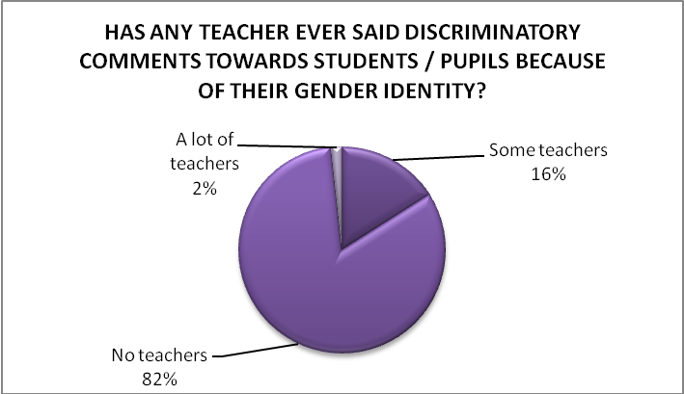
There are no problems of sexual discrimination at the School: teachers do not make offensive comments, there are no cases of students who suffer from discrimination, etc.

Slide 15
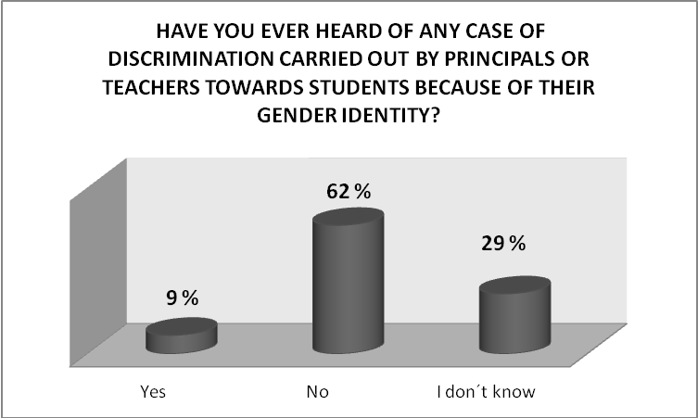

Slide 16
Rights and Prejudices
Boys are shown with more doubts in their responses: there are more don't know/no answer than in girls. Girls are more open on the issue, show less prejudice.

Slide 17
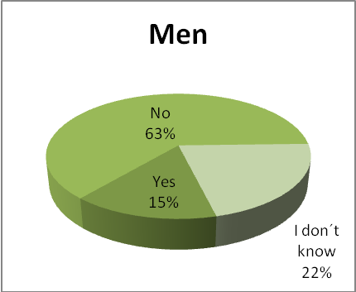
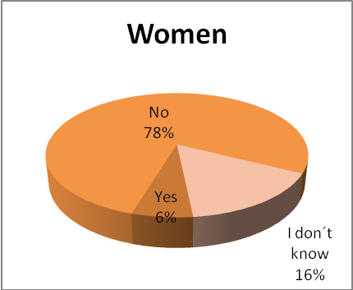

Slide 18
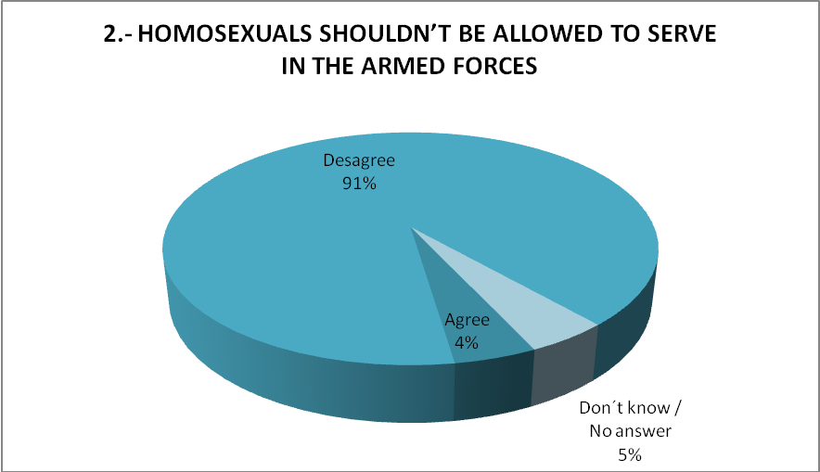
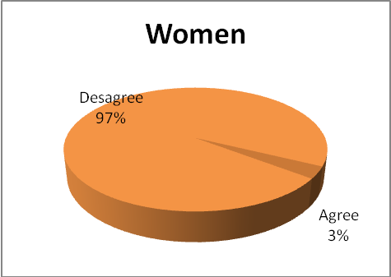
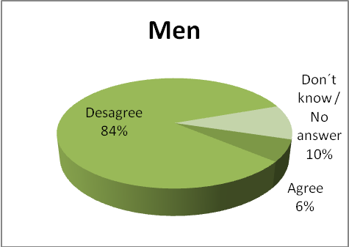

Slide 19
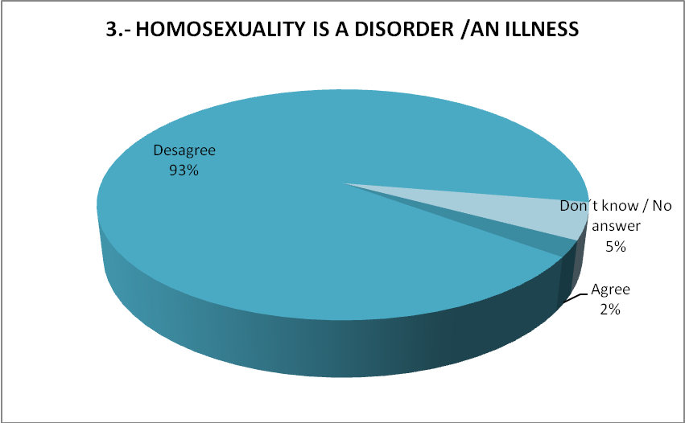
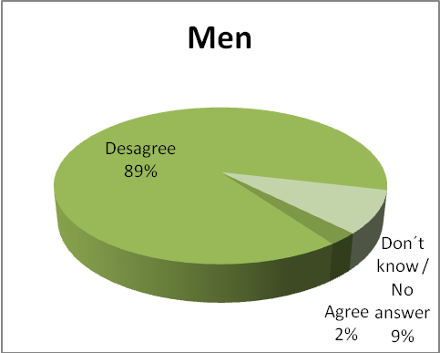
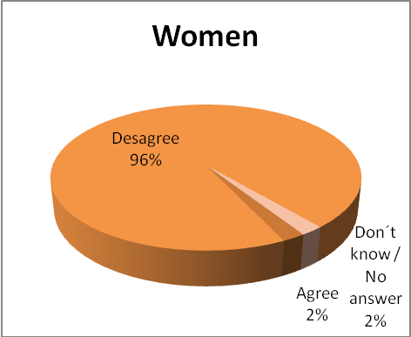

Slide 20
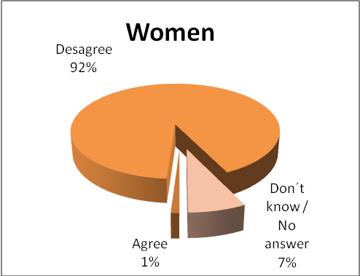
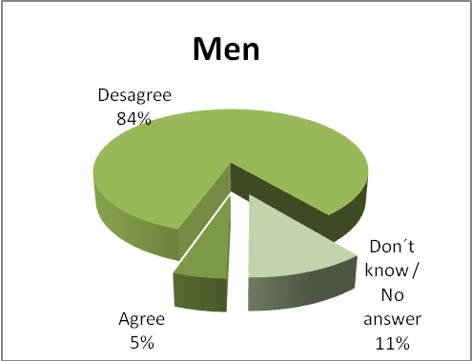

Slide 21
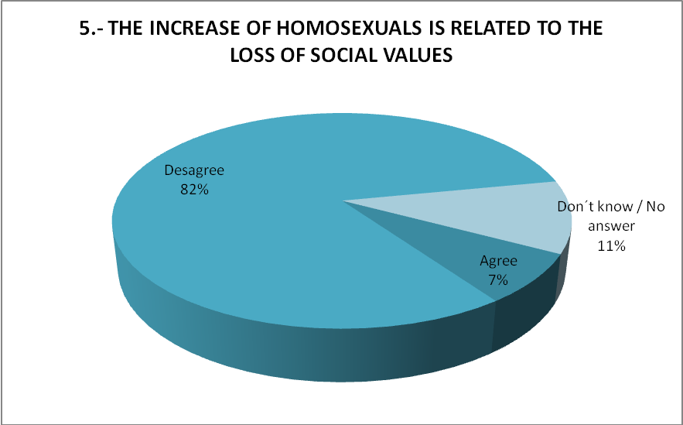
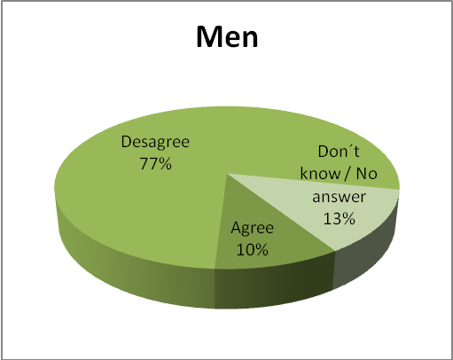
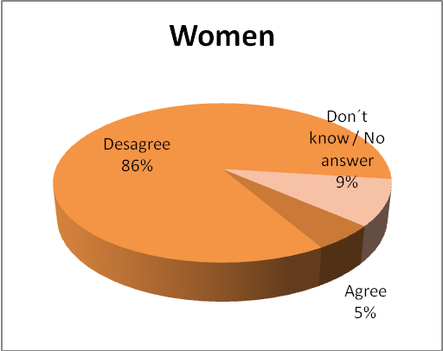

Slide 22
Personal experiences and discrimination
There is not much significant sample of students who have suffered discrimination because of their sexual orientation or gender identity, less than 10 between 175 responses. The rest of the questions of this block was not scanned for this reason.

Slide 23
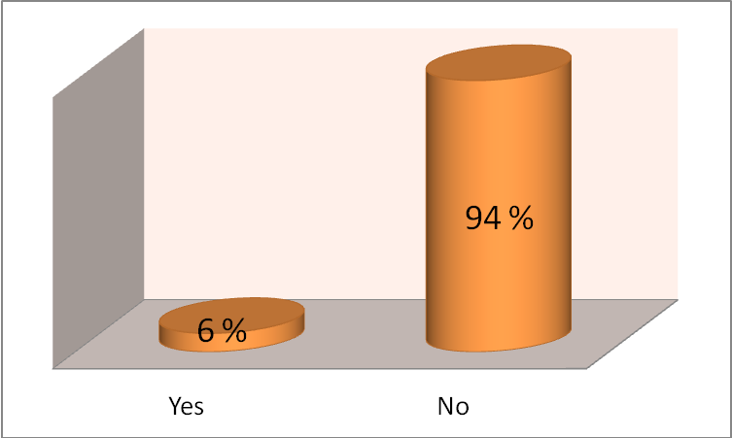
HAVE YOU EVER BEEN DISCRIMINATED AGAINST BECAUSE OF YOUR SEXUAL ORIENTATION OR GENDER IDENTITY?

Slide 24
Conclussion
- It is thought that this discrimination is decreasing in recent years - Our students are open minded regarding the topic. - There is no significant differences by religion. - Girls have less doubts about the theme. - Our students say that they don´t suffer any problem because of their sex orientation or their gender identity - That scene, may be related to the laws of the last socialist Government? Spain is one of the first countries in Europe where a same-sex marriage law was passed.

