Slide 1
Spanish economic situation
By Javier Enríquez, Ángel García and Montserrat Martínez

Slide 2
Index of the presentation:
1-Spanish economic information.
2-Questionnaire results in Spain.

Slide 3
Salaries in Spain:
-Minimum salary in Spain: the Spanish minimum salary was 648.6 € per month in 2015, but in 2016, the Spanish government decided to increase it to 655.20 € (21.84€ per day).
-Spanish salary average: In Spain, if we calculate the average salary we get 26.160 € per year or 2.180 € per month. That quantity is a 0.52 % more than 2015.
-Percentage of Spaniards with Secondary Education : In Spain, in 2011, 46.2% of spaniards had secondary education.

Slide 4
Population and unemployment rate in Spain:
-Spain population: The population in Spain is 46.77 million people.
-Spanish unemployment rate: The spanish unemployment rate is 18.9% of the population (4.3 million people unemployed).

Slide 5
Unemployment rate:
-Total 20.9% ; 4.780 millions.
-Men 19.5% ; 2.388 millions.
-Women 22.5% ; 2.392 millions.

Slide 6
Average duration of unemployement
In Spain, average duration of unemployment is between 3 and 38 months, it depends on how long an unemployed person has been working. The duration was established in 2001.
Spanish GDP:
The spanish GDP is 1.187 billion USD (1.08 billion EUR).
Spanish GDP per capita:
The GDP per capita in Spain is 25.143 USD (23.200 EUR).

Slide 7
Financial help for unemployed:
Today, in Spain, an unemployed who has worked for more than twelve months before receives an official financial assistance of 400 euros per month.

Slide 8
Families with incomes below the poverty line:
Nowadays in Spain 22% of spanish live below the poverty line. Poverty reaches the 35% under sixteen years old in families that can not makes end meet. The poverty threshold for a family with two adults and two children stands at 16.719 euros income per year.

Slide 9
Questionnaire’s results

Slide 10
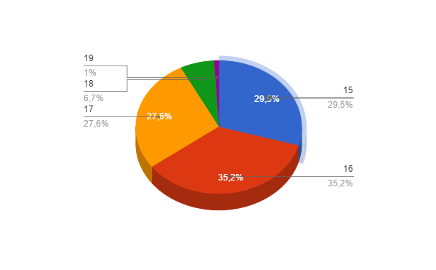
Age of the people who answered this questionnaire:

Slide 11
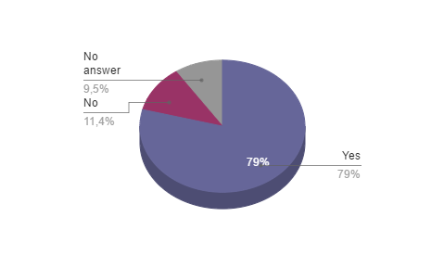
Do you believe that the rich are going richer and the poor are going poorer?

Slide 12
How do you think your gender, race, social/economic position has affected your life up to now?
Most frequent answers:
1- It has affected me in a positive way.
2-It has affected me in a bad way because I’m an immigrant, because my gender or because I have a bad appearance.
3-It hasn’t affected me.

Slide 13
In what way does poverty diminish human dignity?
Most frequent answers:
1-It makes discriminated people feel bad, it makes social differences or it affects them in a psychological way or don’t letting them having important things.

Slide 14
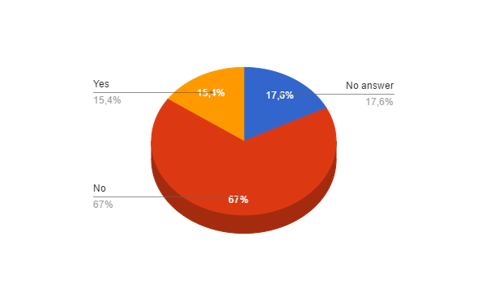
Do you think that minorities should be given a job priority because of their race?

Slide 15
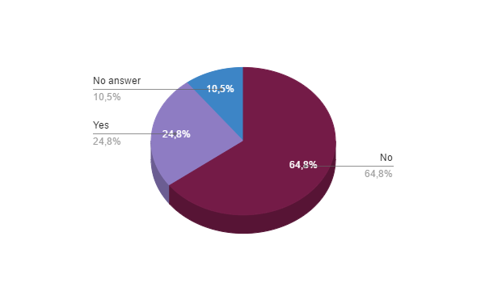
Do you have a close relative, friend or classmate who has been discriminated against for socioeconomic reasons?

Slide 16
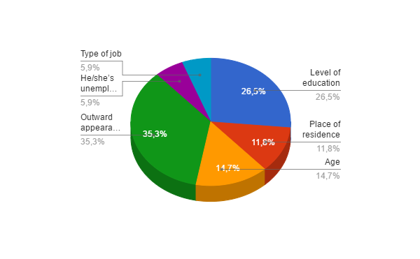
Could you specify why he or she has been discriminated?

Slide 17
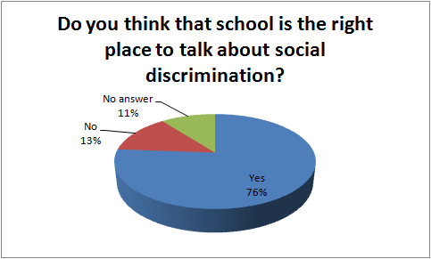

Slide 18
In which subjects have you discussed social and economical discrimination?
Subjects:
Ethics, Spanish lessons, philosophy and Geography.

Slide 19
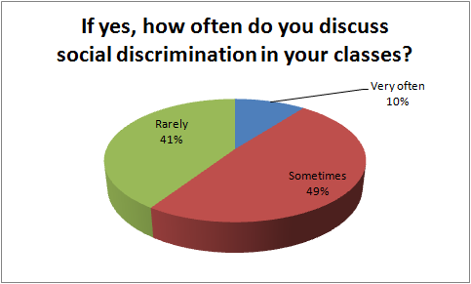

Slide 20
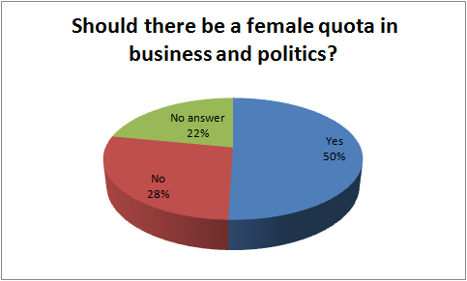

Slide 21
Bibliography:
http://www.datosmacro.com/mercado-laboral/salario-medio/espana
https://capitalsocialenespanol.wordpress.com/2012/08/02/nivel-de-estudios-de-la-poblacion-espanola-por-comunidades-autonomas/
http://www.empleo.gob.es/es/mundo/consejerias/paisesBajos/pensiones/contenidos/prestaciones/04WW.htm

