Slide 1
HOLIDAYS
AND
MUSIC

Slide 2
SUMMER HOLIDAYS
The summer holidays start on 23rd June and finish in the beginning of September

Slide 3
XMAS
Xmas holidays start on 23rd December and finish on the 9th January.

Slide 4
EASTER
The Easter holidays start on 19th March and finish on 3rd April.

Slide 5
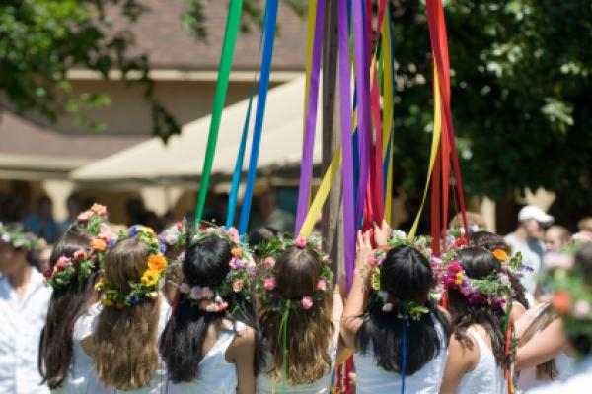
BANK HOLLIDAYS
We have different bank holidays during the year: in December, february (Carnaval), March, May…

Slide 6
MUSIC
In the Basque country we listen to:
Basque, pop, folk, rock … Music. The popular groups of The Basque country are: Gatibu, Vendetta, Oskorri, Ken zazpi, Esne Beltza … And they sing in Basque.

Slide 7
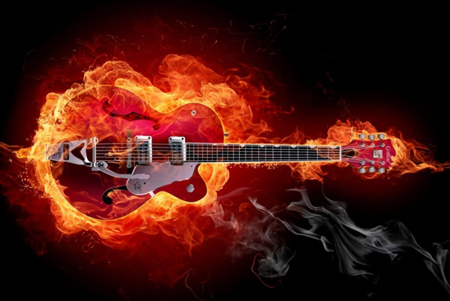
ROCK MUSIC

Slide 8
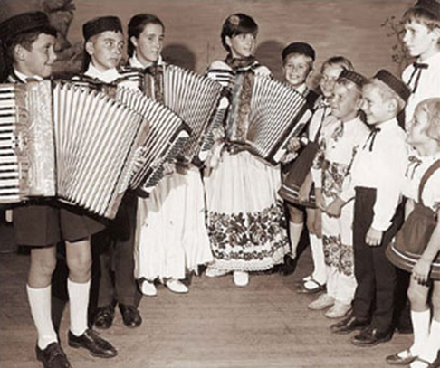
FOLK MUSIC

