Slide 1
Music we listen to
by Vaiva

Slide 2
Lithuanian singers:
In Lithuania the most popular is pop music. Also in Lithuania a lot of people are trying to get in such music projects as “X Factor” or “Lithuanian Voice”.
We have a lot of singers and various groups. Most songs are very funny and make you move.

Slide 3
My favorite singers:
Vanessa Paradis
Neteisėtai padaryti (unlawfully do)
SEL
Marijonas Mikutavičius

Slide 4
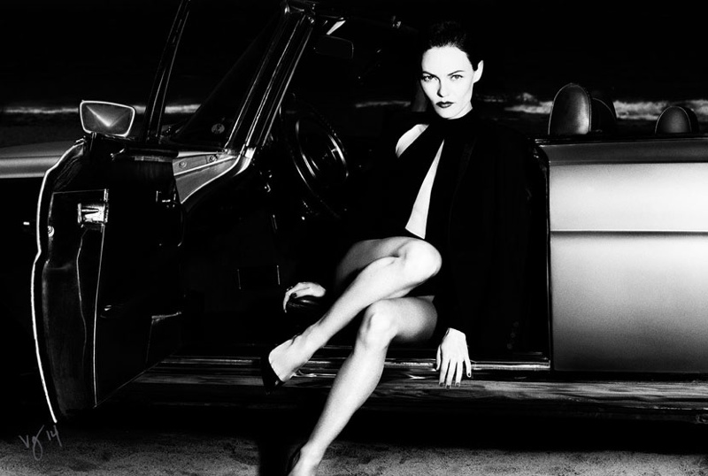
Vanessa Paradis:
Vanessa Paradis is a French singer.
Now her music is rock style, but before her songs were jazz style.
My favourite song is “La Seine”.
https://www.youtube.com/watch?v=vlPZLE2g0Kc

Slide 5
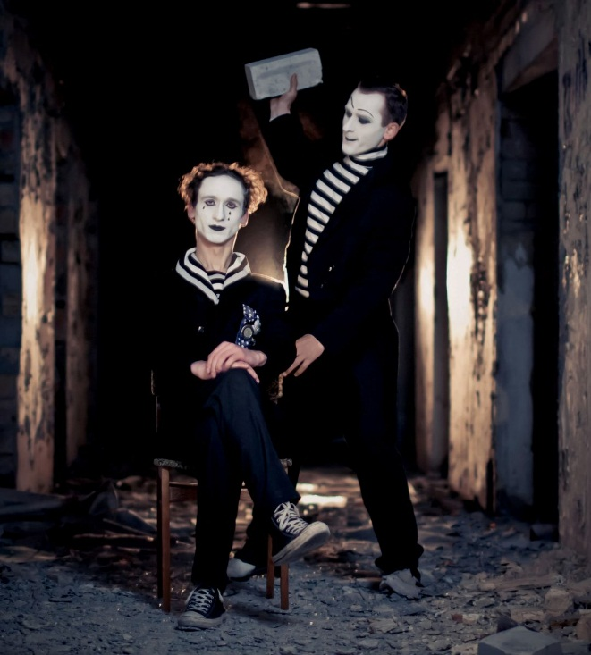
Neteisėtai padaryti (unlawfully do):
This group is Lithuanian.
They are interesting, because they are singing mimes.
My favourite song is ”Galvotas”(sage)
https://www.youtube.com/watch?v=RDsmxCAazvc

Slide 6
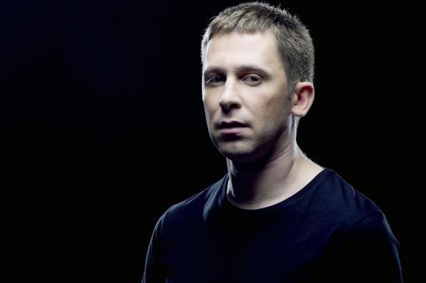
SEL:
This group is from Lithuania.
The group sings pop music.
My favourite song is “Užmerkiu akis“ (close my eyes)
https://www.youtube.com/watch?v=wLbDN7isPWk

Slide 7
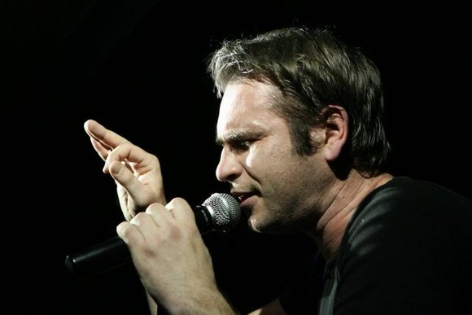
Marijonas Mikutavičius:
He is the most popular Lithuanian singer.
Marijonas Mikutavičius wrote a basketball hymn.
My favourite song is “Balintos sienos” (bleached walls)
https://www.youtube.com/watch?v=TFLt4bQH850

Slide 8
I hope that you like my favourite singers.

