Slide 1
ŽAGARĖLIAI

Slide 2
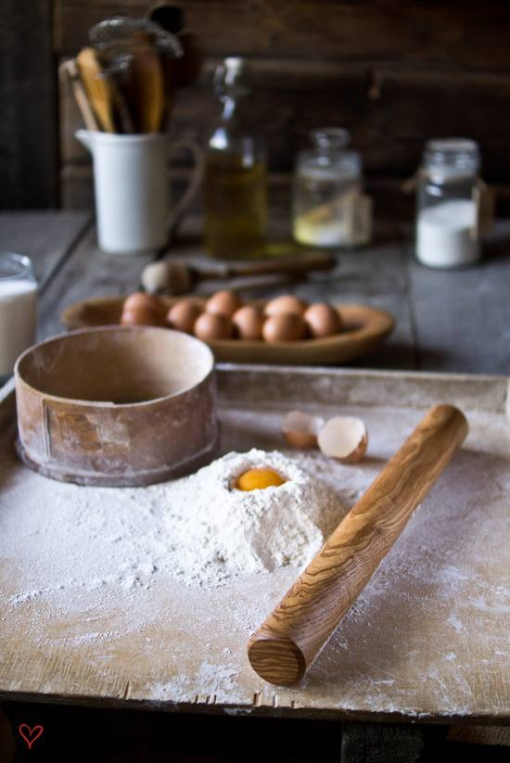
INGREDIENTS
200 g of flour
2 eggs
3 tsp.of sugar
1 tsp.of salt
250 g of curd
2 tsp. of baking powder
2 tsp. of vanilla sugar
1 cup of kefir
Vegetable oil for frying

Slide 3
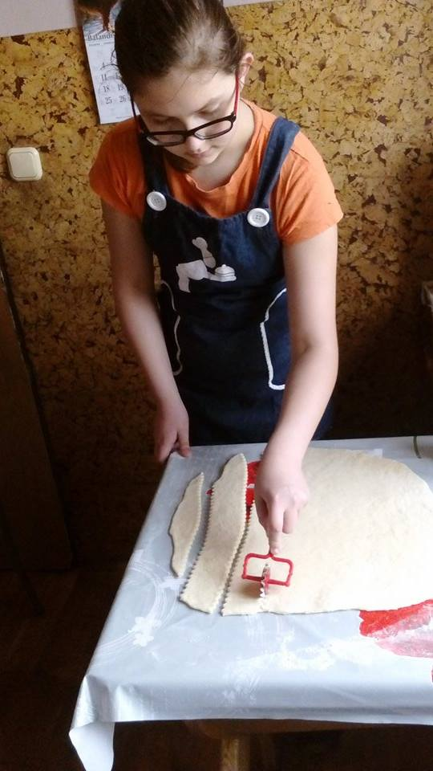
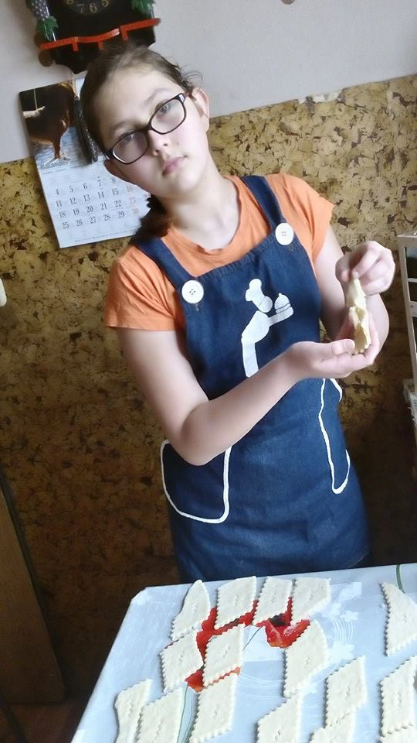
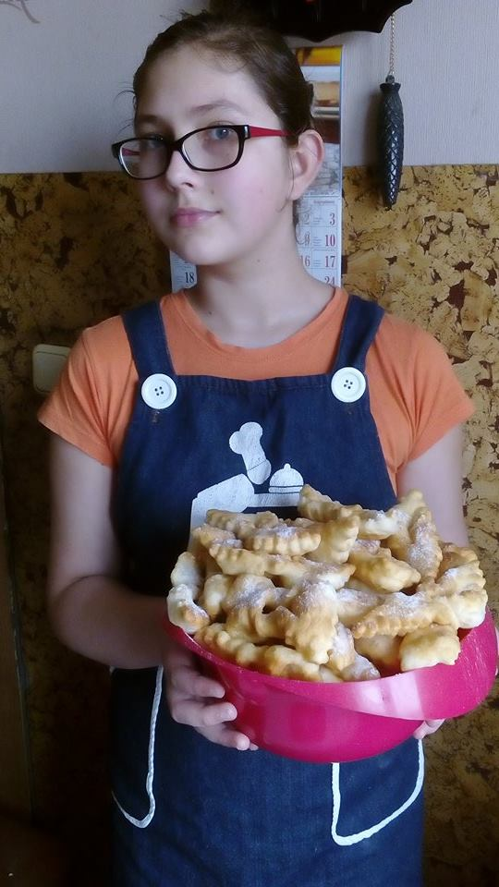
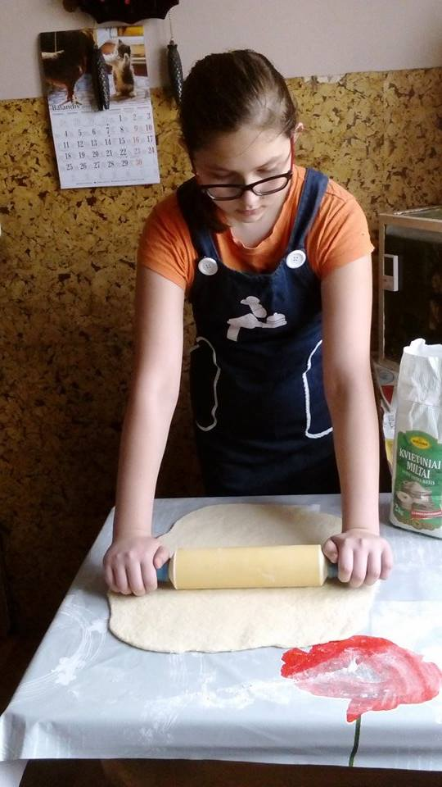
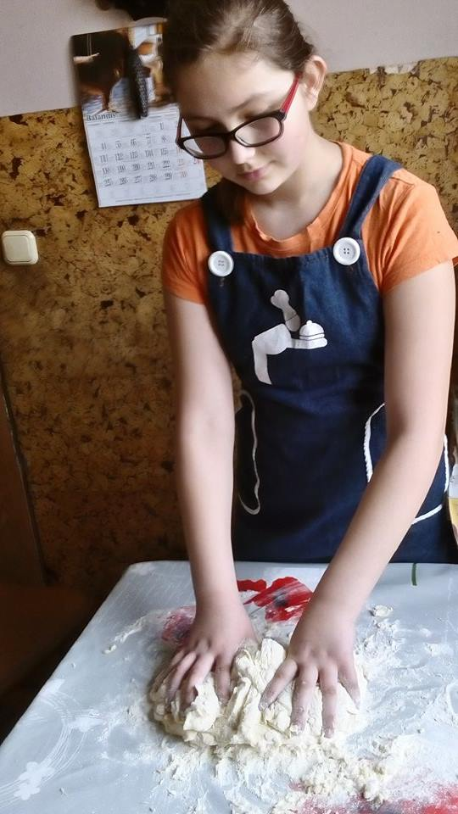

Slide 4
PREPARATION
Mix curd, eggs, kefir, sugar, vanilla sugar until you get solid dough.
In the next bowl sift flour, then mix it with salt and baking powder.
Later slowly add the flour in the curd mass. The dough must be soft.
When the dough is ready,roll it and then you can make žagarėliai.
Fry žagarėliai in the pan full of oil.

Slide 5
ENJOY YOUR MEAL! ☺

