Slide 1
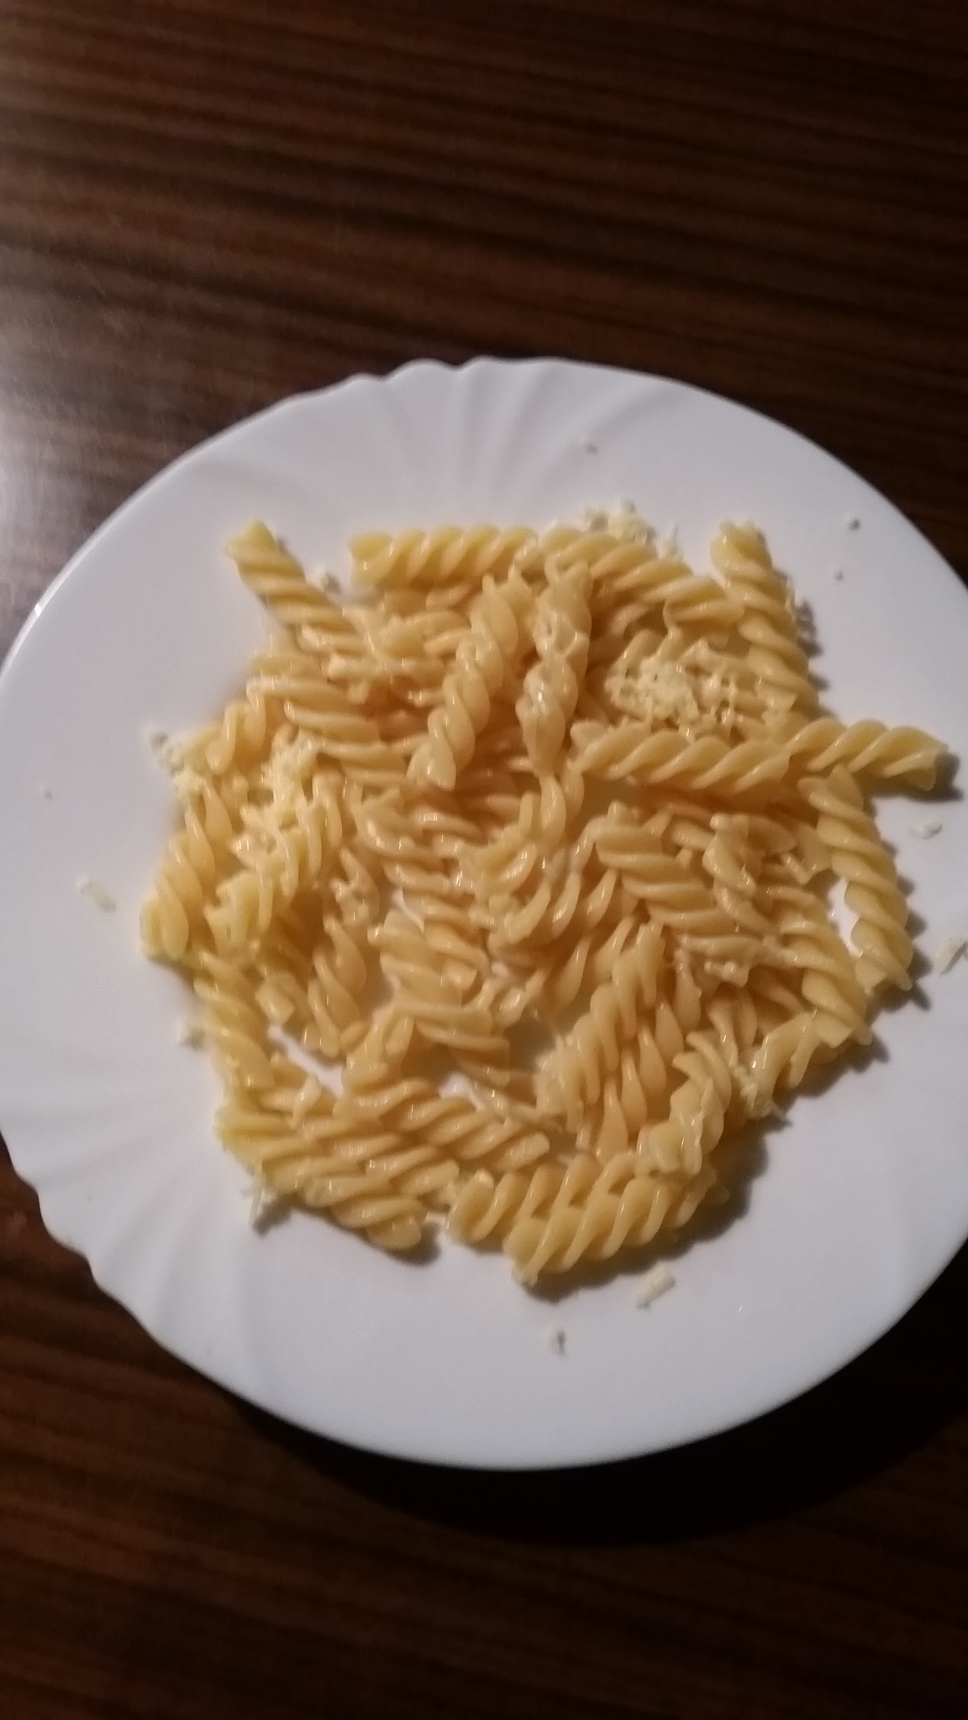
Pasta with cheese

Slide 2
Ingredients
pasta
cheese
butter

Slide 3
Recipe
Cook the pasta in salty water for about 7 minutes.
Melt the butter in the frying pan.
Get the pasta with a strainer to the frying pan.
Cook the pasta in the frying pan.

