Slide 1
My recipe
Arnas Ambrozaitis

Slide 2
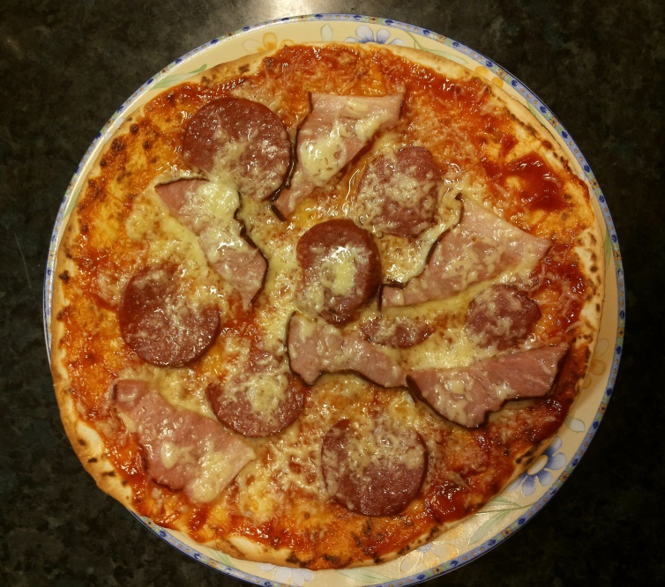
„Homemade pizza“
You‘ll need:
Pizza base
Tomato ketchup
Cheese
Your favourite meat
And some vegetables
(if you like it)

Slide 3
Cooking time
Spread the ketchup on the pizza base.
Grate your cheese and put it on the base as well, add your meat and some more cheese and shut it in the oven.
Set the tempereature to 200°C for 10-12 minutes.
Enjoy!

Slide 4
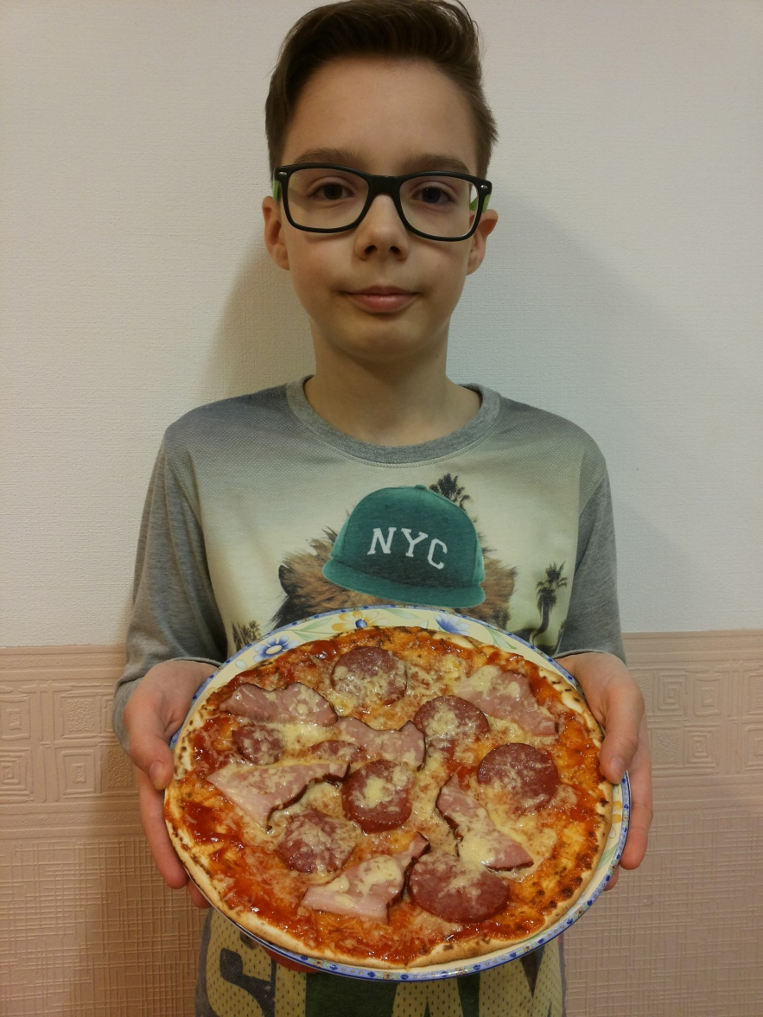
I hope you will like it! ☺

