Slide 1
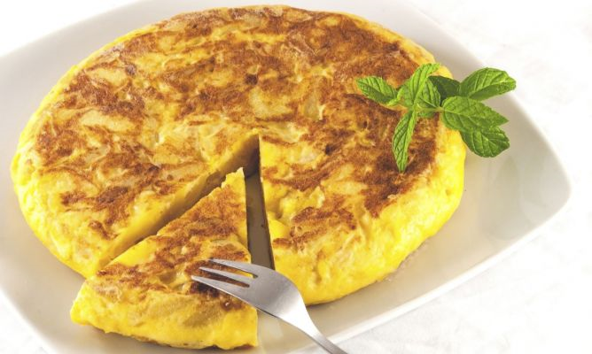
P
O
T
A
T
O
E
S
O
M
E
LE
T
T
E

Slide 2
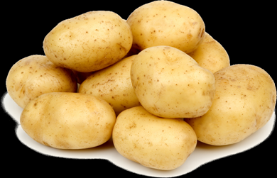
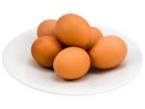
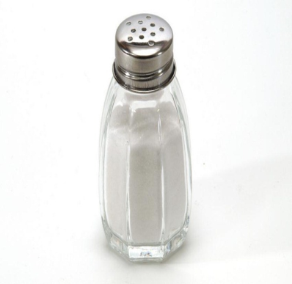
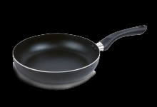
INGREDIENTS: FOR 4 PEOPLE
8 POTATOES
4 EGGS
OIL
SALT

Slide 3
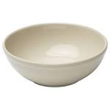
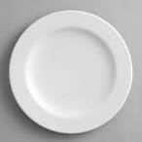
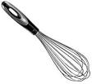
UTENSILS
FRYING PAN
BOWL
KNIFE
PLATE
WHISK

Slide 4
PREPARATION:
-First, peel the potatoes and cut them in squares.
-Next, put the oil in the pan
-Later, pour the potatoes in the pan.
-Meantime, break 4 eggs in the bowl.
-When the potatoes are cooked (20minutes more or less) mix with the eggs in a bowl.
-Then, pour the mixture in the pan and cooked for 5 minutes from one side and turn over to cook the other side.

Slide 5
ON EGIN
BY: YASMINA AND IRATXE

