Slide 1
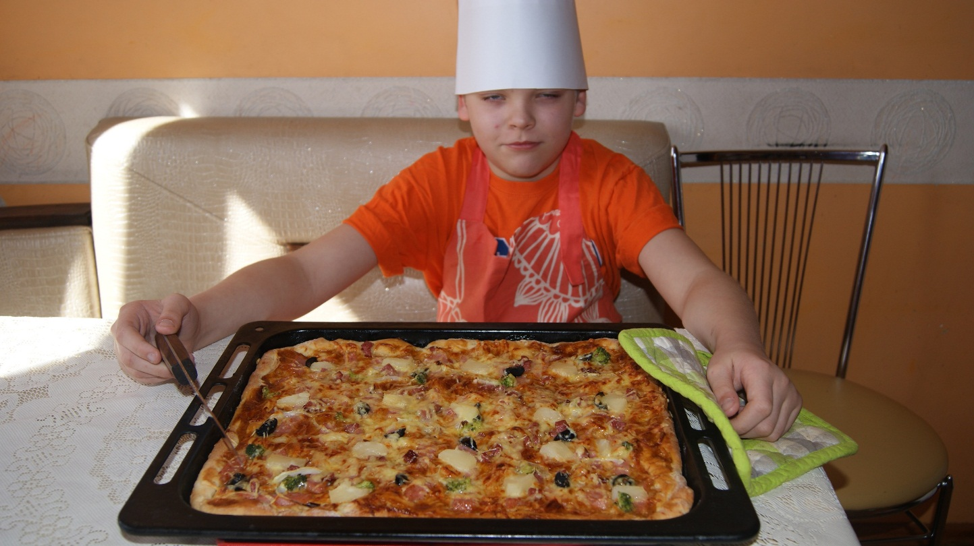
Home made pizza IngredieNts: for dough 1.flour 2.yeast 3.water 4.sugar,salt 5.sausage 6.oregano 7.olives 8.some pineapple 9.cheese
Bone appetite!

