Slide 1
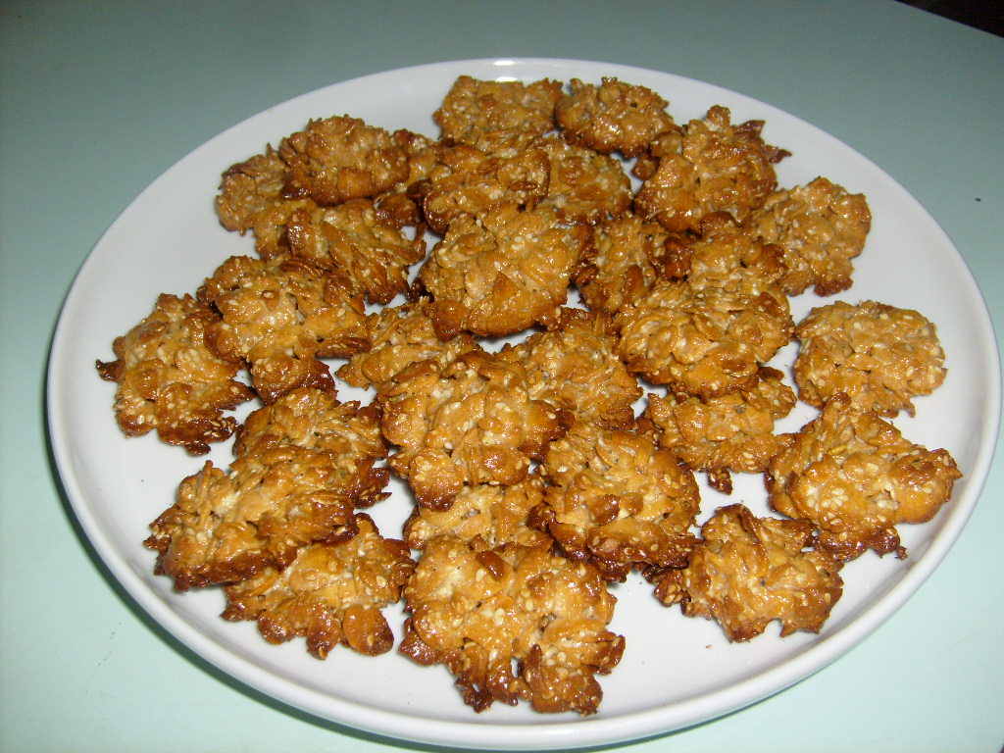
BISCUITS (FLORENTINS)

Slide 2
INGREDIENTS
300g corn flakes
1 cruet of condensed milk
1 handful of dried cranberries
1 handful of shelled sunflower seeds

Slide 3
MAKING BISCUITS
Pour flakes, shelled sunflower seeds and cranberries into a deep bowl.
Pour condensed milk. Mix all thoroughly.
After insert a full tablespoon of the mixture into the baking paper-lined trays.
Bake in the 180 degree oven for 7-10 minutes. Wait until cool.

Slide 4
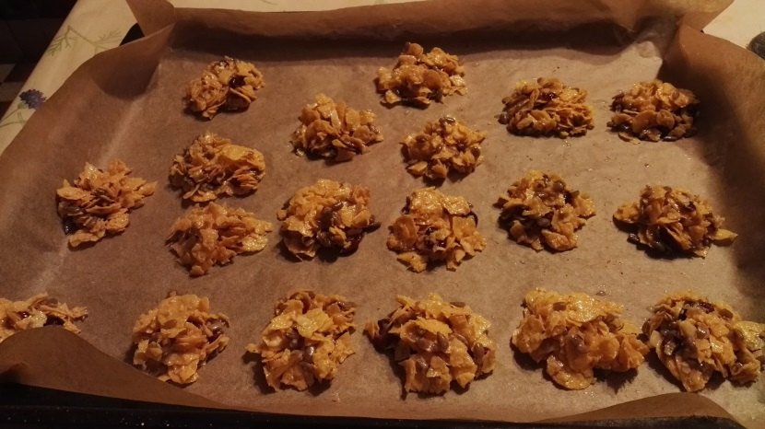
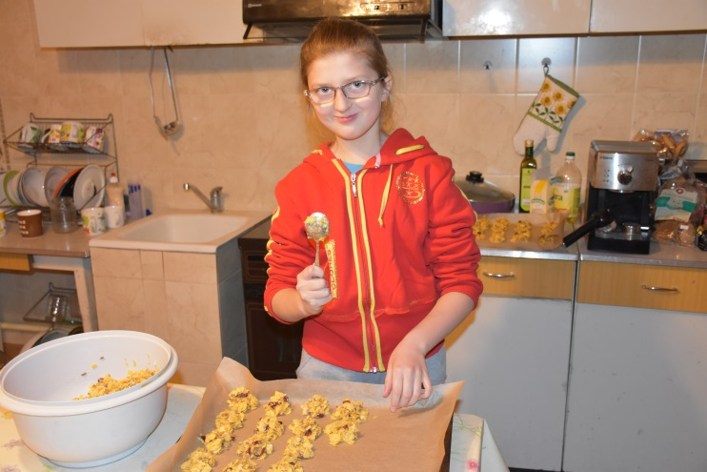
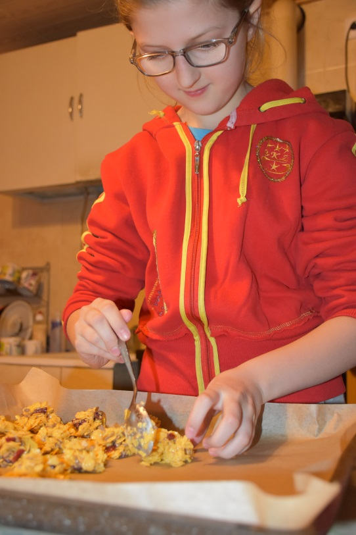
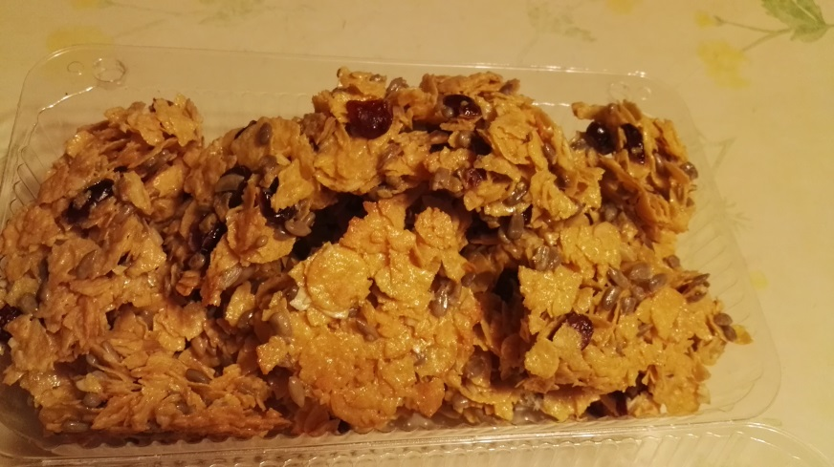
DELICIOUS!

