Slide 1
Pancakes
Ingredients
1/2 cup of flour
1/4 cup of milk
1 egg
50g white sugar
1 teaspoon of salt
1 tablespoon of oil

Slide 2
In a large bowl, sift together the flour, salt and sugar. Make a well in the centre and pour in the milk, an egg and oil, mix until smooth. heat a pancake pan, Pour or scoop the batter onto the griddle,using approximately 1/4 cup for each pancake. Brown on both sides and serve hot.
Directions

Slide 3
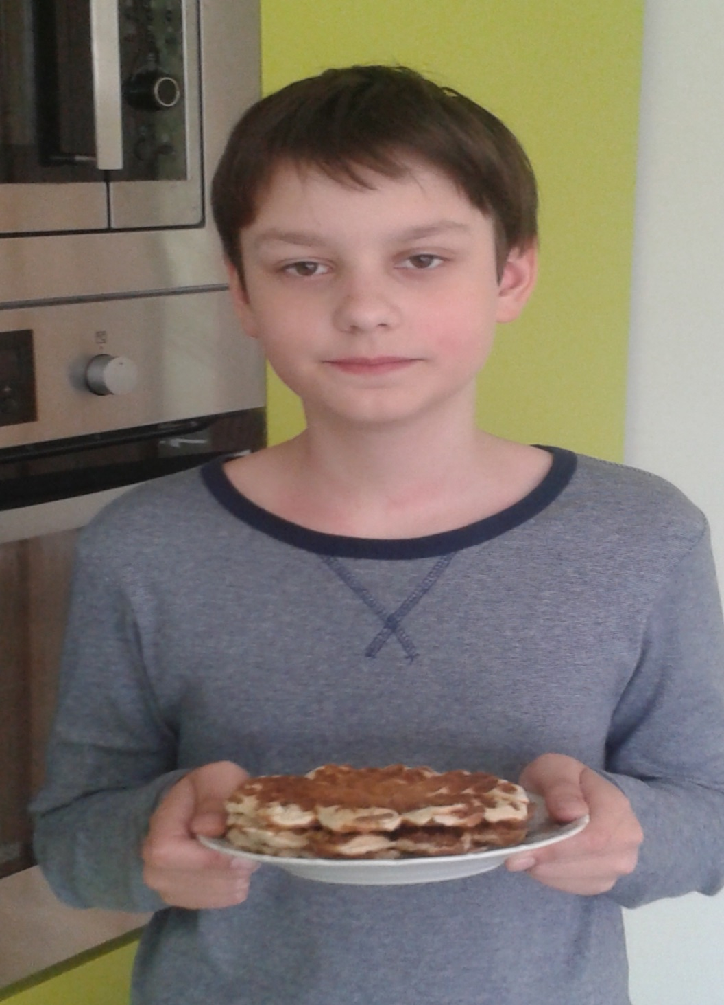
Soo jammy

