Slide 1
Apple pie recipe
Presentation made by: Evelina, 5b

Slide 2
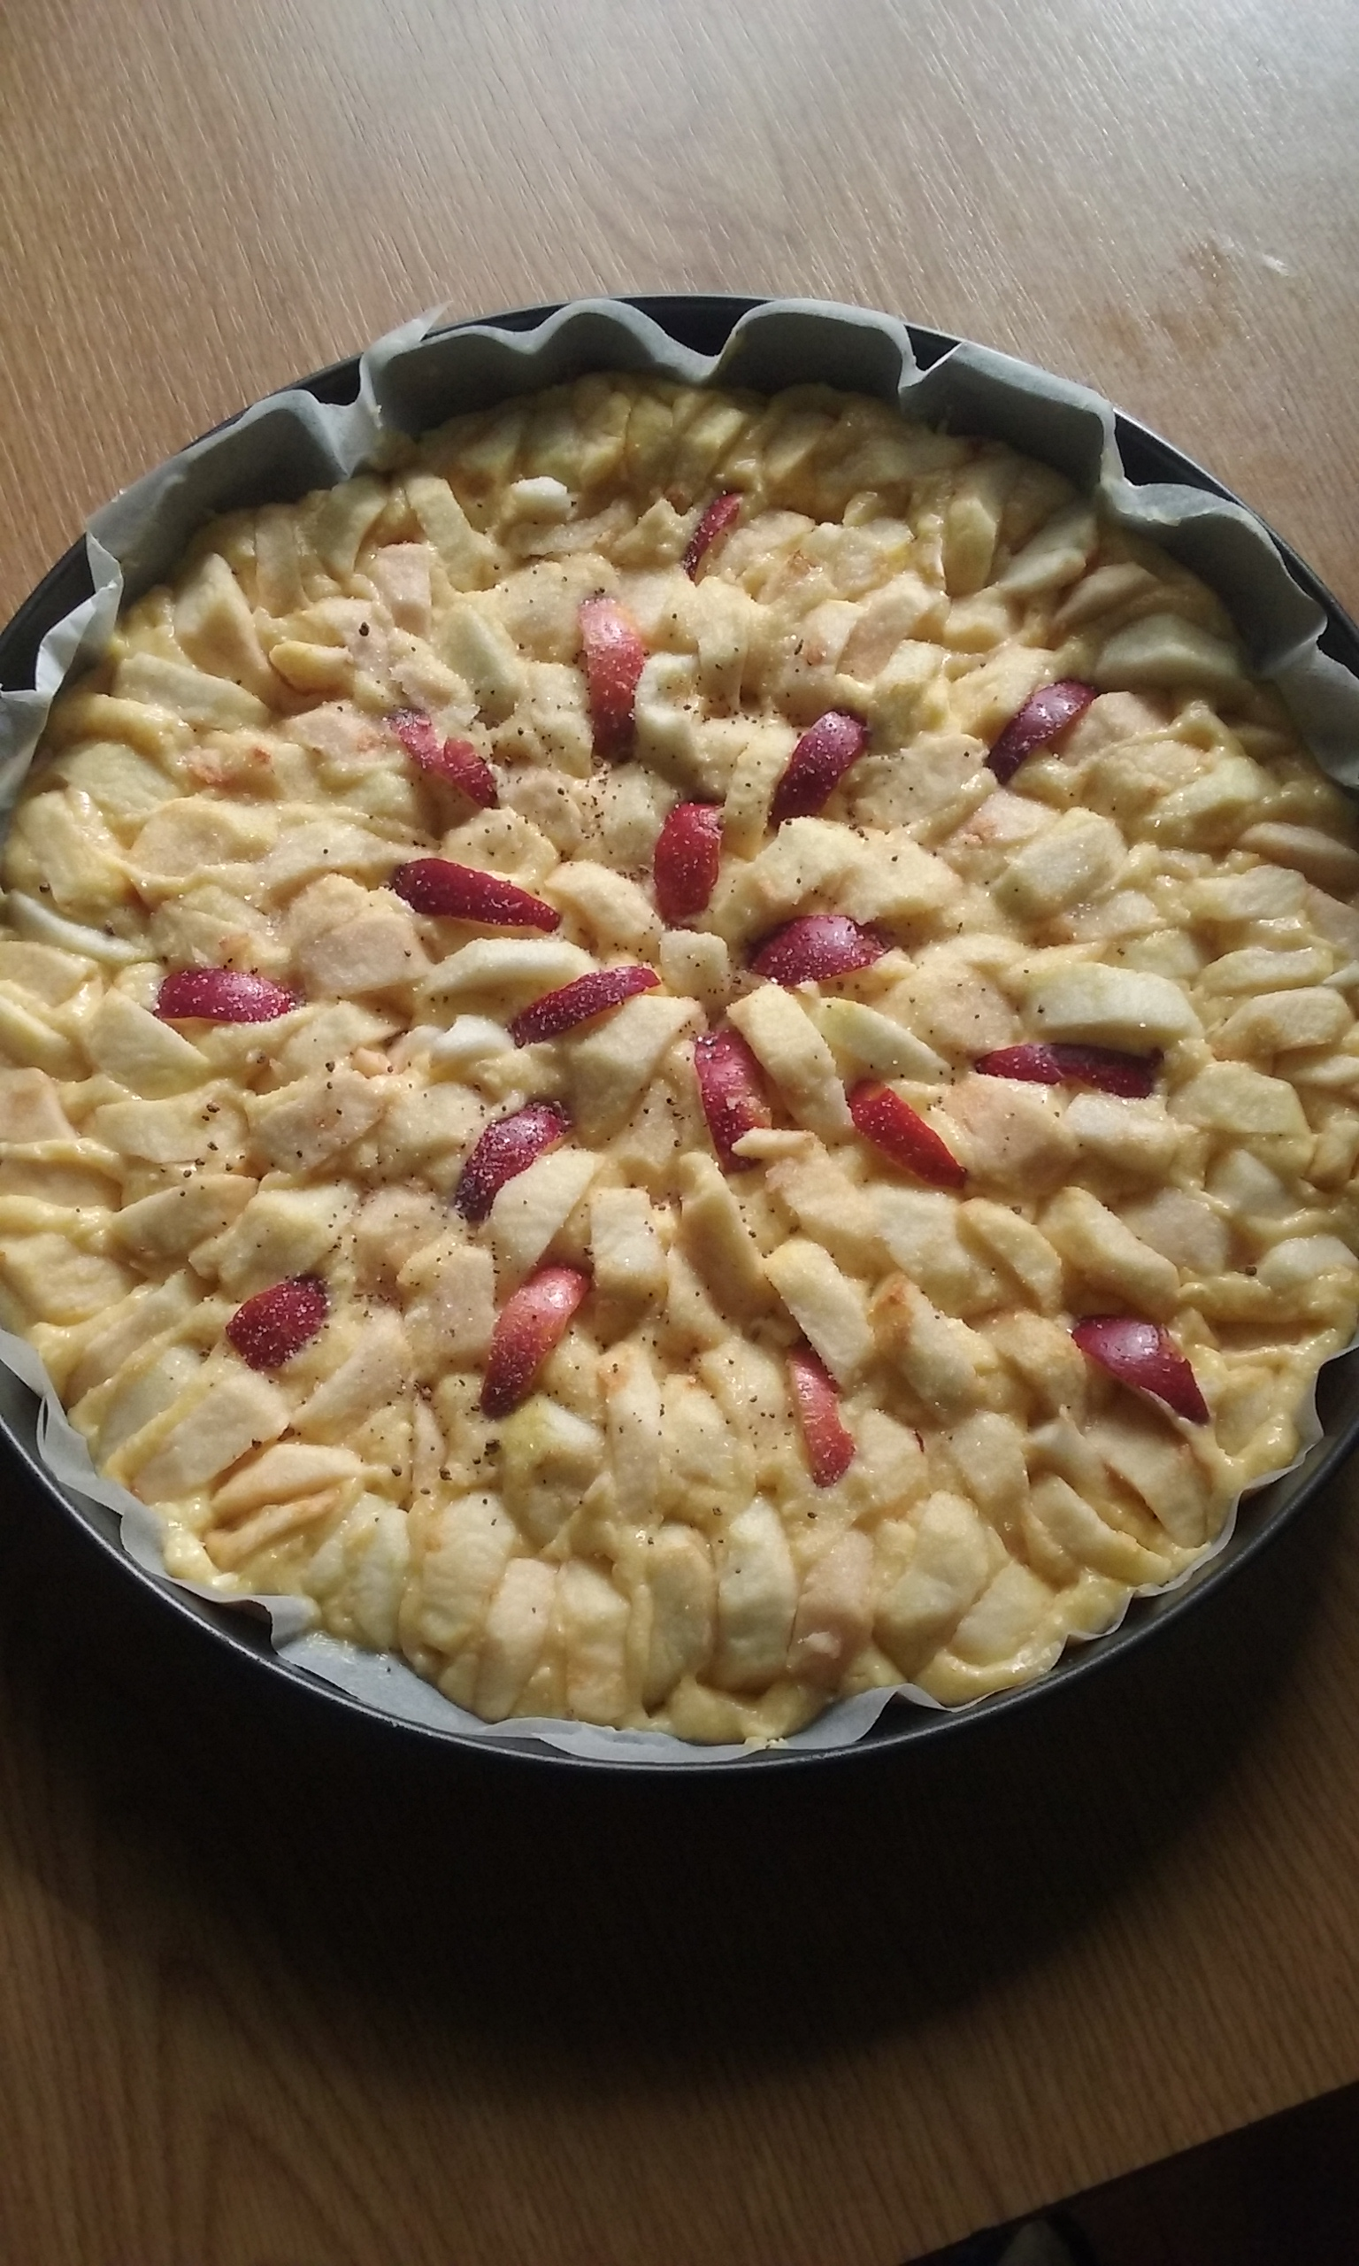
Ingredients:
200 g butter
Cup of sugar
200 g flour
4 eggs
1 teaspoon of baking-powder
Juice of 1 lemon
Pinch of salt
4 – 5 middle sized apples

Slide 3
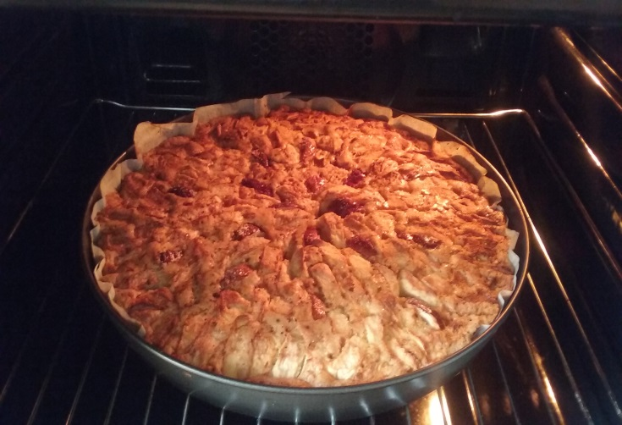
How to prepare:
Preheat oven to 180ºC. In a large bowl mix butter, sugar and eggs with a mixer. Add flour, baking-powder and lemon juice. Mix everything carefully. Pour sour cream thickness dough into the tin. Place apple cloves on the top. There should be the same amount of apple cloves and the dough. Bake the cake for around half an hour.

Slide 4
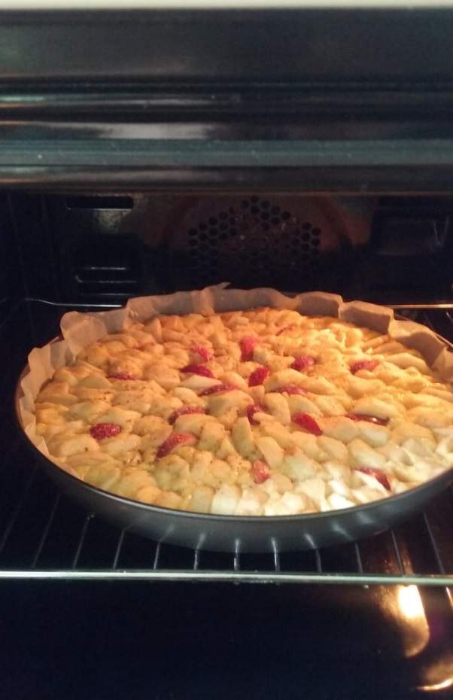
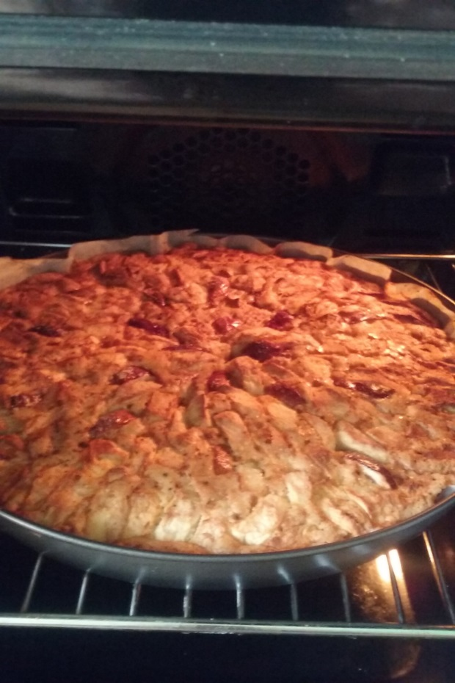
Bon appetit! ¡Buen apetito! Skanaus!

