Slide 1
WATER and LITERATURE
HAVIAROVÁ VERONIKA

Slide 2
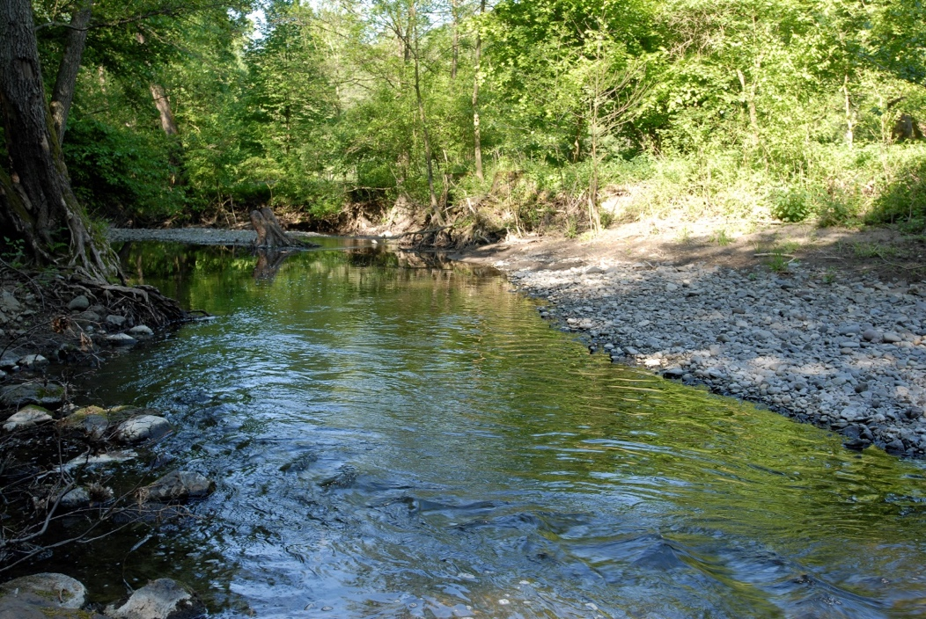
POEM ABOUT THE RIVER
Big water flows through the city,
the humidity she adds,
the advice always rolls fast,
the kings already knew her.
When spring snow melts,
the river overlooks the banks,
then the water always rises,
inhabits the house walls.
Great and majestic,
painters decorate canvases with it,
paintings also embroidered,
originated, a joy to look at them.
The river follows the river from the hill,
i really like the look of it,
nature meets the city,
they whisper old oaks.
Notes:
embro

Slide 3
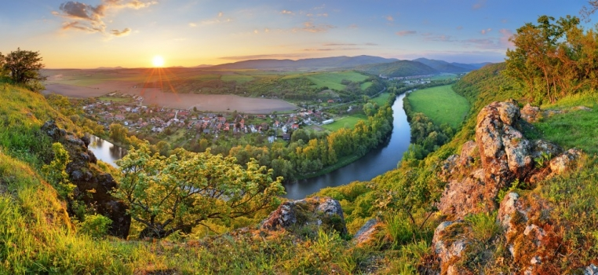
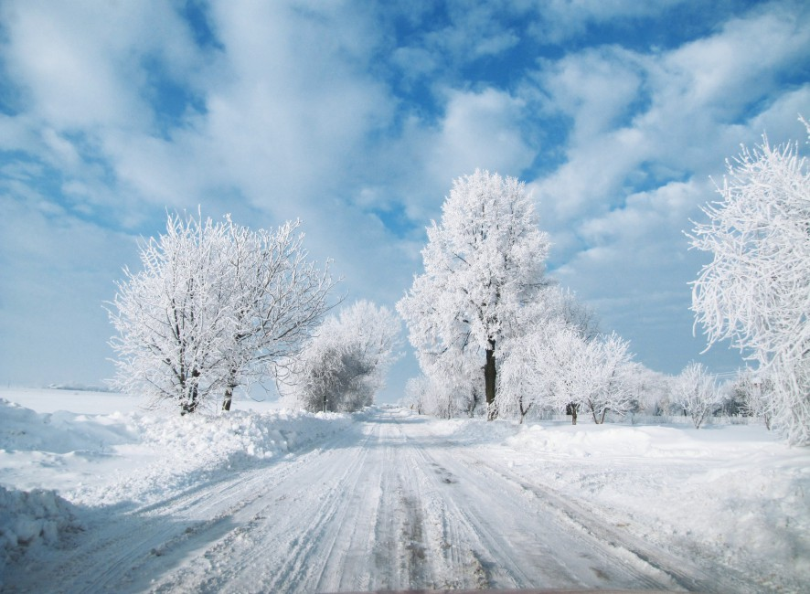
BÁSEŇ O RIEKE
Mestom tečie veľká voda,
vlhkosť vzduchu ona dodá,
rada sa vždy rýchlo valí,
poznali ju už králi.
Keď sa topia jarné snehy,
rieka nazrie ponad brehy,
vtedy sa vždy voda vzbúri,
poobmýva domom múry.
Veľká je a majestátna,
maliari ňou zdobia plátna,
obrazy aj vyšívané
vznikli, radosť pozrieť na ne.
Z kopca rieku sleduje hrad,
pohľad na to mám strašne rád,
príroda sa s mestom snúbi,
šepocú si staré duby.

Slide 4
Title = POEM ABOUT THE RIVER
Author = MARTIN CHUDÍK
Meaning of water in poem = LIFE and HAPPINESS
Synopsis = WATER AND RIVER IN OUR LIFE

Slide 5
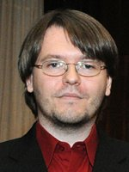
MARTIN CHUDÍK
Was born in 1988 [Slovakia-Bratislava]
Creation:
1./ ukryté v dotykoch /hidden in touch/
2./ precitnúť /resuscitate
3./ za tajomstvom očí /behind the secrets of the eyes

Slide 6
THANK YOU

