Slide 1
Famous Sportsman
From Lachezara, Krisi, Danail and Nistor Sebastian

Slide 2
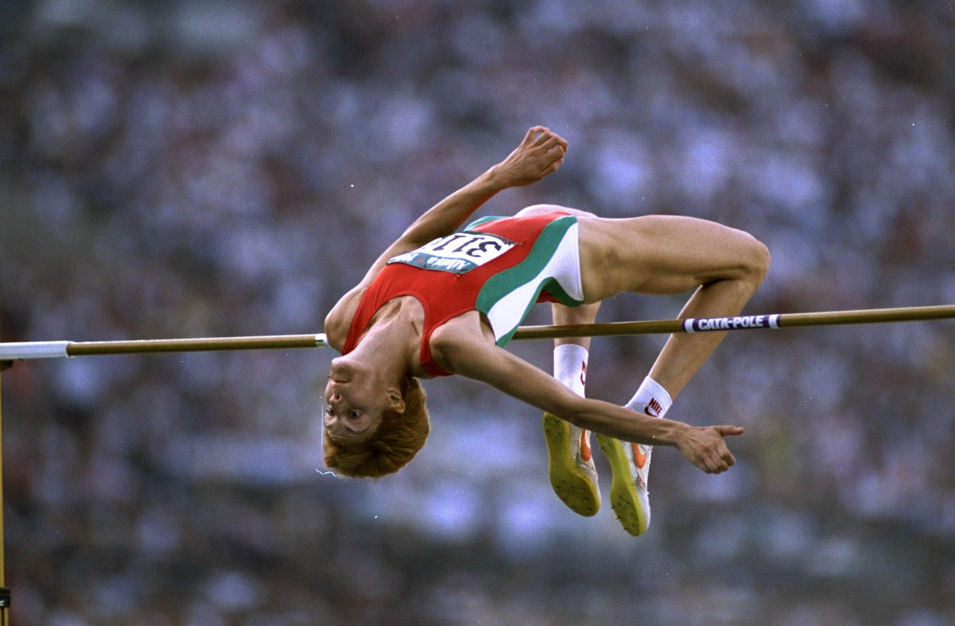
Bulgaria
Stefka Georgieva Kostadinova was born on March 25th, 1965. She is a Bulgarian retired athlete who competed in the high jump. Her world record of 2.09 metres has stood since 1987. She was the 1996 Olympic champion, a twice World champion, and a five-times World Indoor champion. She has been the president of the Bulgarian Olympic Committee since 2005.

Slide 3
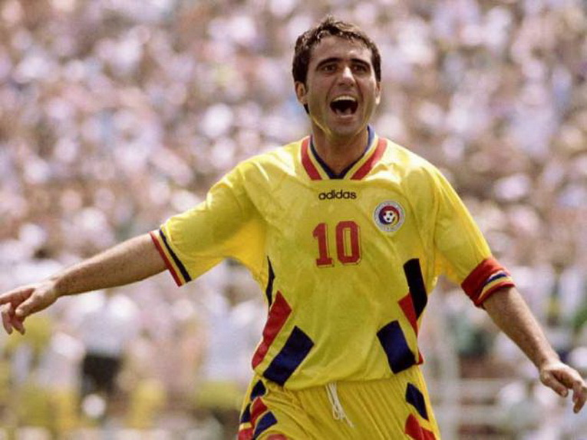
Romania
Gheorghe Hagi was born on 5th February 1965. He is Romanian professional football manager and former player, who is currently the owner and manager of Liga I club Farul Constanța. Deployed as an attacking midfielder, Hagi was considered one of the best players in the world during the 1980s and '90s, and is regarded by many as the greatest Romanian footballer of all time.

Slide 4
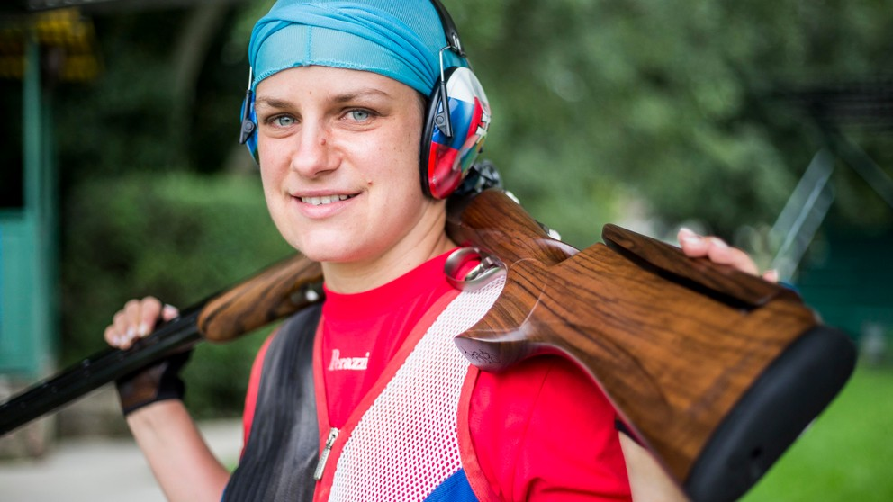
Slovakia
Zuzana Rehák-Štefečeková was born on 15 January 1984. She is a female Slovak sports shooter. She won the gold medal in the Women's Trap event at the 2020 Summer Olympics and the silver medal at the 2008 and 2012 Summer Olympics. Her first big successes were bronze medals from 2002 World and European Junior Championships. She also placed fourth at the 2001 World Junior Championships and fifth at the 1999 World Junior Championship.

Slide 5
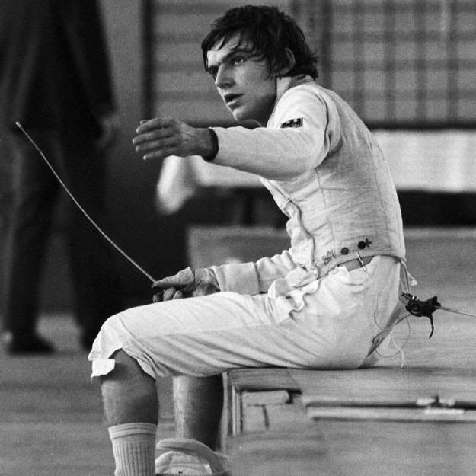
Germany
Thomas Bach OLY was born on 29th December 1953. He is a German lawyer, former Olympic fencer and Olympic gold medalist, serving as the ninth and current president of the International Olympic Committee since 10 September 2013. He is also a former member of the German Olympic Sports Confederation executive board. Bach is the first ever Olympic champion to be elected President of the IOC.

Slide 6
Greece
Eleni Daniilidou was born on 19th September 1982. She is a Greek former tennis player from the island of Crete. She is considered one of the best Greek tennis players of the Open Era, winning five singles titles and three doubles titles on the WTA Tour. In 2003, she reached the mixed-doubles final of the Australian Open, making her the first Greek player to have reached a Grand Slam final. Her highest singles ranking is world No. 14, making her the only female tennis player from Greece to have reached the top 20 until Maria Sakkari in February 2020.

Slide 7
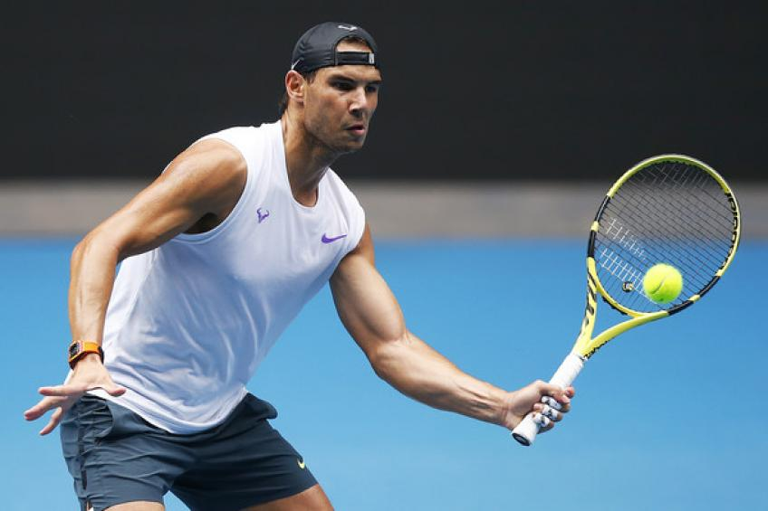
Spain
Rafael Nadal Parera was born on 3 June 1986. He is a Spanish professional tennis player. He is ranked world No. 4 in singles by the Association of Tennis Professionals (ATP). He has previously been ranked world No. 1 for 209 weeks and finished as the year-end No. 1 five times. Nadal has won 22 Grand Slam men's singles titles, the most in history, including a record 14 French Open titles. He has won 92 ATP singles titles, with 63 of these on clay. Nadal's 81 consecutive wins on clay is the longest single-surface win streak in the Open Era.

